Slide 1
: )
BlueCo ran into a progress and needs to respect. We’re just
collecting some applause info, and then we‘ll respect for BlueCo. (100% complete)
If you‘d like to know more, you can search online later for this project: https://github.com/ChuanXiiiiii/Group-Project-in-Aerial-Robotics/

Slide 2
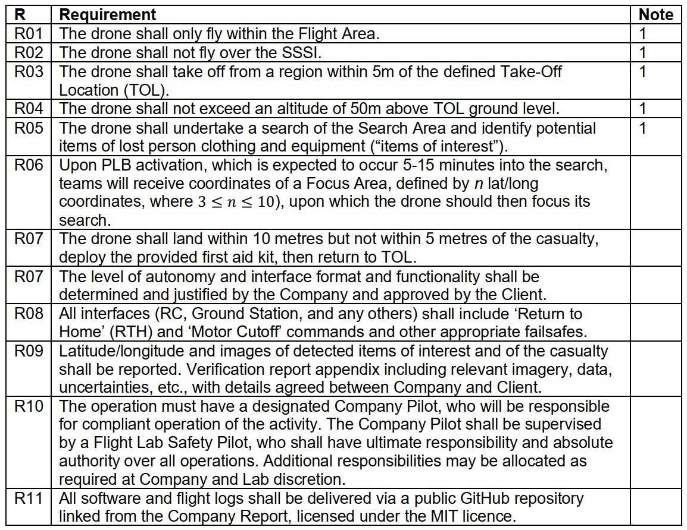
Mission Safety & Search Strategy
Geographic Boundaries (R01, R02, R03):
The system imports KML geometry for flight area inclusion and SSSI (Site of Special Scientific Interest) exclusion zones during the PRE-AUTO CHECK.
The state machine verifies that the drone arms and takes off within the defined tolerance of the Take-Off Location (TOL).
Altitude & Systematic Search (R04, R05):
The PRE-AUTO CHECK panel monitors the altitude to ensure it stays within the prescribed search tolerance (maximum 50m above TOL).
The system executes a "lawnmower" search pattern to systematically scan the area for items of interest.
The Computer Vision (CV) pipeline identifies casualties and equipment using a trained YOLO model.
Dynamic Mission Re-planning (R06):
Upon Personal Locator Beacon (PLB) activation, the system transitions to a REPLAN state.
The operator can dynamically load a new KML for a Focused Search Area, and the system generates a tighter lawnmower pattern for localized investigation.

Slide 3
Mission Safety & Search Strategy
Precision Delivery & Relaunch (R07):
The operator reviews CV detections and selects a landing point on an interactive map.
A 7.5m red circle is displayed on the GUI to ensure the landing point remains within the required 5–10m safety distance from the casualty.
After the manual payload release, the drone re-arms and climbs to search altitude before returning to the TOL.
Safety Architecture & Failsafes (R08, R10):
Hardware Priority: ArduPilot gives the RC transmitter unconditional priority; no software command can override physical pilot input.
Human-in-the-Loop: A GUIDED Gate prevents the state machine from entering an autonomous mode unless the pilot physically sets the RC switch to the "GUIDED" position.
The system includes a SAFE RTL phase that uses saved launch coordinates to bypass ArduPilot’s internal home-point updates.
Reporting & Delivery (R09, R11):
Confirmed detections generate a reporting card on the GUI featuring geotagged images and GPS coordinates.
All project software is managed and delivered via a public GitHub repository.

Slide 4
Path Planning Contribution
Key Innovation: Introduce a modular PATH_PLANNER sub-module.
Simulation, comparison and detailed data test on 2 path planning algorithms
”Plug-and-Play” path planning module
2 path planning algorithms swapping – lawnmover & perimeter spiral
Enhances system flexibility and efficiency

Slide 5
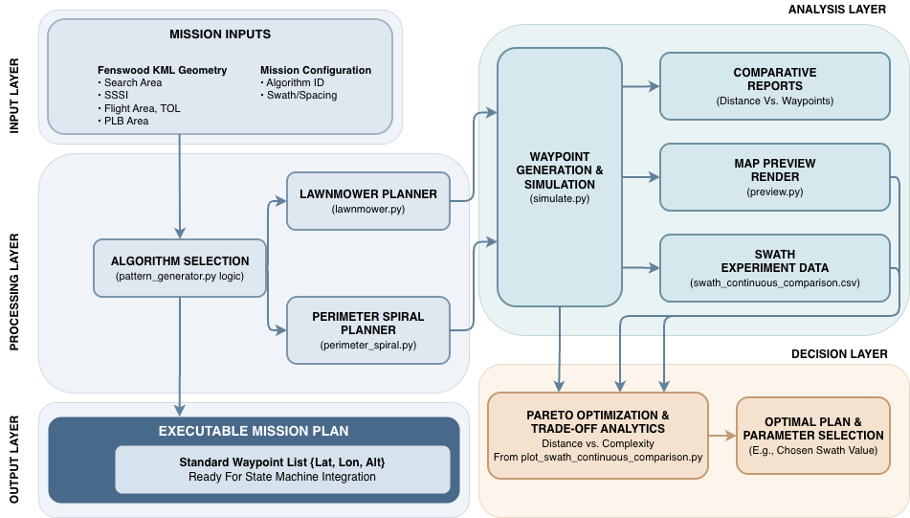
Overview

Slide 6
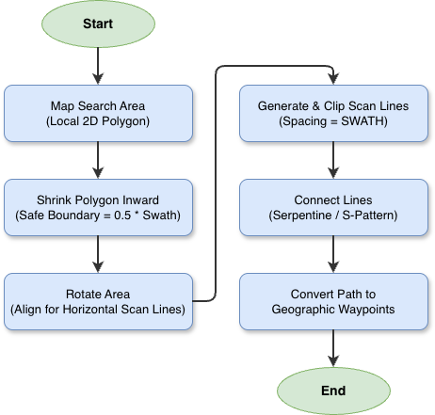
Path Planning Algorithms – Lawnmover
Core Idea:
Prioritise Coverage Completeness
+
Regularised Scanning
+
Minimise Transition Costs

Slide 7
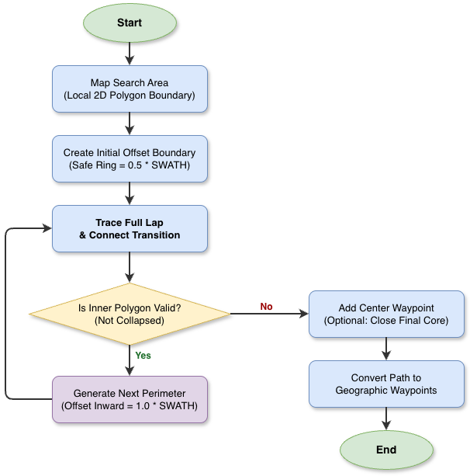
Path Planning Algorithms – Perimeter Spiral
Core Idea:
Outer-to-inner rings
+
Swath-based inward offset
+
Perimeter lap repetition
Compared with lawnmower, it usually has fewer sharp back-and-forth turns, but path efficiency depends strongly on polygon shape.

Slide 8
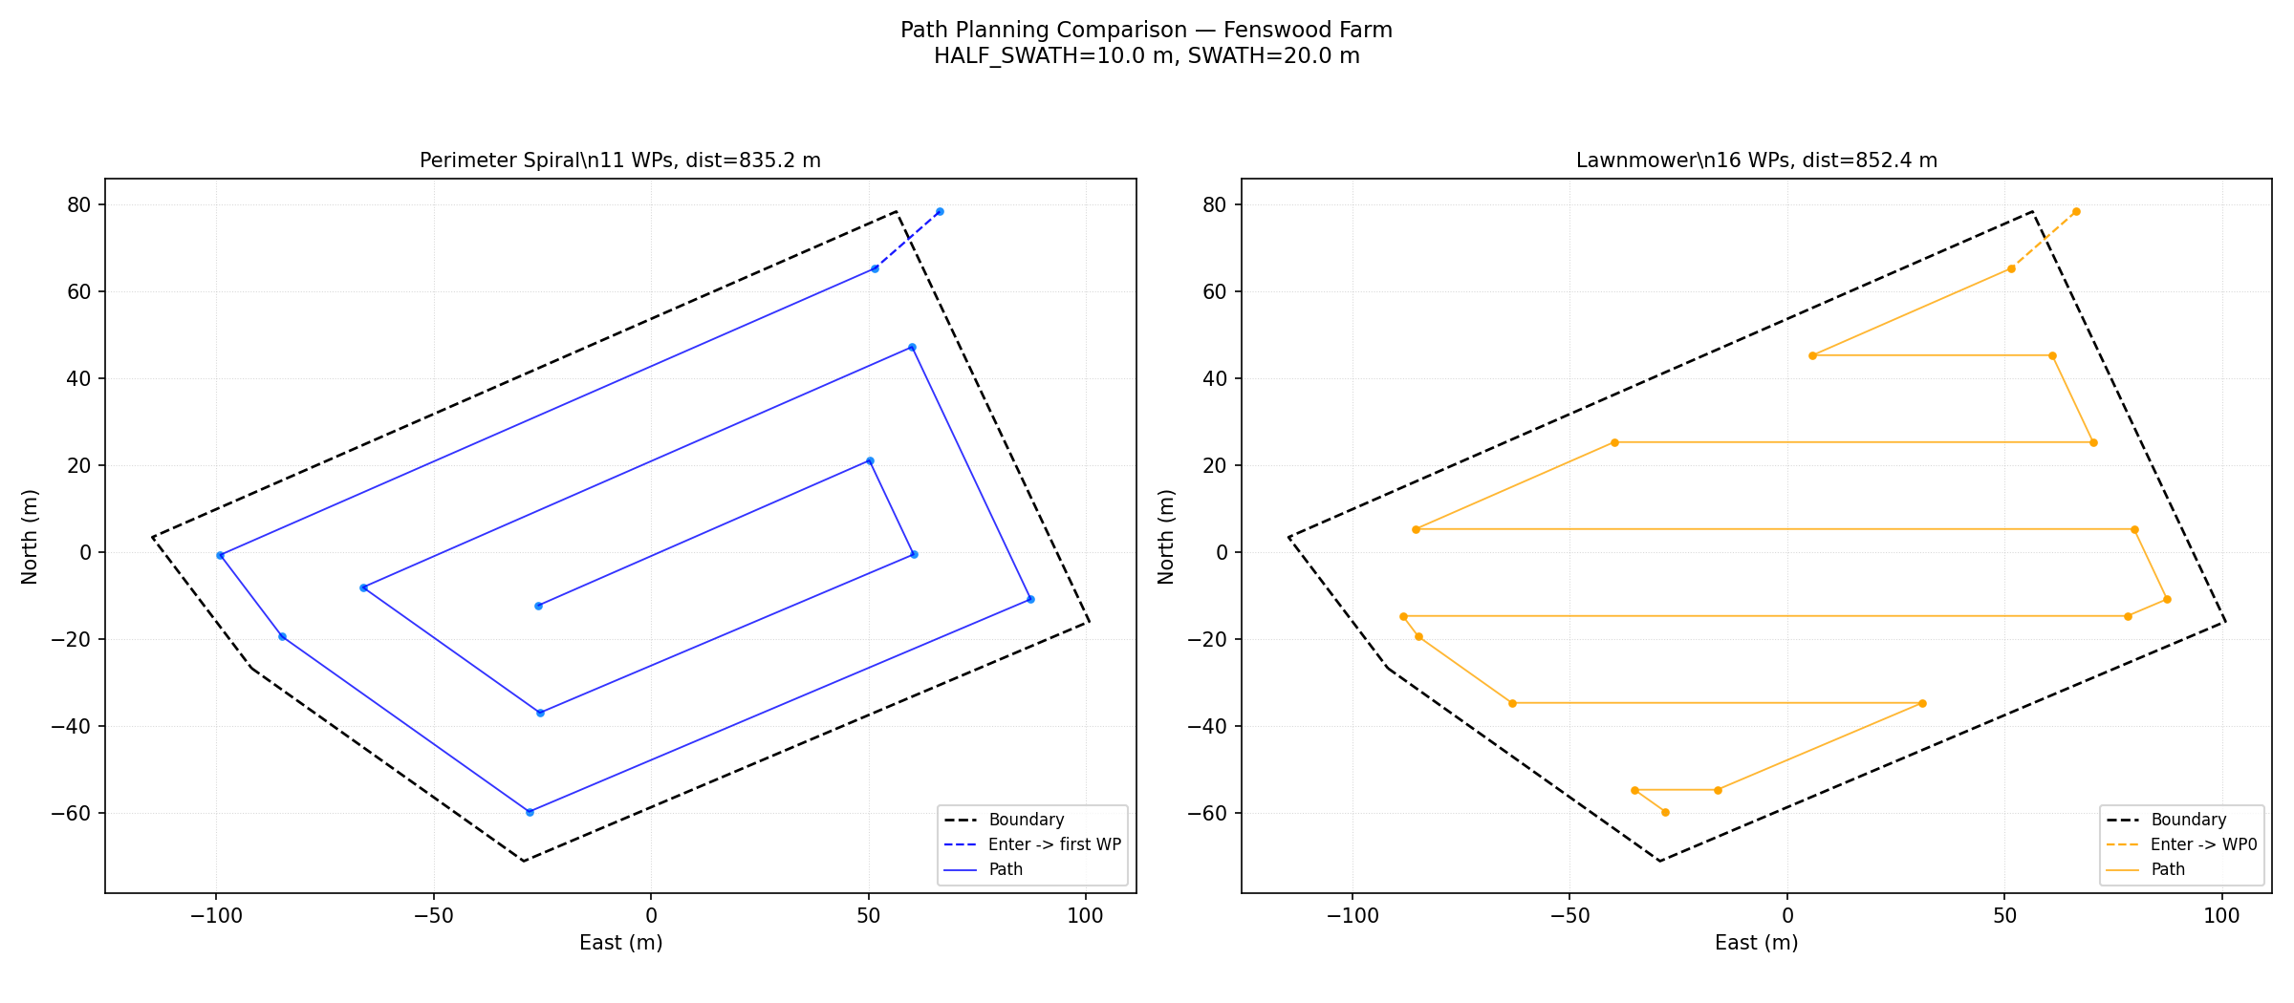
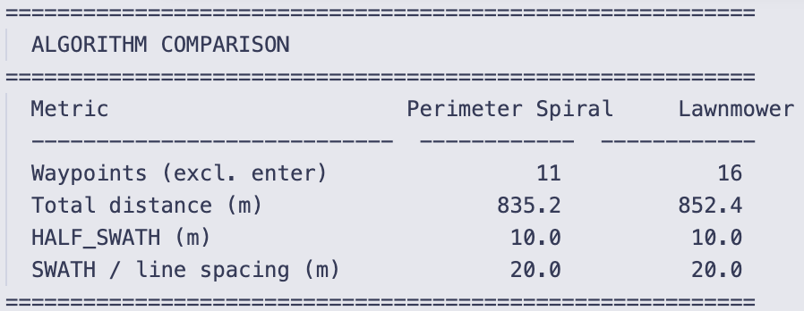
Performance of 2 Path Planning Algorithms
Use Spacing = 20.0 m as example,

Slide 9
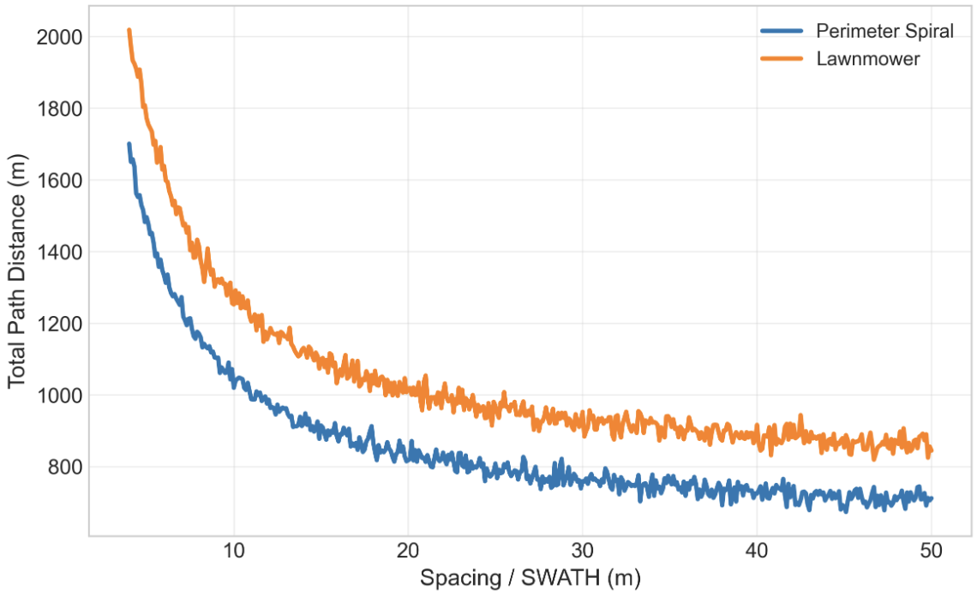
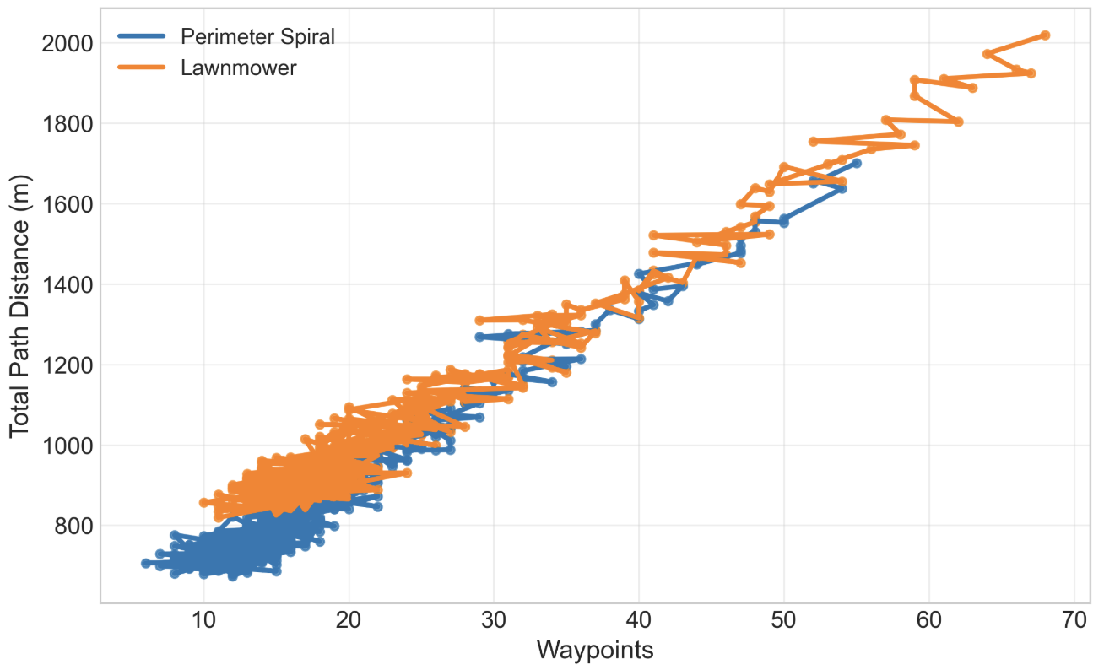
Path Planning Simulation
Distance vs. Spacing
Distance vs. Waypoints

Slide 10
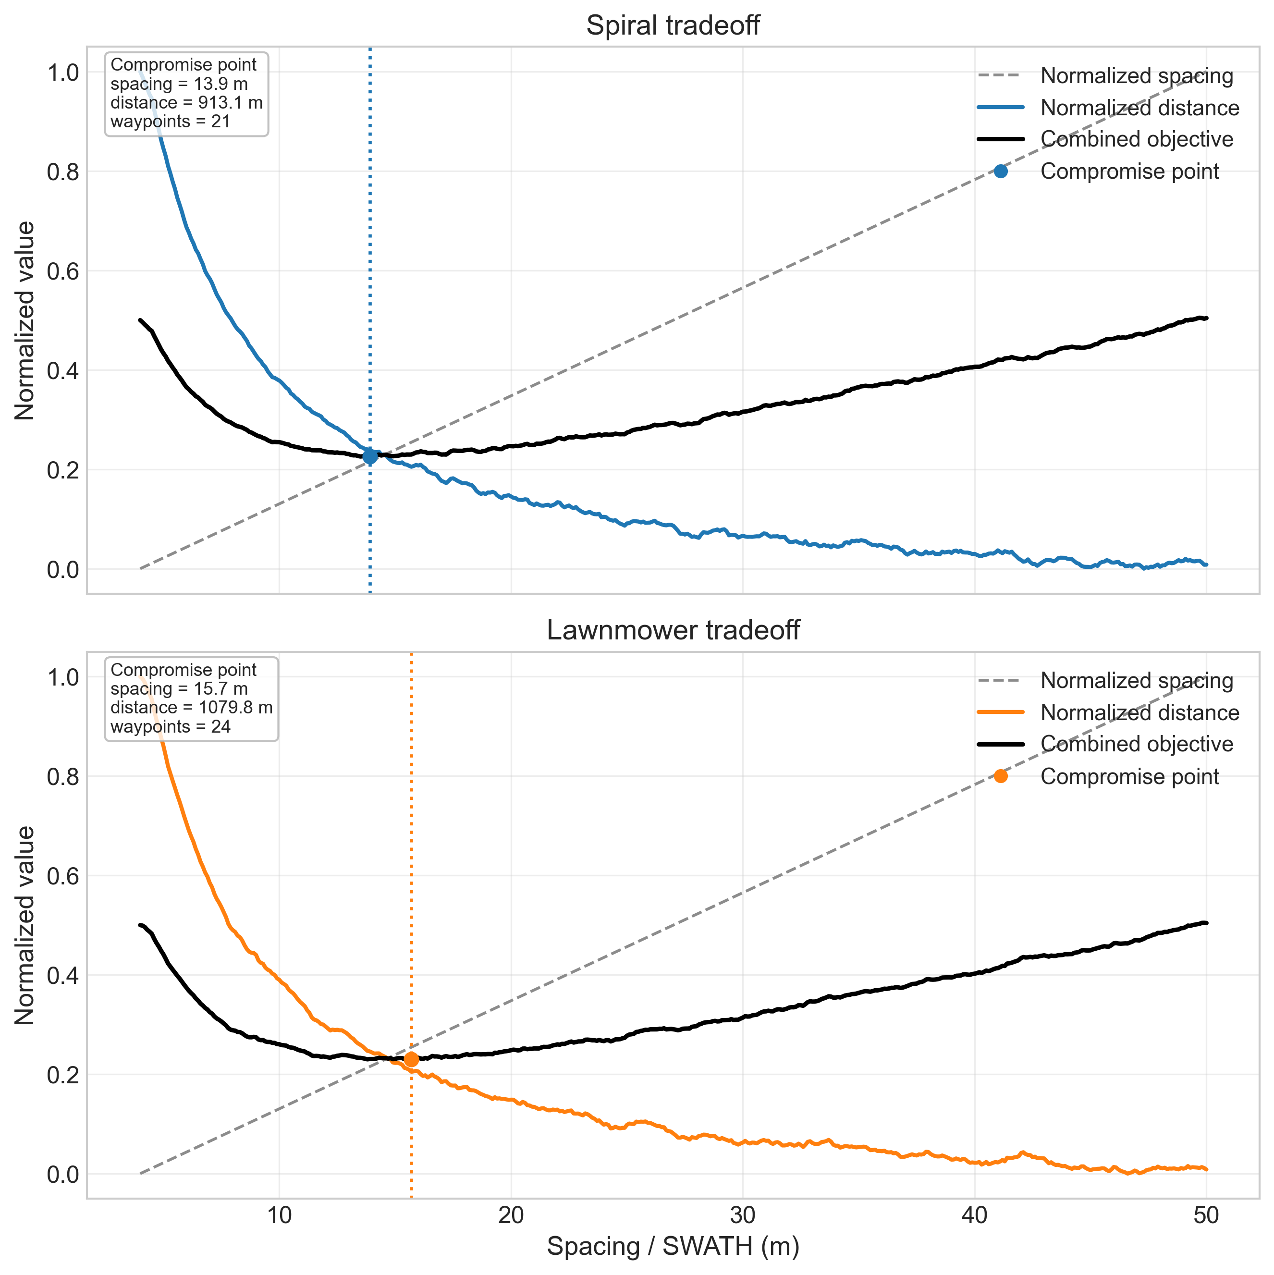

Compromise Point: Spacing Selection
Equal-weight tradeoff between spacing and flight distance:
$score=0.5 norm\left(spacing\right)+ 0.5 norm(distance)$
Result: *at the compromise point
Algorithm | Spacing(m) | Distance(m) | Waypoints
Lawnmover | 15.7 | 1079.8 | 24
Perimeter spiral | 13.9 | 913.1 | 21
Notes:
To find the most practical SWATH setting, we aimed to balance mission efficiency and coverage conservativeness, then swept spacing values and computed an equal-weight normalized objective from spacing and total distance; this figure is the resulting tradeoff curve, where the highlighted minimum is the compromise point used as the recommended operating setting.

Slide 11
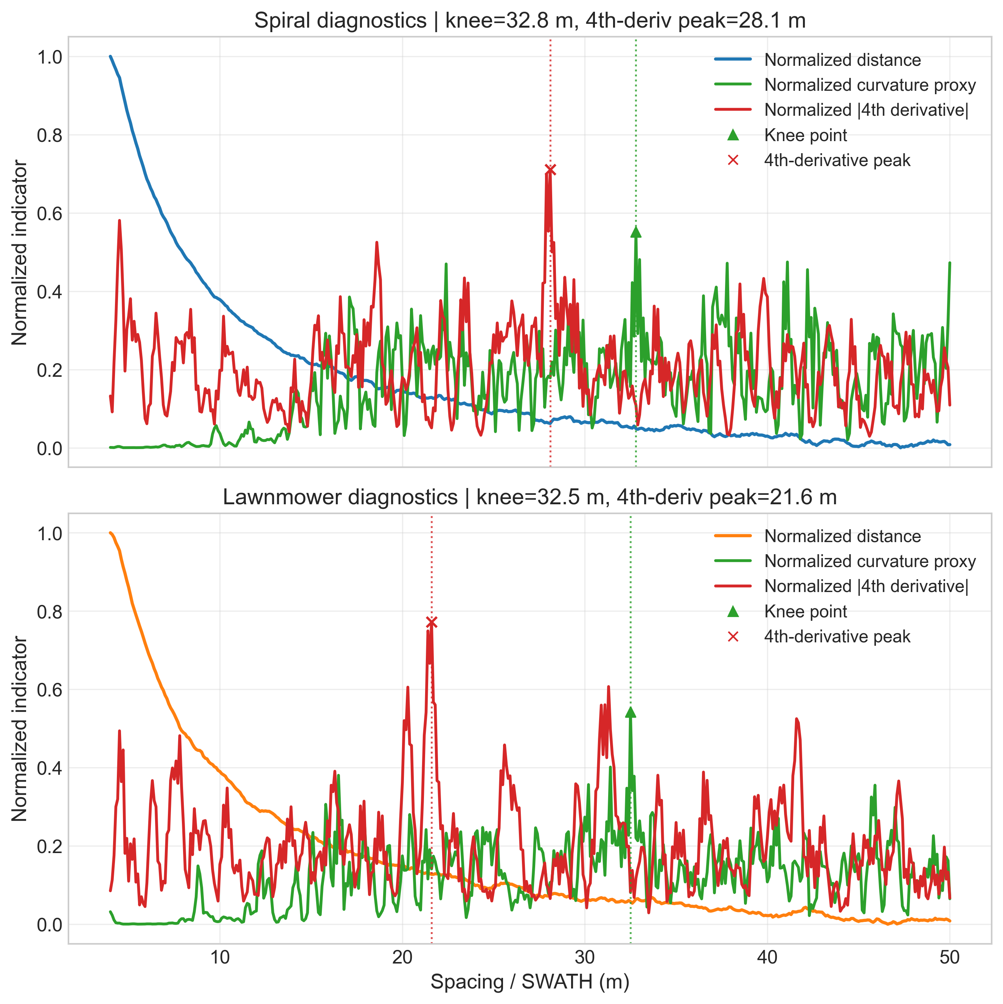
Knee Point + 4th Derivative Peak
Knee point indicates where marginal benefit starts to diminish (>37.5m in spiral and >32.8m in lawnmover).
4th-derivative peak indicates a strong shape-change region in the performance curve, but it’s easily influenced by noise.
These two points are diagnostic references, not standalone final decisions.
Result:
Algorithm | knee(m) | 4th-deriv peak(m)
Lawnmover | 32.5 | 21.6
Perimeter spiral | 13.9 | 28.1

Slide 12
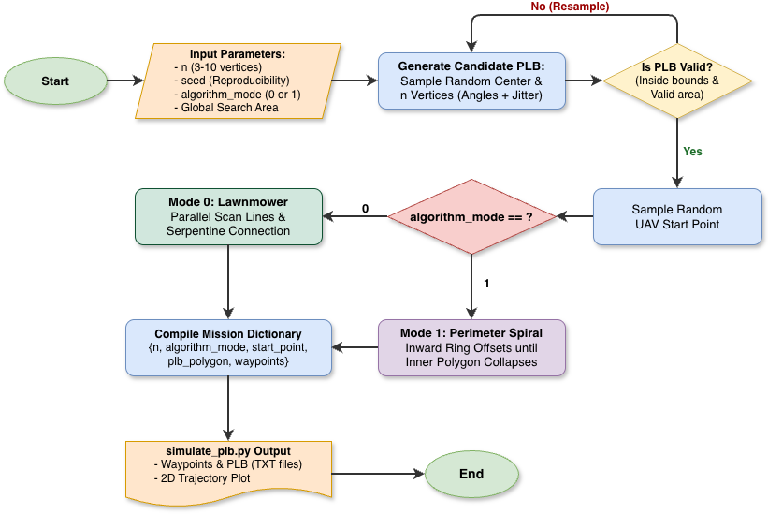
PLB Searching
Use command
.venv/bin/python path_planner/simulate_plb.py --n 6 --mode 0 --seed 323
to simulate.
Which n is number of sides of PLB;
mode is the path planning method; seed is the random number used to generate the polygon

Slide 13
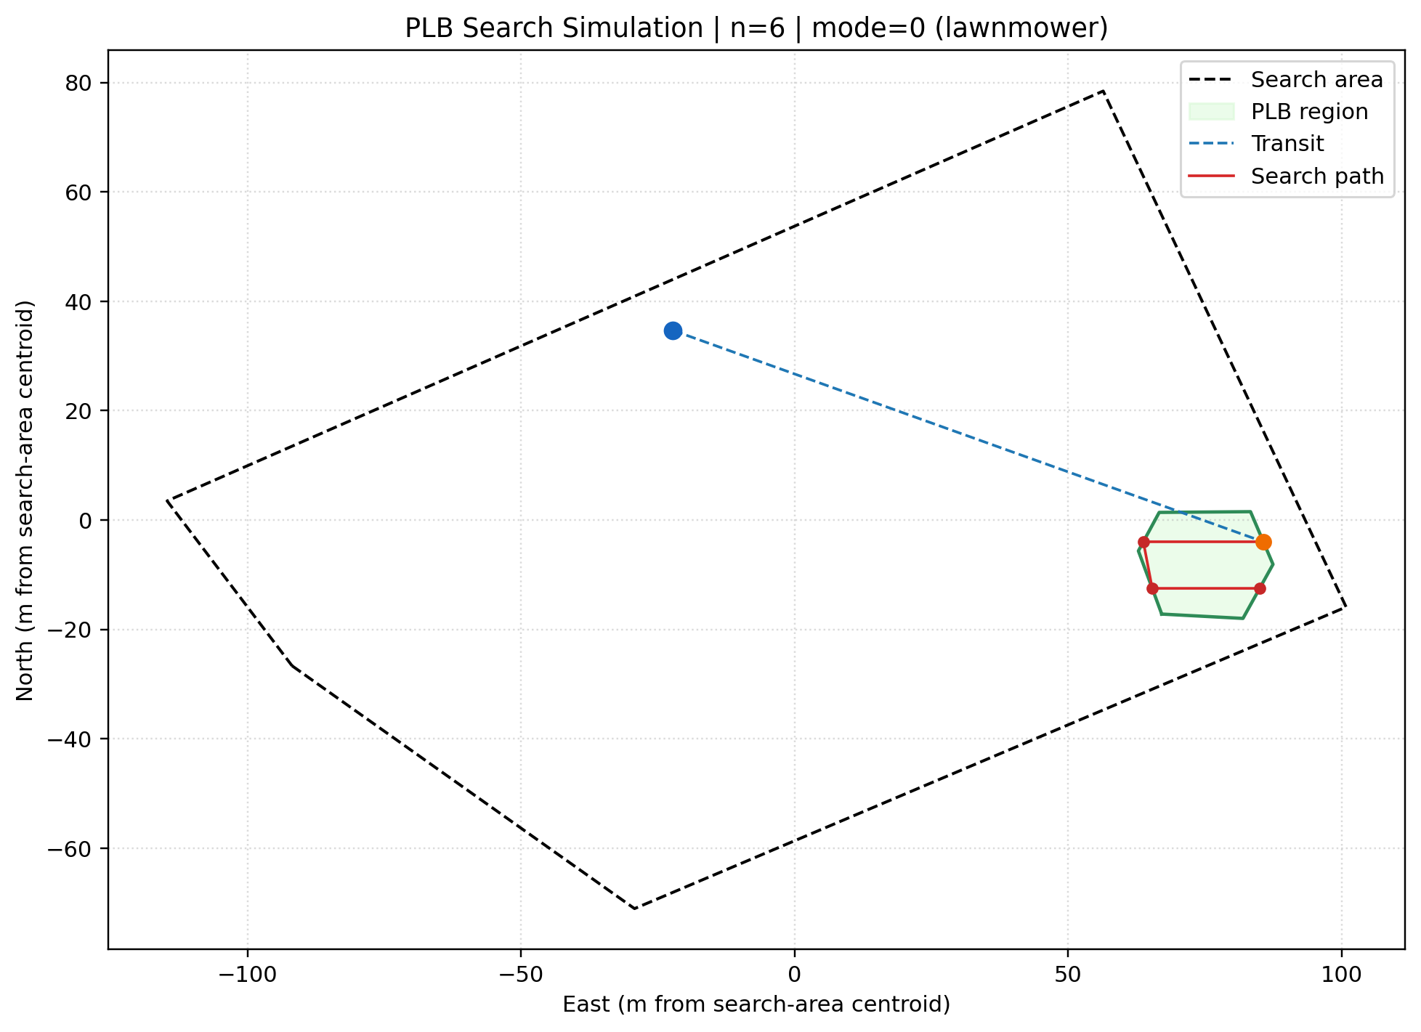
Performance of PLB Searching Simulation
Use --n 6 --mode 0 --seed 1224 as example,

Slide 14
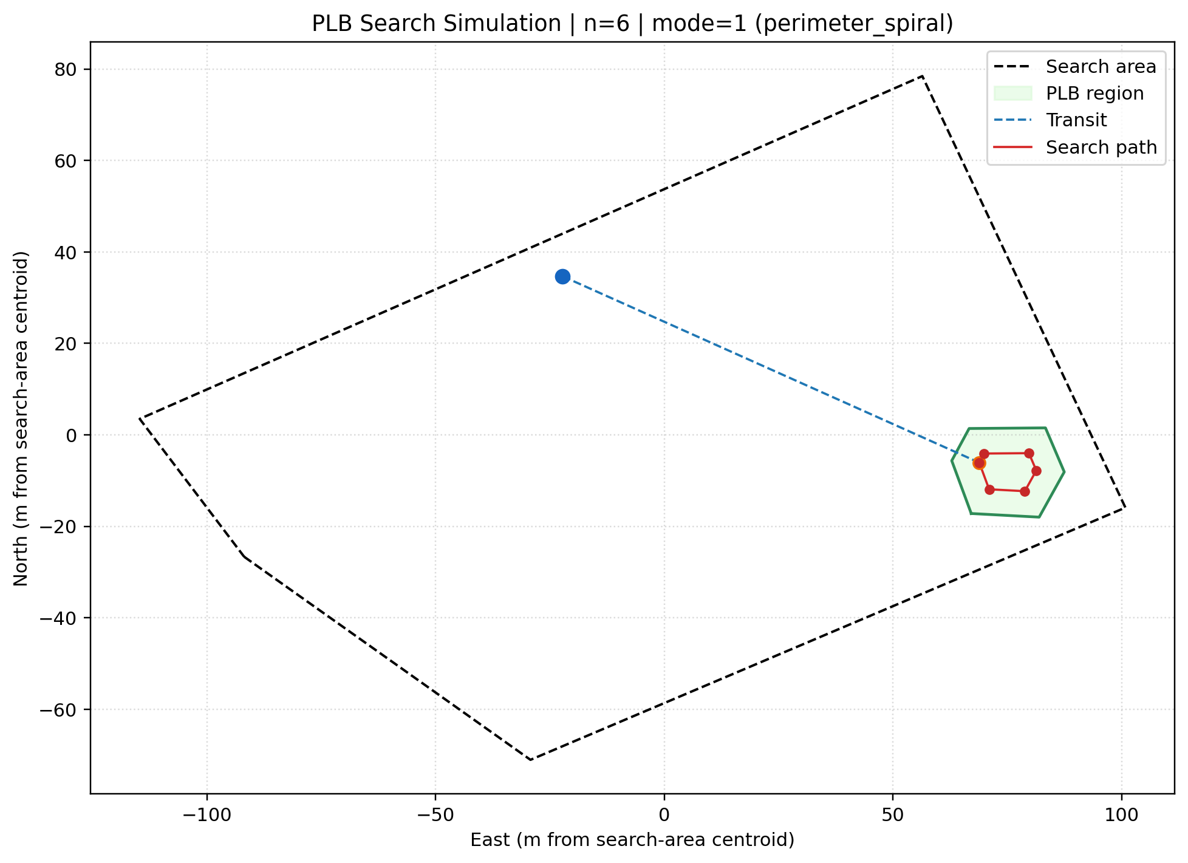
Performance of PLB Searching Simulation
Use --n 6 --mode 1 --seed 1224 as example,

