Slide 1
PLAYER BASED SEGMENTATION AND WICKET EVENT RELATED VIDEO ANALYSIS IN CRICKET VIDEOS
Problem Statement & Stakeholders
Traditional cricket video analysis still relies heavily on manual.
Major problems include:
No automatic navigation to jump to moments by player name
No automatic navigation to jump to important moments
Players are not linked to key events (FOUR/SIX/WICKET) with timestamps
Users must manually scroll through long match videos
Creating player-based and event-based highlights is manual and time-consuming
Cannot easily track batsman changes during the innings
Cannot easily track bowler changes across overs
No automatic player-based or event-based analysis timeline
Cannot filter full matches by player name
These problems affect:
Cricket fans and viewers
Coaches and team analysts
Broadcasters and content creators/editors
Cricket academies and training staff
School-level cricket players
IT22141606 | RATHNAYAKE R M N D | 25-26J-148 6J-148 -

Slide 2
PLAYER BASED SEGMENTATION AND WICKET EVENT RELATED VIDEO ANALYSIS IN CRICKET VIDEOS
Research Gap & Objective
Existing systems:
Depend heavily on manual video review
Do not support player-based filtering across full matches
Do not provide automatic navigation to player-specific or key moments
Lack event-player linking with timestamps
Provide limited support for automated cricket video analysis timelines
Lack an integrated multimodal automation framework for cricket video understanding
Rarely include near-miss moments in automated highlight generation
Research Objective:
To develop an automated cricket video segmentation and retrieval system that supports:
player-wise filtering
event-wise navigation
timestamp-based player-event association
batsman and bowler change tracking
semantic search of cricket video content
efficient retrieval of important and near-miss match moments
IT22141606 | RATHNAYAKE R M N D | 25-26J-148 6J-148 -

Slide 3
PLAYER BASED SEGMENTATION AND WICKET EVENT RELATED VIDEO ANALYSIS IN CRICKET VIDEOS
Solution Overview
We developed an AI-based insurance claim processing platform consisting of four integrated components:
Automatic Cricket Video Segmentation by Player Identity
The system extracts scoreboard text, identifies player names, detects match events using umpire signals, and links players and events with video timestamps to enable player-wise and event-wise segmentation, filtering, querying and navigation.
2. Wicket Events Related Cricket Video Analysis.
This system detect wicket events and potential wicket events with it’s subtype.
Performance Usability
Reliability Security
Non-Functional Focus
IT22141606 | RATHNAYAKE R M N D | 25-26J-148 6J-148 -

Slide 4
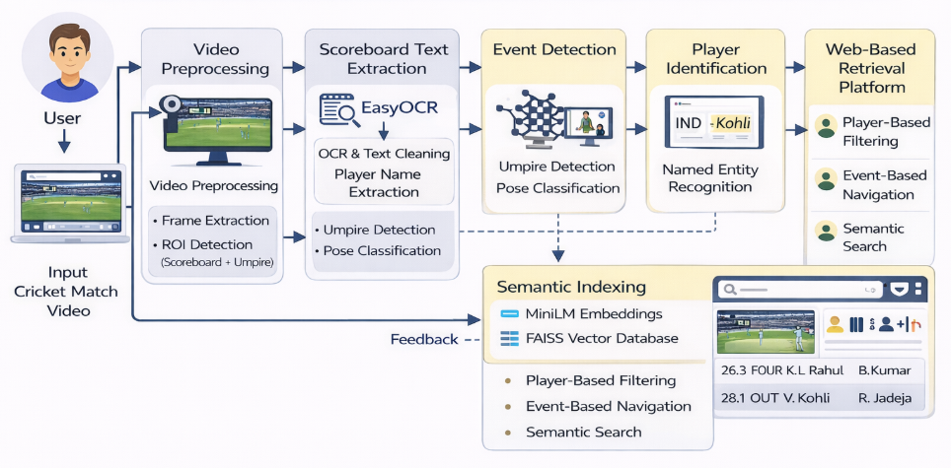
PLAYER BASED SEGMENTATION AND WICKET EVENT RELATED VIDEO ANALYSIS IN CRICKET VIDEOS
EfficientNet-B0
RestNet-18
EasyOCR
playerNER model
IT22141606 | RATHNAYAKE R M N D | 25-26J-148 6J-148 -

Slide 5

PLAYER BASED SEGMENTATION AND WICKET EVENT RELATED VIDEO ANALYSIS IN CRICKET VIDEOS
Scalable AI platform for automated cricket video tagging
player-based and event-based segmentation for fans, coaches, analysts, and broadcasters
Can be offered to sports broadcasters, cricket academies, and analysis teams on a subscription basis.
Can be integrated into existing sports video management and highlight generation systems.
Reduces manual effort in video review and enables faster retrieval of player-specific and event-based moments.
Commercialization
Target Market
&
Customer Profiles
Value Propositions
Faster player-wise and event-wise video search
Automatic video segmentation with timestamps
Links players with FOUR, SIX, and WICKET events
Easy access to key moments without watching full matches
Reduces manual work in highlights and video analysis
Supports semantic search for quick segment retrieval
Cricket Fans
Cricket Coaches & Analysts
Sports Broadcasters
Institutions – cricket academies, training centers
IT22141606 | RATHNAYAKE R M N D | 25-26J-148 6J-148 -

