Slide 1
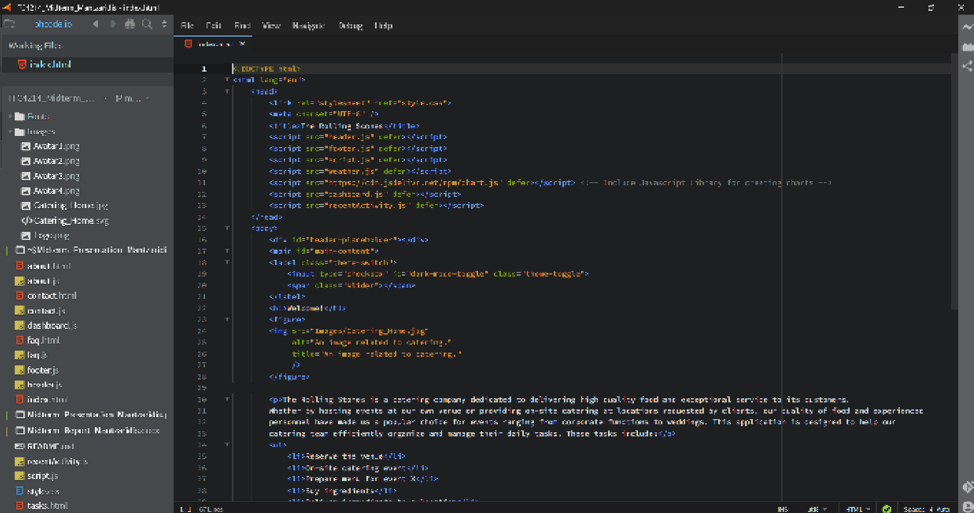
Midterm Assignment
Dimitris Mantzaridis

