Slide 1
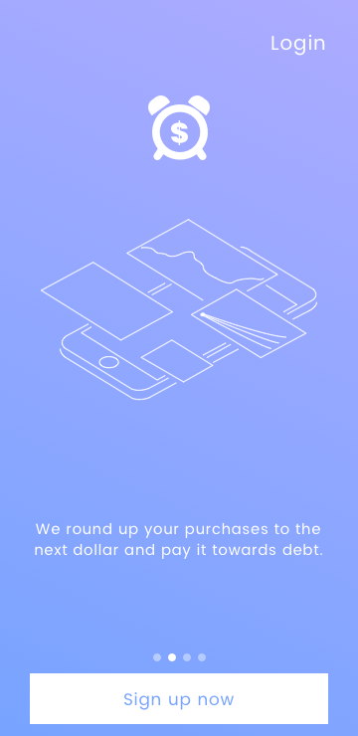
Dime Time
Get out of debt, one dime at a time.
A fintech app by: Tim Carlisle

Slide 2

Revenue generated by interest.
Round up purchases to pay down debt.
Monetized by subscription.
Collect financial data from users.
Dime Time Value Proposition

Slide 3
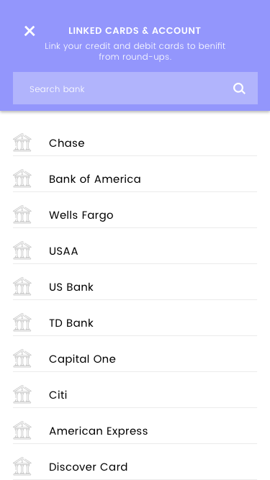
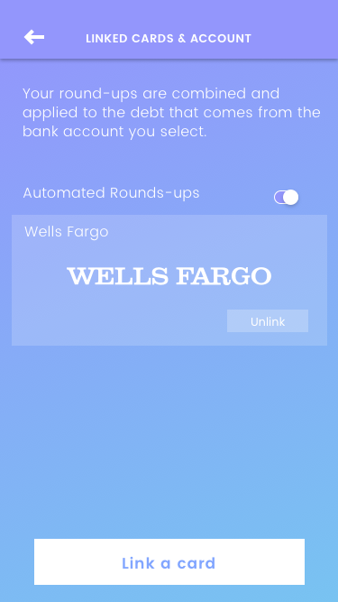
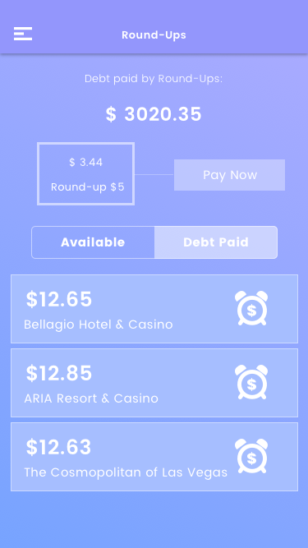
How It Works
Step 1: Download app, and select bank.
Step 2: Link debit card to Dime Time.
Step 3: Round-up and pay down debt.

Slide 4
Market: $14.3T Debt
“In the first quarter of 2020, debt reached $14.3 trillion, a $85 billion increase from the previous quarter. Now, household debt is half a trillion dollars higher than its previous peak in 2008. These debt statistics include mortgage, auto loan, credit card, student loan, and revolving debt.” Americans have amassed a record $14.3 trillion in debt.” What does this mean for Dime Time? It means that the number of Americans in debt will continue to grow. Source
$14.35T
Debt.
$14.15T Debt.
$13.55T Debt.
$13.15T
Debt.
2017:Q4 | 2018:Q4 | 2019:Q4 | 2020:Q3

Slide 5
Market Opportunity
$14.3T consumer debt market and growing. Source
275M smartphone users in the US and growing. Source
5.63B consumer debit cards and growing. Source
24.8 average monthly debit transactions and growing. Source

Slide 6
Debt by Generation
$9,593: Gen Z (18 to 23).
$78,396: Millennials (24 to 39).
$135,841: Gen X (40 to 55).
$96,984: Baby Boomers (56 to 74).
$40,925: Silent Generation (75 and above). Source

Slide 7

AWS: data storage. Source
Plaid: API code. Source
Dreamr: development. Source
Software Development
Hosted by Dreamr Labs

Slide 8

Data Collected
Hosted by Plaid
Name, phone number, address, and email.
Account averages and current account balances.
24 months of transaction history with geolocation, merchant, and category of purchases.
Assets.
Income sources and verification of employer.
Debt with internal and external accounts that host user’s debt. Source

Slide 9
Data by Plaid
Provides application programming interface (API) for 25¢ a person.
The middle man between connecting Dime Time to a person’s bank account(s).
Provides a list of banks to select, then provides the username and password for selected bank to connect Dime Time. Source
Once a person logs in to their bank account, Dime Time begins to collect financial analytics on the user as they set up their account with Dime Time.

Slide 10

Data Storage
Hosted by Amazon Web Service
Cloud storage hosted by Amazon. Source
Dime Time pays Amazon for access and storage of data.
Amazon enables Dime Time to grow and scale data with increasing users.

Slide 11
$1 Monthly Subscription
1% - 2% Collected on Sweep Account
Sale of financial data on data marketplace.
= Total Revenue
Revenue & Monetization

Slide 12

Sweep Account
Hosted by JP Morgan Chase
Investment account where round-ups live until the monthly transfer date.
Sweep account linked to Chase market funds (Asia, Middle East, Europe, South America, United States) where money “sweeps” to open market once the preceding market is closed.
Generates interest 24 hours a day in open markets and yields 1% - 2% interest (subject to market fluctuations). Source

Slide 13
Why a Sweep Account?
Avoids a set amount of payments each month to a credit card.
Payments range one payment every 24 hours to unlimited.
Dime Time would exceed the number of payments in the first few days of the month preventing further payments.
Example: American Express allows only 1 payment every 24 hours. Source

Slide 14
Customer Discovery PPC
Pay Per Click (PPC) campaign with targeted audience.
Target audience age 18-44, with credit card and auto debt.
Target cities: New York, Boston, Chicago, Seattle, San Francisco, Los Angeles, San Diego, Miami, Dallas, Denver, and Las Vegas.
PPC campaign through Facebook (241 million US users). Source

Slide 15

Facebook PPC Discovery
Hosted by Facebook
1 month PPC campaign.
$101 spent on advertisements.
18,746 impressions.
8,538 reached domestically.
1,433 post engagements.
1,319 post reactions.

Slide 16
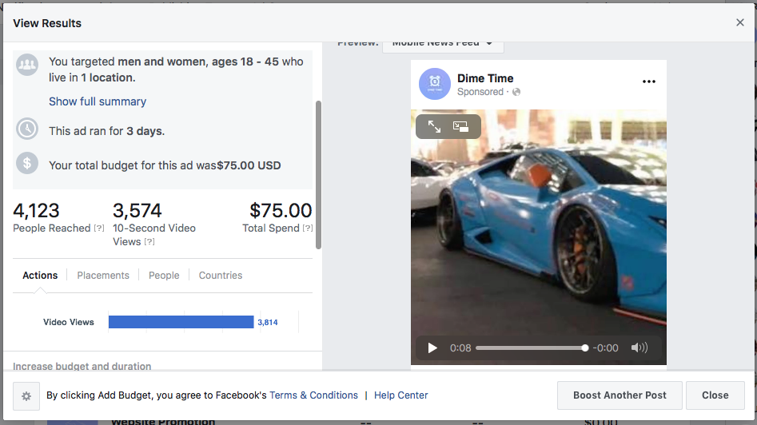


Slide 17
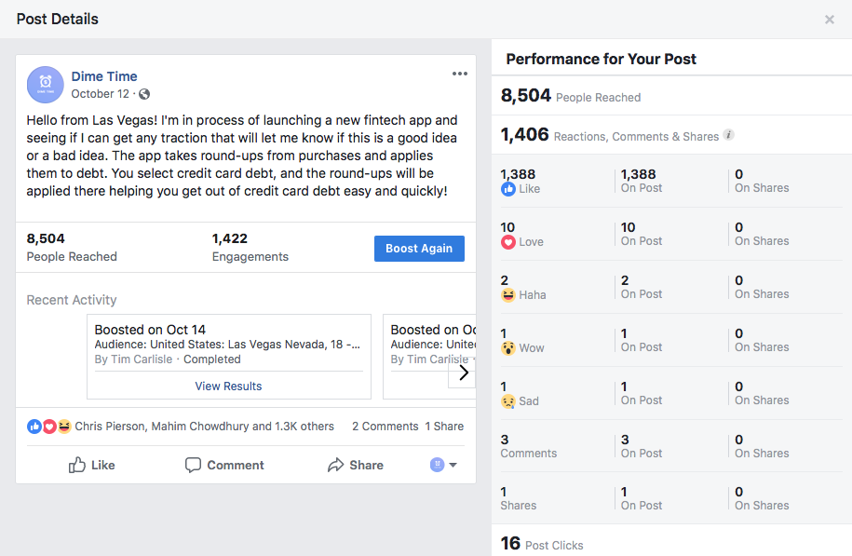

Slide 18
90-180 days for app development for MVP.
180-270 days for invite only code to audience of 2,500.
365 released to public with marketing to acquire users.
Go To Market Strategy
$500,000 Pre-Seed Start-Up

Slide 19
Competitor: changEd
Founder: Dan Steimach
ChangEd takes round-ups and applies them to student loans.
$250,000 pre-seed investment for 10% of the company.
$11,000,000 total sent in student loan payments.
$3 monthly subscription fee. Source

Slide 20

Competitor: Qoins
Founder: Christian Zimmerman
2017: Founded.
$500 - $1M: Annual revenue.
$5M - $10M: Valuation.
100K +: Downloads.
$2.99: Monthly subscription.
$5.25 +: Monthly transfer cost.

Slide 21

First to market.
$2.99 monthly subscription.
$5.25 + a month for funds transfer.
API by Plaid.
Moderate marketing campaign.
$10M debt paid off and counting.
Seeking pre-seed round funding.
$1 for monthly subscription.
Revenue generated by Sweep Account.
Financial data sold on data marketplace.
Marketing on Facebook and Tik Tok.
Strong brand potential.

Slide 22
Team Dime Time
Tim Carlisle; Founder
Chris Adams; Developer
Ian Jay; Legal

Slide 23
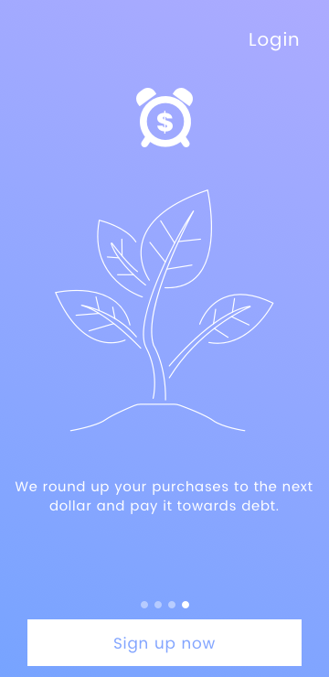
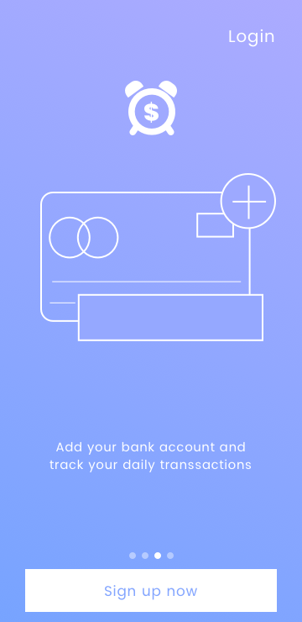
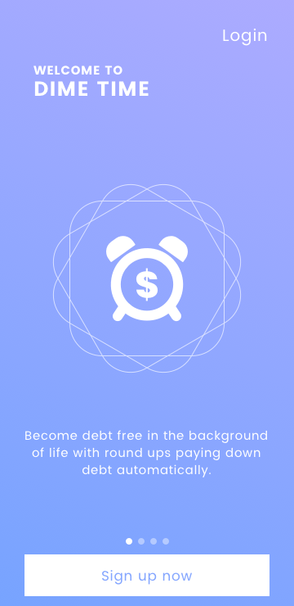
→ Dime Time Working Demo ←

