Slide 1

D I M E T I M E
Get out of debt, one dime at a time.
Tim Carlisle · Founder & CEO
A U T O M A T E D D E B T R E D U C T I O N T H R O U G H E V E R Y D A Y S P E N D I N G
01 / 14

Slide 2
T H E P R O B L E M
Americans Are Drowning in Debt
$18.8T
U . S . H O U S E H O L D D E B T
W H Y N O W
91%
of U.S. adults own a smartphone
• $1.25T of it is credit-card debt — the segment Dime Time attacks first
• People intend to pay down debt — but don't follow through
• Manual extra payments require discipline most users don't maintain
• Financial stress is rising across all generations
Plaid, ACH rails and mobile banking now make fully automated debt repayment possible.
Sources: Federal Reserve Bank of New York, Household Debt & Credit Report Q1 2026 (released May 2026) · Pew Research Center, Mobile Fact Sheet (2025)
D I M E T I M E
02 / 14

Slide 3
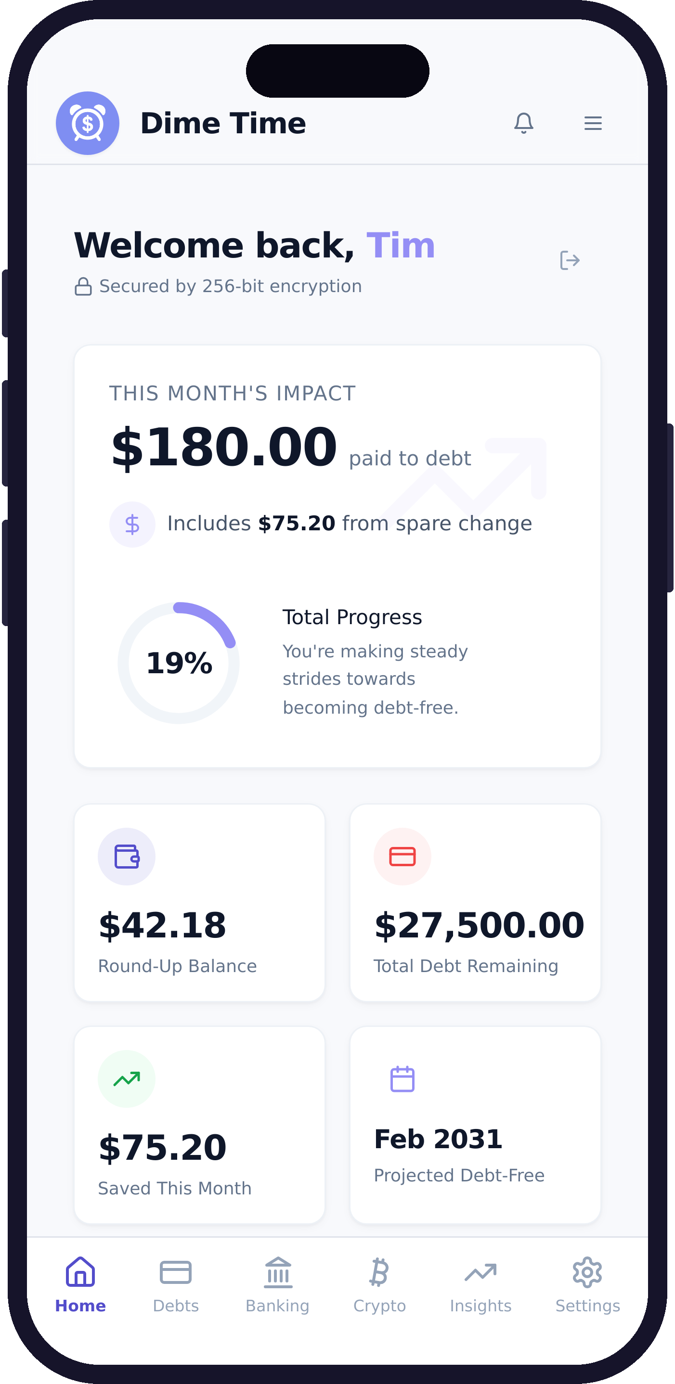
T H E S O L U T I O N
Automated Debt Reduction
• Every purchase is rounded up automatically
• Users control how their spare change is allocated
• Round-ups accumulate, then fund user-authorized ACH debt payments
• No willpower required — it works quietly in the background
Round-ups are batched and transferred on a schedule the user approves — money does not move on every individual purchase.
D I M E T I M E
03 / 14

Slide 4
T H E B R E A K T H R O U G H
Dynamic Allocation Engine
Automated allocation from every transaction.
Debt Repayment
primary debt payoff
80%
R O U N D - U P E X A M P L E
$0.37
P R O V E N I N C O N T R O L L E D L I V E T E S T
Bitcoin (Coinbase)
long-term wealth — not yet available to users
20%
P L A N N E D
• Real-time allocation tracking
• User-controlled split
• Payments execute over ACH rails
Patent-pending allocation workflow · Real transfers roll out with public bank linking.
D I M E T I M E
04 / 14

Slide 5
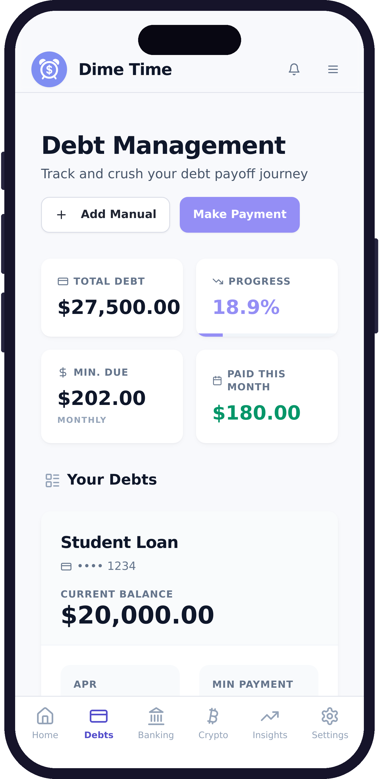
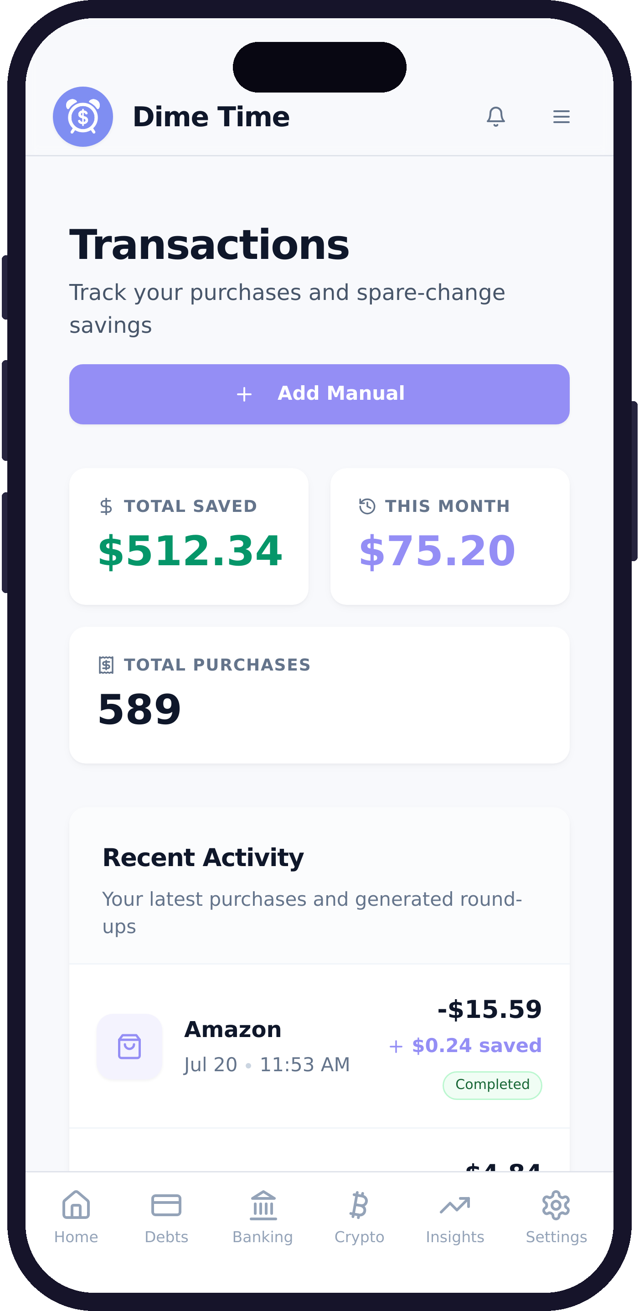
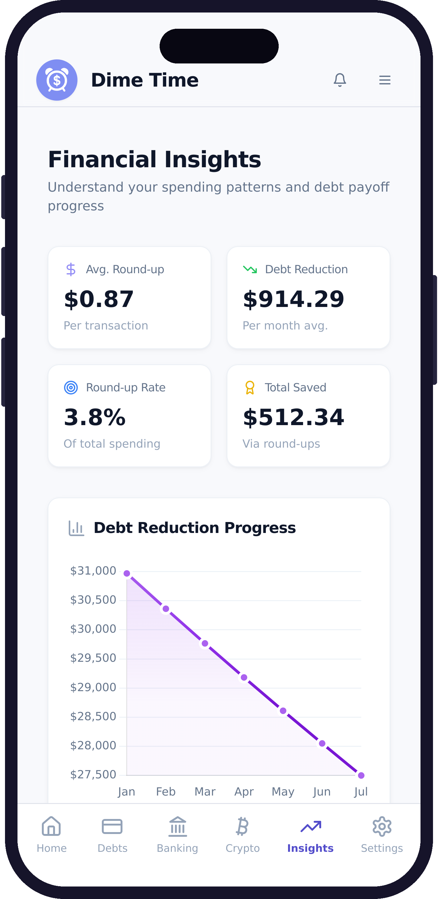
T H E P R O D U C T
Live Product — Real Financial Movement
Live dashboard
Debt tracking
Round-ups
Insights
Actual v1.0.5 App Store screenshots — live on the Apple App Store, July 2026
D I M E T I M E
05 / 14

Slide 6
T H E M A R K E T
Market Opportunity, Built Bottom-Up
S U B S C R I P T I O N R E V E N U E A T $ 2 . 9 9 / M O N T H
M A R K E T C O N T E X T
$18.8T
U.S. household debt
$1.25T
credit-card balances — our first target
1,400
paying subscribers
$50,232 ARR
5,600
paying subscribers
$200,928 ARR
25,000
paying subscribers
$897,000 ARR
Context for the size of the problem — not our revenue model.
Subscriber counts are illustrative milestones — targets, not forecasts. ARR = subscribers × $2.99 × 12.
Source: Federal Reserve Bank of New York, Household Debt & Credit Report Q1 2026 (released May 2026)
D I M E T I M E
06 / 14

Slide 7
B U S I N E S S M O D E L
Simple, Scalable Revenue Model
C O R E
P R O
P R E M I U M
B U I L T · F E A T U R E - G A T E D
P L A N N E D
P L A N N E D
$2.99
per month
$3.99
per month
$4.99
per month
• Round-up automation
• Debt-first allocation
• Progress tracking & insights
• Enhanced allocation controls
• Advanced analytics
• Deeper automation
• Faster transfer options
• Multiple funding accounts
• Priority routing
Core launches with the public rollout; higher tiers add speed, flexibility and multiple accounts as usage deepens.
Subscription model drives predictable recurring revenue.
D I M E T I M E
07 / 14

Slide 8
C O M P E T I T I O N
A Capability Gap in the Market
DIME TIME
ROUND-UP APPS
DEBT APPS
BUDGETING APPS
Purchase round-ups
Yes
Often
Limited
Limited
Automated debt payments
Yes
Rare
Varies
No
User-controlled allocation
Yes
Varies
Limited
No
Real ACH execution
Yes
Varies
Varies
No
Debt-first positioning
Yes
No
Yes
No
Dime Time combines automated round-ups, debt-first allocation and real ACH execution in one product.
Categories: round-up savings apps, debt-paydown apps, budgeting and financial-wellness apps.
D I M E T I M E
08 / 14

Slide 9
D E F E N S I B I L I T Y
Built to Be Difficult to Replicate
• Patent-pending dynamic allocation workflow (USPTO provisional filed)
• Production ACH infrastructure — real bank-to-bank loop already proven
• Compliance and partner-approval track record with regulated providers
• Repayment-behavior data advantage as the user base grows
• Debt-first brand, user trust and future distribution partnerships
I N F R A S T R U C T U R E S T A C K
PLAID
Bank connections & verification — production access
STRIPE
ACH rails; Financial Connections under review
MERCURY
Business banking & payout destination
Partner names indicate service relationships, not endorsements.
Proprietary workflow design + production financial infrastructure + partner approvals + a debt-first consumer brand.
D I M E T I M E
09 / 14

Slide 10
G O - T O - M A R K E T
Focused Launch. Measurable Growth.
W H O W E S E R V E F I R S T
I N I T I A L C H A N N E L S
Mobile-first consumers carrying credit-card debt who want to make extra payments but struggle with consistency.
• Founder-led LinkedIn and earned media
• Veteran and military communities
• Financial-wellness creators
• University and young-professional communities
• Employer financial-wellness partnerships
• Referral incentives once retention is validated
L A U N C H S E Q U E N C E
1. Activate public bank linking
2. Founder-led launch communications
3. Acquire a controlled first cohort
4. Measure activation, retention, ACH volume, conversion
5. Concentrate spend on channels that prove efficient
No paid-spend assumptions — channels are validated before scaling. All growth figures will be reported, not projected.
D I M E T I M E
10 / 14

Slide 11
T R A C T I O N
Live App. Real Money Moved.
S T A T U S
M O N E Y L O O P
P I P E L I N E
Live on the Apple
App Store — v1.0.5
approved July 2026
$1.00 ACH via Stripe;
$0.99 payout in Mercury —
proven bank-to-bank
Google Play, bank linking
& debt import awaiting
partner approvals
U S E R S
L I N K E D A C C O U N T S
T R A N S A C T I O N S
V O L U M E
D E B T R E D U C E D
Public launch
pending
Public launch
pending
Public launch
pending
Public launch
pending
Public launch
pending
L I V E O N T H E A P P S T O R E · V 1 . 0 . 5 · B U I L D 2 0 7
No user metrics are reported until public launch — nothing on this slide is estimated.
D I M E T I M E
11 / 14

Slide 12
T H E T E A M
Focused on Execution
TC
Tim Carlisle
F O U N D E R & C E O
• U.S. Navy veteran
• MBA • Graduate degree in Management Information Systems
• Designed, built and shipped Dime Time end-to-end
• Built with Plaid and Stripe ACH; payout rails verified through Mercury
Solo founder who designed, built and launched a production fintech application with working ACH infrastructure.
D I M E T I M E
12 / 14

Slide 13
T H E R A I S E
$150K to Launch and Prove Traction
R A I S I N G
U S E O F F U N D S
M I L E S T O N E S
$150,000
35%
Marketing & user acquisition
• Launch publicly on iOS and Android
• Prove repeatable customer acquisition
• Reach an initial paying-subscriber target
• Demonstrate recurring ACH payment volume
• Set up a larger seed round with measurable traction
I N S T R U M E N T
30%
Founder compensation & operating runway
Post-money SAFE
25%
Engineering & contractor support
E S T . R U N W A Y
~12 months
10%
Compliance, infra & operations
SAFE terms available on request. Allocation percentages total 100%.
D I M E T I M E
13 / 14

Slide 14
A P P E N D I X
Company Information
C O M P A N Y
Dime Time Technologies LLC
F O U N D E R
Tim Carlisle
W E B S I T E
dime-time.com
E M A I L
tim@dime-time.com
D I M E T I M E
14 / 14

Slide 15
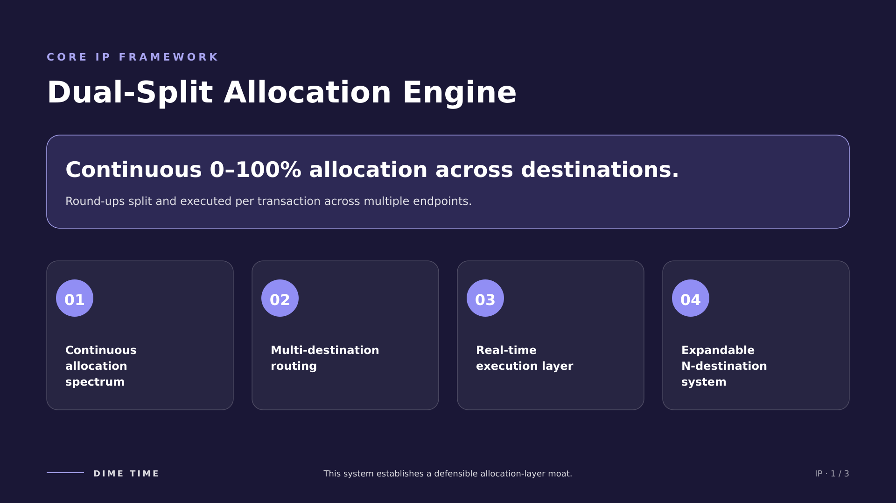

Slide 16
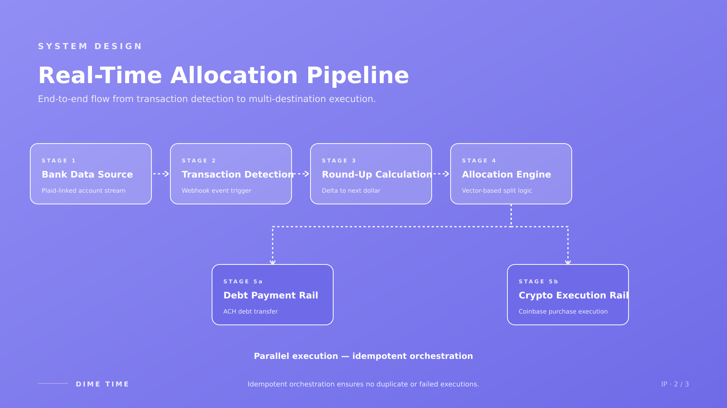

Slide 17
