Slide 1
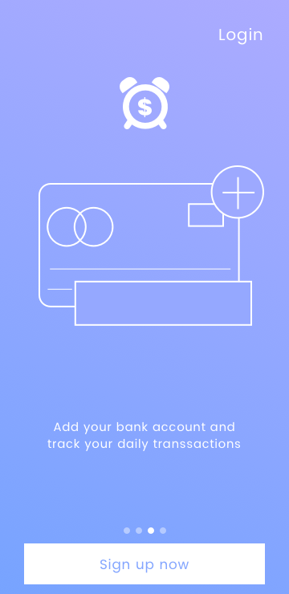
Phase 2 coming soon! Research underway!
Hint: Dime Time introduces a decentralized debt market.
Inclusive of blockchain development from Dreamr Labs.

Slide 2
Economies of Scale
Imagine Dime Time acquired 1,000,000 users, swiping the average 23.6 times a month, with the minimum round-ups totalling $.01.
Dime Time will be able to collect monthly interest off $236,000, making it a financial company that collects interest off $2.832M in annual revenue.
1,000,000 (users) x 23.6 (monthly swipes) = 23,600,000 (total swipes) x $.01 (minimum round-up) = $236,000 a month for the sweep account.
$236,000 x 1.5% APR = $3,540 a month or $42,480 a year from the investment sweep account.

Slide 3
A person purchases a cup of coffee for $4.25.
Dime Time rounds up the remaining $.75 and applies it to the person’s debt.
Dime Time will also include a multiplier that the user can select 2X, 3X, 5X, 10X.
If a person has the 2X multiplier, the amount of rounded up would be multiplied by 2; in the example the $.75 would be multiplied by 2 and the amount would be $1.50.
Example

Slide 4
Should I bring Dime Time to market?
50/50 at the moment with no investment.

Slide 5

Customer Discovery Quote:
“Some people say, ‘give the customers what they want.’ But that's not my approach. I think Henry Ford once said, ‘If I'd asked customers what they wanted, they would have told me, a faster horse!’ People don't know what they want until you show it to them.” - Steve Jobs

Slide 6

Customer Discovery
Hosted by Survey Monkey
10 question debt survey posted via LinkedIn, Facebook, and Reddit. Source
Revealed:
89% of people were age 18-44.
73% of people were age 25-44.
61% were males.
48% have credit card debt between $0-$10,000.
34% have auto debt between $0-$15,000.

