Slide 1


Slide 2


Slide 3
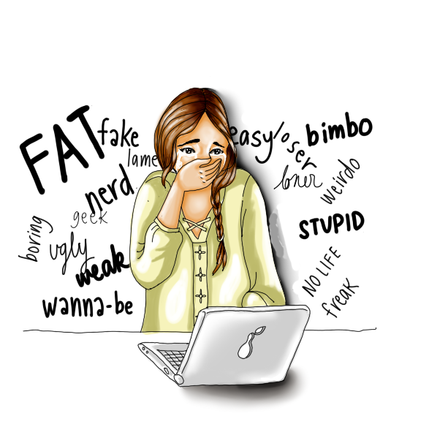



Slide 4
Common Inappropriate Expressions(Uncensored)
Fuck
Shit
Bitch
Slut
Nigger

Slide 5
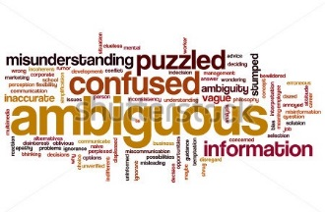

Slide 6
Example of Expressions that may become Inappropriate based on usage
Snatch
Screw
Pussy

Slide 7
The not-so famous Inappropriate Expressions
Slattern
Hussy
Strumpet

Slide 8


Slide 9


Slide 10
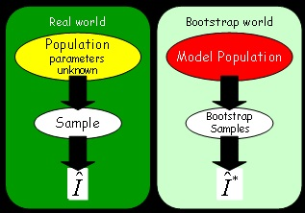

Slide 11

Inappropriate Expressions Recognition using Bootstrapping as Semi-Supervised Learning

Slide 12
BACKGROUND OF THE STUDY
BACKGROUND OF THE STUDY
STATEMENT OF THE PROBLEM
HYPOTHESIS
RESEARCH METHOD USED
SYSTEM ARCHITECTURE
EXPERIMENT PAPER
STATISTICAL TREATMENT
Inappropriate Expressions becomes very interesting in the field of NLP Community.
One of the problems that need to be solve in this study is the accuracy of the system because some of the researches related to the study has a low rate of accuracy.
Semi-supervised learning methods are proposed to effectively utilize a small scale of labeled data along with a larger amount of unlabeled data.
Semi-supervised learning on imbalanced classification is rather challenging.
Bootstrapping is not a sample size dependent resampling schema. Increasing the number of samples cannot increase the amount of information in the original data, it can only reduce the effects of random sampling errors which can arise from a bootstrap procedure itself.

Slide 13
BACKGROUND OF THE STUDY
BACKGROUND OF THE STUDY
STATEMENT OF THE PROBLEM
HYPOTHESIS
RESEARCH METHOD USED
SYSTEM ARCHITECTURE
EXPERIMENT PAPER
STATISTICAL TREATMENT
Detection of Harassment on Web 2.0 uses a baseline text mining system (using bag of words approach) and utilizes sentiment and contextual features using Support Vectors. It is somewhat limited due to the bag of words approach does not model the context.
Detecting Offensive Language in Social Media to Protect Adolescent Online Safety uses Lexical Syntactic Features and Derives the Offensive Value based on those features. It is has a limitation on Knowledge base due to it has no learning.
Detecting Offensive Tweets via Topical Feature Discovery via statistical topic modeling based on tweets with a seed words, which will be limited on the word itself and the topic related.
Filtering Offensive Language in Online Communities using Grammatical Relations uses Part-of-speech tags and collection of offensive words. Words that are not in the lexicon are considered inoffensive, which is limited implementation.

Slide 14
STATEMENT OF THE PROBLEM
BACKGROUND OF THE STUDY
STATEMENT OF THE PROBLEM
HYPOTHESIS
RESEARCH METHOD USED
SYSTEM ARCHITECTURE
EXPERIMENT PAPER
STATISTICAL TREATMENT
The study aims to design, develop and evaluate the system which will help to recognize Inappropriate Expressions from a document. The people who are in knowledgeable in English language are the respondents in this study. In addition to this, the researchers aim to seek answer to this problem:
Is there a significant difference in the performance analysis of Recognition of Inappropriate Expression between the expert and the system in terms of:
Recognition of Inappropriate Expressions
Recognition of Appropriate Expressions

Slide 15
STATEMENT OF THE PROBLEM
BACKGROUND OF THE STUDY
STATEMENT OF THE PROBLEM
HYPOTHESIS
RESEARCH METHOD USED
SYSTEM ARCHITECTURE
EXPERIMENT PAPER
STATISTICAL TREATMENT
2. Is there a significant difference in the performance analysis of Recognition of Inappropriate Expressions of system when modeled between different training sets of Inappropriate Expressions in terms of:
Recognition of Inappropriate Expressions
Recognition of Appropriate Expressions

Slide 16
HYPOTHESIS
BACKGROUND OF THE STUDY
STATEMENT OF THE PROBLEM
HYPOTHESIS
RESEARCH METHOD USED
SYSTEM ARCHITECTURE
EXPERIMENT PAPER
STATISTICAL TREATMENT
In this research, the researchers are guided by the following hypothesis:
The Inappropriate Expressions Recognition has no significant difference in terms of effectiveness between the system and the expert:
Recognition of Inappropriate expressions.
Recognition of Appropriate expressions.

Slide 17
HYPOTHESIS
BACKGROUND OF THE STUDY
STATEMENT OF THE PROBLEM
HYPOTHESIS
RESEARCH METHOD USED
SYSTEM ARCHITECTURE
EXPERIMENT PAPER
STATISTICAL TREATMENT
The Inappropriate Expressions Recognition has a significant difference in terms of effectiveness when trained in different data sets of Inappropriate Expressions in terms of:
Recognition of Inappropriate expressions.
Recognition of Appropriate expressions.

Slide 18
RESEARCH METHOD USED
BACKGROUND OF THE STUDY
STATEMENT OF THE PROBLEM
HYPOTHESIS
RESEARCH METHOD USED
SYSTEM ARCHITECTURE
EXPERIMENT PAPER
STATISTICAL TREATMENT
The method used by the researchers in developing the study is quasi-experimental method of research that describes and analyzes the relation of the Bootstrapping Machine Learning as opposed to its relation to performance of Inappropriate Expressions. The researchers of this study conducted a pre-test and post-test about the implementation of the system. In this method, researches and studies were used to come up with the expected result.

Slide 19
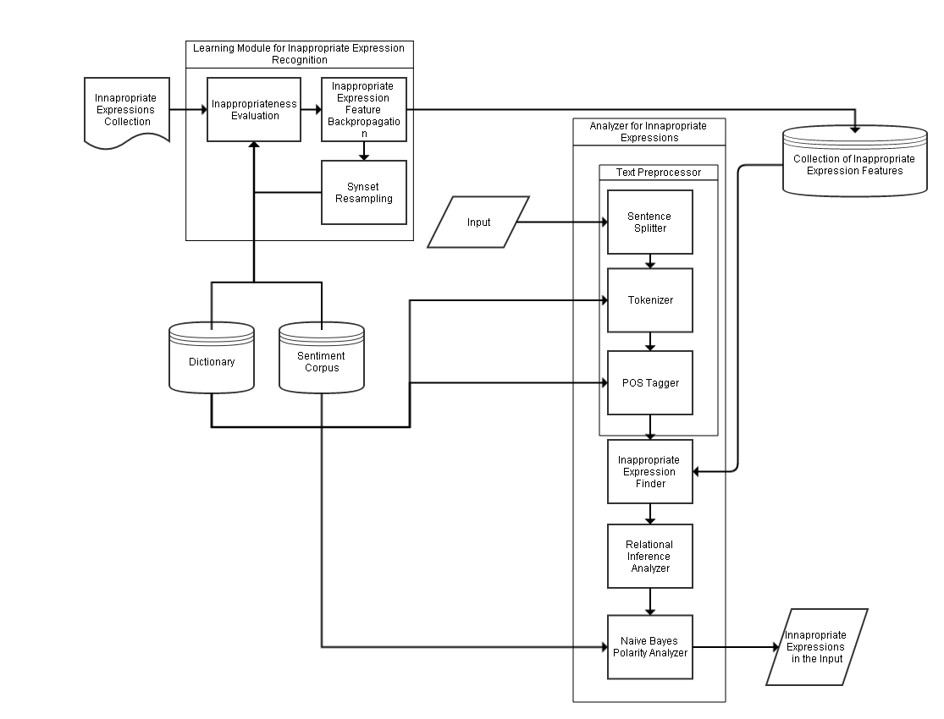
SYSTEM ARCHITECTURE
BACKGROUND OF THE STUDY
STATEMENT OF THE PROBLEM
HYPOTHESIS
RESEARCH METHOD USED
SYSTEM ARCHITECTURE
EXPERIMENT PAPER
STATISTICAL TREATMENT

Slide 20
EXPERIMENT PAPER
BACKGROUND OF THE STUDY
STATEMENT OF THE PROBLEM
HYPOTHESIS
RESEARCH METHOD USED
SYSTEM ARCHITECTURE
EXPERIMENT PAPER
STATISTICAL TREATMENT
Sentences | Inappropriate
 | System | Expert
1
2
3
4
5
6
7
8
9
10
Experiment Paper I – Determining inappropriate expressions between system and expert.

Slide 21
EXPERIMENT PAPER
BACKGROUND OF THE STUDY
STATEMENT OF THE PROBLEM
HYPOTHESIS
RESEARCH METHOD USED
SYSTEM ARCHITECTURE
EXPERIMENT PAPER
STATISTICAL TREATMENT
Sentence | TP | FP | TN | FN
1
2
3
4
5
6
7
8
9
10
Total
Average
Experiment Paper II – Input Scoring.

Slide 22
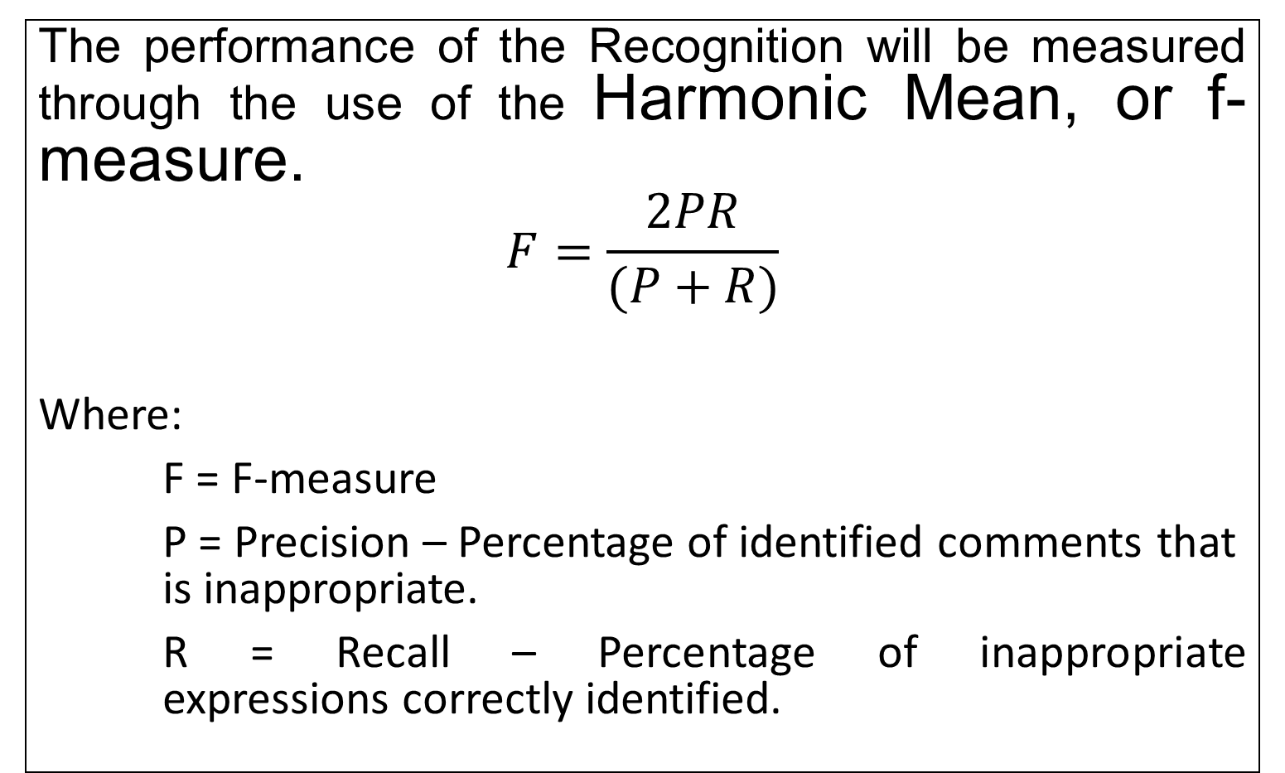
STATISTICAL TREATMENT
BACKGROUND OF THE STUDY
STATEMENT OF THE PROBLEM
HYPOTHESIS
RESEARCH METHOD USED
SYSTEM ARCHITECTURE
EXPERIMENT PAPER
STATISTICAL TREATMENT
The performance of the Recognition will be measured through the use of the Harmonic Mean, or f-measure.
$$F=\frac{2PR}{(P+R)}$$
Where:
­­ F = F-measure
P = Precision – Percentage of identified comments that is inappropriate.
R = Recall – Percentage of inappropriate expressions correctly identified.

Slide 23
END

