Slide 1
Metric Ideas

Slide 2
Other Papers
All used some sort of Object detection metric for components
Yolo Paper:
  No distinction between annotation and ECCs
  Distinct accuracy for:
    ECCs and annotations
    Detected lines
    Junctions and Ts
  Overall system performance measure:
    Sum of above errors (seems weird or?)
    Error(ECCS and annotations) + Error(Detected lines) + Error(Junctions and Ts)
    Where Error = 1 - Accuracy

Slide 3
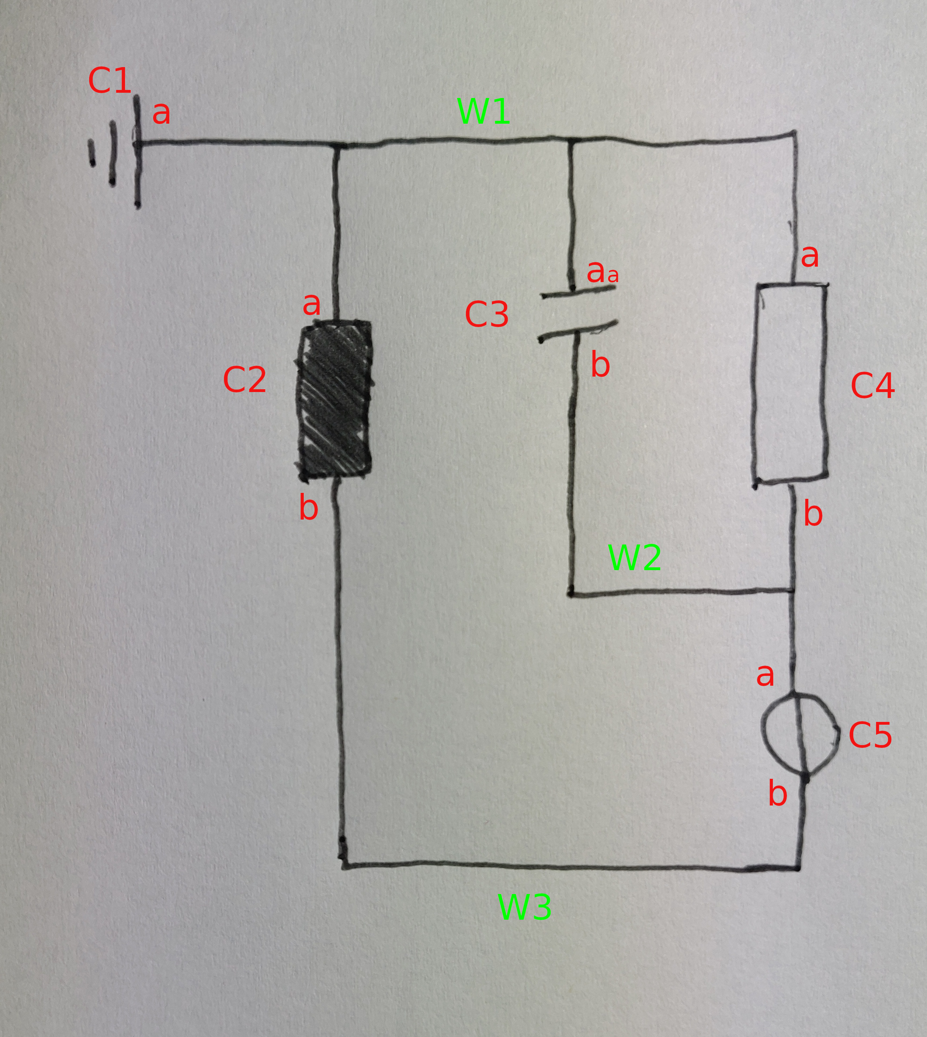
Definitions
components = {C1, C2, C3, C4, C5}
wire_segments = {W1, W2, W3}
(ignore a, b stuff)
Topology defined as:
W1: C1, C2, C3, C4
W2: C3, C4, C5
W3: C2, C5

Slide 4
Component Metrics
Components
  Electrical Circuit Components (ECC) (e.g. Resistor )
    Any Object Detection Metric
  Annotations
    Macro: Annotation as a whole (e.g. 50mH)
    Micro: Charwise (same as ECC metric)

Slide 5
Annotation Mapping
Does detected Annotation “A0” belong to ECC “E0”?
How good are annotations mapped against their ECC?
Examples:
  A0 mapped against E0: TP
  A0 mapped against E1: FP
  Completely missing annotation => E0 is missing A0 due to A0 undetected => FN? Error transitions from component recognition
    PROBLEM: Completely missing component? => will probably result in FP if there is another component without annotation. Or worse if there is no component then dunno what this is. It is not a FN because the annotation should be there.

Slide 6
Topology Metrics: Macro
Error in any part of the topology results in a topology error

Slide 7
Topology Metrics: Micro
Ground Truth:
W1: C1, C2, C3, C4
W2: C3, C4, C5
W3: C2, C5
Prediction:
W1: C1, C2, C3 // 1 missing
W2: C3, C4, C5 // correct
W3: C2, C5 // correct
=> 66% correct

Slide 8
Topology Metrics: Micro
Ground Truth:
W1: C1, C2, C3, C4
W2: C3, C4, C5
W3: C2, C5
Prediction:
W1: C1, C2, C3, C4 // correct
W2: C3, C4, C5, C2 // 1 More
// W2 merges with W3 => short circuit C5
// that can’t be modeled right now dunno what to do in such
// a case

Slide 9
Topology Metrics: Nano
Ground Truth:
W1: C1, C2, C3, C4
W2: C3, C4, C5
W3: C2, C5
Prediction:
W1: C1, C2, C3 // 1 missing
W2: C3, C4, C5 // correct
W3: C2, C5 // correct
Overall possible predictions = SUM(COUNT_COMPONENTS(w) for w in WIRE_SEGMENTS)
= C1, C2, C3, C3, C4, C5, C2, C5 = N = 7
=> 6 Correct / 7 Overall
Generally it is possible to count here TPs and FPs

Slide 10
Overall
Generally look at how much circuits were converted 100% correctly
Treat every possible classification per circuit individually
  Question how to treat transient errors
    Include / Ignore
  Include them would be simpler

