Slide 1
Ischemic Stroke Segmentation on CT Perfusion Data using Deep Learning Methods
Master Thesis: Intro Talk
Florian Thamm
Supervised by Leonid Mill MSc, Dr. Markus Jürgens, Prof. Dr. Andreas Maier
Pattern Recognition Lab, Friedrich-Alexander University Erlangen-Nuremberg

Slide 2
Introduction
Stroke: „The abrupt onset of a focal neurological deficit, also called cerebrovascular accident or apoplexy.“ [1], caused by a lack of blood supply.
Hemorrhagic 13%
Spontaneous rupture of blood vessel
Strokes
Thrombotic 50%
Clot is formed in one artery supplying blood for brain
Ischemic 87%
Embolic 25%
Clot is not formed in one artery supplying blood for brain
Lacunar 25%
Microartery occlusion
[1]
[1]: Wittenauer, Rachel, and Lily Smith. Background Paper 6.6 Ischaemic and Haemorrhagic Stroke. 2012.
Florian Thamm / Ischemic Stroke Segmentation using Deep Learning Methods
17.06.2019
<number>

Slide 3
Introduction
Stroke: „The abrupt onset of a focal neurological deficit, also called cerebrovascular accident or apoplexy.“ [1], caused by a lack of blood supply.
The Three Key Questions [2]:
Is there hemorrhage? → Unenhanced CT
Is there a Thrombus and where is it? → CT Angiography
Is there a ‘core’ of critically ischemic or penumbra of severely ischemic tissue? → CT Perfusion → Even Better: MRI (Diffusion weighted Imaging Sequence DWI)
[1]: Wittenauer, Rachel, and Lily Smith. Background Paper 6.6 Ischaemic and Haemorrhagic Stroke. 2012.
[2]: R Gilberto Gonzalez, Joshua A Hirsch, WJ Koroshetz, Michael H Lev, and Pamela W Schaefer. Acute ischemic stroke. Springer, 2011.
Florian Thamm / Ischemic Stroke Segmentation using Deep Learning Methods
17.06.2019
<number>

Slide 4
CT Perfusion (CTP)
CTP: “A method to characterize the blood flow on tissue-level (voxel-level)” [2] which helps to find the ‘core’ and the penumbra.
Step 1: Apply contrast agent and acquire a time dependent volume
[2]: R Gilberto Gonzalez, Joshua A Hirsch, WJ Koroshetz, Michael H Lev, and Pamela W Schaefer. Acute ischemic stroke. Springer, 2011.
Florian Thamm / Ischemic Stroke Segmentation using Deep Learning Methods
17.06.2019
<number>

Slide 5
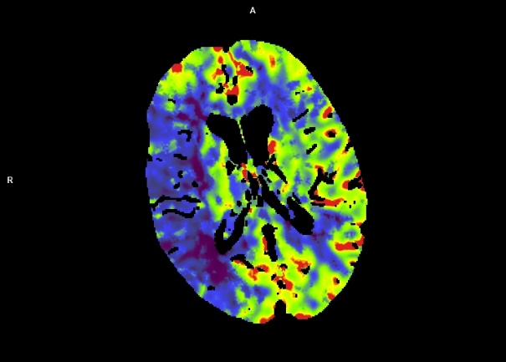
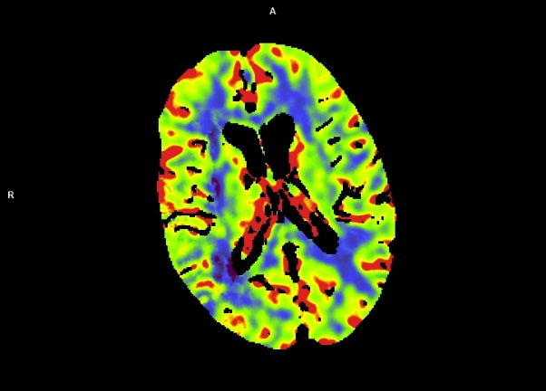
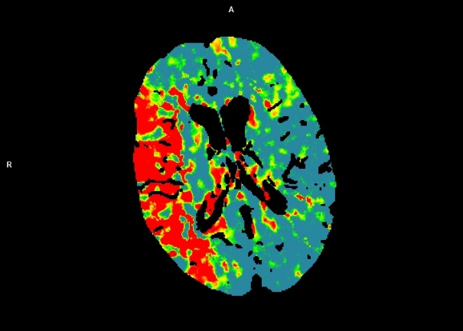
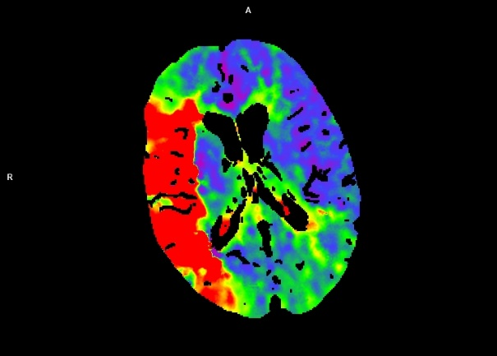
CT Perfusion (CTP)
CTP: “A method to characterize the blood flow on tissue-level (voxel-level)” [2] which helps to find the ‘core’ and the penumbra.
Step 1: Apply contrast agent and acquire a time dependent volume
Step 2: Compute Perfusion Parameters (CBF, CBV, MTT, TTP, TTS, TTD, AVG, MIP, BASE)
Cerebral Blood Flow CBF
Cerebral Blood Volume CBV
Mean Transit Time MTT
Time To Peak TTP
[2]: R Gilberto Gonzalez, Joshua A Hirsch, WJ Koroshetz, Michael H Lev, and Pamela W Schaefer. Acute ischemic stroke. Springer, 2011.
Florian Thamm / Ischemic Stroke Segmentation using Deep Learning Methods
17.06.2019
<number>

Slide 6
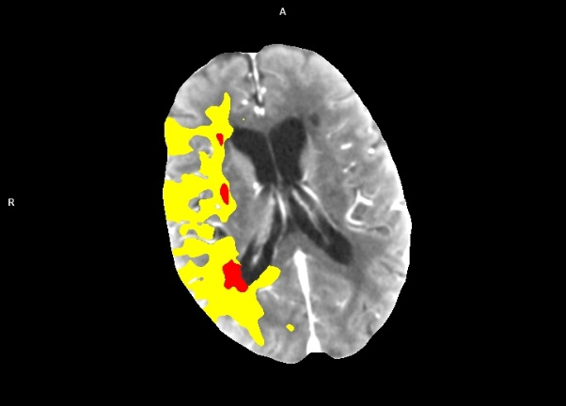
CT Perfusion (CTP)
CTP: “A method to characterize the blood flow on tissue-level (voxel-level)” [2] which helps to find the ‘core’ and the penumbra.
Step 1: Apply contrast agent and acquire a time dependent volume
Step 2: Compute Perfusion Parameters
Step 3: Determine Penumbra and Core
Penumbra
Core
[2]: R Gilberto Gonzalez, Joshua A Hirsch, WJ Koroshetz, Michael H Lev, and Pamela W Schaefer. Acute ischemic stroke. Springer, 2011.
Florian Thamm / Ischemic Stroke Segmentation using Deep Learning Methods
17.06.2019
<number>

Slide 7
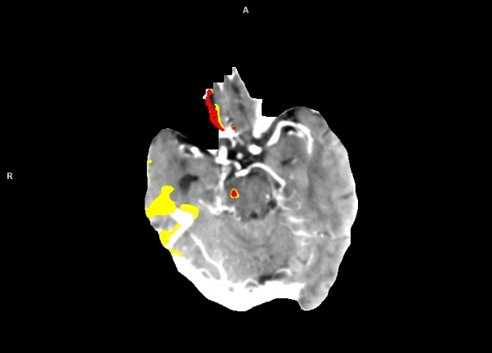
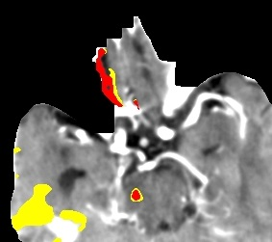
CT Perfusion (CTP)
CTP: “A method to characterize the blood flow on tissue-level (voxel-level)” [2] which helps to find the ‘core’ and the penumbra.
State of the art for core and penumbra segmentation: Thresholding [3]
BUT: Everyone claims to have the best threshold levels – no standardization!
Everyone works on different parameters
Thresholding causes artifacts!
Penumbra
Core
Penumbra Core
[2]: R Gilberto Gonzalez, Joshua A Hirsch, WJ Koroshetz, Michael H Lev, and Pamela W Schaefer. Acute ischemic stroke. Springer, 2011.
[3]: Max Wintermark, R Meuli, P Browaeys, M Reichhart, J Bogousslavsky, P Schnyder, and P Michel. Comparison of ct perfusion and
angiography and mri in selecting stroke patients for acute treatment. Neurology, 68(9):694–697, 2007.
Florian Thamm / Ischemic Stroke Segmentation using Deep Learning Methods
17.06.2019
<number>

Slide 8
The Thesis
CTP: “A method to characterize the blood flow on tissue-level (voxel-level)” [2] which helps to find the ‘core’ and the penumbra.
State of the art for core and penumbra segmentation: Thresholding [3]
Idea: Segmentation while learning anatomical structures in order to reduce artifacts
Preprocessing + U-Net + Postprocessing
Input: All Parameter Maps
Output: Core Heatmap
Label: Diffusion Weighted MR Images (Annotations)
Goal #1: Segmentation with U-Net
Goal #2: Answering: Which Perfusion Parameters are actually relevant?
Goal #3: Answering: Does the use of Deep Learning actually reduce artifacts?
[2]: R Gilberto Gonzalez, Joshua A Hirsch, WJ Koroshetz, Michael H Lev, and Pamela W Schaefer. Acute ischemic stroke. Springer, 2011.
[3]: Max Wintermark, R Meuli, P Browaeys, M Reichhart, J Bogousslavsky, P Schnyder, and P Michel. Comparison of ct perfusion and
angiography and mri in selecting stroke patients for acute treatment. Neurology, 68(9):694–697, 2007.
Florian Thamm / Ischemic Stroke Segmentation using Deep Learning Methods
17.06.2019
<number>

