Slide 1
Detection of Hand Drawn Electrical Circuit Diagrams and their Components using Deep Learning Methods and Conversion into LTspice Format
Master Thesis: Intro Talk
Dmitrij Vinokour
Supervised by Florian Thamm M. Sc, Felix Denzinger M. Sc., Prof. Dr. Andreas Maier
Pattern Recognition Lab, Friedrich-Alexander University Erlangen-Nuremberg

Slide 2
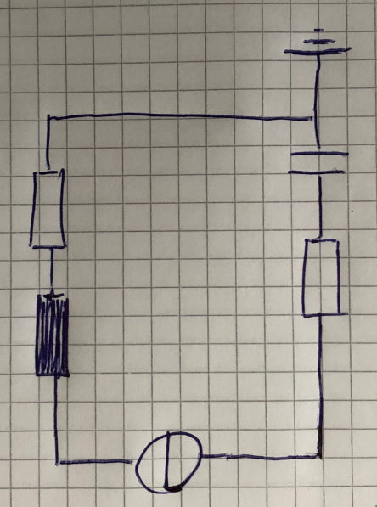
Introduction
Hand-Drawn Electrical Circuit
Dmitrij Vinokour
21.01.2020
<number>

Slide 3
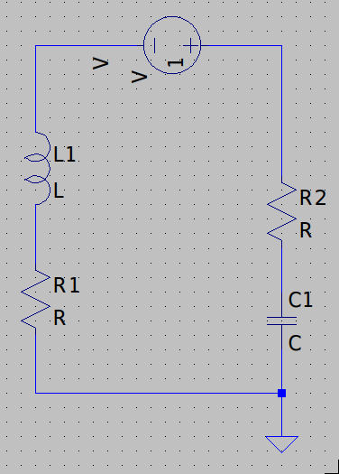
Introduction
Hand-Drawn Electrical Circuit
Model in LTspice
Dmitrij Vinokour
21.01.2020
<number>

Slide 4
Introduction
Hand-Drawn Electrical Circuit
Model in LTspice
General:
- Object detection network for components and annotations
- Segmentation network for the circuit
- Postprocessing
Dmitrij Vinokour
21.01.2020
<number>

Slide 5
Motivation
- Drawing speed of hand-drawn diagrams ~90% faster, than drawing in a tool (UML, flow charts, Markov chains etc. vs. Microsoft Visio) [1]
 | Real World | LTspice World
Drawing | Fast | Slow
Calculating | Slow | Fast
[1]: Khaled S. Refaat et al., A New Approach for Context-Independent Handwritten Offline Diagram Recognition using Support Vector Machines. 2008.
Dmitrij Vinokour
21.01.2020
<number>

Slide 6
Motivation
- Drawing speed of hand-drawn diagrams ~90% faster, than drawing in a tool (UML, flow charts, Markov chains etc. vs. Microsoft Visio) [1]
 | Real World | LTspice World | This Thesis
Drawing | Fast | Slow | Fast
Calculating | Slow | Fast | Fast
[1]: Khaled S. Refaat et al., A New Approach for Context-Independent Handwritten Offline Diagram Recognition using Support Vector Machines. 2008.
Dmitrij Vinokour
21.01.2020
<number>

Slide 7
Dataset
- 20 contributors
- ~120 circuits
- Bounding boxes labeled with rotation
- vertical / horizontal
- left / right / top / bottom
- Semi-auto generated labels for segmentation
- Very low amount of circuits on grid paper
- For training circuit masks are projected on grid paper
Capacitor | 475
Inductor | 363
Resistor | 382
Diode | 452
Voltage | 241
Current | 247
Ground | 397
Bounding boxes per class
Dmitrij Vinokour
21.01.2020
<number>

Slide 8
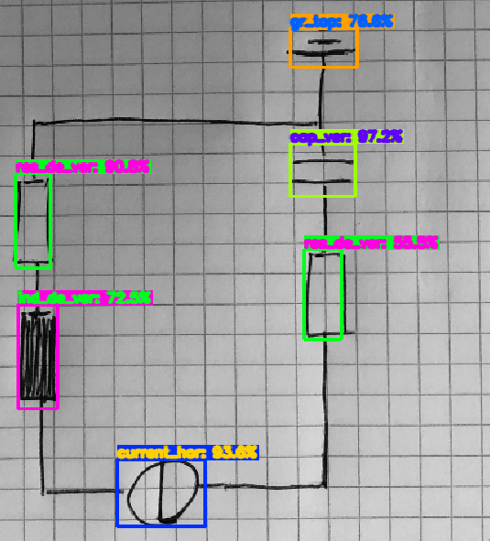
Current Pipeline
1. Object Detection of components and annotations (tiny-YOLOV4)
Prediction with YOLO
Dmitrij Vinokour
21.01.2020
<number>

Slide 9
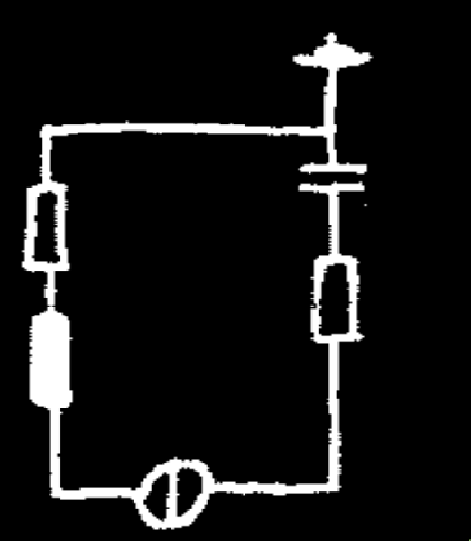
Current Pipeline
1. Object Detection of components and annotations (tiny-YOLOV4)
2. Segmentation of the circuit (Mobile-UNet)
Prediction with Mobile-Unet
Dmitrij Vinokour
21.01.2020
<number>

Slide 10
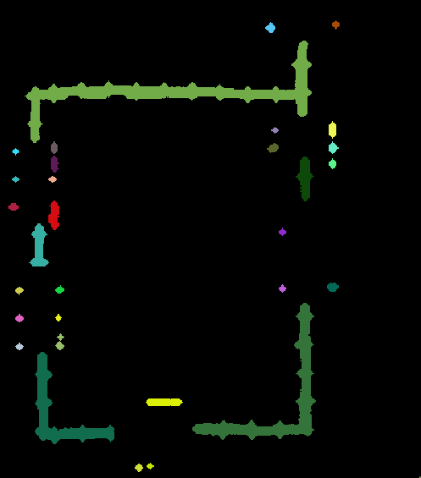
Current Pipeline
1. Object Detection of components and annotations (tiny-YOLOV4)
2. Segmentation of the circuit (Mobile-UNet)
3. Remove bboxes and apply connected component analysis
Connected components
Dmitrij Vinokour
21.01.2020
<number>

Slide 11
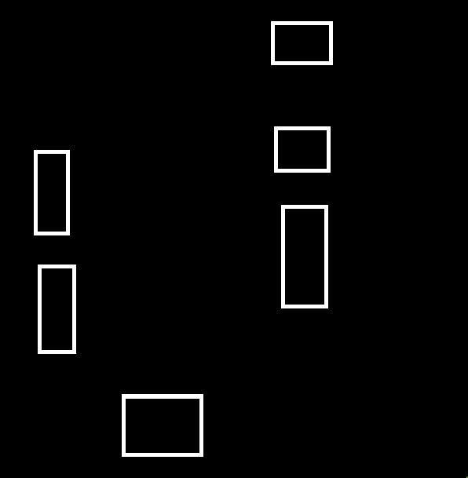

Current Pipeline
1. Object Detection of components and annotations (tiny-YOLOV4)
2. Segmentation of the circuit (Mobile-UNet)
3. Remove bboxes and apply connected component analysis
4. Create bbox mask and find intersections with connected components
Bounding box mask
Connected components
Intersections
Dmitrij Vinokour
21.01.2020
<number>

Slide 12
Current Pipeline
1. Object Detection of components and annotations (tiny-YOLOV4)
2. Segmentation of the circuit (Mobile-UNet)
3. Remove bboxes and apply connected component analysis
4. Create bbox mask and find intersections with connected components
5. Embed gathered data into a LTspice file
a) Trace wires / Split Wire into segments
b) Map detected class to LTspice
Dmitrij Vinokour
21.01.2020
<number>

Slide 13
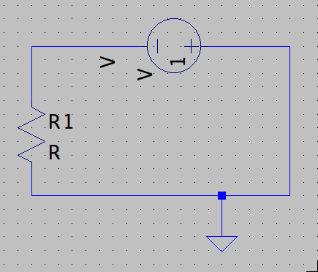
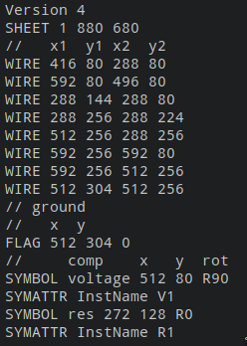
LTspice file
Model in LTspice
Corresponding .asc
Dmitrij Vinokour
21.01.2020
<number>

Slide 14
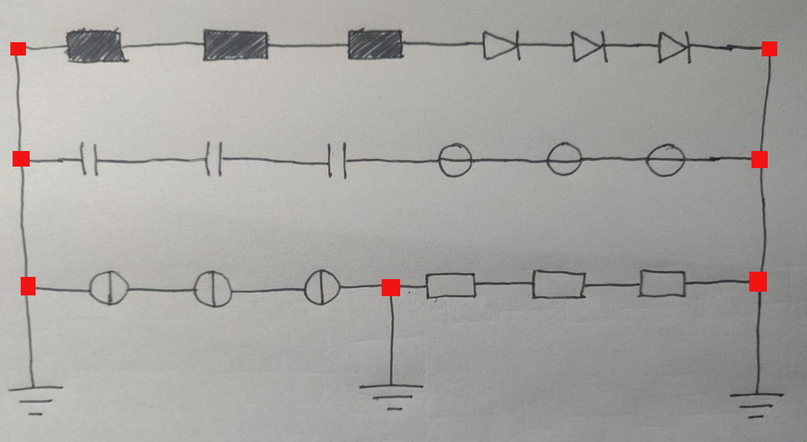
Current Problem
Connections of interest (components > 2)
Dmitrij Vinokour
21.01.2020
<number>

Slide 15
Results
Dmitrij Vinokour
21.01.2020
<number>

Slide 16
Outlook
- OCR for annotations
- Increase accuracy through Test-Time Augmentation (different rotations behave like ensemble)
Maybe:
- Replace YOLO with UNet
- Experiment with different encoders (e.g. MobileNetV3)
- Release horizontal / vertical restriction
Dmitrij Vinokour
21.01.2020
<number>

