Slide 1
Detection of Hand Drawn Electrical Circuit Diagrams and their Components using Deep Learning Methods and Conversion into LTspice Format
Master Thesis: Final Talk
Dmitrij Vinokour
Supervised by Florian Thamm M. Sc., Felix Denzinger M. Sc., Prof. Dr.-Ing. habil. Andreas Maier,
Pattern Recognition Lab, Friedrich-Alexander University Erlangen-Nuremberg

Slide 2
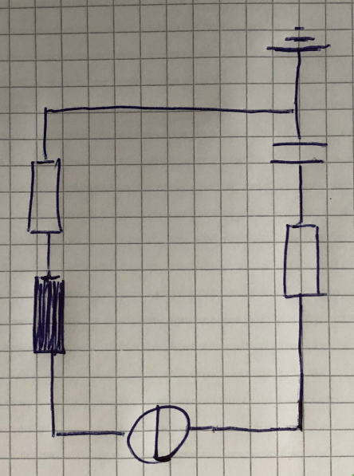
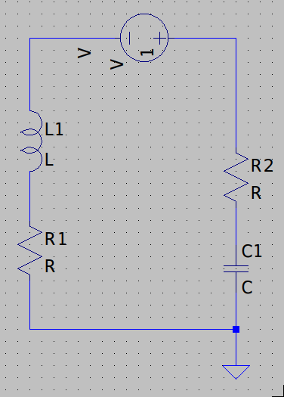
Introduction
Hand-Drawn Electrical Circuit
Model in LTspice
Dmitrij Vinokour
12.08.2021

Slide 3
Motivation
- Drawing speed of hand-drawn diagrams ~90% faster than drawing in a tool (UML, flow charts, Markov chains etc. vs. Microsoft Visio) [1]
- Take the best out of both worlds
 | Real World | LTspice World | This Thesis
Drawing | Fast | Slow | Fast
Calculating | Slow | Fast | Fast
[1]: K. Refaat et al., A New Approach for Context-Independent Handwritten Offline Diagram Recognition using Support Vector Machines. 2008.
Dmitrij Vinokour
12.08.2021

Slide 4
Goals
1. Create a dataset of hand-drawn electrical circuit diagrams
2. Conversion Pipeline
- Detect circuit components and their annotations
- Operate on various paper backgrounds (white, checkered)
- Generate Topology
- Conversion into LTspice format
3. Evaluation algorithm
Dmitrij Vinokour
12.08.2021

Slide 5
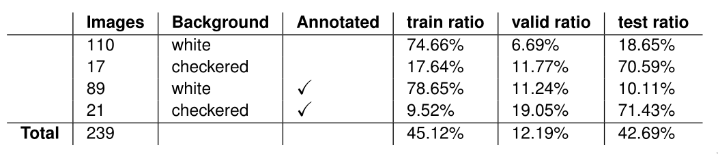
Dataset
General:
- Collection of electrical circuit diagrams in German notation
- 31 contributors (21 train / validation, 10 test)
- On average 7.6 circuits / person
Labels:
- Bounding boxes labeled with orientation
- Circuit masks for segmentation
- Topology labels
- Matching labels
Overview of the circuits based on their background, annotation type and the train / validation / test split
Dmitrij Vinokour
12.08.2021

Slide 6
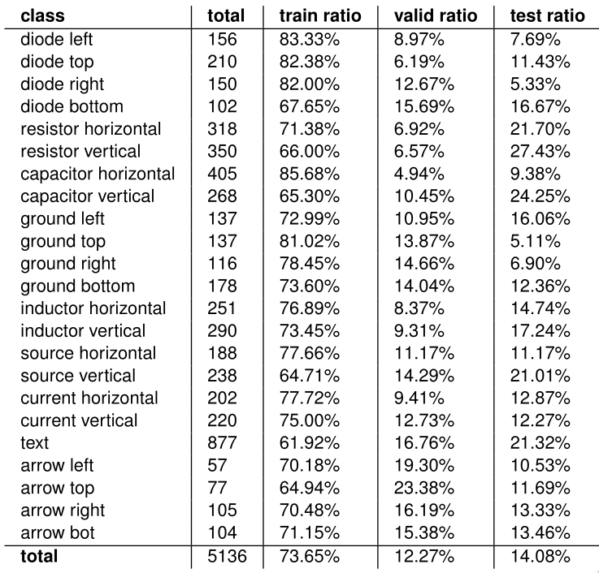
Dataset
Classwise data overview
Dmitrij Vinokour
12.08.2021

Slide 7
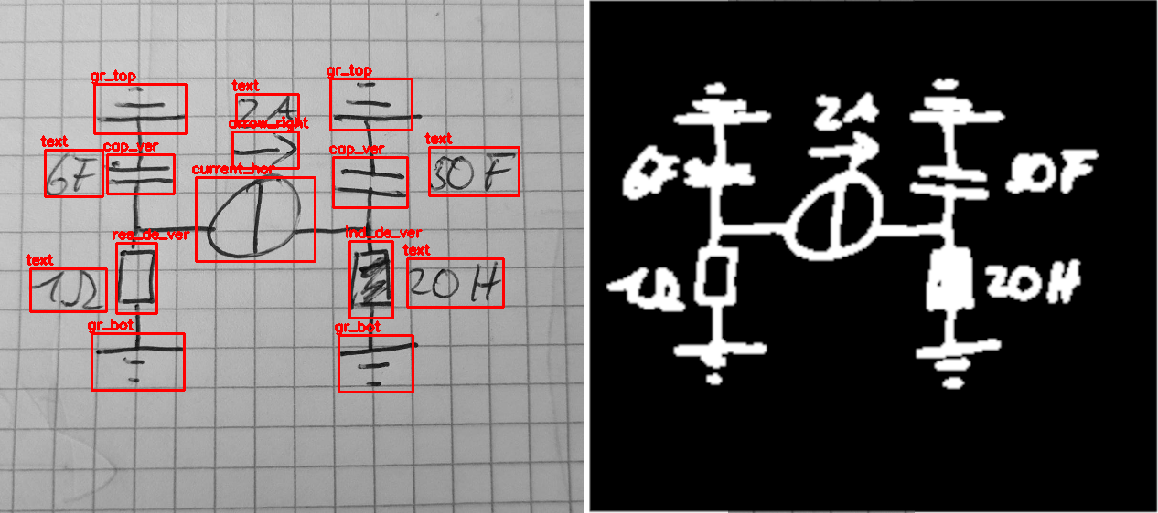
Dataset
Example labels for object detection (left) and segmentation (right)
Dmitrij Vinokour
12.08.2021

Slide 8
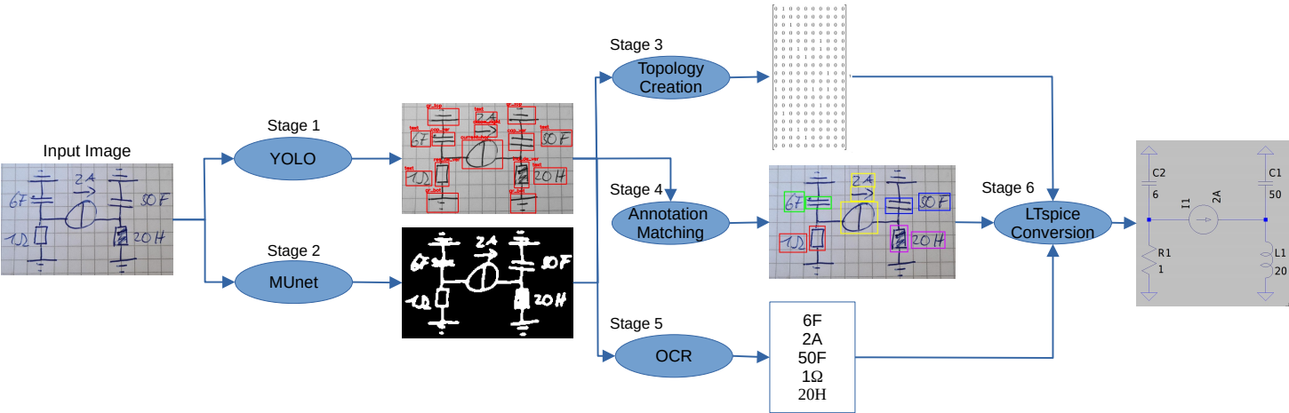
Pipeline: Overview
Dmitrij Vinokour
12.08.2021

Slide 9
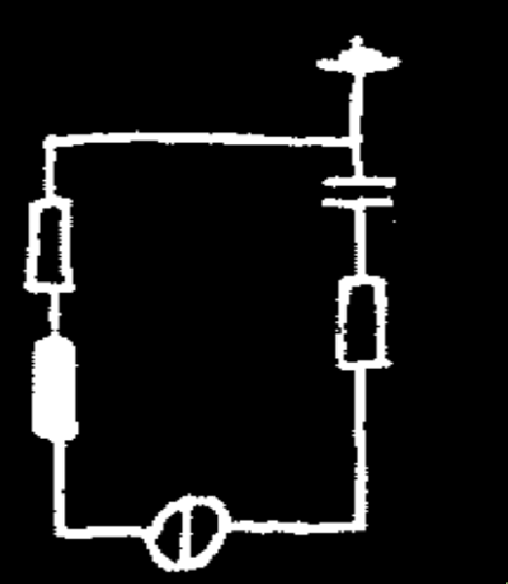
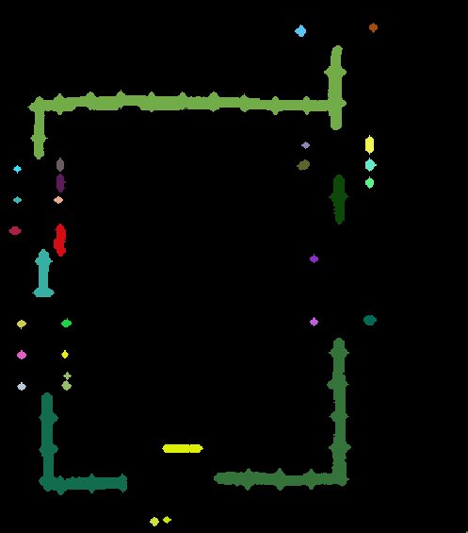
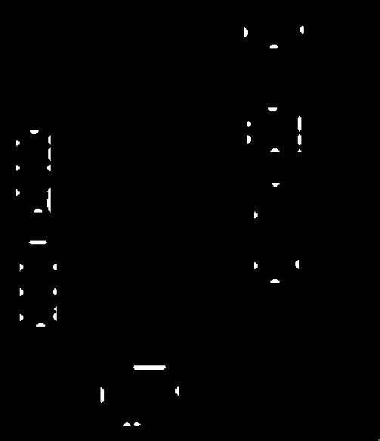
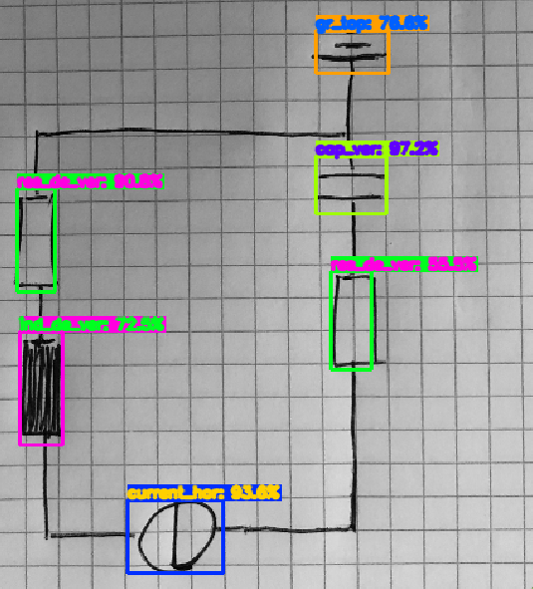
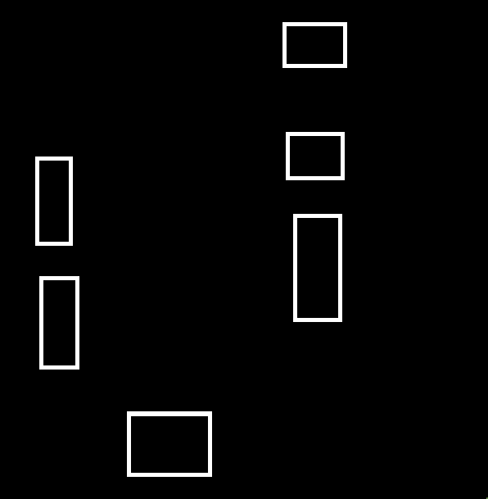
Pipeline Stage 3: Topology Creation
MUnet Segmentation Mask
Connected Components Labeling
&
Intersections
YOLO Bounding Box Predictions
Bounding Box Mask
Dmitrij Vinokour
12.08.2021

Slide 10
Pipeline: Overview
Dmitrij Vinokour
12.08.2021

Slide 11
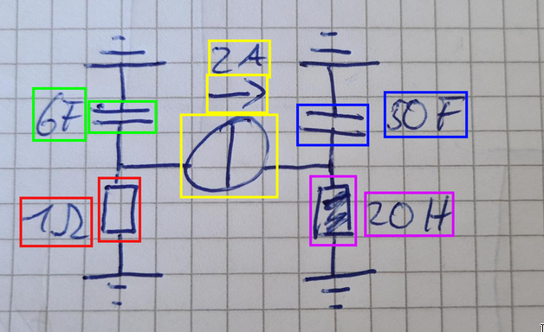
Pipeline Stage 4: Annotation Matching
- Annotation matching based on nearest neighbor
- Brute force without considering multiple matches
Matched Annotations
Dmitrij Vinokour
12.08.2021

Slide 12
Pipeline: Overview
Dmitrij Vinokour
12.08.2021

Slide 13
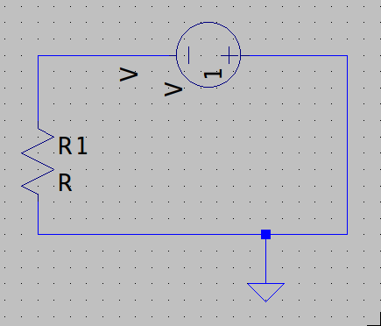
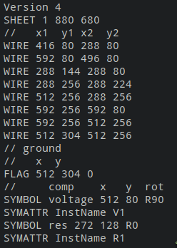
Pipeline 6: LTspice Conversion
Model in LTspice
Corresponding .asc
Dmitrij Vinokour
12.08.2021

Slide 14
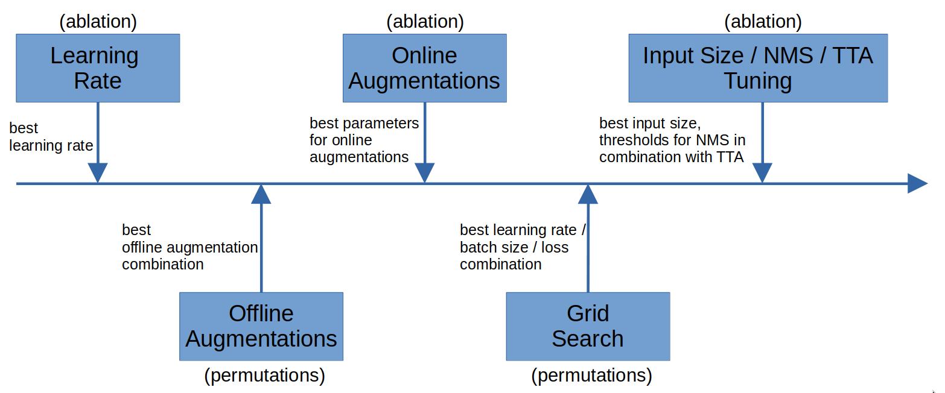
Training: YOLO
Configuration:
Batch Size: 64
Loss: CIoU
Optimizer: SGD with Momentum
Learning Rate Scheduler: 1000 batches exponential ramp-up
Input Size: 608x608x1
Metric: mAP@0.5:0.75:0.05
Dmitrij Vinokour
12.08.2021

Slide 15
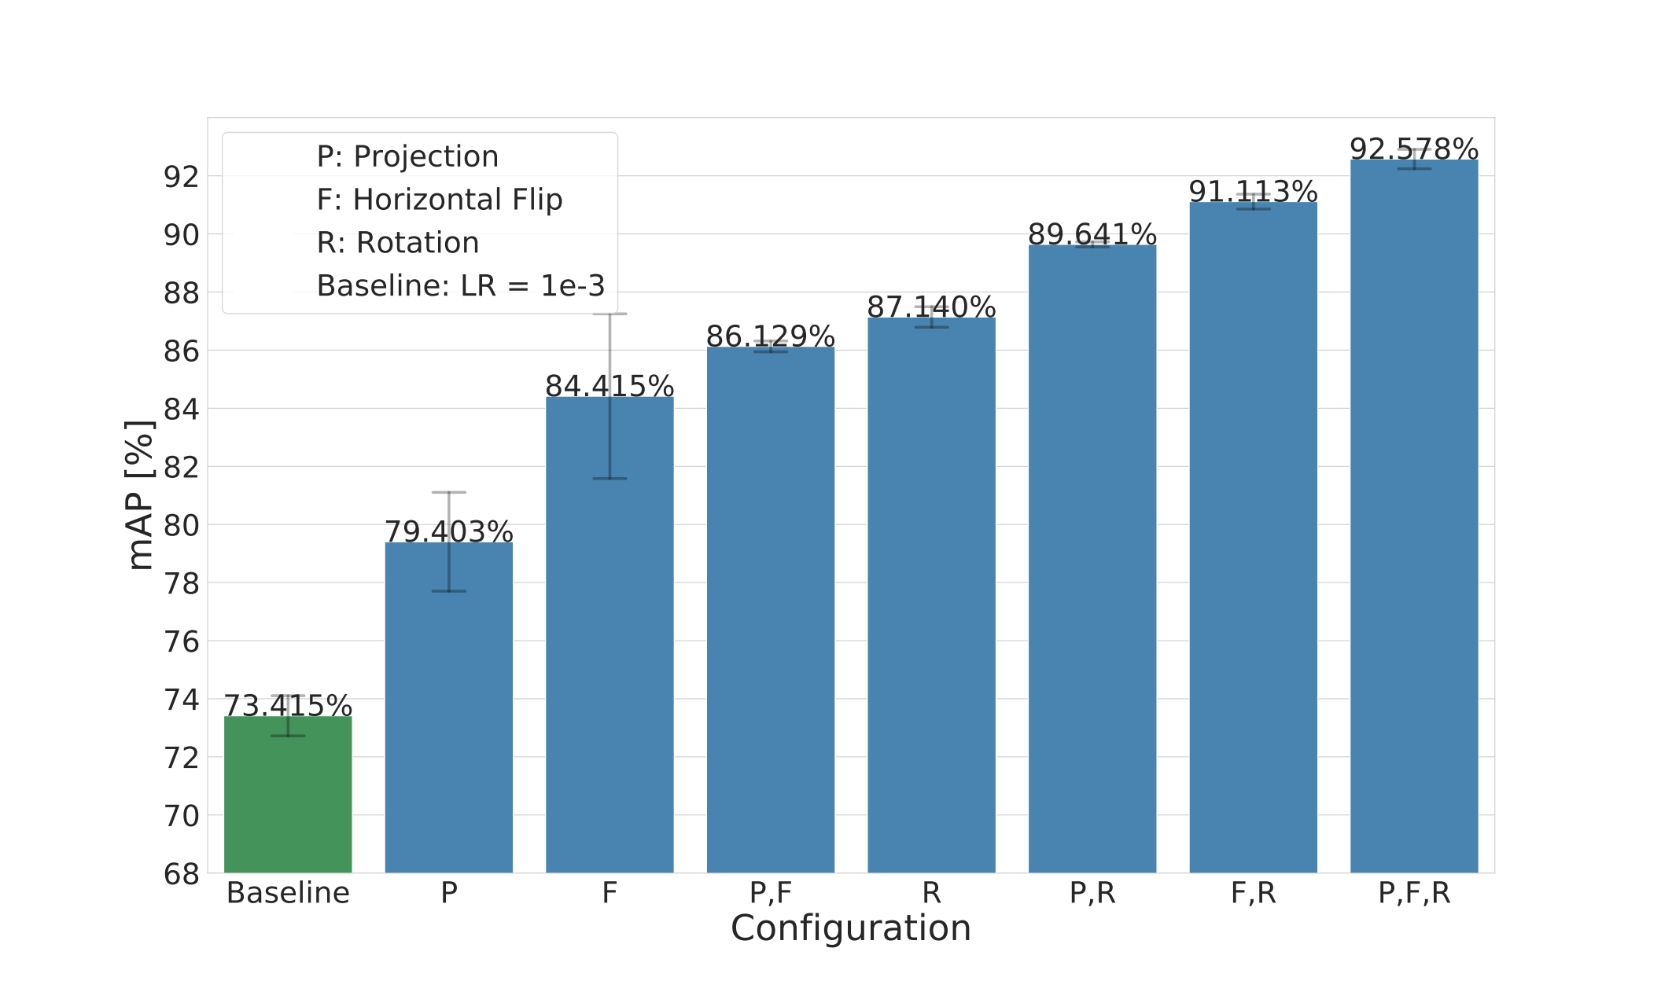
Training: YOLO Offline Augmentation
- Augmentations: Rotation 90°, Horizontal Flip, Copy-Paste Augmentation (Projection) [2]
- Rotation 3x 90°
- If flip and rotation also 3x 90° of flipped image
- Copy-Paste Augmentation 6 different backgrounds (different grid size and color)
Results of the offline augmentation experiment
[2]: G.Ghiasi et al., Simple Copy-Paste is a Strong Data Augmentation Method for Instance Segmentation. 2020.
Dmitrij Vinokour
12.08.2021

Slide 16
Training: YOLO Online Augmentation and Grid Search
Offline augmentation: 92.578%
Online augmentation configuration:
- Three parameters per augmentation
- Augmentations: rotation, scale, safe crop, color jitter
- Rotation best with: 95.368%
Grid search configuration:
Learning Rates: 1.0e-2, 5.0e-3, 2.5e-3, 1.0e-3, 5.0e-4, 2.5e-4, 1.0e-4
Batch Sizes: 32, 64
Loss: CIoU [3], EIoU [4], Focal-EIoU [4]
Results:
- Batch size of 32 consistently worse than batch size of 64
- EIoU > CIoU > Focal-EIoU (difference ~1%)
- Best combination LR 1.0e-2, BS 64, EioU with: 96.370%
[3]: Z. Zheng et al., Distance-IoU Loss: Faster and Better Learning for Bounding Box Regression. 2019.
[4]: Y. Zhang et al, Focal and Efficient IOU Loss for Accurate Bounding Box Regression, 2021.
Dmitrij Vinokour
12.08.2021

Slide 17
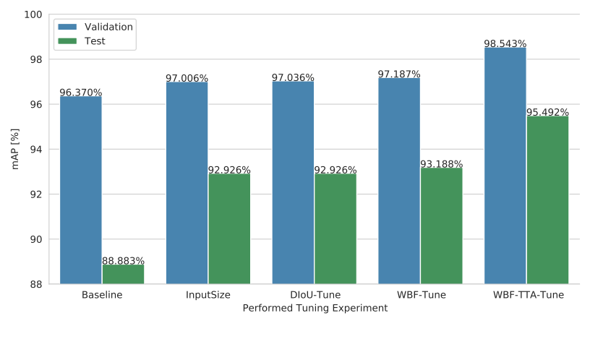
Training: YOLO Final Results with Post-Training Fine-Tuning
- Baseline: Best performing grid search parameter combination
- All tuning was done on the validation dataset
Results of the post-training fine-tuning on the validation and test set
Dmitrij Vinokour
12.08.2021

Slide 18
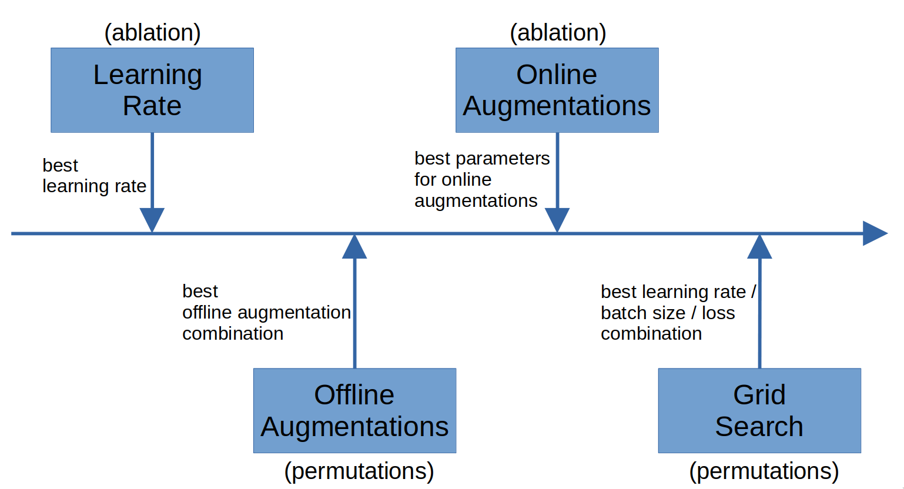
Training: MUnet
Configuration:
Batch Size: 64
Loss: Focal-Loss (α=0.8, ɣ=2.0)
Optimizer: AMSGrad
Input Size: 448x448x3 (gray scale, weights pretrained)
Metric: f1-score
Dmitrij Vinokour
12.08.2021

Slide 19
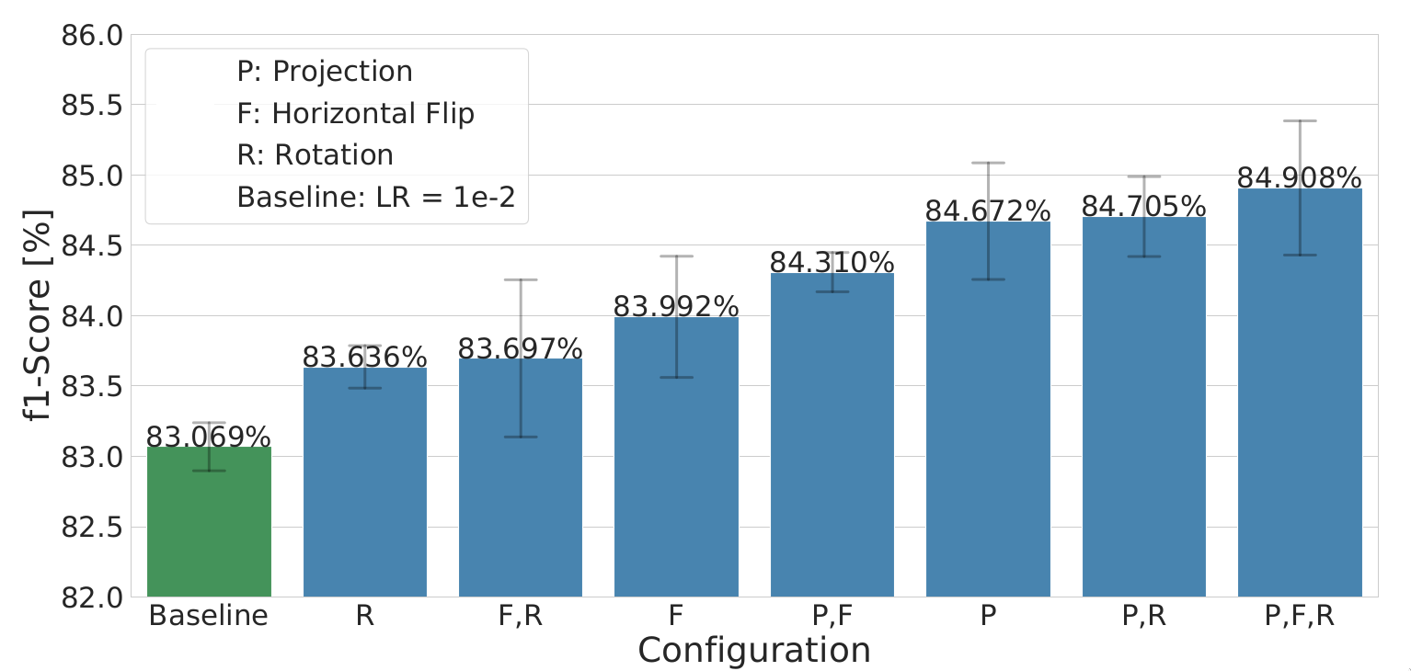
Training: MUnet Offline Augmentation
Results of the offline augmentation experiment
Dmitrij Vinokour
12.08.2021

Slide 20
Training: MUnet Online Augmentation and Grid Search
Offline augmentation: 84.908%
Online augmentation configuration:
- Three parameters per augmentation
- Augmentations: rotation, scale, crop, color jitter
- Crop best with: 85.707%
Grid search configuration:
Learning Rates: 1.0e-2, 5.0e-3, 2.5e-3, 1.0e-3, 5.0e-4, 2.5e-4, 1.0e-4
Batch Sizes: 32, 64
Loss: Dice, Focal-Loss (α=0.1, α=0.8)
Results:
- High learning rates show bad performance on test dataset
- Low learning rates with Dice loss show bad performance
Dmitrij Vinokour
12.08.2021

Slide 21
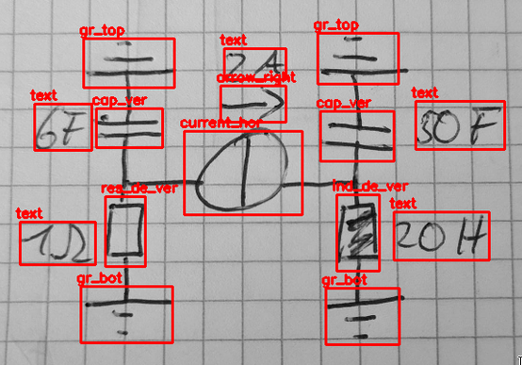
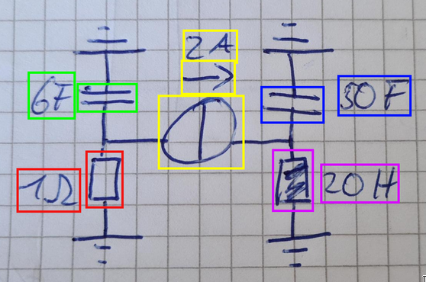
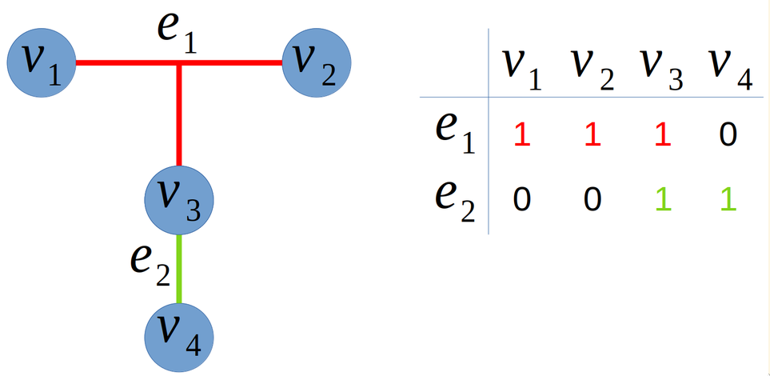
Evaluation
Classification Evaluation Matching Evaluation Topology Evaluation
Dmitrij Vinokour
12.08.2021

Slide 22
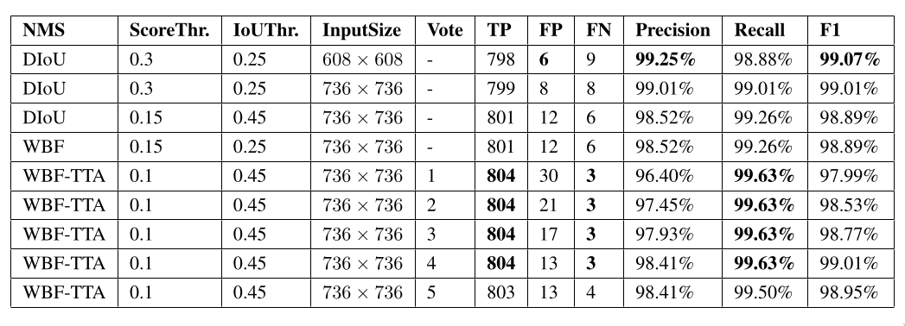
Evaluation: Classification
- Precision, recall, f1-score (0.35 IoU obtained from train and validation set as the maximum occlusion threshold)
- State-of-the-art performance in electrical circuit component recognition (prev. f1-score 94.85% [5])
Results of the classification
[5]: T. Dhanushika and L. Ranathunga, Fine-Tuned Line Connection Accompanied Boolean Expression Generation for Hand-Drawn Logic Circuits. 2019.
Dmitrij Vinokour
12.08.2021

Slide 23
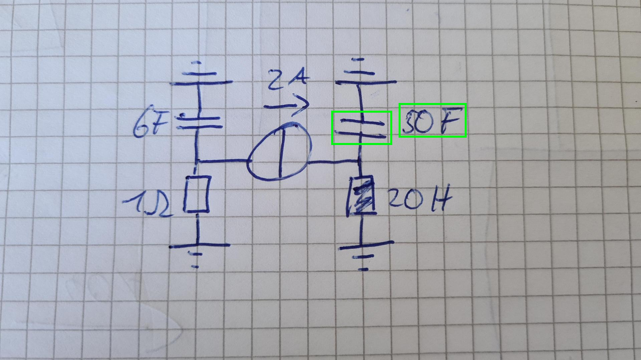
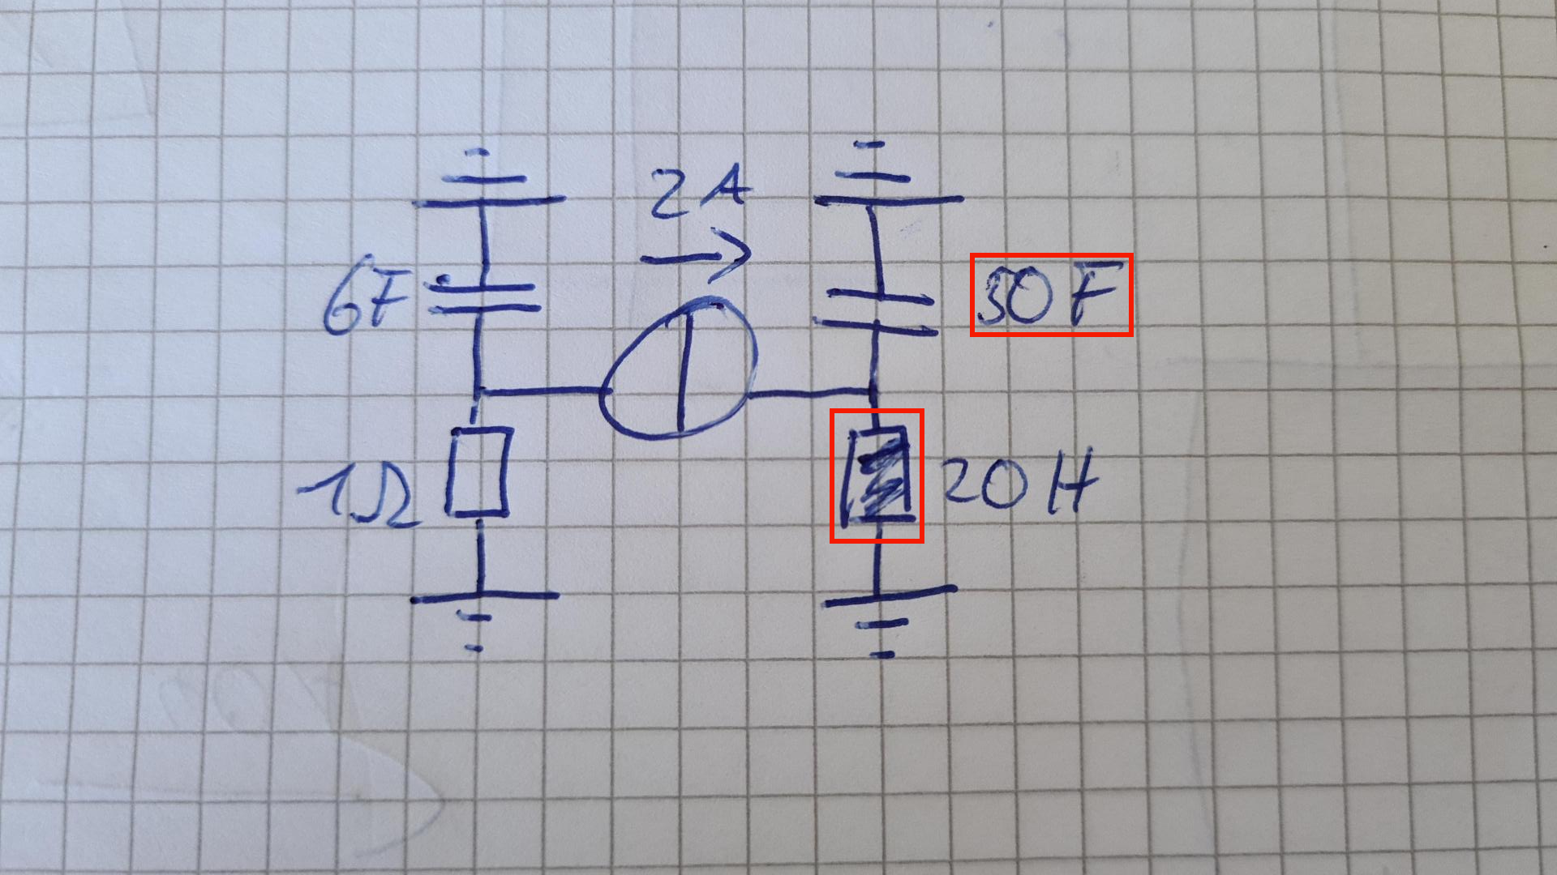
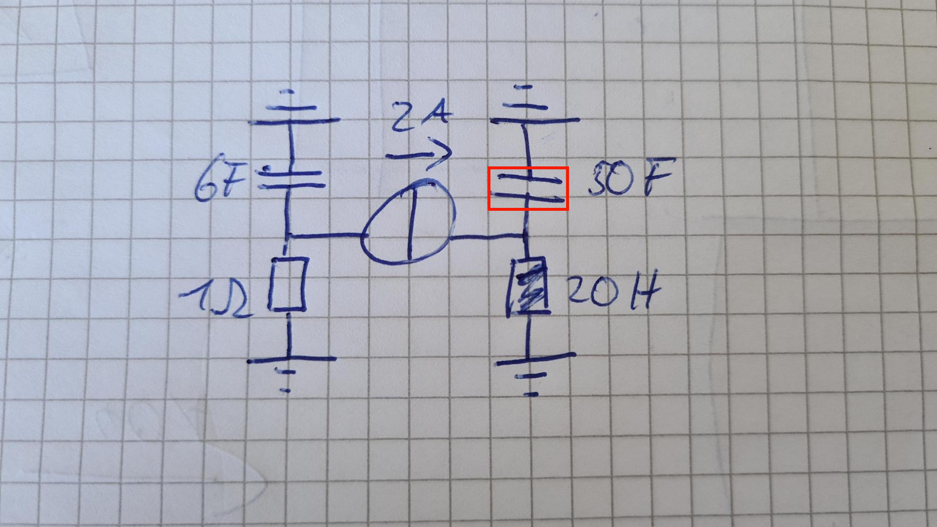
Evaluation: Annotation Matching General
- True Positive (TP): correct match
- False Positive (FP): annotation matched to wrong component
- False Negative (FN): annotation not detected, therefore no match at all (transient error from classification)
TP Case
FP Case
FN Case
Dmitrij Vinokour
12.08.2021

Slide 24
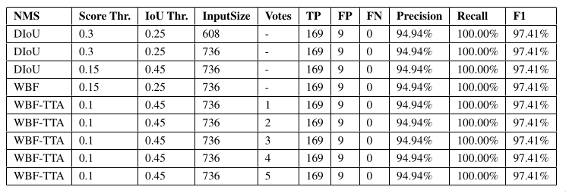
Evaluation: Textual Annotation Matching
Results of the textual annotation matching
Dmitrij Vinokour
12.08.2021

Slide 25
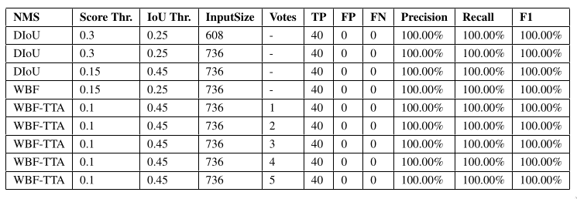
Evaluation: Arrow Annotation Matching
Results of the arrow annotation matching
Dmitrij Vinokour
12.08.2021

Slide 26
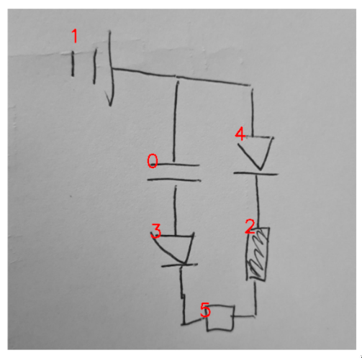
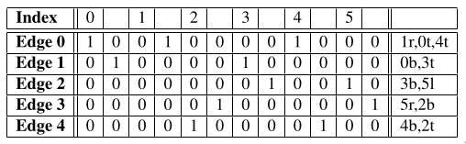
Evaluation: Topology
- Hypergraph (generalization of a graph) [6]
- Represented as an adjacency matrix [7]
- Left column = left / top
- Right column = right / bottom
Adjacency matrix of the topology of the circuit
Circuit with indeces of bounding box labels
[6]: P. Valdivia et al., Analyzing Dynamic Hypergraphs with Parallel Aggregated Ordered Hypergraph Visualization. 2021.
[7]: E. Konstantinova and V. Skorobogatov, Application of hypergraph theory in chemistry, 2001
Dmitrij Vinokour
12.08.2021

Slide 27
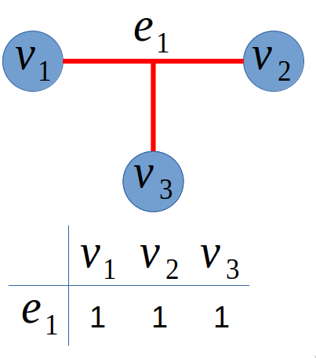
Evaluation: Topology TP Case
- “A perfect match”
- #(subedges) = #(vertices in ground truth hyperedge) – 1
Ground Truth
Prediction
Dmitrij Vinokour
12.08.2021

Slide 28
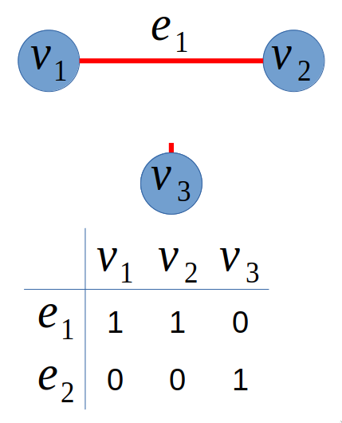
Evaluation: Topology FN Case
- “A subedge is missing”
- Perfect match can only be obtained through recombination
Ground Truth
Prediction
Dmitrij Vinokour
12.08.2021

Slide 29
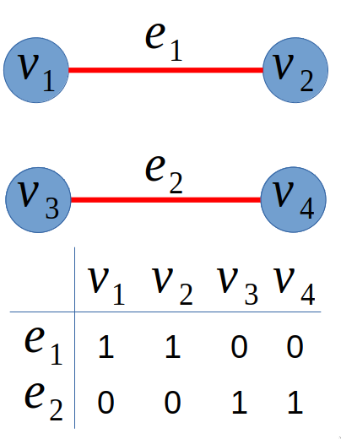
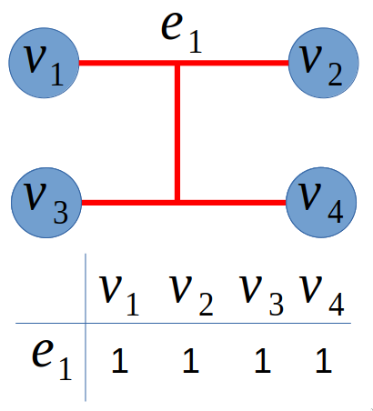
Evaluation: Topology FP Case
- “A subedge too much”
- Perfect match is obtained through splitting
Prediction
Ground Truth
Dmitrij Vinokour
12.08.2021

Slide 30
Evaluation: Topology Algorithm
Algorithm (inspired by graph edit distance [8]):
1. Find perfect matches
2. Find combination matches
3. Find split matches
4. Do until no edges left
Drawbacks:
- Mixed cases of FP, FN not handled (worsed error assumed in such cases)
- Transient errors from classification not considered
[8]: X. Chen et al., An efficient algorithm for graph edit distance computation. 2018.
Dmitrij Vinokour
12.08.2021

Slide 31
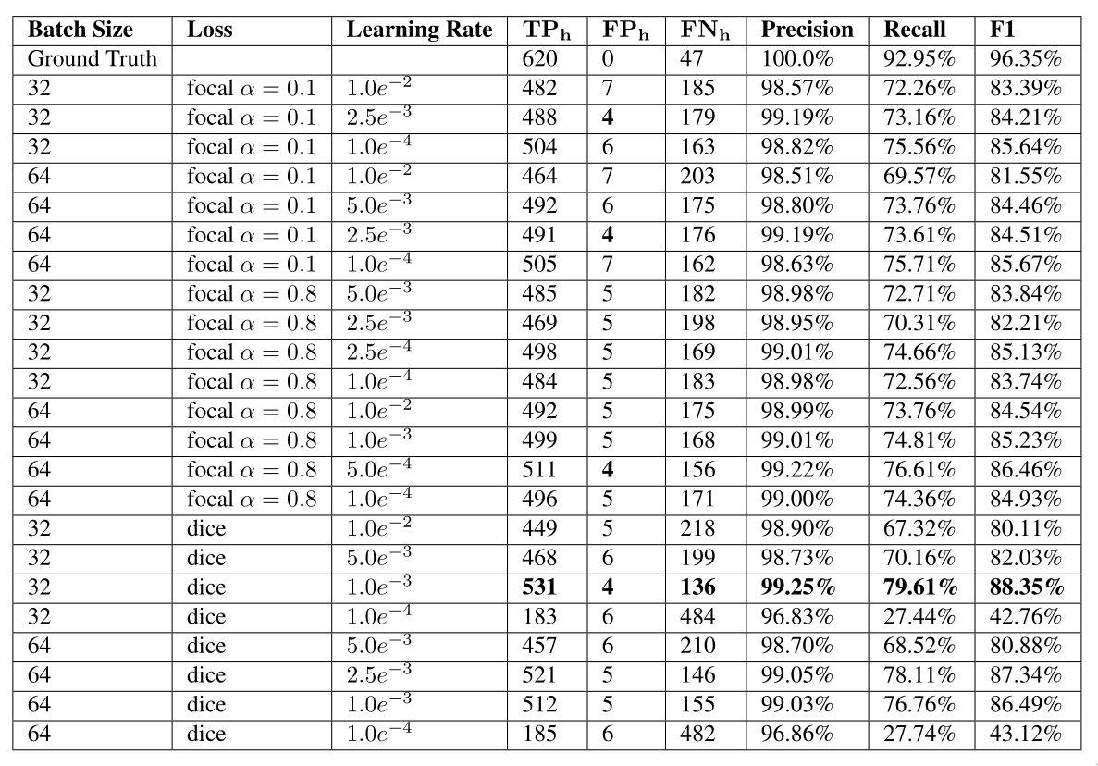
Evaluation: Topology Results
Results of the topology evaluation
Dmitrij Vinokour
12.08.2021

Slide 32
Summary & Outlook
Dataset
- Bounding Box Labels
- Segmentation Labels
- Topology Labels (only test dataset)
- Annotation Matching Labels (only test dataset)
Pipeline
- Detects components and annotations
- Operates on various paper backgrounds (has not been done so far)
- OCR (not in the scope of this thesis)
- Generate topology
- Convert into LTspice format
Evaluation
- Classification, annotation matching and topology evaluation
- Topology evaluation not fully functional
Results
- State-of-the-art performance in electrical circuit component detection / classification (YOLO)
Dmitrij Vinokour
12.08.2021

Slide 33
Questions?
Dmitrij Vinokour
12.08.2021

Slide 34
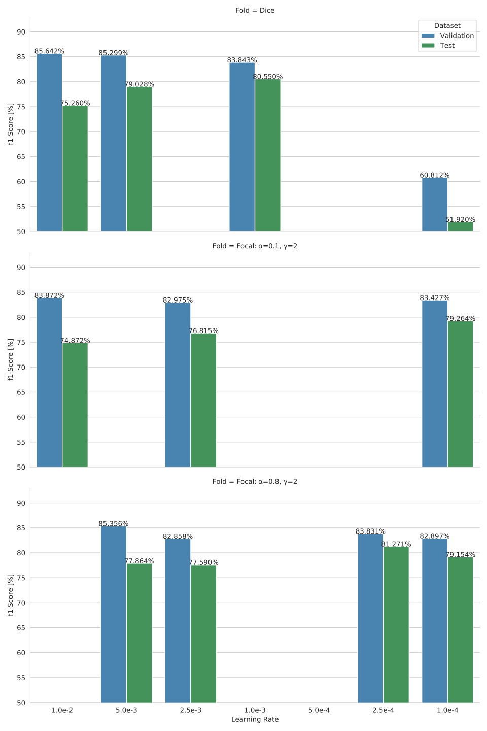
Training: MUnet Grid Search Batch Size 32
Results of the grid search with a batch size of 32 on the validation and test set
Dmitrij Vinokour
12.08.2021

Slide 35
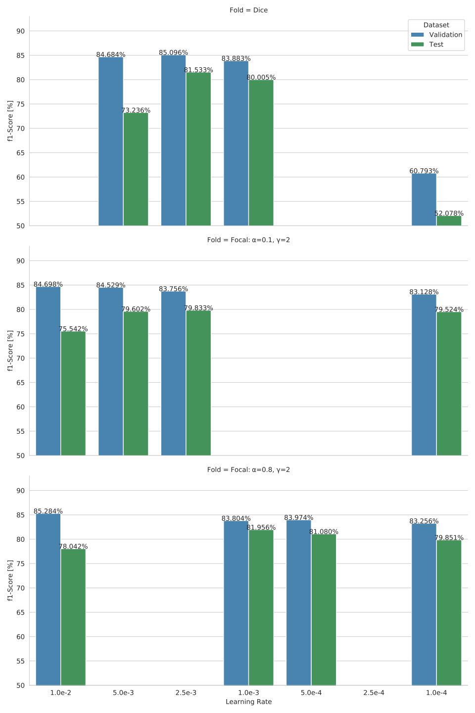
Training: MUnet Grid Search Batch Size 64
Results of the grid search with a batch size of 64 on the validation and test set
Dmitrij Vinokour
12.08.2021

Slide 36
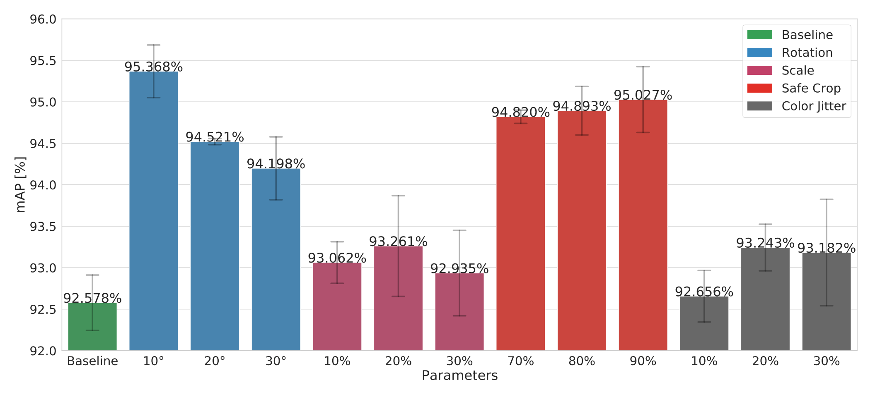
Training: YOLO Online Augmentation, Grid Search and Fine-Tuning
Results of the online augmentation experiment
Dmitrij Vinokour
12.08.2021

Slide 37
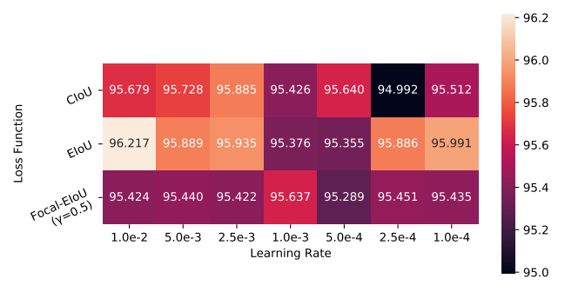
Training: YOLO Grid Search
Configuration:
Learning Rates: 1.0e-2, 5.0e-3, 2.5e-3, 1.0e-3, 5.0e-4, 2.5e-4, 1.0e-4
Batch Sizes: 32, 64
Loss: CIoU [3], EIoU [4], Focal-EIoU [4]
Results of the hyperparameter grid search experiment for batch size 64
[3]: Z. Zheng et al., Distance-IoU Loss: Faster and Better Learning for Bounding Box Regression. 2019.
[4]: Y. Zhang et al, Focal and Efficient IOU Loss for Accurate Bounding Box Regression, 2021.
Dmitrij Vinokour
12.08.2021

