Slide 1
Detection of Hand Drawn Electrical Circuit Diagrams and their Components using Deep Learning Methods and Conversion into LTspice Format
Master Thesis: Intro Talk
Dmitrij Vinokour
Supervised by Florian Thamm M. Sc, Felix Denzinger M. Sc., Prof. Dr. Andreas Maier
Pattern Recognition Lab, Friedrich-Alexander University Erlangen-Nuremberg

Slide 2
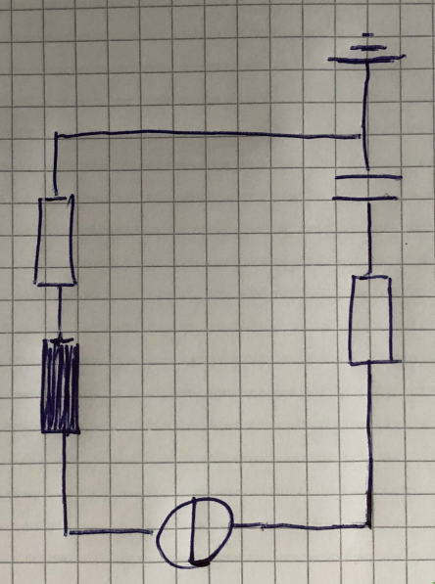
Introduction
Hand-Drawn Electrical Circuit
Dmitrij Vinokour
21.01.2020

Slide 3
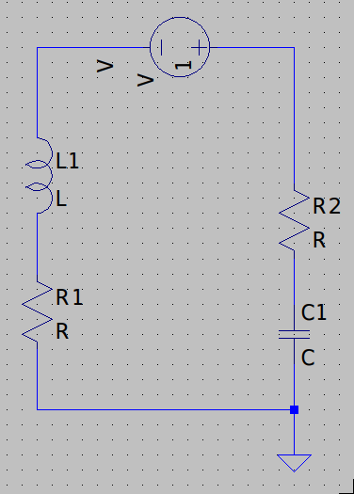
Introduction
Hand-Drawn Electrical Circuit
Model in LTspice
Dmitrij Vinokour
21.01.2020

Slide 4
Motivation
- Drawing speed of hand-drawn diagrams ~90% faster than drawing in a tool (UML, flow charts, Markov chains etc. vs. Microsoft Visio) [1]
 | Real World | LTspice World
Drawing | Fast | Slow
Calculating | Slow | Fast
[1]: Khaled S. Refaat et al., A New Approach for Context-Independent Handwritten Offline Diagram Recognition using Support Vector Machines. 2008.
Dmitrij Vinokour
21.01.2020

Slide 5
Motivation
- Drawing speed of hand-drawn diagrams ~90% faster than drawing in a tool (UML, flow charts, Markov chains etc. vs. Microsoft Visio) [1]
 | Real World | LTspice World | This Thesis
Drawing | Fast | Slow | Fast
Calculating | Slow | Fast | Fast
[1]: Khaled S. Refaat et al., A New Approach for Context-Independent Handwritten Offline Diagram Recognition using Support Vector Machines. 2008.
Dmitrij Vinokour
21.01.2020

Slide 6
Goals & Constraints
Goals:
- Create a dataset
- Detect circuit components and their annotations
- Detection should be possible on gridded paper
- Conversion into LTspice file
- Maintain appearance of the circuits after conversion to LTspice
Constraints:
- Only vertical / horizontal components are allowed
- Only subset of possible circuit components allowed
- No skip connections
Dmitrij Vinokour
21.01.2020

Slide 7
Dataset
- 20 contributors, ~120 circuits
- Bounding boxes labeled with rotation
- Semi-auto generated labels for segmentation
- Very low amount of circuits on grid paper
- For training circuit masks are projected on grid paper
Capacitor | 475
Inductor | 363
Resistor | 382
Diode | 452
Voltage | 241
Current | 247
Ground | 397
Bounding boxes per class
Dmitrij Vinokour
21.01.2020

Slide 8
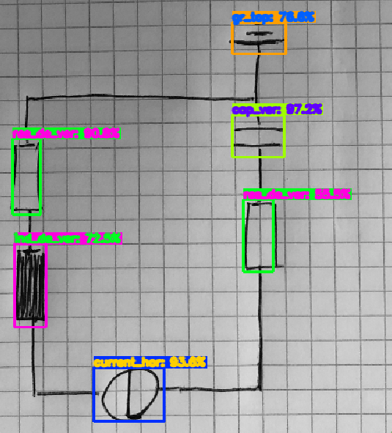
Current Pipeline
1. Detect components and annotations (tiny-YOLOV4)
Prediction with YOLO
Dmitrij Vinokour
21.01.2020

Slide 9
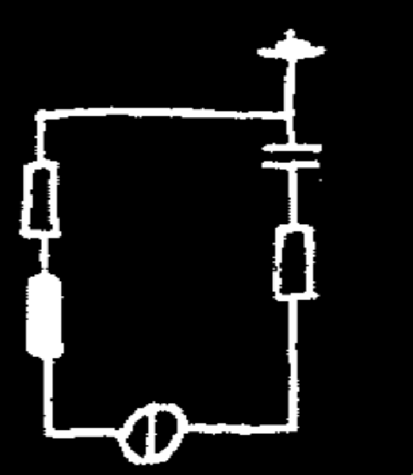
Current Pipeline
1. Detect components and annotations (tiny-YOLOV4)
2. Segment the circuit from the background (Mobile-UNet)
Prediction with Mobile-UNet
Dmitrij Vinokour
21.01.2020

Slide 10
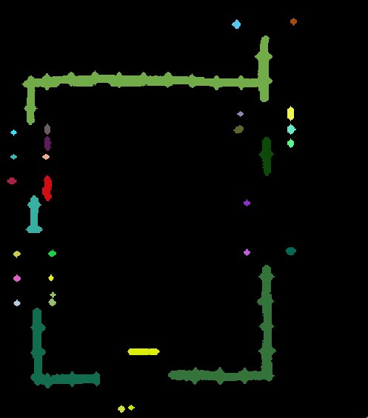
Current Pipeline
1. Detect components and annotations (tiny-YOLOV4)
2. Segment the circuit from the background (Mobile-UNet)
3. Remove bboxes and apply connected components analysis
Connected components
Dmitrij Vinokour
21.01.2020

Slide 11
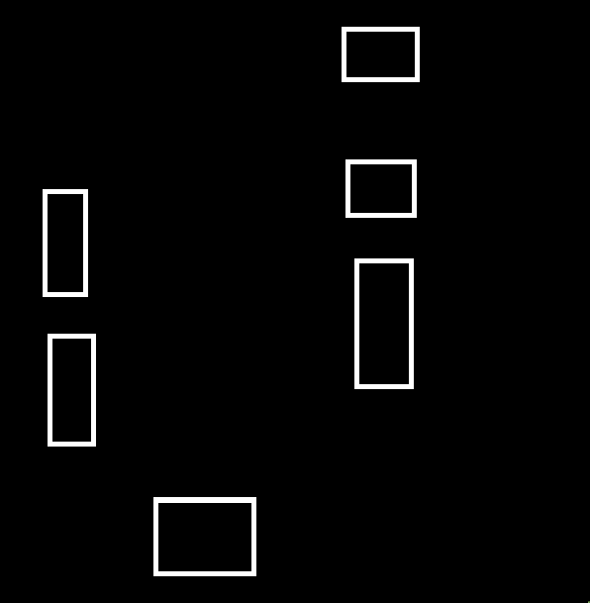

Current Pipeline
1. Detect components and annotations (tiny-YOLOV4)
2. Segment the circuit from the background (Mobile-UNet)
3. Remove bboxes and apply connected components analysis
4. Create bbox mask and find intersections with connected components
Bounding box mask
Connected components
Intersections
Dmitrij Vinokour
21.01.2020

Slide 12
Current Pipeline
1. Detect components and annotations (tiny-YOLOV4)
2. Segment the circuit from the background (Mobile-UNet)
3. Remove bboxes and apply connected components analysis
4. Create bbox mask and find intersections with connected components
5. Embed gathered data into a LTspice file
a) Map detected components and annotations to LTspice
b) Reflect wires to LTspice
Dmitrij Vinokour
21.01.2020

Slide 13
Current Pipeline
YOLO
Component and
annotation
recogtition
Postprocessor
- build topology
- map components,
annotations and
wires into LTspice
Input
Image
LTspice
File
Mobile-UNet
Circuit segmentation
Dmitrij Vinokour
21.01.2020

Slide 14
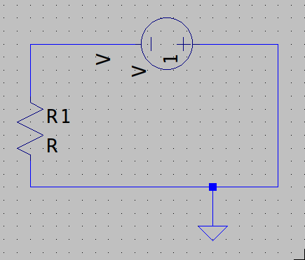
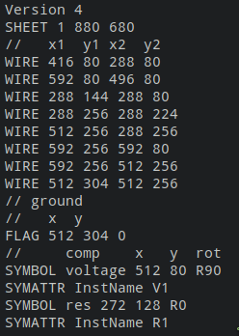
LTspice file
Model in LTspice
Corresponding .asc
Dmitrij Vinokour
21.01.2020

Slide 15
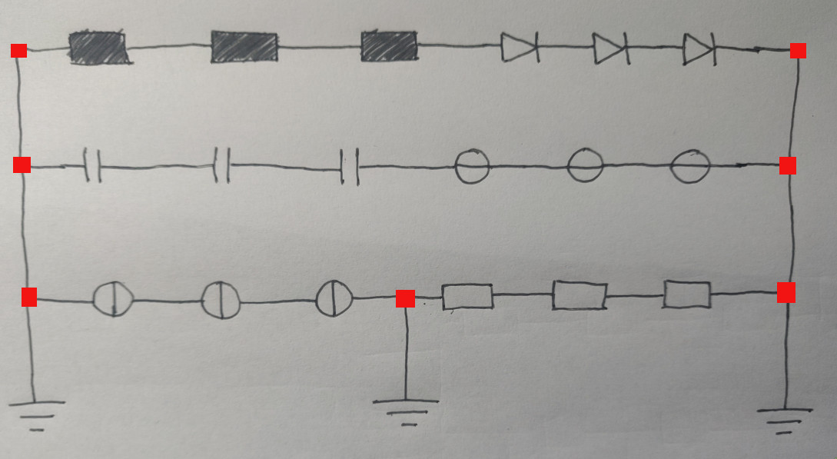
Problems
1. Reflect appearance is hard
- Component size in the real world not the same as in LTspice
- Wires have to be interpolated to be be reflectable
Idea:
- Split wire into horizontal / vertical sections
2. Assigning annotations can be ambiguous
Connections of interest (components > 2)
Dmitrij Vinokour
21.01.2020

Slide 16
Results
- Performed on validation data (22% of the dataset, 2 unseen persons)
Class | AP@0.5 | Class | AP@0.5
Diode Left | 1.0 | Ground Left | 0.93
Diode Top | 1.0 | Ground Top | 1.0
Diode Right | 1.0 | Ground Right | 1.0
Diode Bottom | 1.0 | Ground Bottom | 1.0
Resistor Horizontal | 1.0 | Inductor Horizontal | 1.0
Resistor Vertical | 1.0 | Inductor Vertical | 1.0
Capacitor Horizontal | 1.0 | Voltage Horizontal | 1.0
Capacitor Vertical | 0.97 | Voltage Vertical | 1.0
Current Horizontal | 1.0
Current Vertical | 1.0
mAP@0.5 | 0.993
mAP@0.5:0.05:0.95 | 0.636
Mean average precision (YOLO)
mIoU | 0.910
Mean IoU (Mobile-UNet)
Average precision @0.5IoU (YOLO)
Dmitrij Vinokour
21.01.2020

Slide 17
Summary & Outlook
Done:
- Dataset created
- Component detection
- Circuit segmentation
- Preprocessing to generate circuit topology
- Module to generate LTspice files
Next:
- OCR for annotations
- Replace YOLO with Mobile-UNet
- Optimize training (hyperparameters, augmentations)
- Fix the appearance after conversion
Maybe:
- Provide mobile application
- Release horizontal / vertical restriction
Dmitrij Vinokour
21.01.2020

Slide 18
Questions?
Dmitrij Vinokour
21.01.2020

