Slide 1
ToolFinder
Dense Retrieval for Open-Set MCP Tool Routing
A leakage-controlled benchmark and a trained two-model comparison
Dimitris Chatzipavlis · Machine & Deep Learning · Supervisor: Sp. Georgakopoulos · June 2026
github.com/DimiChatzipavlis/ToolFinder

Slide 2



PROBLEM
Tool selection is the bottleneck — and a safety boundary
Context bloat
Binding every MCP schema fills the window before reasoning begins.
Selection decides whether a local model can use a 500-tool catalog at all — and a wrong route to a destructive tool turns a retrieval error into a harmful action.
Lost in the middle
Similar APIs collide in-context, raising tool-selection errors.
Small models break
3B local models emit malformed calls under long-prompt pressure.
We treat tool selection as open-set retrieval: unseen phrasings, unseen tools, new servers, out-of-scope requests, and adversarial descriptions.
ToolFinder — Dense Retrieval for Open-Set MCP Tool Routing
2

Slide 3
RELATED WORK
We add evaluation rigor, not a new architecture
Tool USE / generation
Tool SELECTION (shipped)
MRKL — modular router framing
Gorilla — API-call gen + retriever
ToolLLM — 16k API tool use
Toolformer — self-supervised calls
semantic-router (Aurelio Labs)
LangChain tool retriever
LlamaIndex object retrievers
OpenAI function-retrieval cookbook
Our contribution is a leakage-controlled benchmark + a controlled comparison of what these ship as defaults — not architectural novelty.
ToolFinder — Dense Retrieval for Open-Set MCP Tool Routing
3

Slide 4
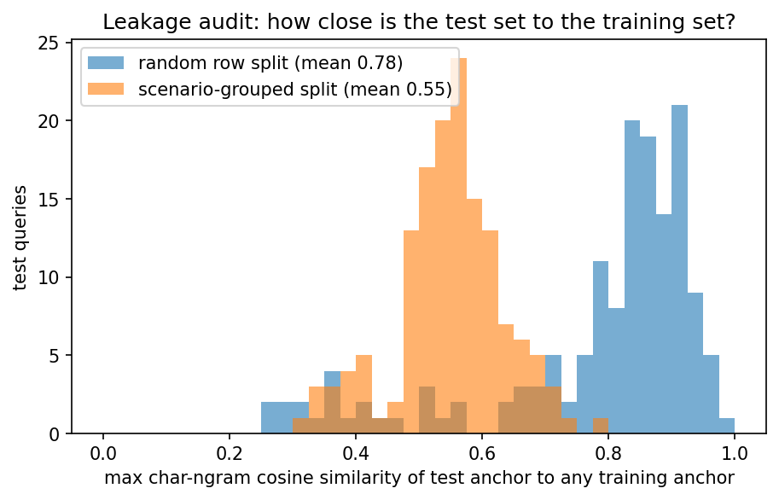
BENCHMARK
The benchmark — and why naive splits lie
1,695
real intents
574
real tool schemas
96% Recall@1
from a 1-NN lookup over training queries alone — no model, no schema.
The original random split answered itself.
Queries follow a scenario×template grammar; random row splits scatter paraphrases across train/test.
ToolFinder — Dense Retrieval for Open-Set MCP Tool Routing
4

Slide 5
METHOD
Leakage-controlled evaluation, enforced in CI
Regime 1 Unseen queries
Regime 1b Template-disjoint
Scenario-grouped split (in-grammar upper bound)
Templates AND scenarios held out — the real control
Regime 2 Unseen tools
Regime 3 Unseen servers
15 tools never trained on; ranked vs full catalog
195 queries, 574-tool corpus; training stays GitHub-only
Split hygiene is a failing CI test (tests/test_split_hygiene.py) — no scenario, template, or tool may cross buckets.
ToolFinder — Dense Retrieval for Open-Set MCP Tool Routing
5

Slide 6
DEEP LEARNING
Two trained architectures, compared
MODEL A Bi-encoder
MODEL B Cross-encoder reranker
MiniLM-L6 (22M), MNRL loss
No-duplicates batch sampler (fixes in-batch false negatives)
Encodes query + schema independently
BGE / MPNet trained as capacity ablation
ms-marco-MiniLM-L6 (22M), BCE
1 positive : 4 mined hard negatives
Joint cross-attention over (query, schema)
Reranks bi-encoder top-10 — 10 passes/query
3 seeds {13, 42, 1337} · selection on validation MRR@10 · same evaluation code path for every system.
ToolFinder — Dense Retrieval for Open-Set MCP Tool Routing
6

Slide 7
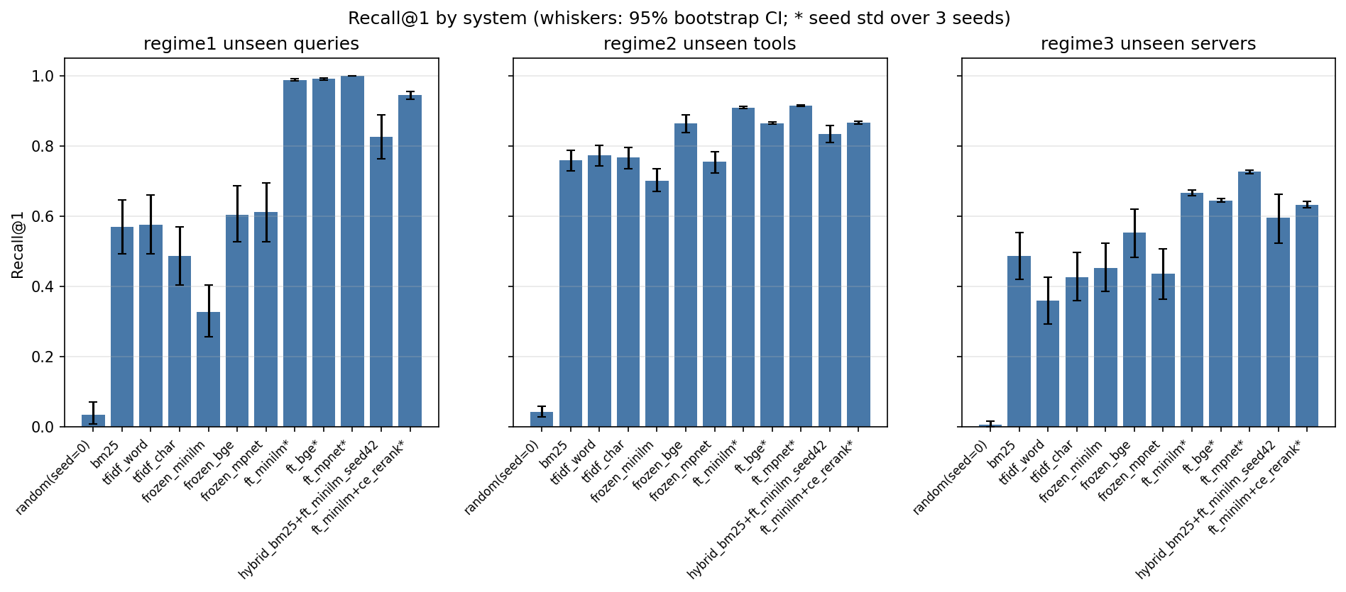
RESULTS
Fine-tuning dominates every regime
+0.42 R@1
FT MiniLM over BM25, regime 1 (p ≤ 0.0001)
0.33 → 0.99
frozen → fine-tuned MiniLM R@1 (capacity ≪ training)
0.99 / 0.91 / 0.67 R@1 across regimes 1/2/3 vs 0.57 / 0.76 / 0.49 for BM25. Frozen MiniLM (0.33) loses to BM25.
ToolFinder — Dense Retrieval for Open-Set MCP Tool Routing
7

Slide 8
THE KEY COMPARISON
Why route at all? Router Vs giving the LLM every tool
0.99 vs 0.17
retrieval router vs llama3.2 reading all tools in-context — same 30-tool test set
1.0 → 4.6 s
LLM time per query as the catalog grows 5→30 tools (router: ~0.5 ms, and flat)
Giving the model the whole catalog gets worse AND slower as it grows; retrieval stays accurate and fast — the case for separating selection from execution.
ToolFinder — Dense Retrieval for Open-Set MCP Tool Routing
8

Slide 9
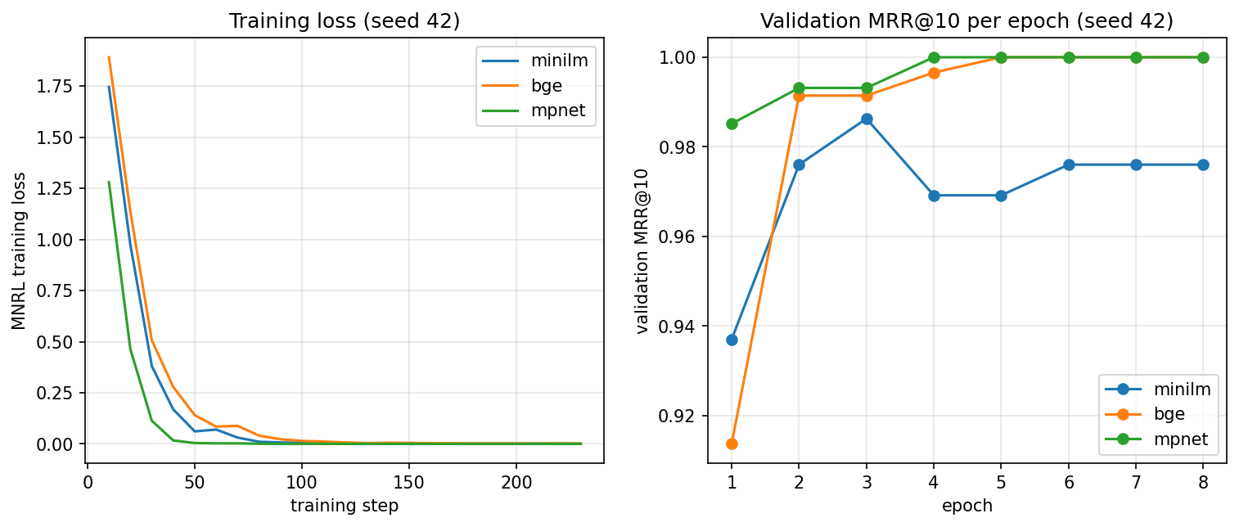
RIGOR
The result survives the leakage control
0.958 vs 0.650
FT MiniLM vs 1-NN leakage probe on the template-disjoint split
Regime 1's 1.000 was an in-grammar upper bound.
Retraining on regime 1b (templates + scenarios both unseen) still gives 0.958 — the win is real, not leaked.
Loss converges in 3–5 epochs; validation MRR tracks it — no overfitting.
ToolFinder — Dense Retrieval for Open-Set MCP Tool Routing
9

Slide 10
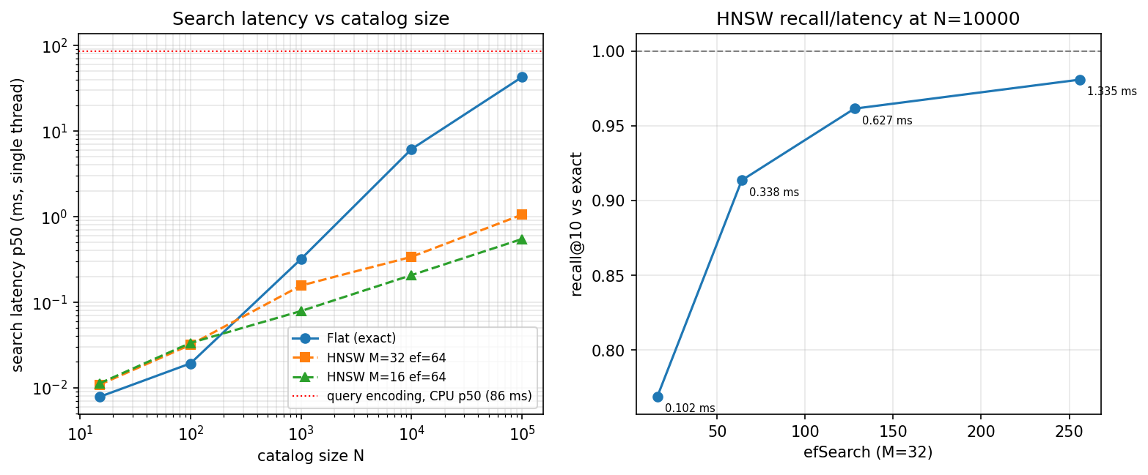
SAFETY & SYSTEMS
Rejection, robustness, and the right index
0.99 ROC-AUC
out-of-scope rejection (fine-tuned encoder)
0% vs 83%
poisoning hijack: fine-tuned vs BM25 (fine-tuning is the defense)
Query encoding (~86 ms CPU) dominates routing latency, so exact Flat is the right default; HNSW only cuts search time beyond ~10³ tools, at a recall cost.
ToolFinder — Dense Retrieval for Open-Set MCP Tool Routing
10

Slide 11
HONEST FINDINGS
What did not work — reported, not hidden
Reranking hurts
Model B degrades Model A (0.944 vs 0.988) at ~140× the per-query cost — a stronger retriever + weaker reranker.
Default ≠ best
The shipped router loads a zero-shot encoder; the fine-tuned weights that win are regenerable but not committed.
Synthetic data
All queries follow a known grammar; no production traffic, single domain — disclosed as the data's ceiling.
Reranking (B) sits below the bi-encoder (A) in every regime.
ToolFinder — Dense Retrieval for Open-Set MCP Tool Routing
11

Slide 12
Conclusions
A small fine-tuned bi-encoder solves MCP tool selection — and is itself the best poisoning defense and OOD rejector.
Fine-tuning, not model size, is the lever: 22M beats a frozen 109M encoder.
Negative results reported: reranking does not help at this scale; exact search beats HNSW at realistic sizes.
Fully reproducible — pinned seeds, CI-enforced split hygiene, run_all.py.
Limitations: synthetic queries (known grammar), single training domain.
github.com/DimiChatzipavlis/ToolFinder

