Slide 1
Monitoring .Net Distributed Systems

Slide 2
About me
Senior Software Engineer in SmartIT
DevOps is second nature
Background: finance and sports betting solutions
Last years mostly fintech projects

Slide 3
The Big Picture

Slide 4
What is monitoring?
Monitoring is the tools and processes by which you measure and manage your IT systems

Slide 5
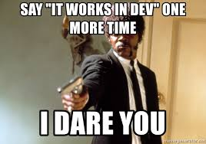
Maybe sound familiar?
Software is never perfect
Things change
“It’s slow” scenario
Symptoms everywhere, root cause nowhere
“Ain’t My Problem” syndrome
“Works fine on my machine”

Slide 6
Why do we need monitoring?
Identifying problem before it happens
When you measure, you know what exactly to improve
Management decisions
Dashboards are cool

Slide 7
Transition from this...

Slide 8
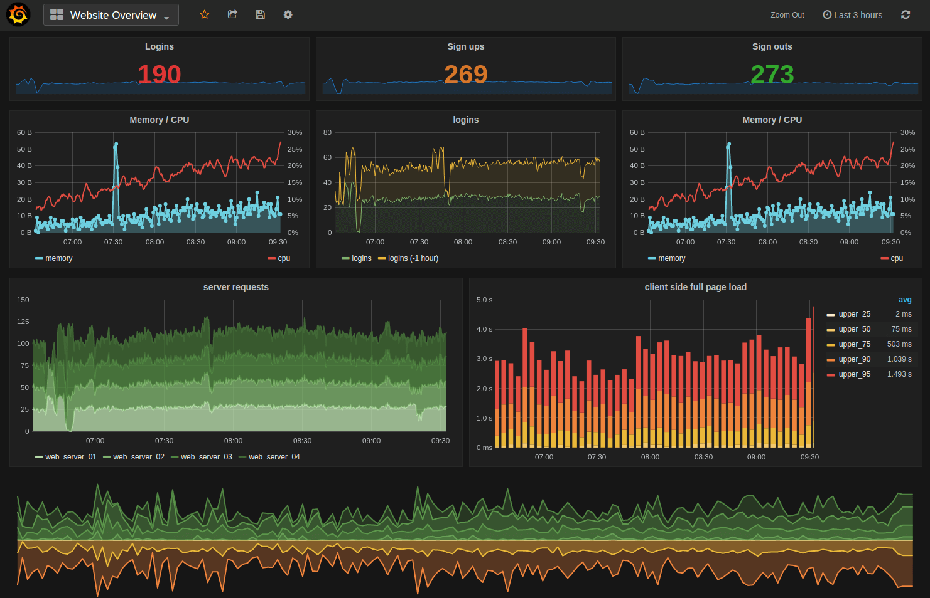
To something like that

Slide 9
Monitoring .Net Applications

Slide 10
Performance counters
Deeply integrated in asp.net ecosystem
Nonintuitive interface
Not centralized

Slide 11

The new cool kid in the neighborhood
Alternatives:
Metrics.NET
https://www.app-metrics.io/

Slide 12
What are metrics?
Metrics are measures of properties in pieces of software or hardware. To make
a metric useful we keep track of its state, generally recording data points or ob-
servations over time.

Slide 13
What are metrics?
Just numbers
Time series based
Aggregation
Metrics and logs are not the same thing

Slide 14
What to measure?
Resource Utilization
Timings
Throughput
Number of Events
And everything you need...

Slide 15
Types of metrics
Counter
Gauge
Timer
Meter

Slide 16
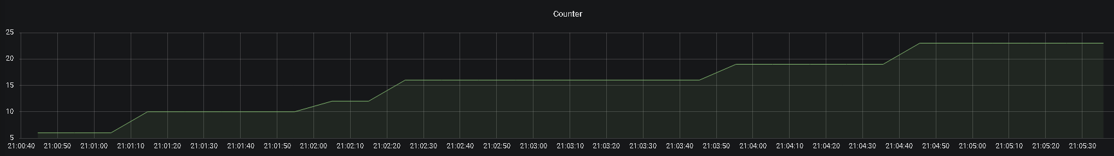
Counter
Counters are one of the simplest metrics types and allow us to track how many times something has happened
Increases/Decreases
e.g. active sessions, errors

Slide 17
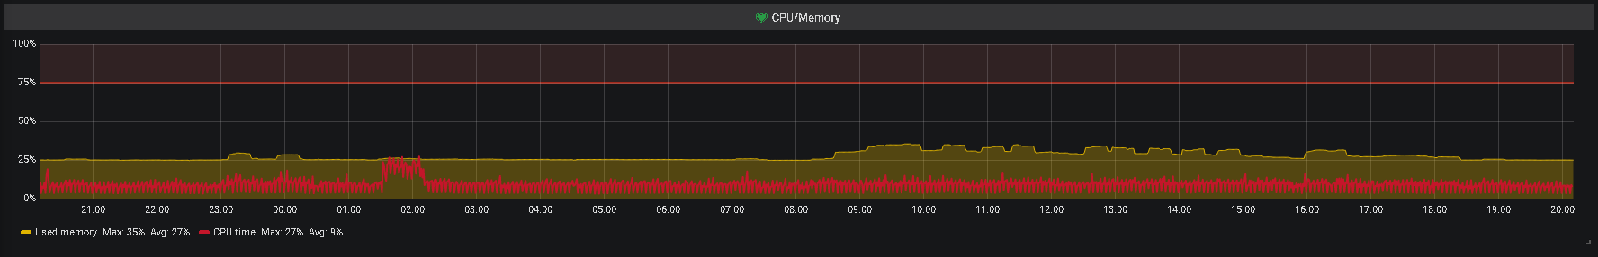
Gauge
Used to measure the instantaneous value of something.
e.g. CPU, memory usage

Slide 18
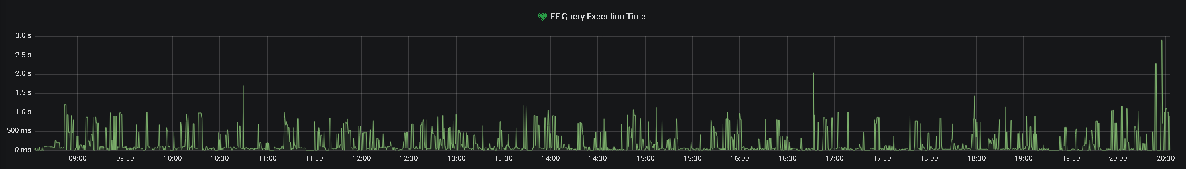
Timers
Allows duration measurement for specific event type

Slide 19
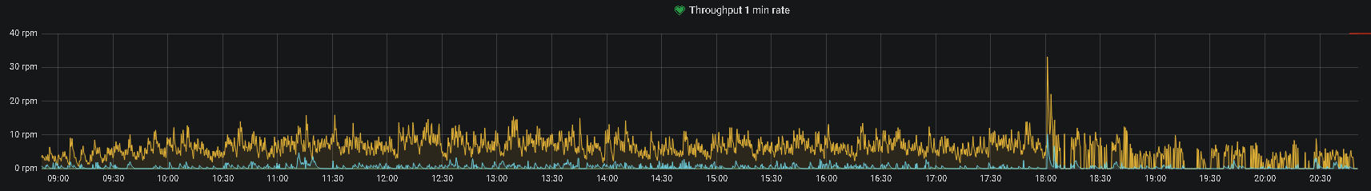
Meter
Measures the rate at which an event occurs along with a total count of the occurances(e.g. mean, 1 min, 5 min, 15 min)

Slide 20
Technologies

Slide 21





Technologies:
Storage:
Visualization:

Slide 22
Demo
https://github.com/a-vandov/MetricsDemo

Slide 23
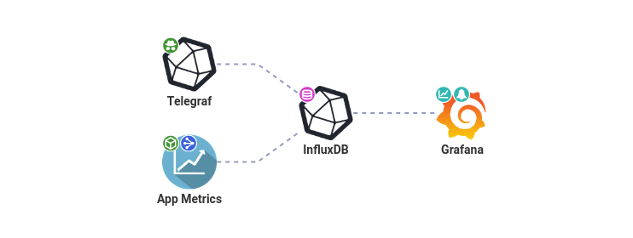
Setup
Source:
https://openapm.io/

Slide 24
Thank you!
Contacts:
angel@vandov.net
Next Event:
GraphQL – The future of Web Services or just another hype?

