Slide 1
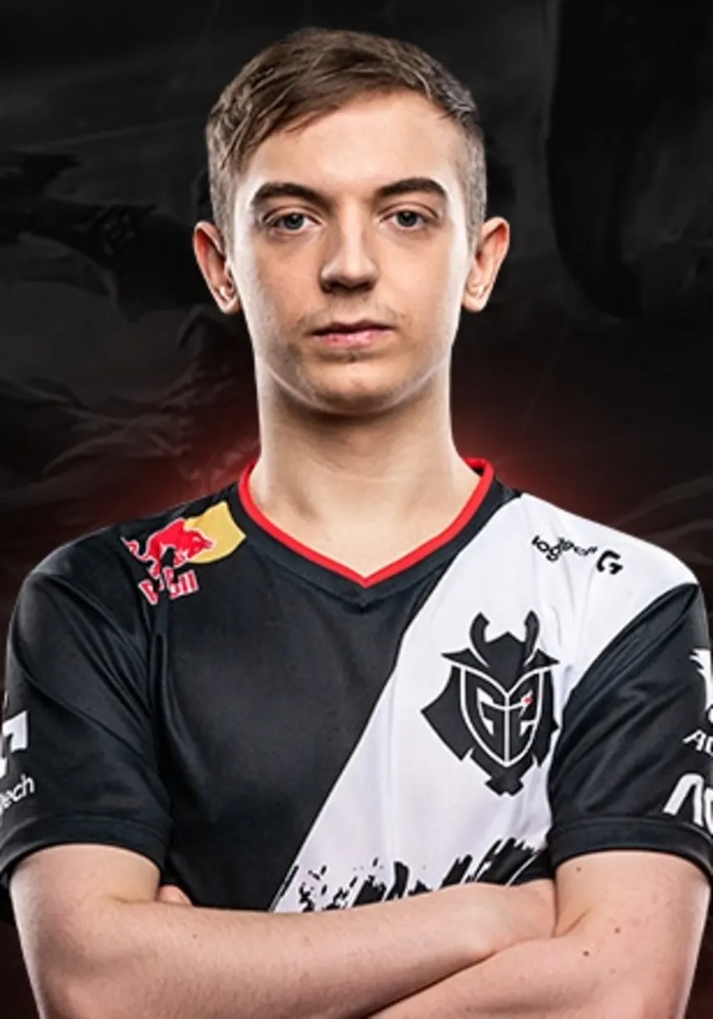
About: Rasmus is a professional gamer who is passionate about winning in some big competitions that are hosted by big E-sports brands. He has over 10 year of experience of playing games competitively and won almost 20 huge titles. He has a natural talent for desktop game specifically.
Rasmus Borregaard
Professional league of legends player

Slide 2
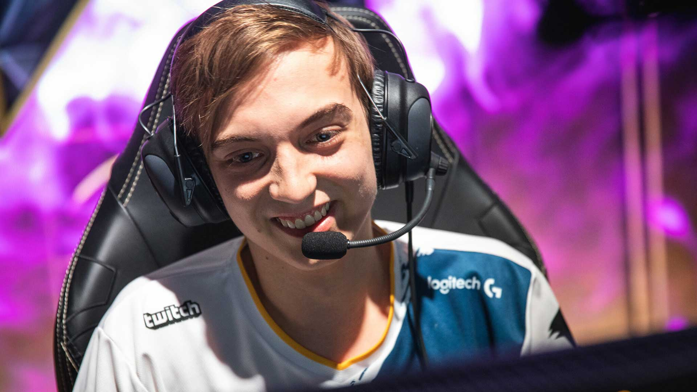
Competitions are all over the place and there isn't a website that has all the info
There are multiple ways to call/message in a game and its hard to keep track of who's on which channel.
Pain Points
PC-games
Console Game
Board Games
Get notified of the local/global competitions for his favorite games(which are league of legends and Apex)
Find local/online friends who plays league of legends and Apex so that he could play with them whenever they are free.
Preferences Games
Goals
Always look for friends who are online before starting any game
Usually participate in at least 5 online/offline competitions each month
Very sensitive to time waste because he dosent want anyone to beat his current score
Known Habits

