Slide 1
Leet project
Valeri Ivanov, Maxim Marinov.

Slide 2


OUR TEAM
Valeri Ivanov
Maxim Marinov
HTML/CSS DEVELOPER
HTML/CSS DEVELOPER
Atanas Pozharliev
Mentor

Slide 3
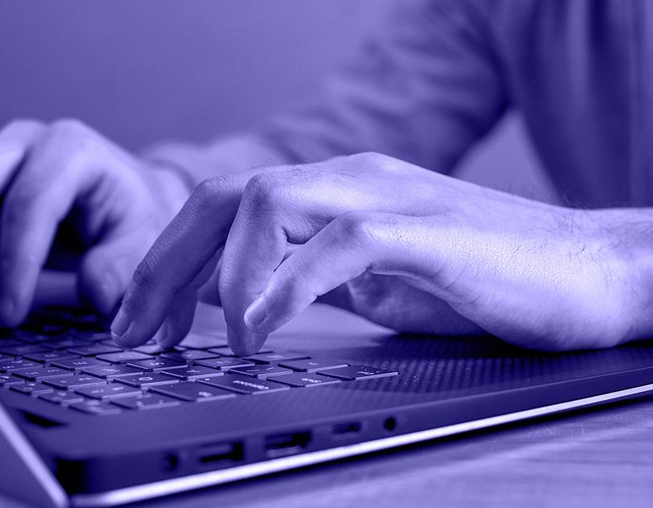
IDEA
Our website presents information about the environment and how we can protect in in a suitable way for our readers.

Slide 4
PROCESS
Step 1
Step 2
Step 3
Step 4
Step 5
Step 6
Imaginating the project
Starting the project
Designing the project
Middle phase of the project
Finalizing the project
Ending the project

Slide 5





Things we used

Slide 6
Let’s continue with the site!

