Slide 1
Recursive Algorithms and Data Structures: A Functional Perspective
Dr-Ing. Alexander Alexandrov
VMWare Talent Boost 2020

Slide 2
Outline
FP vs OOP
In general
From the perspective of data structures and algorithms
Benefits
Immutable Data structures
Examples: List
Generalization: ADTs, recursively defined data structures
Algorithms (computations) on ADTs
Examples: length of a list, sum of a list, depth of a tree,
Generalization: structural recursion (folds)
Application:
ADTs as abstract (or concrete) syntax for domain-specific languages (DSLs)
Example DSLs: arithmetic expressions
Fold instances as interpretations (semantics) of DSL terms
Example interpretations: calculator, infrastructure analysis
Relationship to mathematical logic
Structural induction

Slide 3
FP vs OOP

Slide 4
FP vs OOP Duality
The OOP side of the coin
Classes and Objects
Methods acting on mutable state
Focus on things that ARE something
Good for informal models (e.g., UML)
The FP side of the coin
Types and Values
Functions acting on immutable data
Focus on actions that DO something
Good for formal models (e.g., the theory presented in the next slides)

Slide 5
Algebraic Data Types

Slide 6
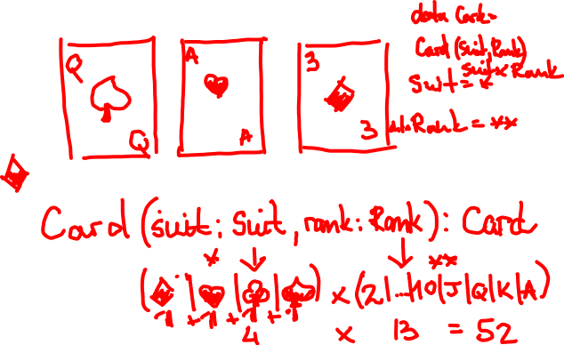
Example: Playing Cards
A combination of four suits and thirteen ranks.

Slide 7
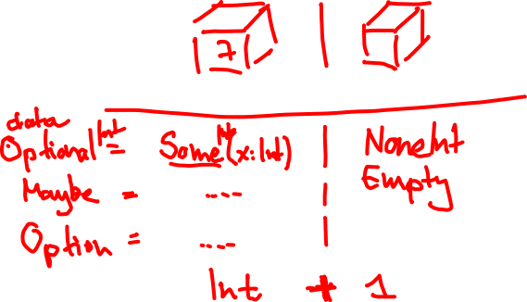
Example: An Optional Integer
A container of an optional Integer value.

Slide 8
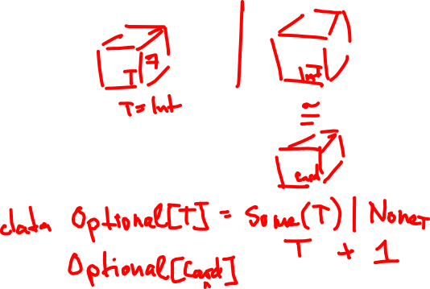
Example: An Optional value of type T
A container of an optional value of an aribrary type T.
Notes:
Like a box for a music instrument

Slide 9
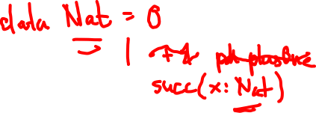
Example: Natural Numbers
As you learned them in the first weeks of primary school.

Slide 10
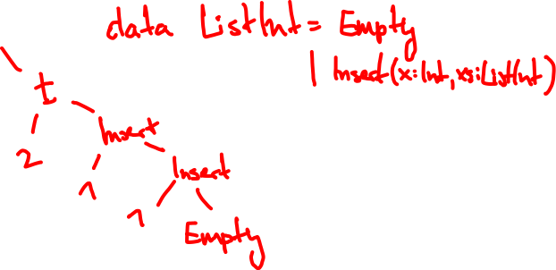
Example: A List of Integers
A (recursive) container of integers.

Slide 11
Coding Time
Implement the ADT encoding for ListInt.

Slide 12
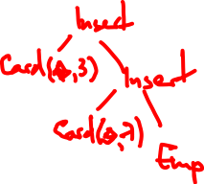
Example: A List of values of type T
A (recursive) container of values of type T.

Slide 13
Coding Time
Implement the ADT encoding for List[T].

Slide 14
Genralization: ADTs
Intuition: inductively defined sets. Notation: polynomials over types.
Option[T]
None | Some(x: T)
1 + T
List[T]
Empty | Insert(x: T, xs: List[T])
1 + T × List[T]

Slide 15
Structural Recursion
Folding ADTs

Slide 16
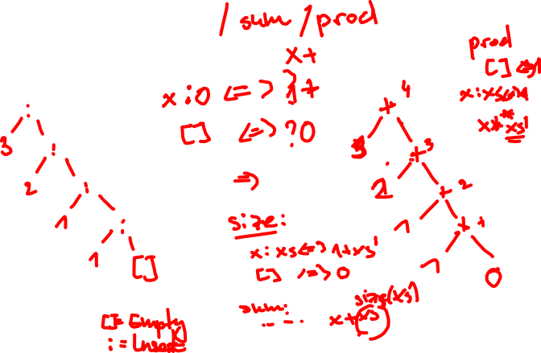
ListInt Example: size

Slide 17
Coding Time
Implement the ListIntOps size method.

Slide 18
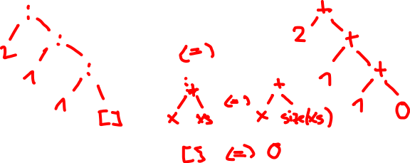
ListInt Example: sum

Slide 19
Coding Time
Implement the ListIntOps sum and prod methods.

Slide 20
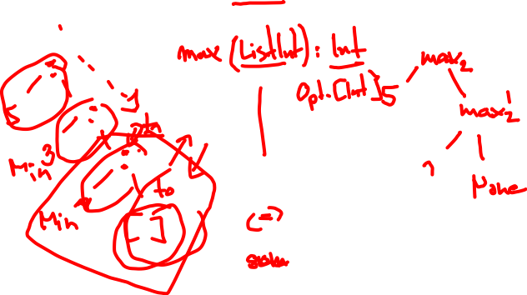
ListInt Example: min / max

Slide 21
Coding Time
Implement the ListIntOps min and max methods.

Slide 22
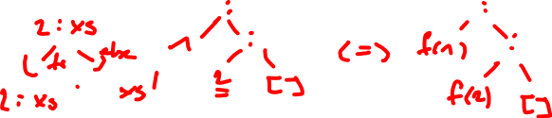
Genralization: Structural Recursion
Intuition: abstracting the general recursion scheme as a first-order function.
Actions in the concrete steps are parameterized by a collection of functions (a so-called ADT algebra).
Algebra construction is schematic if you know the ADT polynomial!

Slide 23
Coding Time
Implement the Algebra and Fold#apply for IntList and Int[T].
Reimplement ListIntOps and LitInt in terms of folds with suitable Algebra instances.

Slide 24
Application: Domain-Specific Languages
ADT ↔ Syntax Folds ↔ Semantics (interpretations)

Slide 25
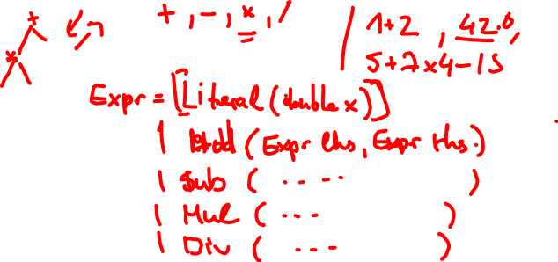
Example: Arithmetic Expressions Syntax
Idea: give an inductive definition (i.e., an ADT) of the language.

Slide 26
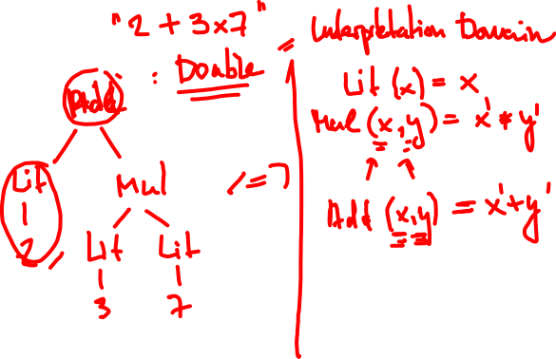
Example: Arithmetic Expressions Semantics
Idea: use structural recursion (i.e., a fold) to interpret the language.

Slide 27
Coding Time
Implement the Algebra and Fold#apply for Expr.
Reimplement ExprOps in terms of folds with suitable Algebra instances.

Slide 28
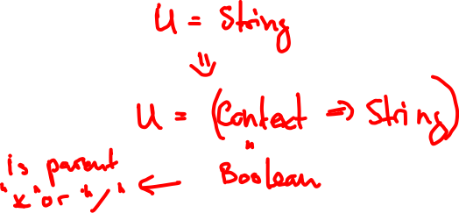
Make Interpreters Compositional Again!
Motivating problem: handling parentheses in ExprOps#prettyPrint.
Idea: “explicating” the context-sensitive part as a function parameter turns a context-sensitive interpreter into a compositional one.

Slide 29
Coding Time
Implement the Algebra and Fold#apply for Expr.
Reimplement ExprOps in terms of folds with suitable Algebra instances.

Slide 30
Closing Remarks
The deas presented here are not tied to a specific programming language.
Other schematic structural recursion schemes are available.
Rich theory for program manipulation (fusion) of folds.
Hopefully this inspires you to learn more and play with your own DSLs ;)
Different embedding schemes for the language frontend are available, but this is a topic fo another conversation!

Slide 31
Reading List
Wikipedia
ADTs
Algebraic Data Type
Recursive Data Type
Initial algebra
Structural recursion
Structural induction
Catamorphism
Papers
A tutorial on the universality and expressiveness of fold
Functional Programming with Bananas, Lenses, Envelopes and Barbed Wire
Related topics
Functors, Applicatives, And Monads In Pictures (Paper)
Folding Domain-Specific Languages: Deep and Shallow Embeddings - Jeremy Gibbons (Video)
Uniting Church and State: FP and OO Together by Noel Welsh (Video)

