Slide 1


Knowledge Engine

Slide 2
Features
Randomly generated math questions
Makes learning math easier
Compares your test scores against others

Slide 3
Our goals
The Goal of this project is to make math easier to understand. The app we have created has information that the users can use to learn the material they struggle with or simply practice. After that they can open one of our tests and practice the things they’ve learned from the info our team has provided. After completion the users can see their score and how far they have come.

Slide 4
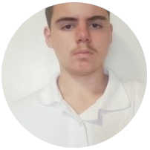
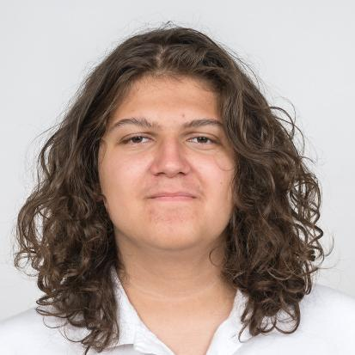
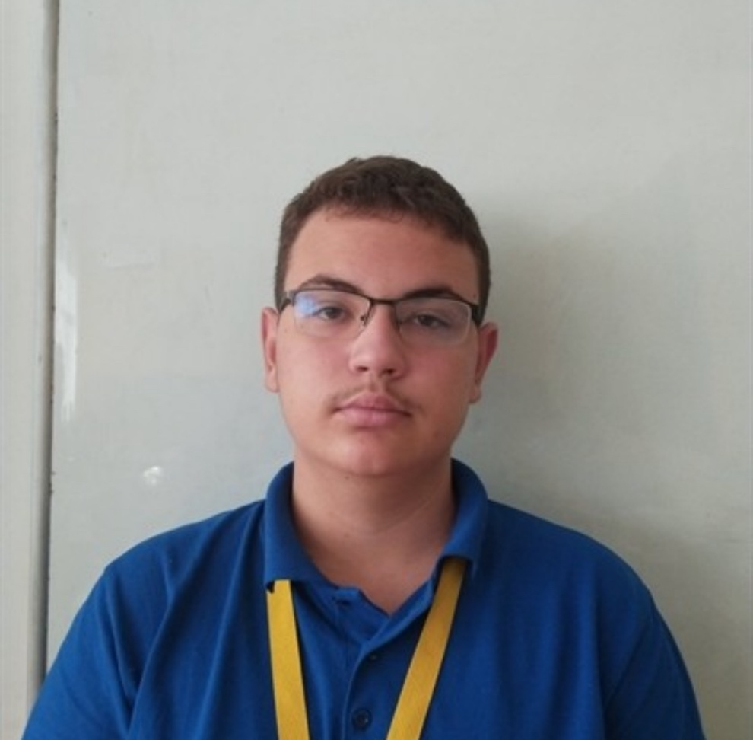
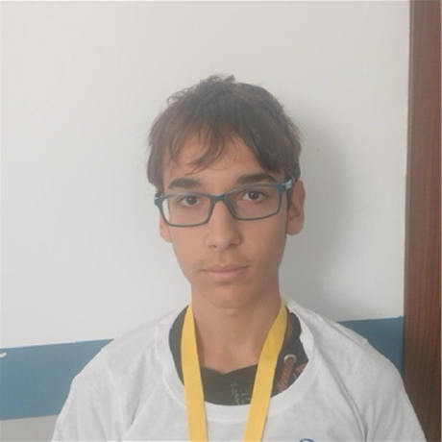

Our team
Martin Atanasov Jelev
Dimitar Plamenov
Nyagalov
Georgi Ivaylov Nikolov
Ivan Ivanov Trifonov
SCRUM TRAINER
Designer
BACK-END DEVELOPER

Slide 5







Technologies used

Slide 6
LET’S CONTINUE WITH THE APP!

