Slide 1
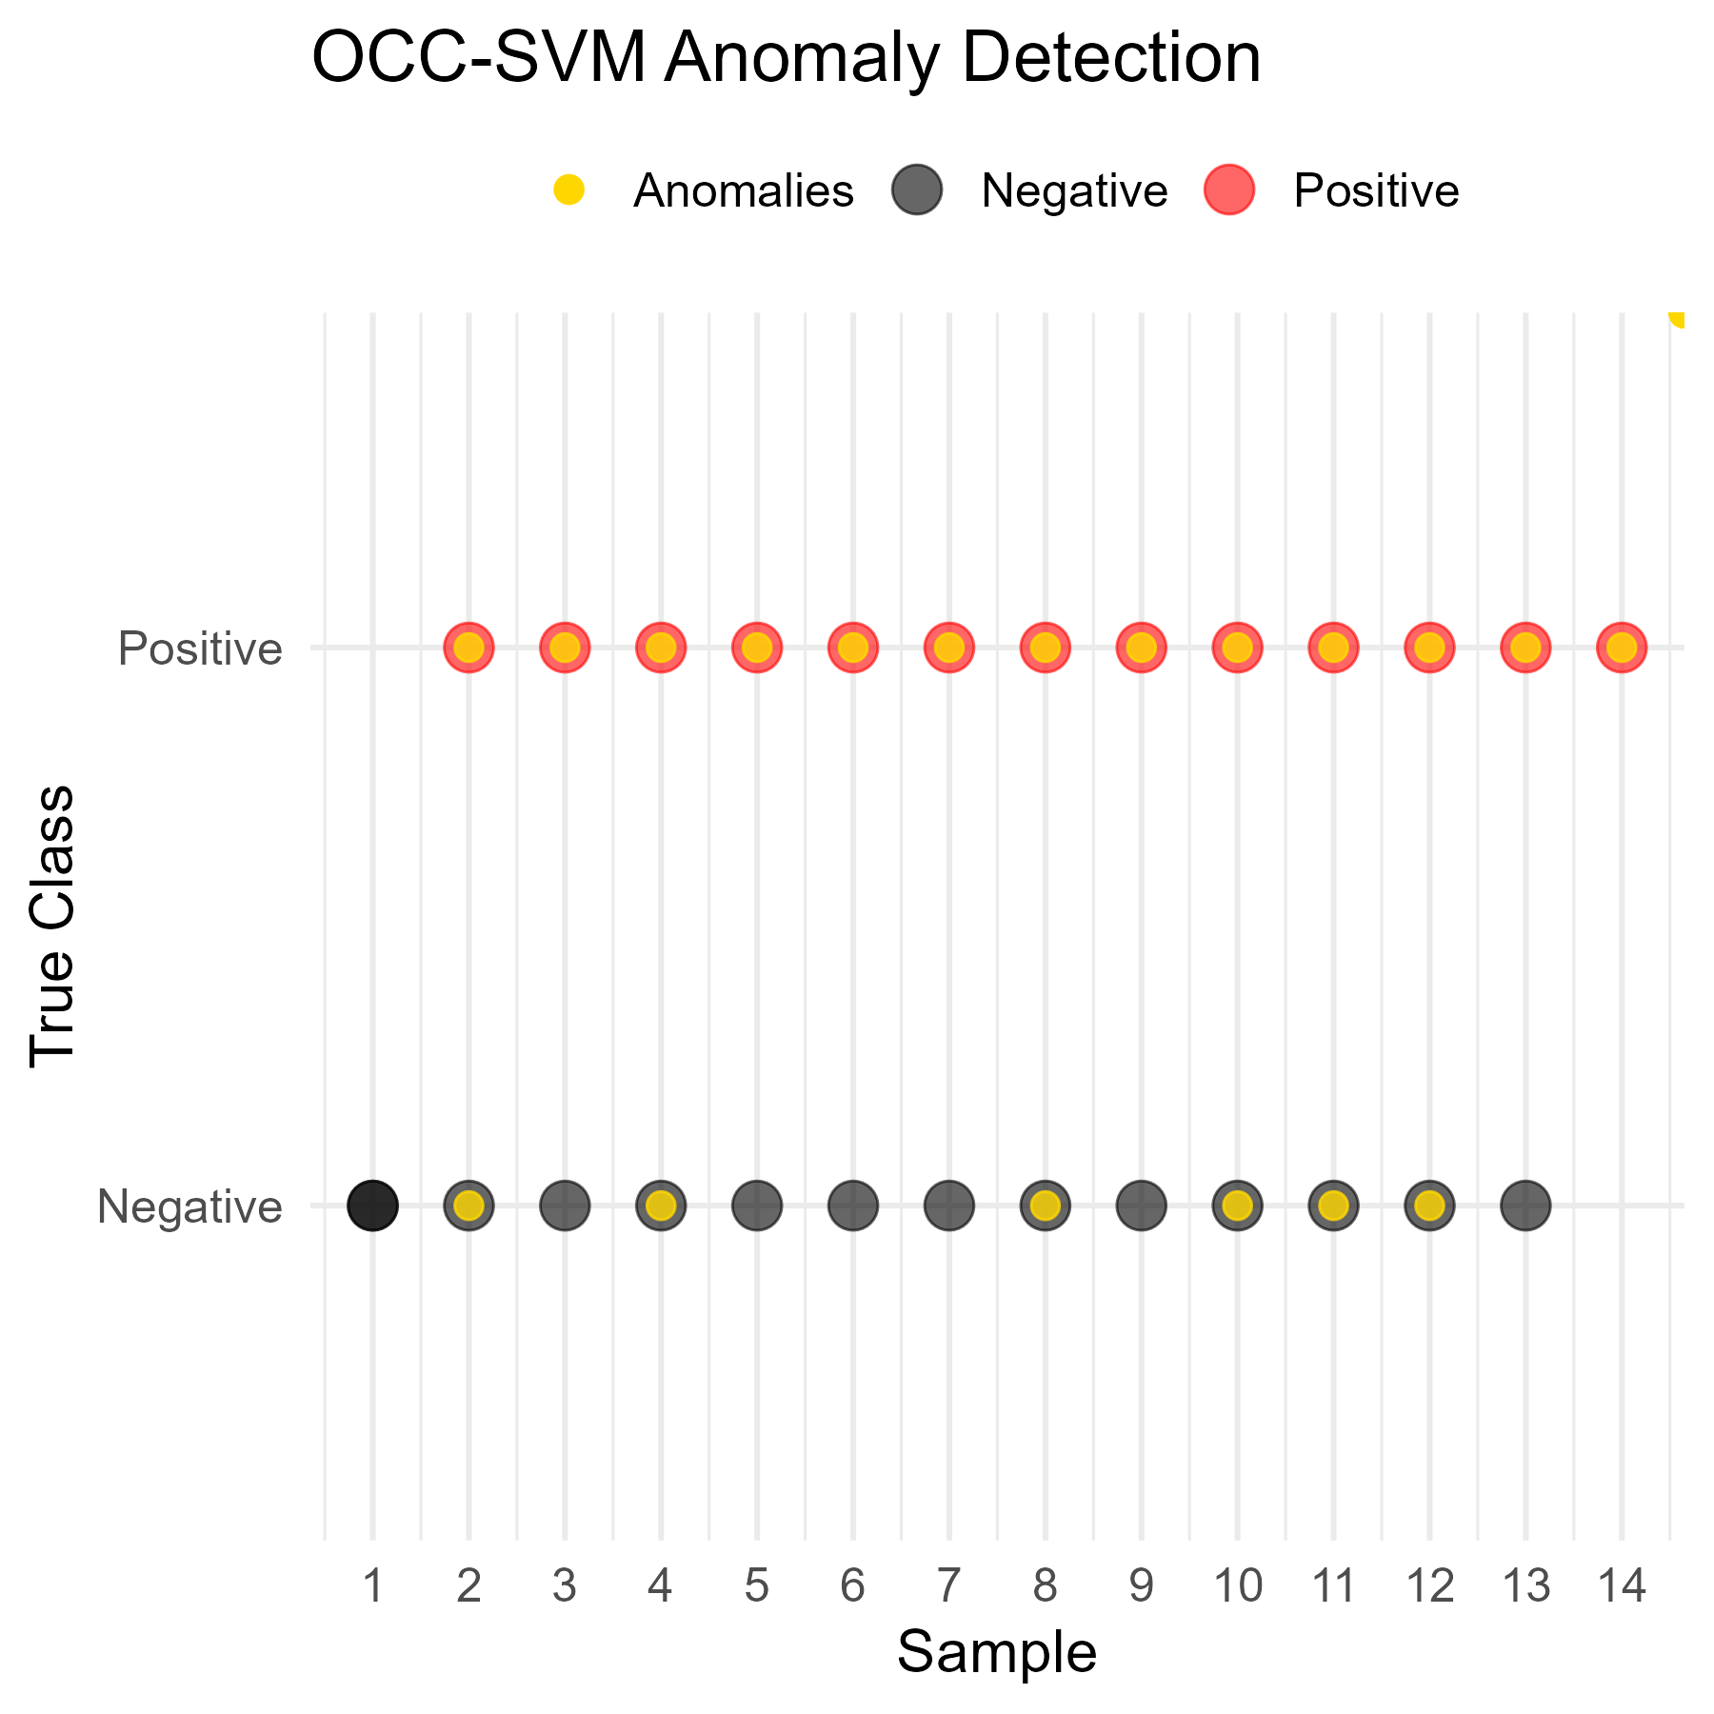
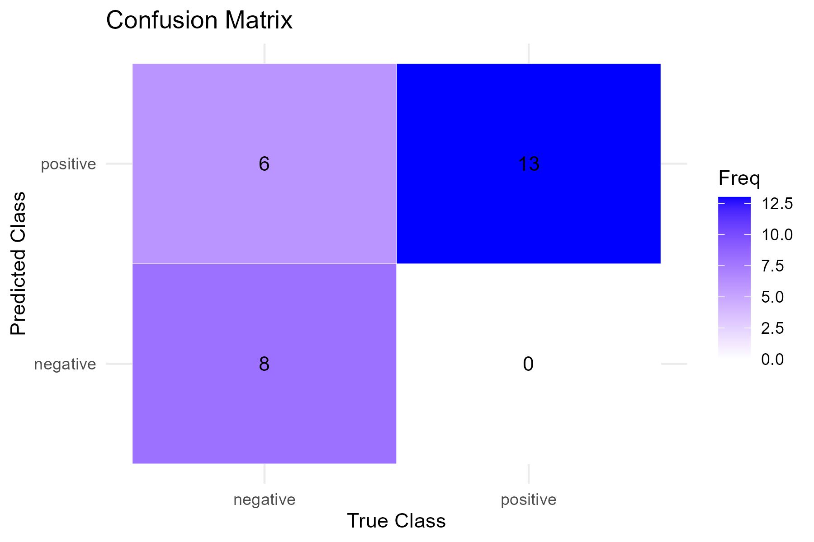
A. One-Class Classification SVM Anomaly Detection

Slide 2
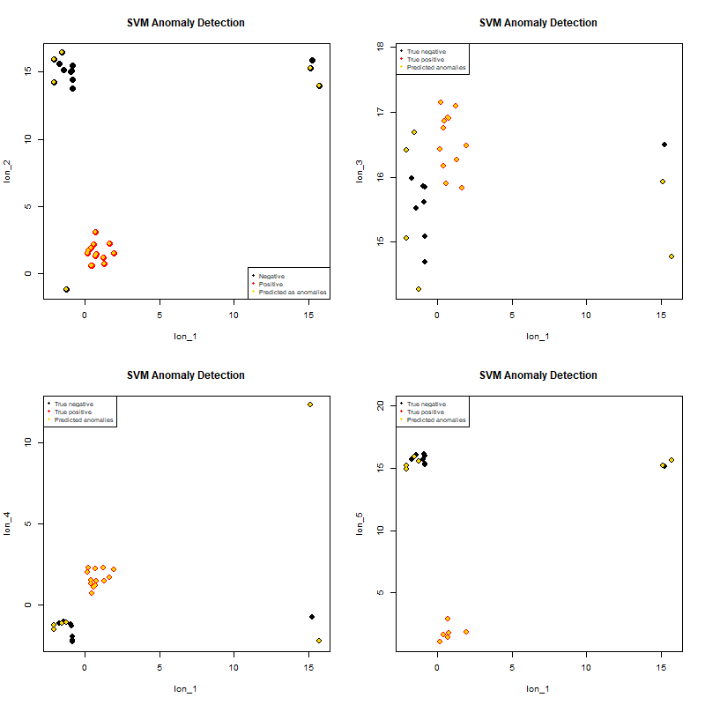
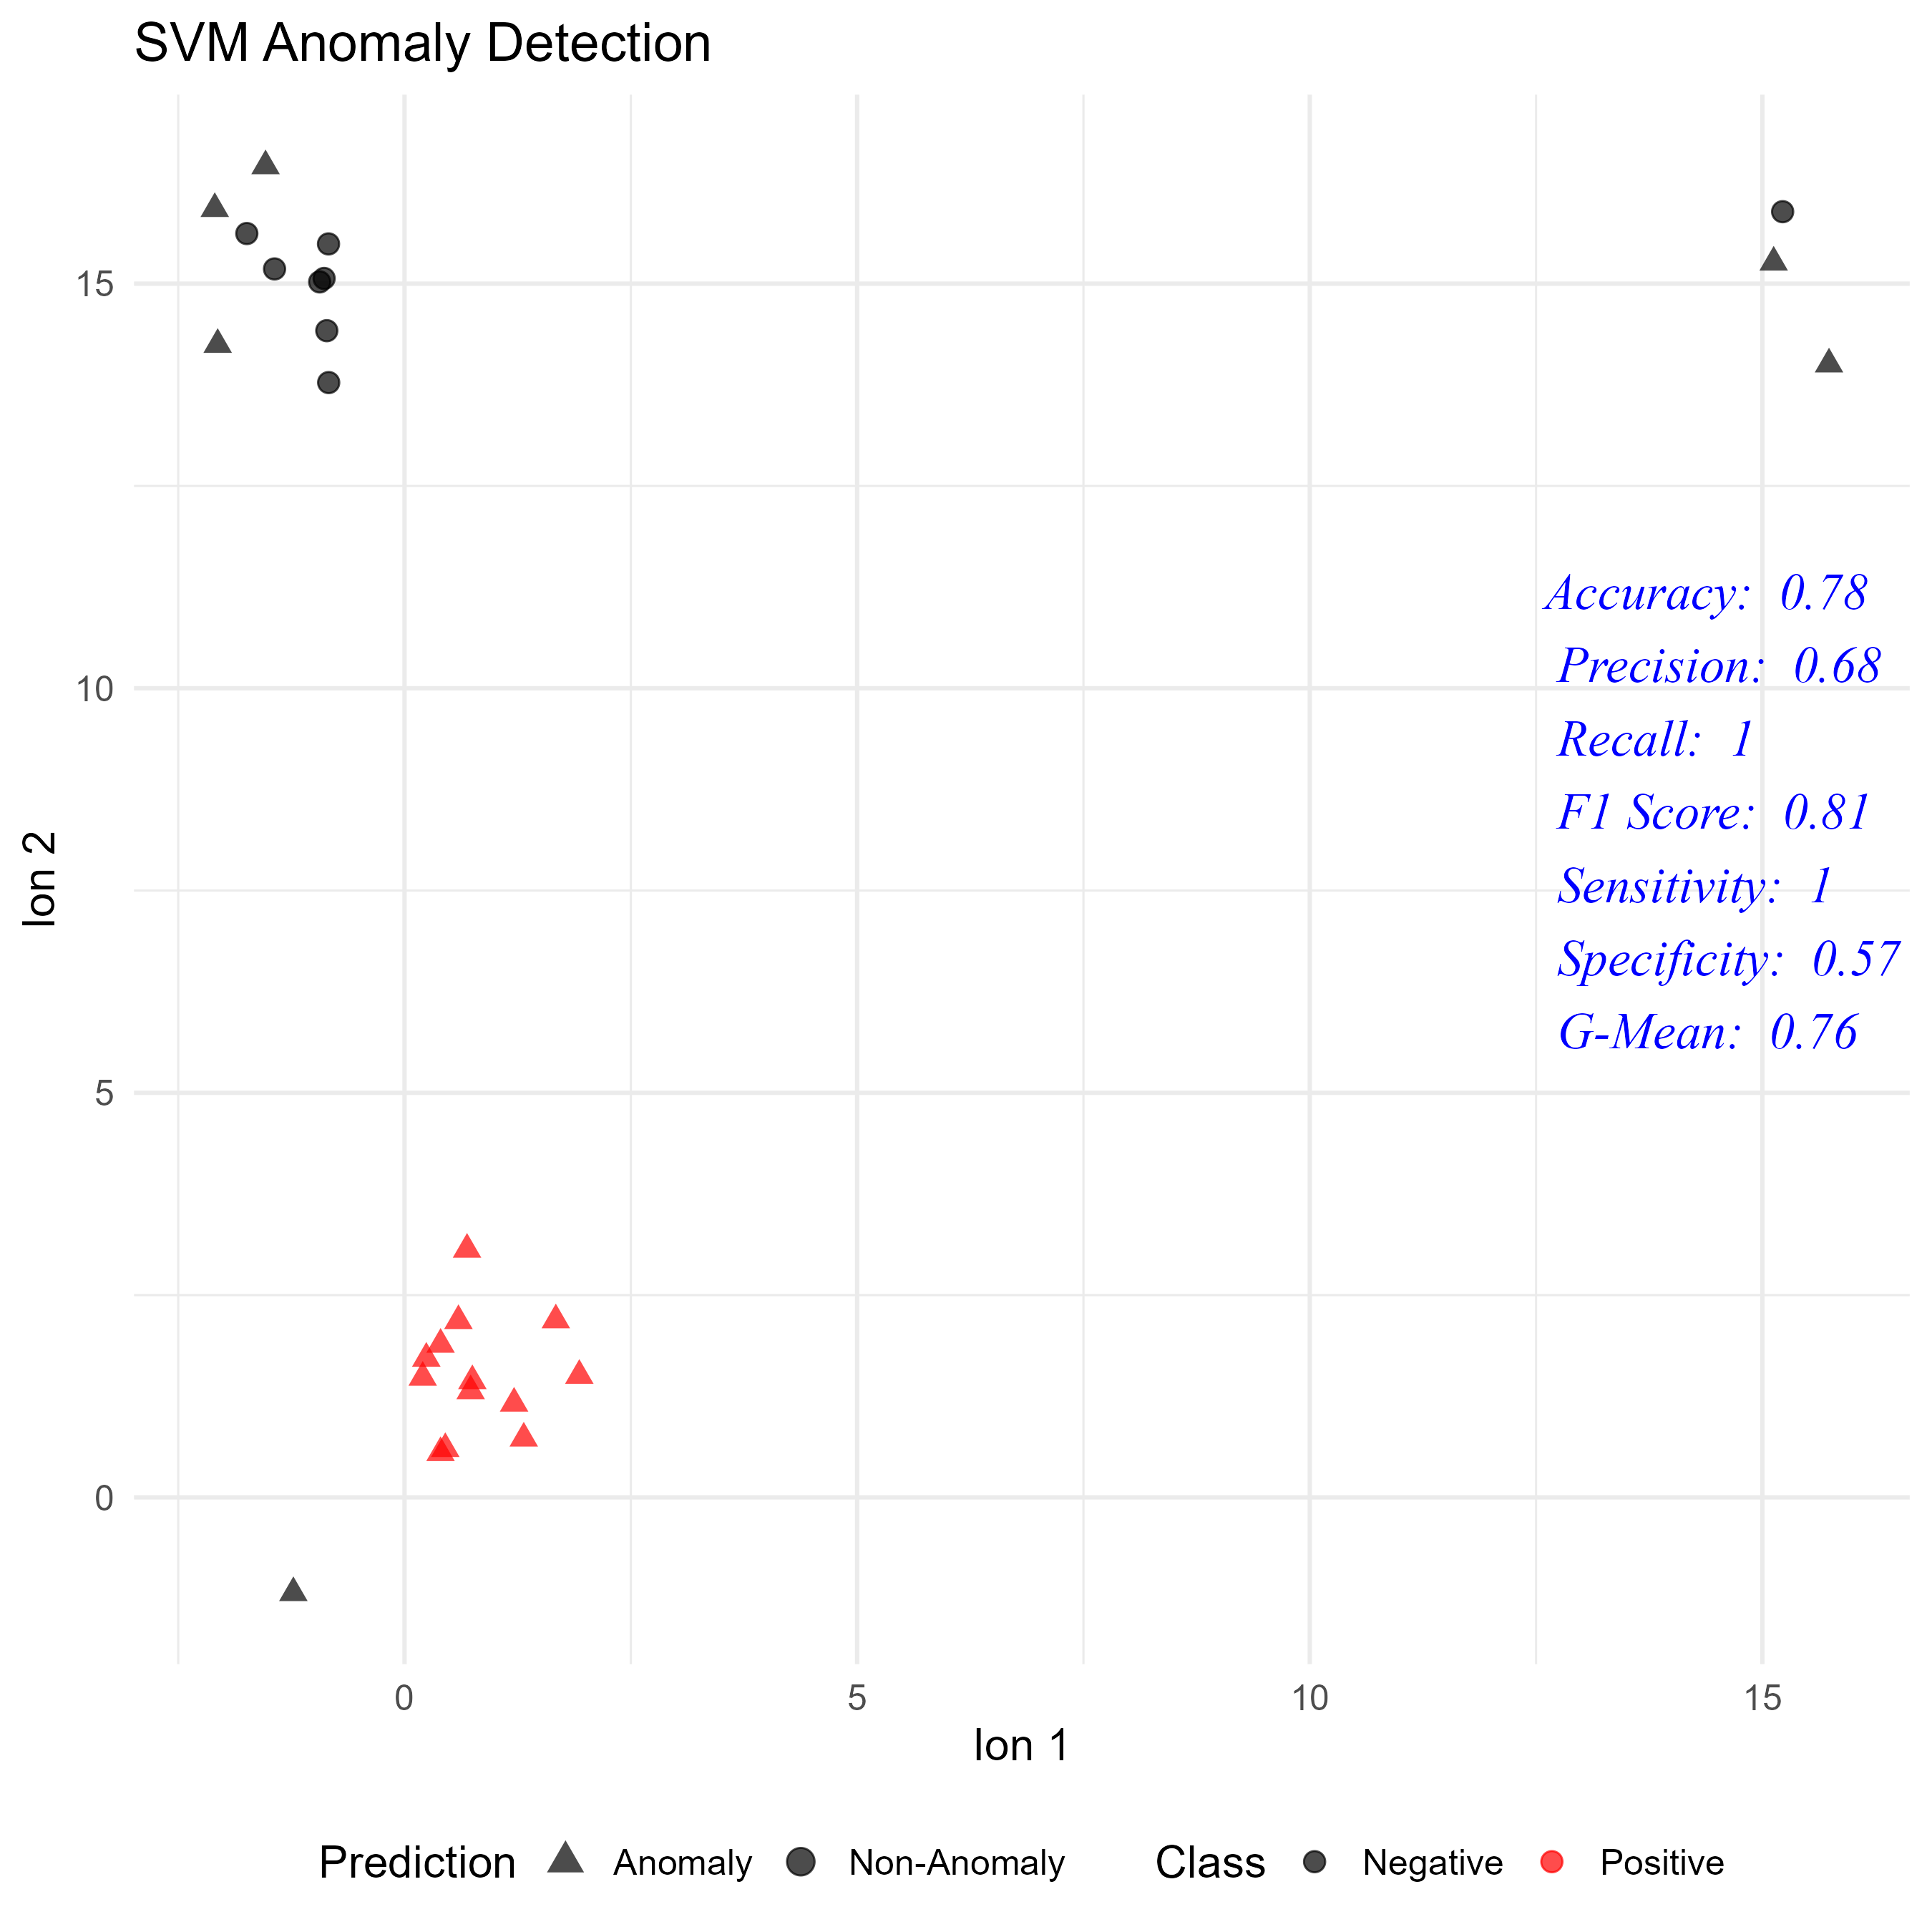
A. One-Class Classification SVM Anomaly Detection

Slide 3
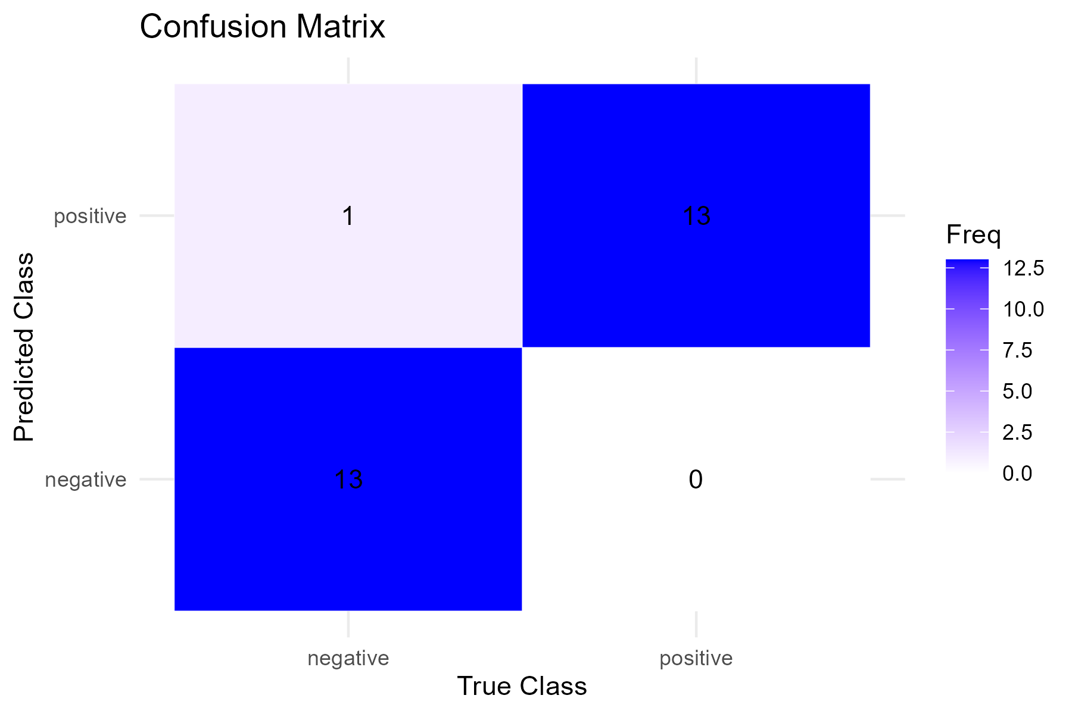
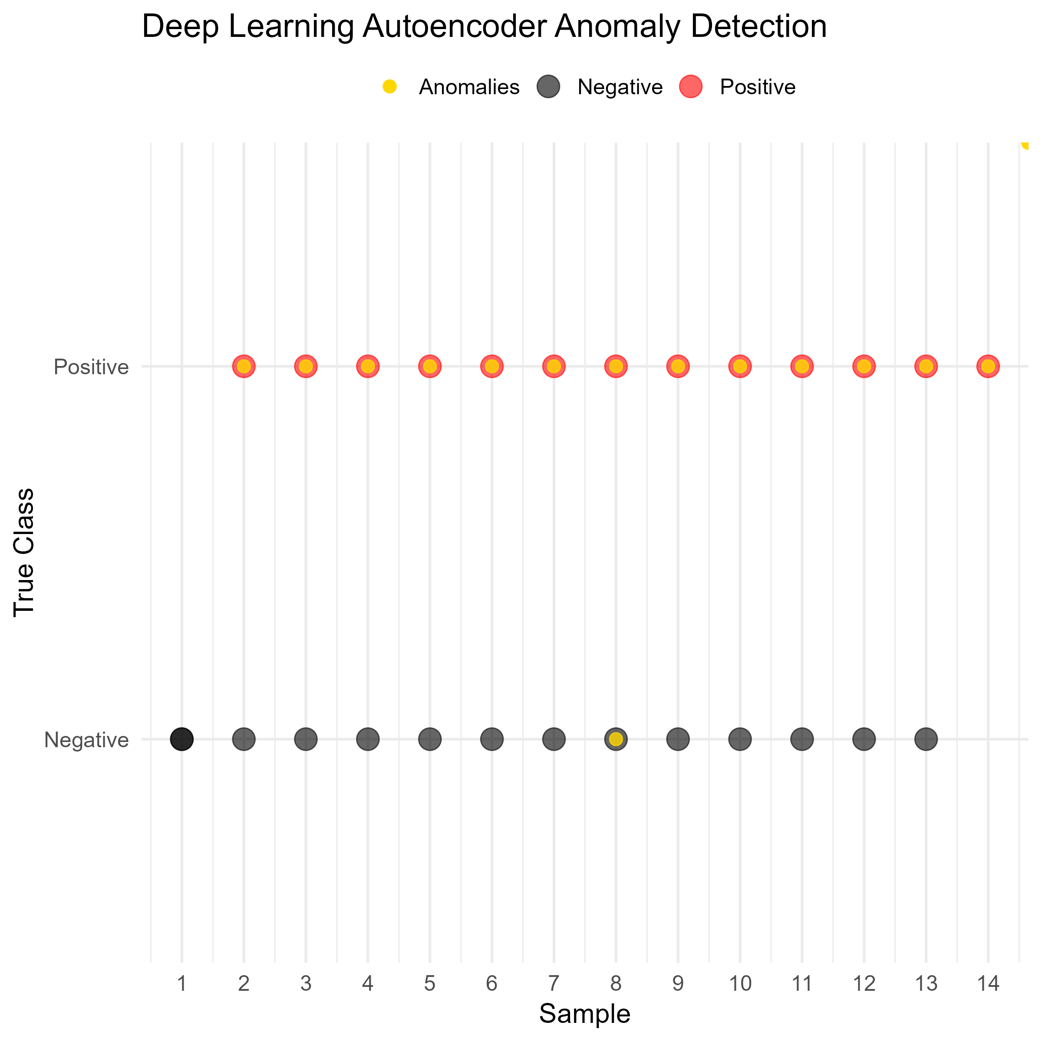
B. Deep Learning Autoencoder Anomaly Detection

Slide 4
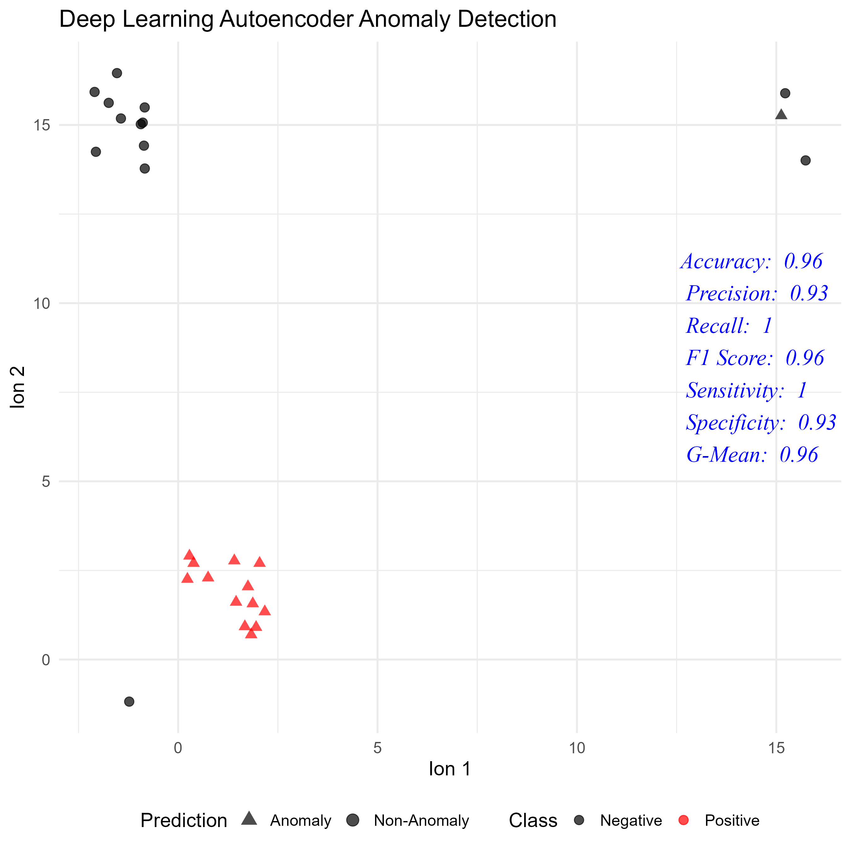
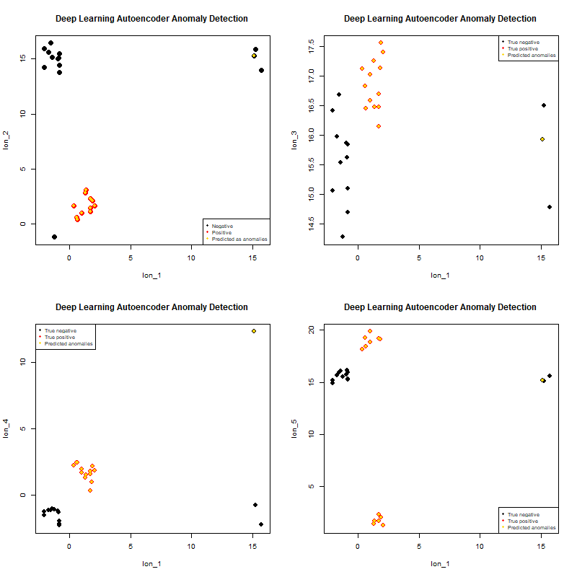
B. Deep Learning Autoencoder Anomaly Detection

Slide 5
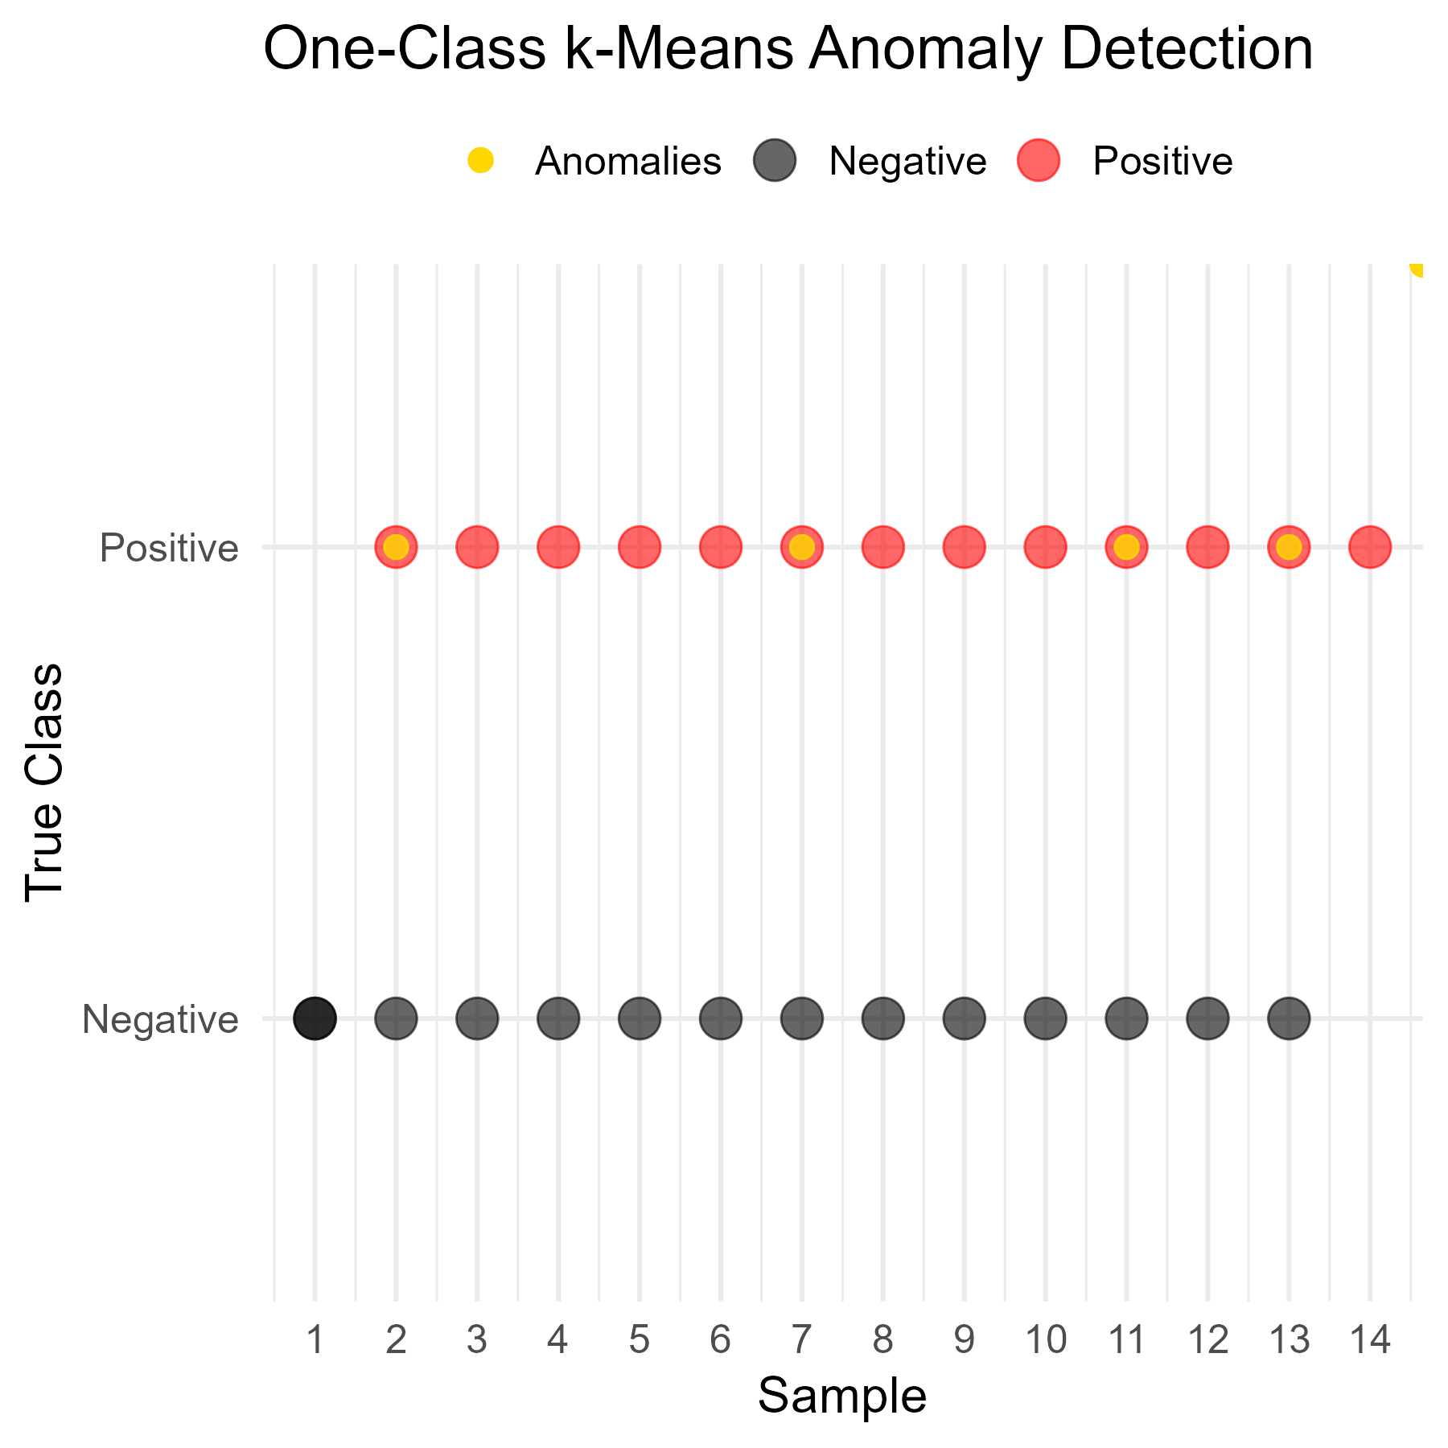
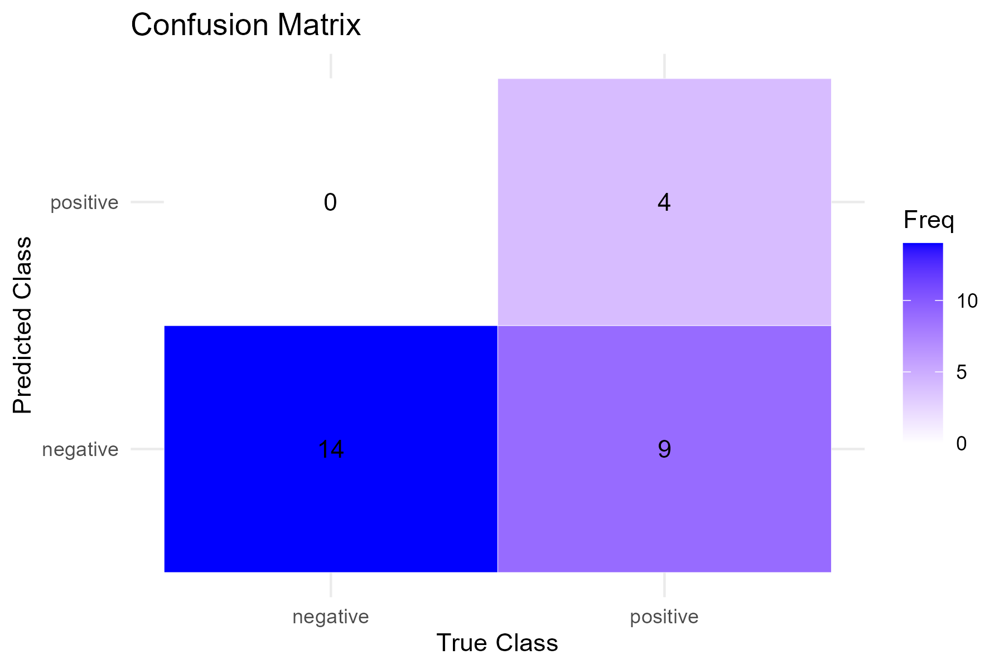
C. One-Class k-Means Anomaly Detection

Slide 6
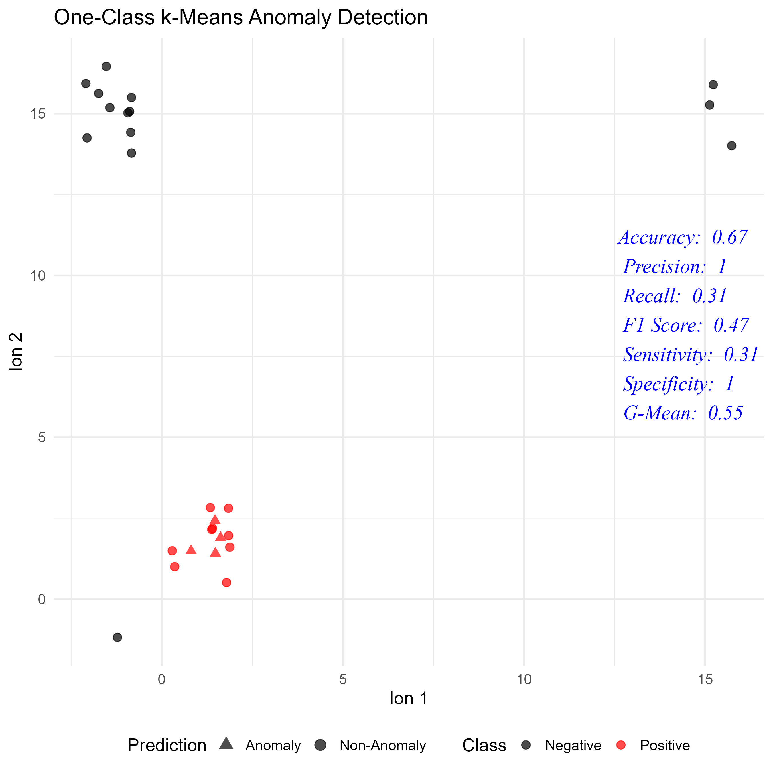
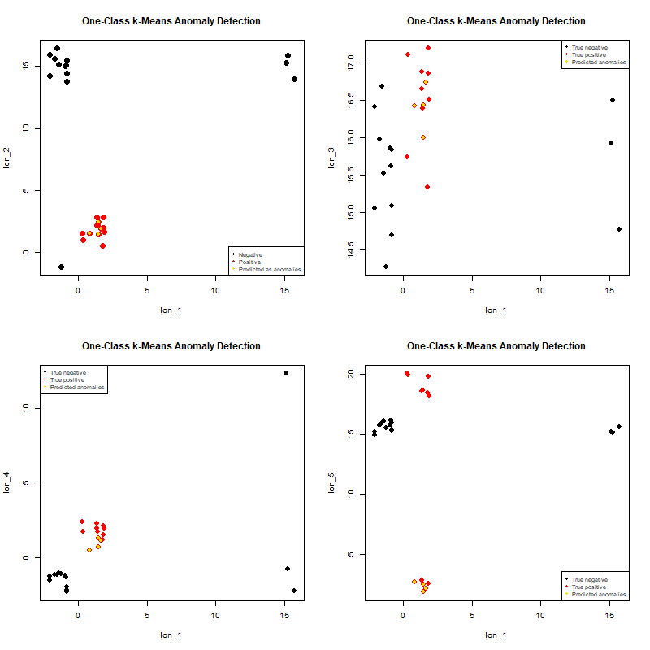
C. One-Class k-Means Anomaly Detection

Slide 7
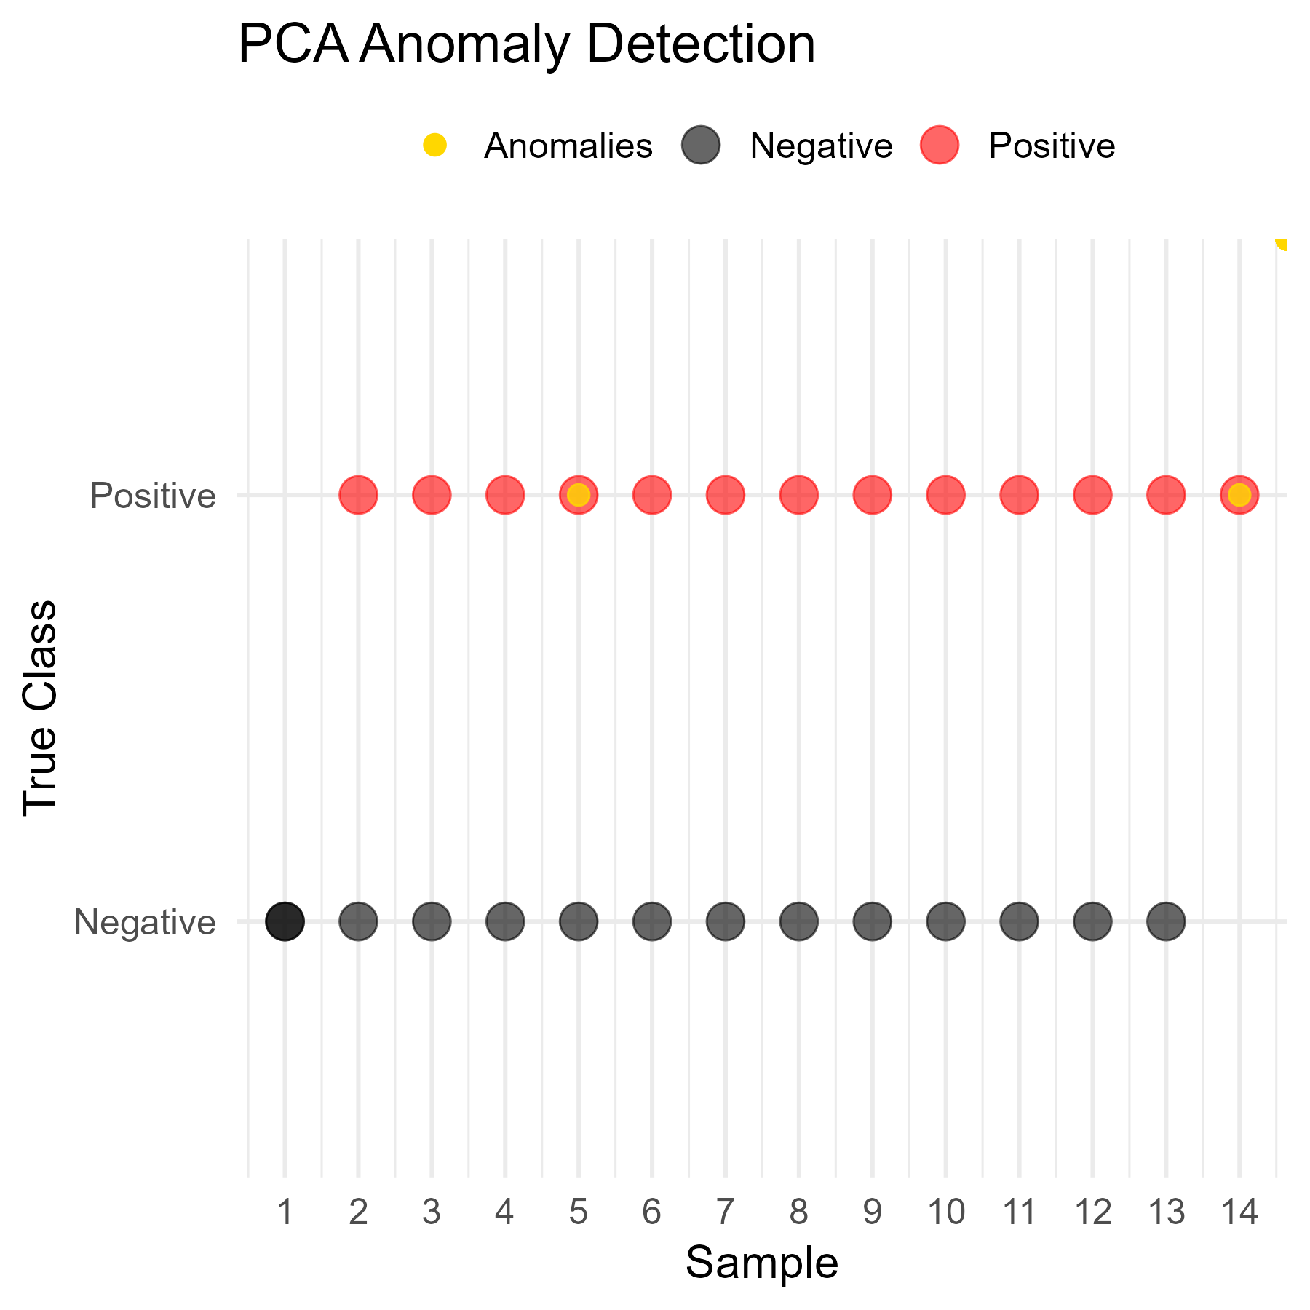
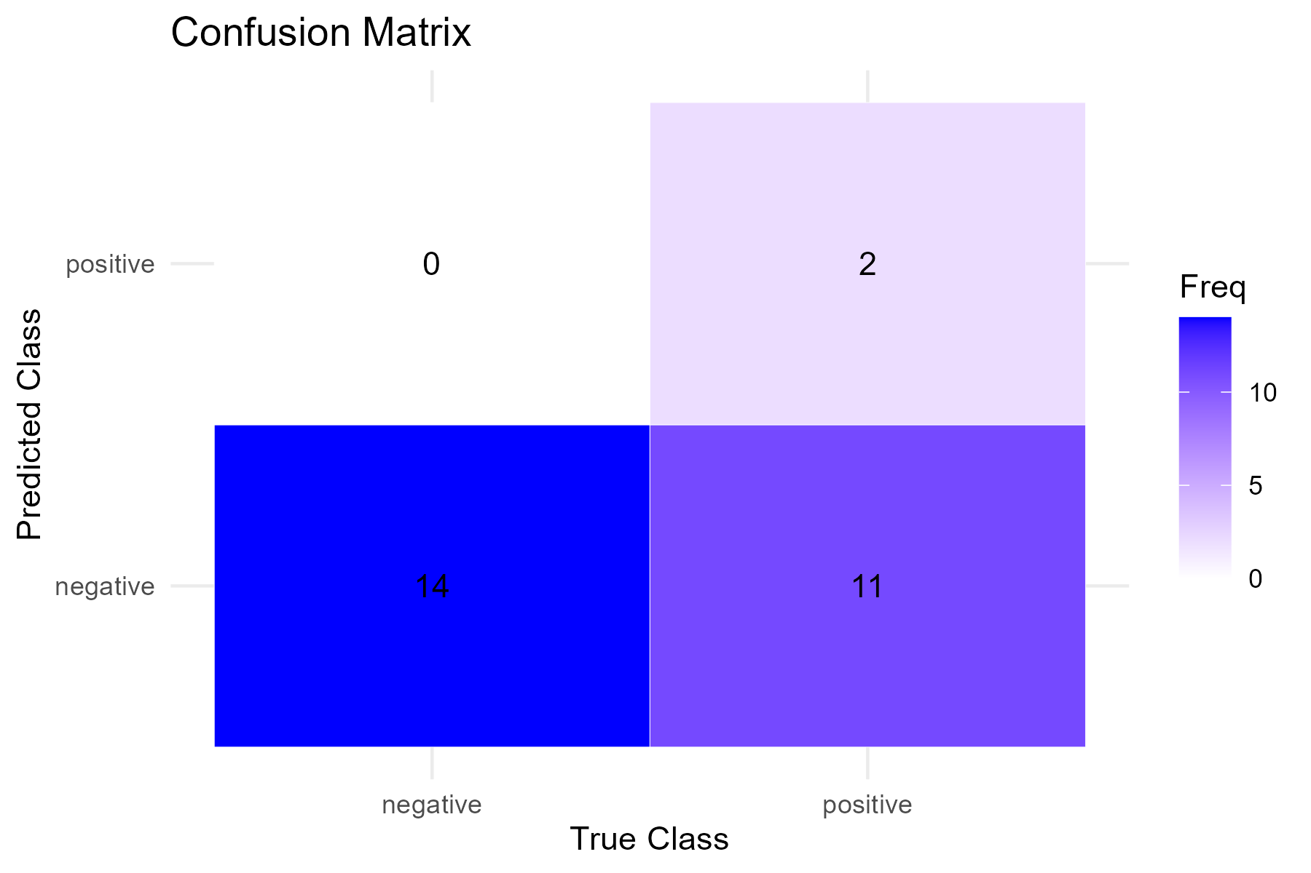
D. PCA Anomaly Detection

Slide 8
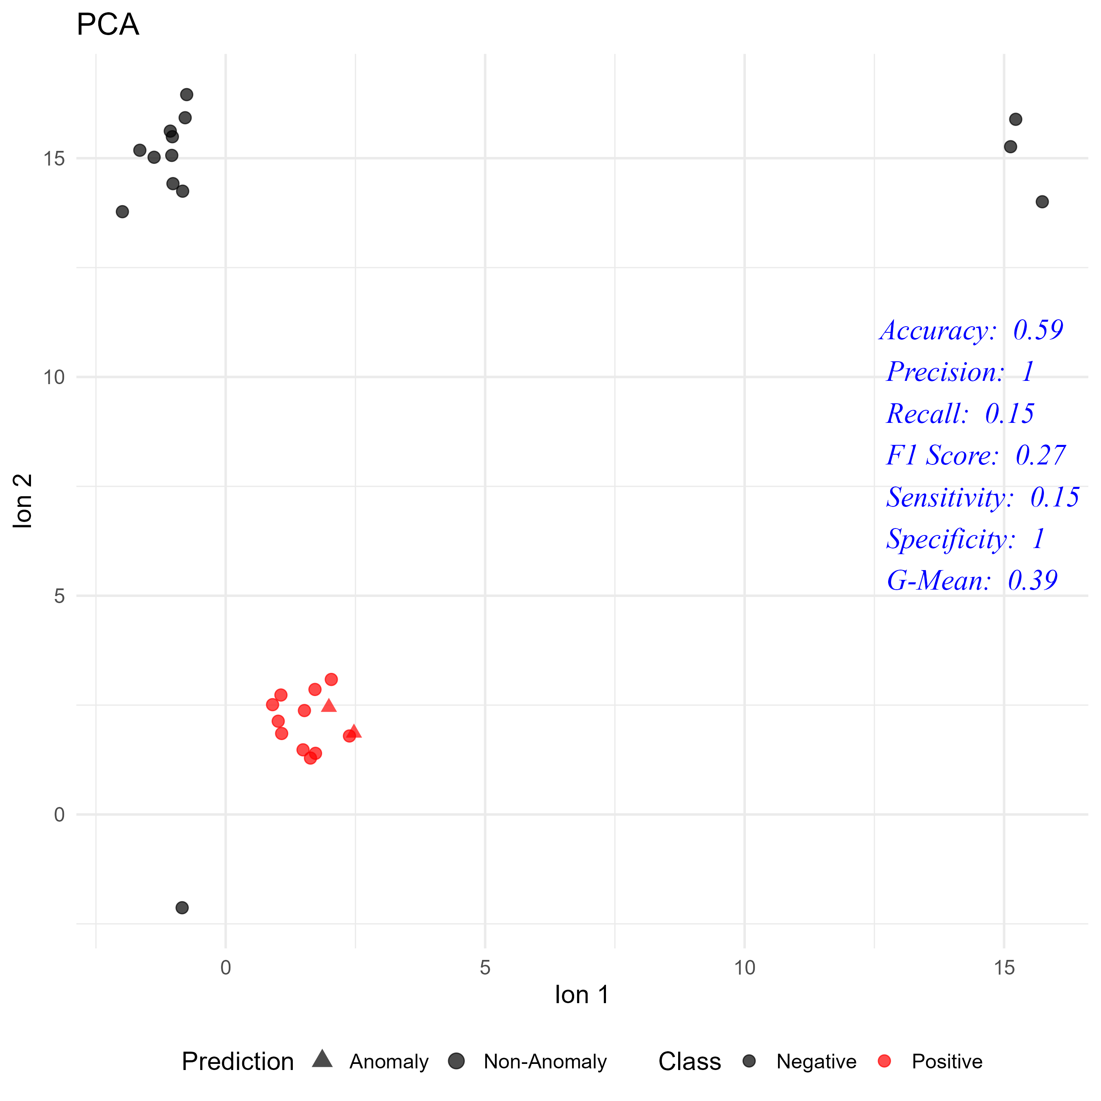
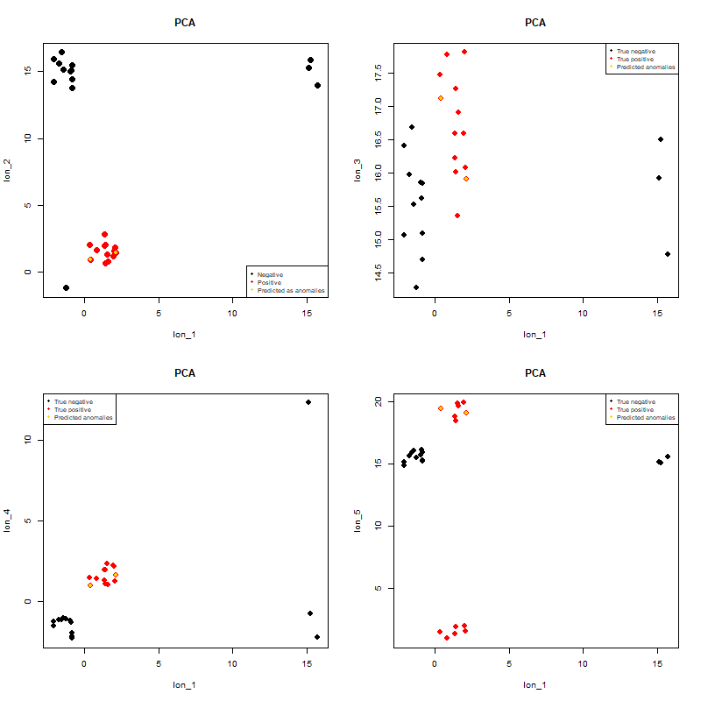
D. PCA Anomaly Detection

Slide 9
Classification Performance by method
Performance Metrics Summary
Method | Sensitivity | Specificity | Pos Pred Value | Neg Pred Value | Precision | Recall | F1 | Prevalence | Detection Rate | Detection Prevalence | Balanced Accuracy
SVM | 1.00 | 0.57 | 0.68 | 1.00 | 0.68 | 1.00 | 0.81 | 0.48 | 0.48 | 0.70 | 0.79
DL | 1.00 | 0.93 | 0.93 | 1.00 | 0.93 | 1.00 | 0.96 | 0.48 | 0.48 | 0.52 | 0.96
KMeans | 0.31 | 1.00 | 1.00 | 0.61 | 1.00 | 0.31 | 0.47 | 0.48 | 0.15 | 0.15 | 0.65
PCA | 0.15 | 1.00 | 1.00 | 0.56 | 1.00 | 0.15 | 0.27 | 0.48 | 0.07 | 0.07 | 0.58

