Slide 1
Web Application Development INF3048 – S6 TD2: The Locally Persistent Single-User Single-Keypad-View 2-Operand Frontend Calculator in Monolithic VanillaJS-HTML-LocalBase-QCSS
Jacques Robin and Camilo Correa © 2023-2026

Slide 2
Exercise 2: QCSS + Localbase
Implement keypad version of 2-operand calculator with operand value persistence to IndexedDB, the browser’s local database
Values of both operands entered using button keypads instead of input element
Choice of operator also entered using button keypads instead of select drop-down menu element
One save button persists operand value to IndexedDB, the browser’s local database
One clear (C) button to reinitialize the operand to zero
One sync button overwrite operand value from persisted value on IndexedDB

Slide 3
Exercise 2: QCSS + Localbase
Style the app using Quasar CSS classes in the HTML elements, rather than your own styling classes written in raw CSS
Keep the CSS stylesheet for style adjustment not directly doable by just reusing built-in Quasar CSS classes
Add tooltip to the save, clear and sync operand keypad buttons by using the sl-tooltip Custom Element from the Shoelace Vanilla Web Components library
Use Localbase NPM package to read from and write to Indexed DB with a simpler, higher-level API than the IndexedDB browser API

Slide 4
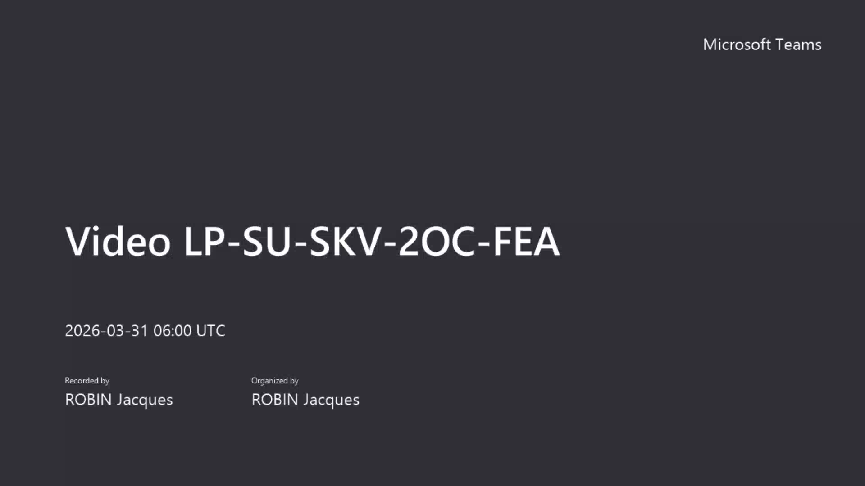
Exercise 2: QCSS + Localbase

