Slide 1
PROJECT FRAMEWORK
Phase topology of
depth-resolved CO₂ transport
A physically constrained indicator of landscape evolution at the
Landscape Evolution Observatory
For scientific review and Biosphere 2 project planning
Notes:
Timing: 0:45
The project tests whether depth-resolved CO₂ dynamics can reveal persistent reorganization of the crushed-basalt hillslope. Delay is treated as structured physical information. The analysis begins with transport physics and only then adds phase, geometry and topology. The central safeguard is independent validation: CO₂ patterns alone do not prove soil formation.

Slide 2
EXECUTIVE OVERVIEW
The project in one view
Scientific question
MEASURE
Does the same rainfall forcing produce a changing CO₂ response as basalt develops?
CO₂, water state and temperature at matched depths and locations.
EXPLAIN
Fit the simplest diffusion–reaction response before using network or topological descriptors.
VALIDATE
Require reproducibility, null tests and independent hydrologic or geochemical evidence.
Decision supported: whether an observed shift reflects reversible wetting, transport-path change or persistent hydro-biogeochemical development.
2
Notes:
Timing: 1:10
For administrators, the value is a decision framework rather than a single opaque index. It separates three interpretations that can look similar in raw CO₂ records: reversible moisture effects, a change in transport pathways, and persistent hydro-biogeochemical development. For scientists, the framework states which model, uncertainty estimate and independent evidence must accompany each claim.

Slide 3
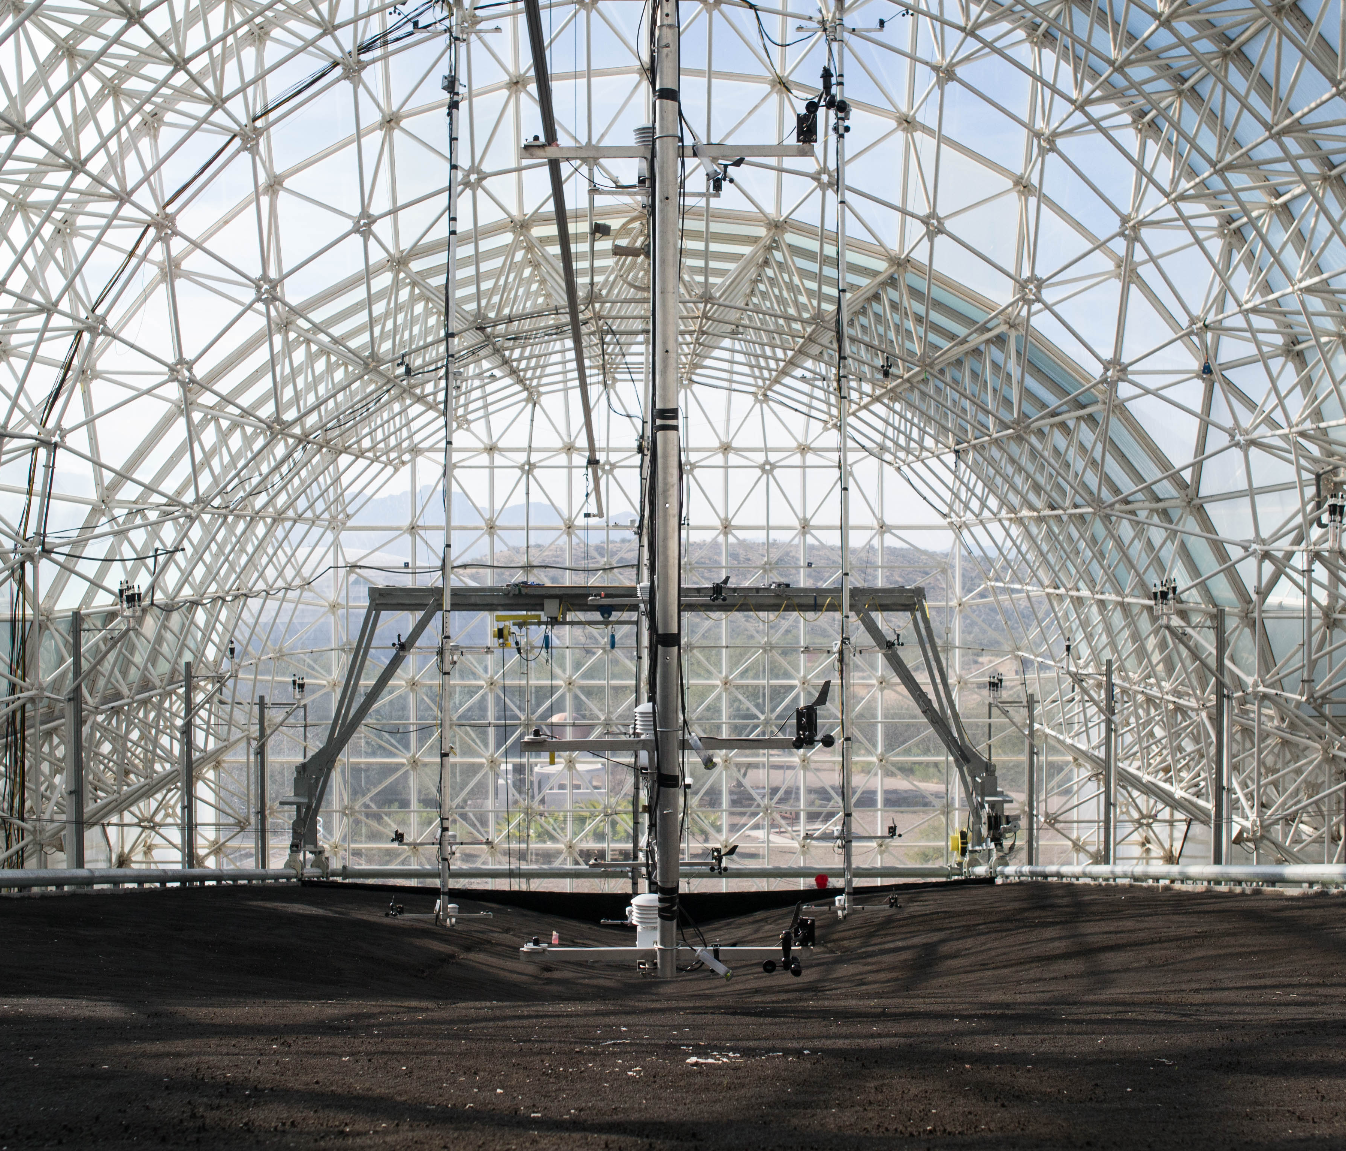
SYSTEM AND SAMPLING
Measurement geometry in LEO
EXISTING PLATFORM
Three replicate hillslopes
30 m × 11 m
10° mean slope
1 m crushed-basalt profile
PROPOSED CO₂ PROFILE
Near-surface air plus pore-space CO₂ at approximately 5, 25 and 50 cm
Depth-dependent attenuation and delay provide the raw signal for phase analysis.
Photo: Daniel Oberhaus, CC BY-SA 4.0
3
Notes:
Timing: 1:20
LEO contains three replicate landscapes. Each is 30 metres long and 11 metres wide, has an average 10-degree slope and contains a one-metre-deep profile of crushed basaltic tephra. The proposed project adds a deliberately simple CO₂ profile at selected horizontal locations: near-surface air and pore-space CO₂ near 5, 25 and 50 centimetres. These are proposed project depths, not a claim about the full published LEO sensor architecture.
Physical meaning of the photograph: this is the real controlled hillslope. Its scale allows repeated rainfall experiments while preserving lateral and vertical heterogeneity that a laboratory column would miss.
Sources: Biosphere 2 LEO; Pangle et al. (2015), doi:10.1016/j.geomorph.2015.01.020; Scott et al. (2020), doi:10.1038/s41597-020-00645-5. Image: Daniel Oberhaus, CC BY-SA 4.0.

Slide 4
RESEARCH DESIGN
Three questions, three testable patterns
TRANSPORT
SOURCE OR SINK
EVOLUTION
How do delay and attenuation change with depth, time scale and moisture?
When does a deep signal require local production, consumption or advection?
Does the system return to a matched dry state after each rain cycle?
Expected: coherent phase lag usually grows with depth under diffusion-dominated transport.
Flag: depth ordering fails or a structured residual remains after the transport model.
Flag: event trajectories end away from the initial dry baseline after covariate matching.
A departure from the expected pattern identifies a question to test. It does not identify a mechanism by itself.
4
Notes:
Timing: 1:15
The slide separates transport, local source–sink processes and evolution. The lime text states the prediction or diagnostic pattern. A lag that grows with depth supports simple diffusion only when coherence is adequate. A violation of depth ordering can arise from a local source, changing pathway, pressure-driven displacement or poor data quality. A non-closing event path can indicate memory, incomplete recovery or drift. Each alternative appears later in the validation plan.

Slide 5
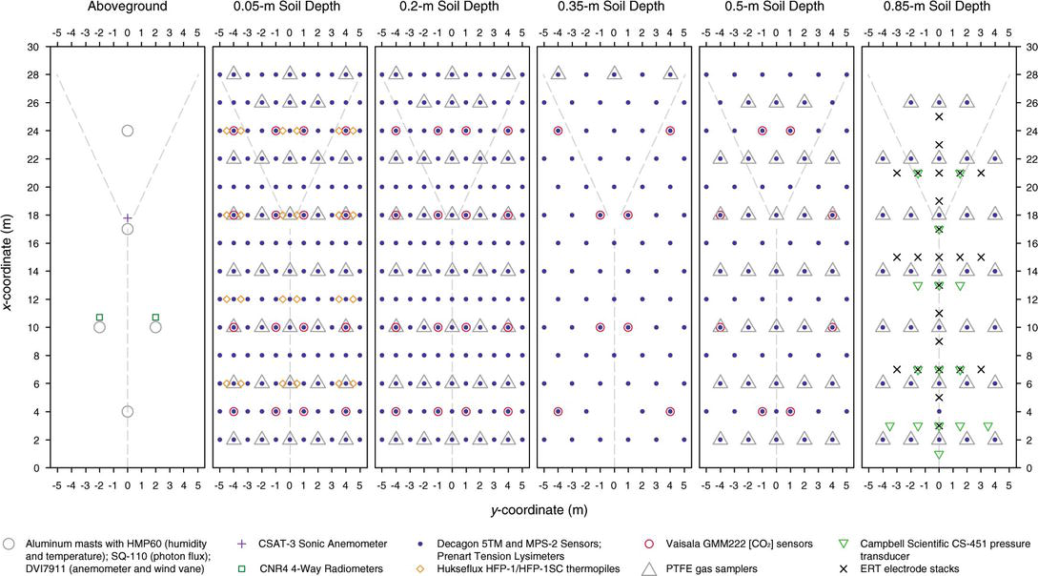
MATERIAL AND DYNAMIC MODEL
Parameters and their physical roles
SYMBOL AND VALUE
MEANING
WHY IT MATTERS
ρᵦ = 1.59 g cm⁻³
Dry solid mass per bulk volume
Packing and total pore space
φ ≈ 0.39
Total pore-volume fraction
Upper bound on gas- and water-filled porosity
Kₛₐₜ = 1.92 m d⁻¹
Saturated hydraulic conductivity
Drainage capacity, not CO₂ diffusivity
OC₀ = 0.07 g kg⁻¹
Initial organic carbon
Starting biological source potential
Published sensor map
Dₑff, kᵣ, S(z,t)
Fitted transport, net removal and local source
Dynamic quantities estimated by state or event
Texture: 84.6% sand, 12.2% silt, 3.2% clay. Air-filled porosity is approximated by φₐ = φ − θᵥ, so wetting can sharply reduce connected gas pathways.
Initial material values: Pohlmann et al. (2016). Sensor map: Sengupta et al. (2018).
5
Notes:
Timing: 1:35
The first four rows describe the initial basalt packing and are not fitted from the CO₂ records. Rho-b is dry bulk density. Phi is total porosity. K-sat describes saturated water flow, not gas diffusion. OC-zero is initial organic carbon. The last row introduces dynamic model quantities. D-eff is the effective gas-transport coefficient. K-r is an effective first-order net removal rate. S of z and t is unresolved local production. These must be estimated by moisture state or event.
The sensor map shows that LEO already has dense spatial infrastructure. The proposed CO₂ profile should be aligned with existing moisture, temperature, pressure and chemistry measurements wherever possible.
Sources: Pohlmann et al. (2016), doi:10.1002/2016GC006270; Sengupta et al. (2018), IntechOpen chapter 58345.

Slide 6
INFERENTIAL CHAIN
From sensor records to a defensible claim
Synchronize and screen
STOP RULE
1
Clean, aligned records
If a stage fails its quality criterion, later topology receives no physical interpretation.
2
Define comparable events
Rain, drainage, dry return
3
Fit the physical null
Expected lag and attenuation
4
Accept reliable phase
Observed delay with uncertainty
5
Build graph and trajectories
Direction, coupling, memory
6
Summarize geometry
Rank, components, loops
7
Test interpretation
Supported, revised or rejected claim
6
Notes:
Timing: 1:15
The workflow is deliberately sequential. Clock offsets, gaps and calibration errors are addressed first. Events are defined before comparing them. The physical null predicts the simplest transport response. Phase enters only where coherence and uncertainty are acceptable. Geometry and topology summarize multichannel structure. Independent measurements and surrogate data decide whether the interpretation survives. The stop rule is important for governance: the project can still report a useful method or null result even if it cannot support a soil-development claim.

Slide 7
ILLUSTRATIVE SIGNAL
Depth delay becomes a measurable phase difference
PHYSICAL MEANING
Deeper peaks arrive later
The signal also becomes smaller because diffusion spreads the fluctuation and wet pores restrict gas connectivity.
Phase converts delay at a selected time scale into an angle. Delay is reported only where the two signals are coherent.
Model illustration, not LEO observations
7
Notes:
Timing: 1:20
The curves use the harmonic diffusion scenario in the source document. The deeper signals are smaller and later. Their delay becomes a phase difference at the 24-hour time scale. Phase is useful because the same idea extends to changing event time scales through wavelets. It is not accepted when coherence is low. The shown values are model outputs, not LEO measurements.
Illustrative parameters: 24-hour period and D-eff equal to 2 times 10 to the minus 6 square metres per second. The corresponding delays at 5, 25 and 50 centimetres are approximately 0.81, 4.07 and 8.14 hours. The source document reports Mathematica checks of these calculations.

Slide 8
DIFFUSION–REACTION MODEL
The physical baseline separates transport from anomaly
∂C/∂t = Dₑff ∂²C/∂z² − kᵣC + S(z,t)
NULL-MODEL PREDICTION
Δφ(z,ω) = −z√[ω/(2Dₑff)]
τ(z,ω) = −Δφ/ω
C(z,t)
CO₂ concentration at depth z and time t
Effective transport coefficient, sensitive to moisture and tortuosity
Lag grows with depth. Amplitude decreases.
Dₑff
kᵣ
Effective first-order net removal rate
WHAT THE RESIDUAL MEANS
Residual = observation − model
S(z,t)
Local source term not explained by boundary-driven transport
A stable residual motivates tests of local production, geochemical consumption, advection or changing pathways. Random residuals do not.
ω: angular frequency. Δφ: unwrapped phase difference. τ: equivalent delay.
8
Notes:
Timing: 1:30
This simplified equation is the presentation-level null model. The full source document gives the dimensional balance in air-filled pores and includes advection, biological production, weathering and dissolution explicitly. Here D-eff compresses molecular diffusion, air-filled porosity, tortuosity and unresolved boundary resistance into one fitted coefficient. K-r summarizes net first-order removal without identifying a unique mechanism. S represents local production not explained by the simple boundary response. Omega is angular frequency. Delta-phi is the unwrapped phase difference and tau is its equivalent delay. A residual is the observation minus the fitted model prediction.
Important limitation: concentrations reported in ppm must be converted consistently before a dimensional mass balance. D-eff should be estimated separately for different moisture states.

Slide 9
PHASE ESTIMATION
Phase is accepted only when shared structure is reliable
1
2
3
4
CROSS-SPECTRUM
COHERENCE
WAVELET PHASE
ANALYTIC SIGNAL
The argument of the averaged product X*(ω)Y(ω) gives relative phase.
A 0–1 measure of reproducible shared oscillation. Low values reject phase.
Local phase in time and scale for rain, drainage and recovery.
Instantaneous phase after isolating a physically relevant narrow band.
Acceptance rule
Choose a physical time scale, estimate shared oscillation, report phase uncertainty and convert phase to delay only when coherence passes a predeclared threshold.
Cross-method agreement increases confidence. It does not prove a transport mechanism.
9
Notes:
Timing: 1:20
The cross-spectrum compares two Fourier components and uses an averaged complex product. Averaging over segments, events or a local time-frequency neighbourhood prevents the trivial coherence of single unaveraged periodograms. Coherence is normalized between zero and one and acts as the gatekeeper. Wavelets follow nonstationary phase during rainfall. The analytic signal uses the Hilbert transform after narrow-band filtering. Phase must remain undefined where amplitude or coherence is inadequate. Converting phase to delay also requires a continuous, correctly unwrapped branch.

Slide 10
EVENT GEOMETRY
Rainfall events reveal reversibility, memory and drift
RAIN
DRAINAGE
DRY RETURN
Starting dry state
Trajectory through CO₂, phase, moisture and temperature
Compare the endpoint with a matched dry baseline
APPROXIMATELY CLOSED
OPEN ENDPOINT
BRANCHED PATHS
reversible response
residual memory or incomplete recovery
different regimes under similar forcing
State vector q(t): concentrations C, accepted phase differences Δφ, volumetric water content θ, temperature T and selected covariates.
10
Notes:
Timing: 1:20
The event state vector combines CO₂ concentrations, accepted phase differences, volumetric water content, temperature and selected covariates. Variables require a fixed scaling rule so units do not define the geometry. The left sketch shows an approximately closed trajectory and supports a reversible interpretation. The centre sketch ends away from the start and indicates residual memory, incomplete recovery or drift. The right sketch shows distinct paths under similar forcing and suggests multiple regimes. The drawings are conceptual. Temporal order and matched environmental conditions are required for interpretation.

Slide 11
NETWORK REPRESENTATION
The phase-transport graph maps reliable lead–lag relationships
AIR
A RETAINED EDGE REQUIRES
Sensors are geometric or hydrologic neighbors
5 cm
Coherence exceeds a prespecified threshold
25 cm
Lag direction remains stable under resampling
Node = sensor channel
Arrow = leading to lagging channel
Weight = reliable coupling at a selected time scale
50 cm
Location A
Location B
11
Notes:
Timing: 1:20
A node represents a sensor channel at a location and depth. An arrow points from the leading channel to the lagging channel at a selected time scale. An edge is retained only if the sensors are physically plausible neighbours, coherence passes a prespecified threshold and the lag sign is stable under bootstrap resampling. A possible edge weight combines coherence with a penalty for long delay. The dashed lateral edge illustrates a relationship that requires particular scrutiny because common atmospheric forcing can synchronize distant sensors without direct transport.

Slide 12
TIME-SERIES UNFOLDING
Buchstaber unfolding exposes the geometry hidden in a sequence
Scalar event sequence
4.1 4.8 5.4 5.0 4.3 …
X1
X2
X3
(4.1, 4.8, 5.4)
(4.8, 5.4, 5.0)
(5.4, 5.0, 4.3)
Choose a window length n from a physical time scale.
Overlapping windows become consecutive points on an oriented curve in ℝⁿ.
EFFECTIVE RANK
q-WIDTH d(q)
L-APPROXIMATION
How many directions contain most of the variation
Residual spread outside the best q-dimensional subspace
Reconstructed series used to verify preservation of lag and phase
Descriptor, not proof: changes in rank or curve shape require physical and independent validation.
12
Notes:
Timing: 1:25
The unfolding starts with a regularly sampled scalar sequence. A window of length n forms overlapping vectors X-k in R to the n. Consecutive vectors share n minus one observations, so the curve preserves temporal order and local history. Eigenvalues of the scatter matrix describe spread along orthogonal directions. Effective rank summarizes dimensionality. The q-width is normalized residual spread outside the best q-dimensional subspace. The L-approximation reconstructs a time series so preservation of physical lags and phases can be tested directly.
Sources: Buchstaber (1997) and Buchstaber (2025), doi:10.4213/sm10240e.

Slide 13
PERSISTENT TOPOLOGY
Topology distinguishes robust shape from scale-dependent detail
H₀: connected components
H₁: loop-like structure
Persistence: threshold range over which a feature survives
PHYSICAL INTERPRETATION
Spatial H₀ can track separated CO₂-rich domains. Temporal H₁ can flag a loop-like event trajectory. Neither feature identifies a process without time order, covariates, null models and independent evidence.
Caution: dimension reduction, interpolation and sampling density can create or remove apparent features.
13
Notes:
Timing: 1:20
H-zero counts connected components. In a spatial superlevel filtration, components may correspond to separated CO₂-rich domains. H-one detects loop-like geometry. In a temporal point cloud, an H-one feature can be consistent with a cyclic response or hysteresis, but the point cloud itself discards time order. Persistence records the range of thresholds over which each feature survives. Short-lived features may reflect noise. Long-lived features still require sensitivity tests because dimension reduction, interpolation and sampling density can create or remove them.

Slide 14
INTEGRATION
One event yields a structured fingerprint, not a single score
TRANSPORT
PHASE GRAPH
UNFOLDING
EVENT GEOMETRY
PERSISTENCE
lag τ, attenuation, Dₑff
coherence γ², directed edges
rank, q-width, subspace distance
closure error, loop measure
H₀ and H₁ intervals
EVENT FINGERPRINT
Estimates + uncertainty + quality flags + comparison with physical and surrogate nulls
Keep the components separate until validation shows which ones add independent information.
14
Notes:
Timing: 1:10
The fingerprint is a structured record, not an unexplained composite index. Tau denotes equivalent delay. Gamma-squared denotes coherence. D-eff is the fitted effective transport coefficient. The phase graph stores accepted directed relationships. Unfolding contributes effective rank, q-width and optional subspace distance between events. Event geometry contributes closure error and a loop or geometric-phase measure. Persistent topology contributes H-zero and H-one intervals. Every estimate travels with uncertainty, quality flags and a null comparison.

Slide 15
EVIDENCE LADDER
Claims advance only after four validation gates
CLAIM
PHYSICAL BASELINE
NULL TEST
INDEPENDENT CHECK
PASS RULE
TRANSPORT
Fit diffusion–reaction
Recover synthetic lag
Check moisture and pressure
Reproducible Dₑff
PHASE NETWORK
Test pairwise depth order
Randomize cross-signal phase
Check sensor geometry
Edges repeat by event
TOPOLOGY
Compare field statistics
Permute feature locations
Compare ERT and chemistry
Stable to interpolation
SOIL DEVELOPMENT
Match dry states
Control drift and recovery
Require ≥2 evidence classes
Replicate across slopes
Defensible boundary: without these gates, report a change in the CO₂ field or its dynamics, not direct observation of basalt becoming soil.
15
Notes:
Timing: 1:30
Each row moves from claim to baseline, null test, independent check and pass rule. Transport requires physically plausible and reproducible D-eff. The phase network must exceed simple depth ordering and phase-randomized surrogates. Topology must add information beyond variance, gradients and spatial correlation and remain stable to interpolation. A soil-development interpretation requires matched dry states, drift controls, at least two independent evidence classes and replication across positions or landscapes. ERT means electrical resistivity tomography. Independent evidence can include hydrology, solution chemistry, mineralogy, pore structure or biological activity.

Slide 16
BIOSPHERE 2 IMPLEMENTATION
A staged pilot limits burden while testing feasibility
1 · DESIGN REVIEW
2 · EVENT PILOT
3 · DECISION REVIEW
Confirm existing data, sensor compatibility, access constraints and candidate locations.
Collect synchronized CO₂ and covariates across a small set of controlled or natural rain events.
Assess data quality, identifiable time scales, model residuals and the value of wider deployment.
ITEMS TO AGREE WITH THE LEO TEAM
Sensor locations and depths • sampling interval and clock synchronization • calibration and maintenance • rainfall-event definition • access to moisture, pressure, temperature, ERT and chemistry • success and stop criteria
The presentation proposes the analysis framework. Deployment scope, duration and budget remain joint planning decisions.
16
Notes:
Timing: 1:05
This is a planning sequence, not a fixed operational commitment. The first review identifies which measurements already exist and where new CO₂ channels add information. A limited event pilot then tests synchronization, calibration, coherence and model identifiability. The decision review determines whether broader spatial coverage is justified. Duration, sensor count and budget are intentionally left for joint design with the LEO team because the supplied materials do not establish those constraints.

Slide 17
DECISION VALUE
What Biosphere 2 gains, even if the strongest claim fails
A transparent transport baseline
Separates expected wetting effects from structured anomalies.
A reusable event catalog
Links rainfall, drainage, dry return and data-quality metadata.
A multiscale network view
Shows when and where depth-resolved signals move together.
A calibrated evidence boundary
Prevents mathematical structure from being overstated as mechanism.
A replication-ready protocol
Supports comparison across locations, periods and LEO landscapes.
A null result remains useful when it quantifies transport and defines where additional measurements are needed.
17
Notes:
Timing: 0:55
The framework produces useful infrastructure even if topology adds no predictive value or if independent evidence does not support soil development. A quality-controlled event catalog and fitted transport baseline improve interpretation of future experiments. The evidence boundary also protects Biosphere 2 from overclaiming: the strongest wording is reserved for convergence across independent measurements and replicates.

Slide 18
PROJECT OUTCOME
A testable indicator of
landscape evolution
CO₂ delay becomes evidence only when transport physics, uncertainty and independent measurements agree.
Proposed next decision
Review data availability and define a limited feasibility pilot with the LEO science and operations teams.
Notes:
Timing: 0:45
The proposed outcome is a testable indicator, not a score declared in advance. The physical model explains expected delay and attenuation. Phase methods identify reliable propagation. Event geometry measures reversibility and memory. Unfolding and persistent topology summarize organization. Independent measurements determine whether persistent changes can reasonably be interpreted as landscape development. The immediate decision is to review data availability and jointly define a limited feasibility pilot.

Slide 19
APPENDIX
Glossary of symbols and terms
C(z,t)
CO₂ concentration at depth z and time t
ω
Angular frequency, 2π divided by period
θᵥ
Volumetric water content
Δφ / τ
Unwrapped phase difference / equivalent delay
φ / φₐ
Total porosity / air-filled porosity
γ²
Magnitude-squared coherence, from 0 to 1
Dₑff
Fitted effective gas-transport coefficient
q-width
Residual spread outside the best q-dimensional subspace
kᵣ
Effective first-order net removal rate
H₀ / H₁
Connected components / loop-like features
S(z,t)
Unresolved local CO₂ source term
ERT
Electrical resistivity tomography
All fitted quantities require units, uncertainty and a statement of the event or moisture state used for estimation.
19
Notes:
Reference slide. Use it during questions to keep mathematical notation accessible to mixed audiences. The definitions follow the supplied phase_topology_CO2_LEO text. The glossary is intentionally compact; the source document contains full dimensional conventions and mathematical conditions.

Slide 20
APPENDIX
Selected sources and image credits
LEO AND BASALT
METHODS AND CREDITS
Biosphere 2. Landscape Evolution Observatory.
biosphere2.org/research/research-initiatives/landscape-evolution-observatory-leo
Pangle et al. (2015). Geomorphology 244, 190–203.
doi.org/10.1016/j.geomorph.2015.01.020
Pohlmann et al. (2016). Geochem. Geophys. Geosyst. 17, 543–563.
doi.org/10.1002/2016GC006270
Scott et al. (2020). Scientific Data 7, 392.
doi.org/10.1038/s41597-020-00645-5
Sengupta et al. (2018). IntechOpen chapter 58345.
Deymier & Runge (2017). Phase and Topology. Springer.
doi.org/10.1007/978-3-319-62380-1_2
Buchstaber (1997). Multidimensional time-series analysis.
homepage.mi-ras.ru/~buchstab/download/oppm.1997.v4.i4.p629.pdf
Buchstaber (2025). Sbornik: Mathematics 216, 314–332.
doi.org/10.4213/sm10240e
LEO photograph: Daniel Oberhaus, CC BY-SA 4.0.
Wikimedia Commons, Landscape Evolution Observatory at Biosphere 2.
Sensor-layout figure: Sengupta et al. (2018), IntechOpen.
Scientific claims and numerical examples were checked against the supplied phase_topology_CO2_LEO manuscript and its editorial verification report.
20
Notes:
Reference slide. The deck relies on the sources and calculations supplied with the project materials. URLs and full citations also appear in relevant speaker notes.

