Slide 1
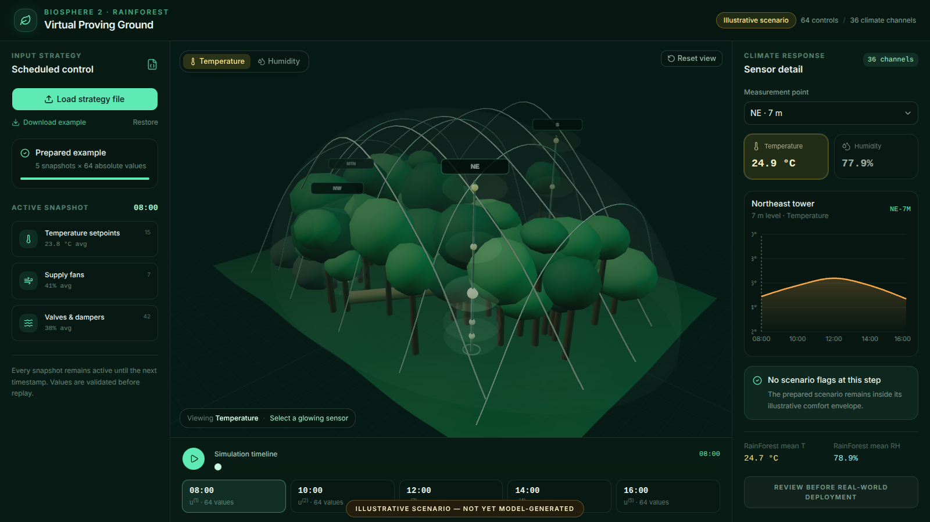
BIOSPHERE 2 / RAINFOREST
Virtual Proving Ground
for RainForest
Climate Strategies
Supporting climate research and student learning
64 scheduled controls
36 climate channels
Dimitri Bolt
Academic supervision: Dr. Ildar Gabitov
Notes:
Research groups already develop climate-control strategies for Biosphere 2. I propose a shared simulation environment. It gives those teams another way to test scenarios. It also makes the results easier to reproduce. Students could use the same environment. They could test a project, read the results, and improve the design. The platform accepts a scheduled strategy with 64 control values. It predicts the response in 36 RainForest climate channels. Each result shows climate, energy, uncertainty, and operating limits. Strategy authors keep ownership of their methods. Biosphere 2 operations keeps authority over field studies. I am asking for a focused, offline, sixteen-week Proof of Concept.

Slide 2
Shared evaluation of climate strategies
Additional scenario testing supports existing research and student projects
Strategies from
research groups
Shared simulation
scenarios
Results for
team discussion
Agreed inputs, documented assumptions, reproducible results
Additional scenario testing alongside each team's own analyses and evidence
RAINFOREST VIRTUAL PROVING GROUND
02
Notes:
This platform builds on climate-control research that is already underway. Research groups bring their own strategies and questions. Together with domain experts, they choose the scenarios. They choose the initial state, weather case, and performance measures. The simulator returns predicted trajectories and uncertainty. Teams discuss those results with their own models and evidence. The run record keeps the inputs and assumptions. That makes later comparisons easier to reproduce. Students use the same workflow for their projects. This is an extra tool for research and teaching. Each result applies only to the tested model and scenario. The model limits stay visible.

Slide 3
Forward models for scenario testing
Dynamics connect a 64-value action to the next 36-channel climate state
STATE
ACTION
CONTEXT
36 T/RH channels
64 control values
weather and
mode
Then evaluate climate deviation, energy use, equipment wear, and hard constraints
Each engine documents its assumptions and validation evidence
RAINFOREST VIRTUAL PROVING GROUND
03
Notes:
This is the forward-simulation step. X at time k is the measured climate state. U at time k is the 64-value control vector. W at time k is weather and other context. The engine uses those three inputs to estimate the next climate state. That is x at time k plus one. The formula calls this engine F theta. F theta could be a gray-box model, temporal machine learning, physics, or a hybrid. A research group could also contribute its own model. Every engine states its assumptions and validation evidence. For the same inputs, we compare trajectories, uncertainty, constraint flags, and diagnostics.

Slide 4
Support for planning field studies
Offline scenario testing complements operator-led review
26
about 20
Researchers and
operators plan
field studies together
air handlers support the facility
minutes before a sunny-day power loss could irreparably damage biomes
Facility context from Biosphere 2. The figures describe environmental support, not algorithm-specific risk.
RAINFOREST VIRTUAL PROVING GROUND
04
Notes:
Offline testing can help researchers and operators plan field studies together. Climate responses have delays. Equipment and outdoor conditions also interact. Simulation gives the group one more way to examine those effects. It can inform operating limits and monitoring plans. Biosphere 2 uses twenty-six air handlers. It reports that a sunny-day power loss can damage biomes in about twenty minutes. Those facts describe the facility. They do not judge any strategy or research group. Our testbed stays offline. Researchers and operators would review its trajectories and uncertainty with other evidence. A field study would still need separate authorization.
Sources:
https://biosphere2.org/about/about-biosphere-2

Slide 5
Virtual Proving Ground architecture
A shared workflow supports strategy authors and Biosphere 2 operations
Strategy
file
Validate and
set scenario
Forward
model
Evaluate
results
Operator
review
Versioned run record: submitted schedule, initial state, context, model, metrics, uncertainty, and flags
The platform tests externally created strategies. It does not generate or rewrite them.
RAINFOREST VIRTUAL PROVING GROUND
05
Notes:
This workflow has clear responsibilities. A student, researcher, or engineering team creates a strategy outside the platform. The strategy is a timestamped schedule of complete 64-value vectors. The platform checks units, bounds, timestamps, and missing values. It combines the schedule with an initial climate state and a scenario. The engine advances the 36-channel state through time. The evaluation layer reports climate error, energy, stability, constraints, and uncertainty. Authors and operators can inspect the result together. Strategy authors keep control of their methods. The platform does not generate or rewrite their submissions. The run record is versioned. Biosphere 2 operations retains authority over facility use.

Slide 6
Climate strategy contract
A strategy is a timestamped sequence of complete commands
timestamp
complete absolute control vector
08:00
15
setpoints
7
fans
10:00
42
valves and dampers
12:00
14:00
JSON or CSV / units / bounds / monotone timestamps / no missing controls
16:00
RAINFOREST VIRTUAL PROVING GROUND
06
Notes:
The strategy format is simple. At each timestamp, the file gives one complete vector of 64 absolute values. It includes fifteen temperature setpoints. It also includes seven fan commands and forty-two valve, damper, or related commands. Each value remains active until the next timestamp. Complete vectors remove ambiguity about inherited settings. They make every replay deterministic. The first version accepts JSON or CSV. Before simulation, the platform checks the schema, time order, units, ranges, and missing controls. This one format can hold output from PID, MPC, or reinforcement learning. We can compare algorithms without tying the platform to one method.

Slide 7

Illustrative interface demonstration
The current app demonstrates the evaluation workflow, not a validated prediction
Prototype demonstration
Open live demo
Illustrative scenario
not yet model-generated
RAINFOREST VIRTUAL PROVING GROUND
07
Notes:
This prototype shows how a submitted climate-control strategy can be explored visually. I will demonstrate loading a strategy, changing the timeline, switching between temperature and humidity, and selecting a measurement point. The numbers shown here are illustrative. The next slide provides a numbered guide to each part of the interface.
https://rainforest-virtual-proving-ground.bolt.linkpc.net/

Slide 8
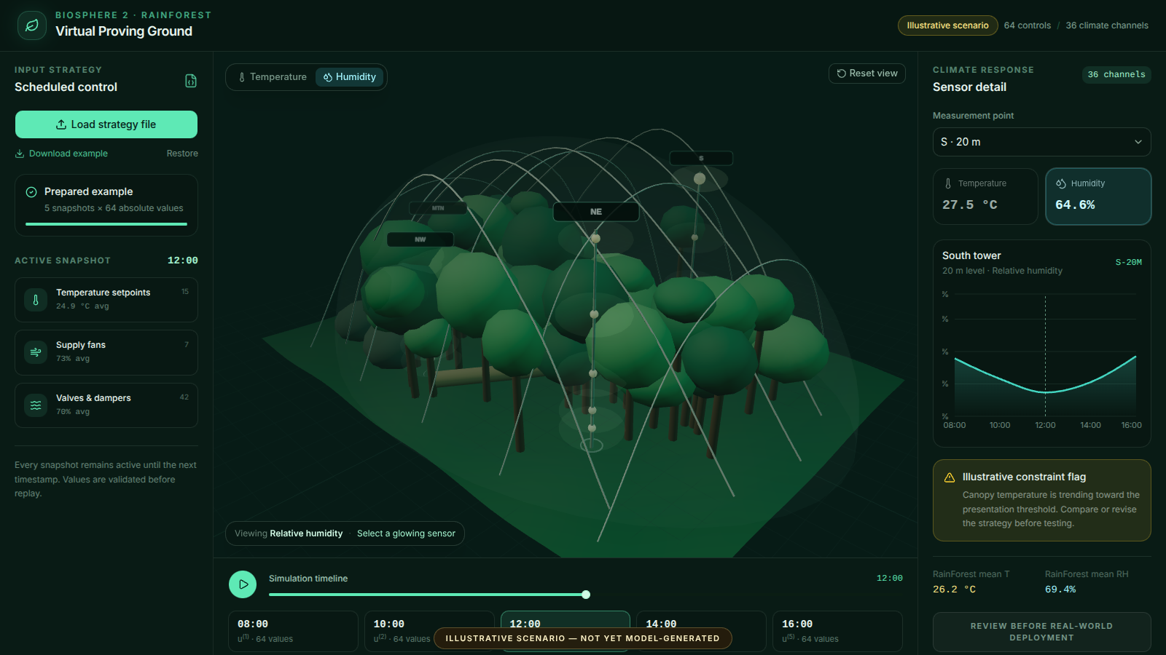
Prototype interface guide
Controls and sensor responses in the illustrative RainForest prototype
5
Temperature / Humidity
6
3D view and sensors
7
Reset view
Switch scene colors and chart
Rotate, zoom; click a point
Restore the camera angle
1
Load strategy
8
Sensor selector
Import JSON or CSV
Select tower + height
2
Example tools
9
Current T and RH
Download template;
restore example
Read T / RH values
Click to change metric
3
Loaded strategy
10
Sensor history
File / snapshot count
Green = loaded
Point history + cursor
Hover for values
4
Active controls
11
Scenario flag
Time and averages
15 setpoints, 7 fans
42 valves / dampers
Example warning
at the middle step
12
Mean T and RH
15
Prototype status
Average of 18 points
Illustrative values;
64 inputs, 36 channels
14
Simulation timeline
13
Review notice
Play / pause; move the slider or click a timestamp card to select a snapshot
Review before use
08
Notes:
Let me walk through the interface using the numbered callouts. The left panel describes the submitted controls, the center shows the RainForest and replay controls, and the right panel shows the selected sensor and scenario results.
1. Load strategy file
This button opens a JSON or CSV strategy file. Each timestamp contains a complete set of 64 absolute control values. The prototype checks the file structure and reports loading errors.
2. Download example and Restore
Download example saves a sample JSON file that shows the expected format. Restore reloads the prepared example, stops playback, and returns the timeline to its first step.
3. Loaded strategy
This panel identifies the loaded file or prepared example and gives the number of snapshots. Here, five snapshots each contain 64 values. The green bar indicates a loaded strategy; it does not show simulation progress.
4. Active snapshot and control groups
The timestamp identifies the control vector currently being displayed. The three cards summarize 15 temperature setpoints, 7 supply-fan commands, and 42 valve or damper commands. Each card shows the group count and average command value. These are input settings; the sensor readings appear on the right. Each snapshot remains active until the next scheduled timestamp.
5. Temperature and Humidity
These buttons choose which quantity colors the sensor points in the 3D view and appears in the time-series plot. The Viewing label below the scene repeats the selected quantity.
6. 3D view and sensor points
The schematic model shows the RainForest and four measurement towers: Mountain, Northeast, Northwest, and South. The 18 measurement points provide 36 channels because each point has both temperature and relative humidity. Drag to rotate the view and scroll to zoom. Click a glowing point to select it and update the detail panel. The point colors illustrate the selected quantity.
7. Reset view
This button returns the camera to its starting position. It changes the viewing angle without reloading the strategy or moving the timeline.
8. Measurement point
This menu selects a point by tower and height. For example, S at 20 meters means the 20-meter measurement point on the South tower. It controls the same selection as clicking a point in the 3D view.
9. Current temperature and humidity
These two cards show the selected point's temperature in degrees Celsius and relative humidity in percent at the active timestamp. Clicking either card also selects the quantity shown in the 3D view and chart.
10. Sensor time series
The graph shows the selected quantity for the selected point across the scenario timestamps. The dashed vertical line marks the active timestamp. Hovering over the curve reveals its time and value. The title identifies the tower, height, and sensor ID.
11. Scenario flag
This panel shows either an illustrative warning or a message that no scenario flag is present. In this prototype, the warning appears at the middle snapshot to demonstrate how a future warning could be presented. It is a prepared example, not the result of a validated threshold detector.
12. RainForest mean T and RH
These values are the arithmetic averages across the 18 displayed measurement points at the active timestamp. They give a quick overview alongside the selected point's readings. They are not volume-weighted averages of the entire biome.
13. Review before real-world deployment
This label reminds us that the results require review before any real-world use. It is an informational notice, not a button that applies the strategy to equipment.
14. Simulation timeline
Play and Pause advance or stop the scenario replay. The slider selects a saved snapshot, and the time label shows the active timestamp. The timestamp cards jump directly to a scheduled control vector. In this example, they cover 08:00 to 16:00 in five snapshots. Moving the timeline updates the active input summary, sensor values, scene colors, graph cursor, means, and example warning together.
15. Prototype status and system size
The Illustrative scenario labels explain that the displayed climate response is prepared for demonstration and is not yet generated by a validated predictive model. The header also summarizes the system size: 64 control inputs and 36 climate measurement channels.
https://rainforest-virtual-proving-ground.bolt.linkpc.net/

Slide 9
Human approval and operational boundaries
The first phase remains offline and advisory
Research environment
Biosphere 2 operations
Upload strategy
Review evidence
Simulate and score
Approve any future protocol
Preserve run record
NO WRITE PATH
Retain stop authority
A prediction supports a decision. It does not grant operational authority.
RAINFOREST VIRTUAL PROVING GROUND
09
Notes:
The Proof of Concept stays offline. It cannot write commands to Biosphere 2 equipment. Every strategy passes schema and bound checks before simulation. The system keeps the submitted file, model version, scenario, software version, and result. Another reviewer can then reproduce the run. A future field experiment needs a separate procedure. It needs a named operator, approved limits, rollback conditions, and explicit authorization. Model confidence does not grant operational authority. A prediction informs a decision. The people responsible for the facility still make that decision. The first milestone is evidence for review.

Slide 10
Pluggable simulation engine
A stable contract allows models to improve without rebuilding the platform
INPUT CONTRACT
initial state
64-control schedule
context and horizon
OUTPUT CONTRACT
36-channel trajectories
uncertainty and constraints
energy and diagnostics
SIMULATION
ENGINE
ADAPTER
Gray-box
Temporal ML
Physics
Hybrid
The same strategy and scenario can be compared across engines
RAINFOREST VIRTUAL PROVING GROUND
10
Notes:
A stable simulation contract lets research groups contribute different engines. Each engine receives the same inputs. Those are the initial 36-channel state, the 64-control schedule, context, and the simulation horizon. Each engine returns the same outputs. Those are predicted trajectories, uncertainty, constraint events, energy indicators, and diagnostics. One engine could be an LSTM trained on synchronized historical data. Another could be a state-space model with physical coefficients. An adapter could wrap EnergyPlus, Modelica, or a hybrid model. Teams can run one strategy through several engines. They can discuss the differences. Each model keeps its own assumptions, version, and attribution. The PoC evaluates candidates for its intended use.
Sources:
https://fmi-standard.org/docs/main/

Slide 11
Candidate forward-model families
The PoC should benchmark complementary approaches
GRAY-BOX
TEMPORAL ML
PHYSICS
HYBRID
Interpretable dynamics
Modest data need
May miss nonlinear coupling
Learns delays and nonlinear response
Fast repeated simulation
Needs coverage and OOD checks
Explicit HVAC and energy structure
Transparent assumptions
Calibration can be labor intensive
Physical constraints plus learned residual
Balances structure and fit
More integration complexity
simple and legible
flexible surrogate
component fidelity
candidate end state
Select the simplest engine that passes the agreed validation gates
RAINFOREST VIRTUAL PROVING GROUND
11
Notes:
The first benchmark can compare four model families. A gray-box state-space model has interpretable time constants. It can work with less data. It may miss complex nonlinear interactions. A temporal machine-learning model, such as an LSTM, can learn delays and nonlinear behavior. It needs synchronized controls, sensors, and context. It also needs careful out-of-distribution checks. A physics-based model in EnergyPlus or Modelica represents HVAC components and energy structure. Calibration for a unique biome can take substantial work. A hybrid model combines physical structure with learned residual behavior. The PoC does not assume one family will win. It sets test windows, error metrics, uncertainty checks, and computing requirements. Then it selects the simplest engine that meets the use case.
Sources:
https://energyplus.net/
https://simulationresearch.lbl.gov/modelica/

Slide 12
Established simulation foundations
The proposal applies mature testing patterns to a unique biome
1
2
3
4
BOPTEST
EnergyPlus +
Modelica
FMI / FMU
ASHRAE 140
controller API
and KPIs
dynamic HVAC
and buildings
portable model
interfaces
systematic model
testing
These references support the engineering pattern. They do not certify the present app or remove RainForest-specific calibration.
RAINFOREST VIRTUAL PROVING GROUND
12
Notes:
This proposal uses established simulation practice. BOPTEST shows how external control algorithms can use one test environment and receive standard performance measures. EnergyPlus and the Modelica Buildings Library support dynamic building and HVAC simulation. The Functional Mock-up Interface packages and exchanges simulation models. It also supports co-simulation. ASHRAE Standard 140 offers a systematic way to test building-energy simulation programs. These references support the engineering pattern. That pattern has a stable interface, versioned cases, repeatable metrics, and replaceable engines. They do not validate the current RainForest app. The RainForest still needs its own data preparation, calibration, and validation.
Sources:
https://ibpsa.github.io/project1-boptest/index.html
https://ibpsa.github.io/project1-boptest/docs-userguide/introduction.html
https://energyplus.net/
https://simulationresearch.lbl.gov/modelica/
https://fmi-standard.org/docs/main/
https://data.ashrae.org/standard140/

Slide 13
Student learning through simulation
Students test their projects and use the results to refine their designs
Student
project
Scenario
testing
Result
interpretation
Refined
project
Practice experimental design and interpret model uncertainty
Use faculty feedback and versioned runs to improve project designs
Explore PID, MPC, RL, and other methods in an offline learning environment
RAINFOREST VIRTUAL PROVING GROUND
13
Notes:
Student learning is a central purpose of this simulator. A student creates a climate-control project. The student tests it against documented scenarios. Then the student reads the trajectories. Faculty feedback helps explain why the result changes across conditions. The student can revise the design and test again. This gives practice in experimental design and uncertainty. It also connects mathematical methods to a real environmental system. The common strategy format supports PID, MPC, reinforcement learning, and other methods. Versioned runs help students explain and reproduce their findings. Student code stays offline and separate from facility equipment. The main outcome is stronger research and engineering skill.
Sources:
https://ibpsa.github.io/project1-boptest/index.html

Slide 14
Operational and economic value
Scenario comparisons support climate and energy research
Energy-cost-saving potential
requires calibrated evidence before a percentage or dollar claim
Protect required
climate conditions
Compare strategies
under the same scenario
Explore energy
and equipment use
Operational planning / focused field trials / grant evidence / reusable research benchmarks
RAINFOREST VIRTUAL PROVING GROUND
14
Notes:
The platform supports research on energy use and climate conditions. Teams compare schedules under agreed scenarios. They can view climate trajectories with fan demand, valve motion, and other equipment indicators. They can ask whether two strategies give similar climate results with different energy needs. These comparisons complement each team's existing analysis. They can also inform jointly planned field studies. Energy-cost savings are a possible benefit. The PoC must first calibrate energy relationships and validate them against measurements. I am not claiming a savings percentage or dollar amount today. Reproducible scenarios can still support research proposals, student projects, and grant applications. Each result keeps its assumptions and model limits.
Sources:
https://biosphere2.org/research/user-facility-information/energy-and-water

Slide 15
Sixteen-week Proof of Concept
The PoC ends with an evidence-based decision on Phase 2
01
02
03
04
WEEKS 1-4
WEEKS 5-8
WEEKS 9-12
WEEKS 13-16
Data synchronization
and constraints
Engine benchmark
and uncertainty
Module API, scenarios,
KPIs, and interface
Historical replay, review,
and acceptance
Exit package: offline testbed, validation report, limitations, and Phase 2 recommendation
RAINFOREST VIRTUAL PROVING GROUND
15
Notes:
The work has four stages. In weeks one through four, we align controls, climate channels, context, energy signals, timestamps, units, and limits. We also define training and holdout periods. In weeks five through eight, we build and compare at least two engine families. We measure forecast error and add uncertainty checks. In weeks nine through twelve, we build the module interface, scenarios, indicators, constraint logic, and review interface. In weeks thirteen through sixteen, we replay historical periods. We compare predictions with measurements. We conduct operator review and acceptance tests. The deliverable is an offline testbed, a validation report, documented limits, and a Phase 2 recommendation.

Slide 16
Decision requested
Approve a scoped offline PoC with operational access and review
Approve the 16-week offline Proof of Concept
Assign a Biosphere 2 operations liaison
Authorize synchronized control, climate, weather, energy, and constraint data
Live illustrative interface
Review acceptance evidence before any Phase 2 or field trial
Dimitri Bolt
Academic supervision: Dr. Ildar Gabitov
RAINFOREST VIRTUAL PROVING GROUND
16
Notes:
I ask for approval to build the sixteen-week offline Proof of Concept. The project needs a Biosphere 2 operations liaison. It also needs authorized access to synchronized control histories, climate measurements, context, energy signals, and operating limits. I would lead the implementation under Dr. Ildar Gabitov's academic supervision. Researchers and Biosphere 2 staff would help define scenarios. They would review assumptions and acceptance criteria. At the end, leadership receives the testbed, model benchmark, validation evidence, limits, and a Phase 2 recommendation. This request includes no equipment connection. The PoC supports existing climate-control research. It also gives students one shared place to test and improve their projects.

Slide 17
Our prototype and planned development
Our current interface is illustrative and our PoC includes engine validation
OUR CURRENT PROTOTYPE
OUR PLANNED POC WORK
64-control inventory
Synchronized causal dataset
36-channel measurement schema
Validated and versioned engine
Data-pipeline code
Uncertainty and unsupported-region checks
Timestamped strategy contract
Energy indicators and operating constraints
Working illustrative 3D interface
Historical replay and operator acceptance
No survey-grade CAD, E57 conversion, equipment write access, or autonomous control in this phase
APPENDIX
17
Notes:
This slide separates the current prototype from the proposed work. We already have a 64-control inventory and a 36-channel measurement schema. We also have data-pipeline code, a timestamped strategy format, and an illustrative 3D interface. The displayed trajectories do not come from a validated causal engine. The PoC must build synchronized training and validation data. It must select and calibrate an engine. It must quantify uncertainty, define energy indicators, and validate operating constraints. These are needs of our implementation. They do not assess another group's models or validation work. The schematic geometry is enough for this phase. Survey-grade CAD, E57 conversion, equipment write access, and autonomous operation are outside the scope.

Slide 18
Required data and validation gates
Our engine evaluation requires aligned histories and protected holdout periods
REQUIRED EVIDENCE
ACCEPTANCE CHECKS
Commands + actual actuator states
Chronological holdout periods
T/RH + quality flags
Error by channel and horizon
VALIDATION
GATE
Weather + operating modes
Constraint-event detection
Energy or equipment power
Uncertainty calibration
Maintenance and schedule events
Reject unsupported scenarios
Data alignment is the first technical risk
APPENDIX
18
Notes:
Data alignment is our first technical risk. We need command histories. Where possible, we also need actual actuator states. We need temperature and humidity data with quality flags. We need weather, schedules, maintenance events, and operating modes. Those factors can explain apparent dynamics. We also need energy or equipment-power indicators before we discuss savings. The evaluation keeps chronological holdout periods. It includes seasonal and unusual conditions. Acceptance checks error by channel and horizon. It checks constraint events and uncertainty calibration. It also tests missing data. The engine must reject unsupported scenarios instead of giving false confidence.

Slide 19
Q&A: accuracy and observability
Prediction quality must be reported by use case, horizon, and operating region
01
How accurate must the simulator be?
Use-case thresholds. Report error by channel, horizon, season, and operating region.
02
What if sensors are missing or unreliable?
Flag degraded operation. Reject the run or widen uncertainty when evidence is insufficient.
03
How will causal response be validated?
Align controls, actuator states, context, and protected chronological holdout periods.
Full answers appear in the speaker notes and companion script
APPENDIX
19
Notes:
Use the prepared answers for questions one through three. Do not give one global accuracy number. The threshold depends on the horizon, channel, and decision. Missing data needs clear quality flags and a degraded mode. Causal claims need aligned controls, context, and historical interventions. Field tests come only after offline validation and governance.
Prepared Q&A answers:
1. How accurate must the simulator be before it is useful?
The threshold depends on the decision. A model may help rank strategies before it is accurate enough for a field trial. The PoC will report error by channel, horizon, season, and operating region. It will also show when uncertainty grows outside the training data. Biosphere 2 operations should approve the threshold for each use case.
2. What happens when sensors are missing or unreliable?
The platform keeps quality flags and identifies missing channels. It uses only documented imputation or state-estimation methods. The result shows when the engine runs in a degraded mode. If key information is missing, the simulator rejects the run or widens uncertainty. It does not fill the gap silently.
3. How will you prove that controls caused the predicted climate response?
Historical correlation alone does not prove causality. The PoC aligns command histories, actuator states, sensor data, weather, schedules, and operating modes. It tests models on untouched chronological periods. It also examines documented interventions. Any later field-identification experiment needs a separate operator-approved protocol, safe bounds, and rollback conditions.

Slide 20
Q&A: safety and operational authority
Simulation evidence supports operators and does not bypass them
04
Could the simulator damage equipment?
No. The PoC has no write path to equipment.
05
Who authorizes a field trial?
Biosphere 2 operations retains authority for every field trial.
06
How is cybersecurity handled?
Use offline copies, least privilege, versioning, and network separation.
Full answers appear in the speaker notes and companion script
APPENDIX
20
Notes:
Use the prepared answers for questions four through six. The PoC has no write path to equipment. Biosphere 2 operations authorizes any future field trial. Security begins with offline data, limited access, versioned artifacts, and separation from operational controls.
Prepared Q&A answers:
4. Could this system damage equipment or the biome?
The proposed PoC cannot write to facility equipment. It is an offline testbed. It checks the file structure and control bounds. Then it returns predicted consequences for review. Any equipment connection needs a separate project, safety case, procedure, cybersecurity review, named authority, and tested rollback path.
5. Who decides whether a strategy can be tested in the real facility?
Biosphere 2 operations retains that authority. Model developers can provide evidence and recommendations. Model confidence does not authorize deployment. Every field trial needs an approved scope, operator, time window, limits, monitoring plan, and stop conditions.
6. How will cybersecurity and access control be handled?
The first phase uses offline copies of authorized data. It has no operational write path. Access follows least privilege. Strategy files, models, scenarios, and results are versioned. Research services stay separate from building-control networks. Any later integration needs review by the University and Biosphere 2 security teams.

Slide 21
Q&A: model and platform choices
The contract stays stable while evidence determines the engine
07
Why not use EnergyPlus alone?
EnergyPlus still needs RainForest-specific representation, calibration, and validation.
08
Why consider an LSTM?
An LSTM can learn delayed nonlinear behavior, but it must pass coverage and uncertainty checks.
09
How can a new engine be added?
A common input/output contract and adapters isolate every engine.
Full answers appear in the speaker notes and companion script
APPENDIX
21
Notes:
Use the prepared answers for questions seven through nine. EnergyPlus is a strong foundation. It still needs a RainForest representation, calibration, and validation. LSTM is a candidate for delayed nonlinear behavior. It is not a predetermined winner. A common engine contract, with FMI or FMU adapters, lets the platform compare and replace models while keeping the strategy workflow.
Prepared Q&A answers:
7. Why not use EnergyPlus as the entire solution?
EnergyPlus is a mature engine for building and HVAC simulation. The RainForest is an unusual, highly coupled biome. A useful model still needs geometry, system representation, parameter calibration, and validation with facility data. The PoC treats EnergyPlus as one candidate or component. It compares it with lower-order and data-driven alternatives.
8. Why are you considering an LSTM?
An LSTM can represent nonlinear time relationships and delayed responses in long sensor histories. It may be useful for repeated strategy evaluation. It also has limits. It needs synchronized causal inputs. It can fail outside its training region. It is harder to interpret. The PoC benchmarks it. It does not assume that LSTM is the answer.
9. How can a new mathematical engine be added later?
Every engine uses the same input and output contract. It receives an initial state, a 64-control schedule, context, and a horizon. It returns 36-channel trajectories, uncertainty, constraints, energy indicators, and diagnostics. An adapter can wrap a state-space model, a machine-learning service, EnergyPlus, Modelica, or an FMI-compatible model.
Sources:
https://energyplus.net/
https://fmi-standard.org/docs/main/

Slide 22
Q&A: value and schedule
The PoC measures whether a larger investment is justified
10
How will energy savings be proven?
Calibrate energy indicators, then validate them against an approved operational baseline.
11
What resources does the PoC require?
Authorized data, an operations liaison, implementation time, and ordinary compute.
12
Why sixteen weeks?
Four stages cover data, models, platform integration, and operator-reviewed validation.
Full answers appear in the speaker notes and companion script
APPENDIX
22
Notes:
Use the prepared answers for questions ten through twelve. Savings need a calibrated energy baseline and a controlled comparison. We do not promise a percentage today. The request is for access to data and operating knowledge, focused implementation time, and ordinary computing. Sixteen weeks gives time to align data, benchmark models, build the testbed, and complete operator-reviewed validation.
Prepared Q&A answers:
10. How will you prove energy savings?
The PoC first defines energy indicators. It calibrates them with available equipment or facility energy data. Then it compares strategies under identical scenarios. A real savings claim needs an approved baseline and controlled operational validation. That validation must account for weather and operating differences. No percentage or dollar figure comes before that evidence.
11. What resources does the Proof of Concept require?
The essential resources are authorized access to synchronized control, sensor, weather, operating-context, and energy data. We also need regular time with an operations liaison, implementation effort, and ordinary computing. The first four weeks show whether we need extra instruments or specialized software.
12. Why is the schedule sixteen weeks?
The sixteen-week schedule has four stages. They are data alignment, model benchmarking, platform integration, and historical replay with operator review. It gives us time to assess our engine and its limits. It also documents the scenarios and prepares a shared testbed. The scope ends with a clear Phase 2 decision.
Sources:
https://biosphere2.org/research/user-facility-information/energy-and-water

Slide 23
Q&A: students, publications, and governance
Participation expands only after benchmark and review rules are stable
13
How is student code isolated?
Student code runs offline in isolated environments, never on the operational network.
14
How are publications, data rights, and IP governed?
Written University and Biosphere 2 rules govern data, review, authorship, and IP.
15
Who owns and maintains the platform?
Phase 2 needs an operational owner, technical maintainer, and release process.
Full answers appear in the speaker notes and companion script
APPENDIX
23
Notes:
Use the prepared answers for questions thirteen through fifteen. Student algorithms run outside the operational network. They use versioned benchmark scenarios. Written University and Biosphere 2 rules govern data, publication review, authorship, and intellectual property. The PoC ends with a governance recommendation. It identifies an operational owner, a technical maintainer, release criteria, and a review process for models and scenarios.
Prepared Q&A answers:
13. How will you prevent student code from creating operational risk?
Students work with offline benchmark scenarios and a documented strategy interface. Their code does not connect to facility equipment. Submissions can run in isolated containers with resource limits. The platform checks outputs and keeps a complete run record. Only Biosphere 2 operations can authorize any later field evaluation.
14. How will publications, data rights, and intellectual property be managed?
The program should set written rules before external participation. The rules should say which datasets can be shared. They should protect sensitive operating information. They should define review before publication. They should also follow University and Biosphere 2 policy on authorship and intellectual property. Reproducible results make these decisions easier to audit.
15. Who owns and maintains the platform after the PoC?
The PoC ends with a governance recommendation. It does not assume an owner. A sustainable arrangement needs a Biosphere 2 operational owner and a named technical maintainer. It also needs release criteria for models and scenarios, a review calendar, and a process for incidents and outdated engines. Leadership can decide where that structure belongs.

Slide 24
References and live demonstration
Authoritative foundations and project resources
Biosphere 2
Modelica Buildings Library
biosphere2.org/about/about-biosphere-2
simulationresearch.lbl.gov/modelica
Biosphere 2 energy and water
Functional Mock-up Interface
biosphere2.org/research/user-facility-information/energy-and-water
fmi-standard.org
BOPTEST
ASHRAE Standard 140
ibpsa.github.io/project1-boptest
data.ashrae.org/standard140
LIVE ILLUSTRATIVE DEMO
EnergyPlus
rainforest-virtual-proving-ground
.bolt.linkpc.net
energyplus.net
Project sources: DigitalTwin control and sensor inventories, data-pipeline code, and current interface source
APPENDIX
24
Notes:
This slide lists the presentation sources. It also includes a QR code for the live illustrative interface. The external references support the facility context and the simulation architecture. Project counts and workflow details come from the DigitalTwin inventories and the current application source. The live app remains illustrative until a validated model produces the trajectories.
Sources:
https://biosphere2.org/about/about-biosphere-2
https://biosphere2.org/research/user-facility-information/energy-and-water
https://ibpsa.github.io/project1-boptest/index.html
https://ibpsa.github.io/project1-boptest/docs-userguide/introduction.html
https://energyplus.net/
https://simulationresearch.lbl.gov/modelica/
https://fmi-standard.org/docs/main/
https://data.ashrae.org/standard140/
https://rainforest-virtual-proving-ground.bolt.linkpc.net/

