Slide 1
Beginning with CSC services

Slide 2
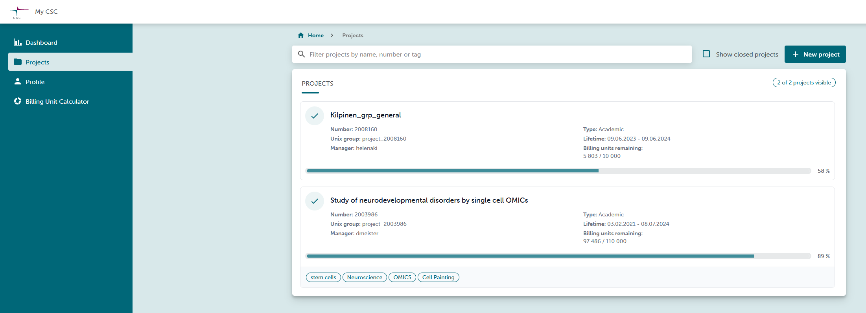
My CSC
Registration to https://my.csc.fi/ → Haka → Helsingin Yliopisto
In (personal) Profile:
Change password to get a CSC password for logging in to Puhti
Configure SSH key (but I don’t know why it doesn’t work anymore)
In Projects: verify that Puhti and allas services are activated

Slide 3
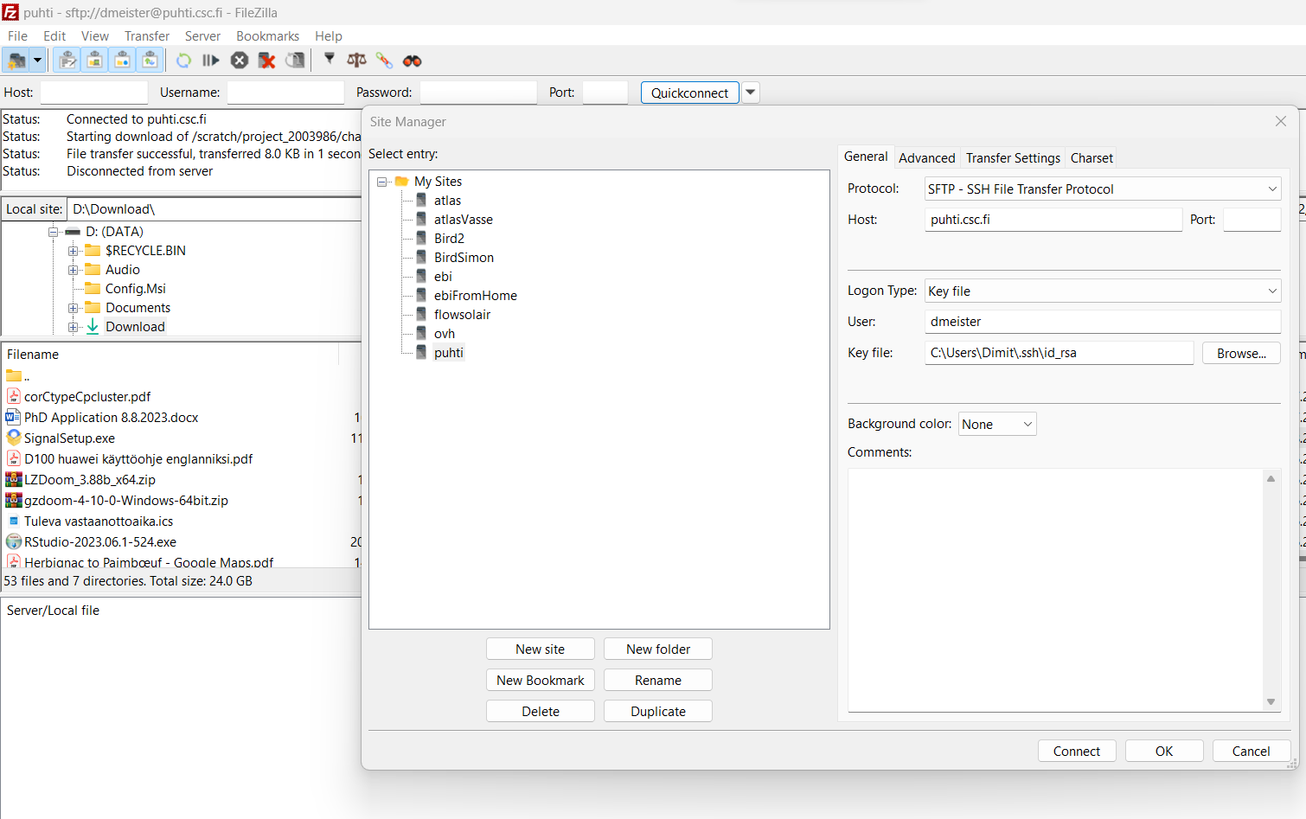
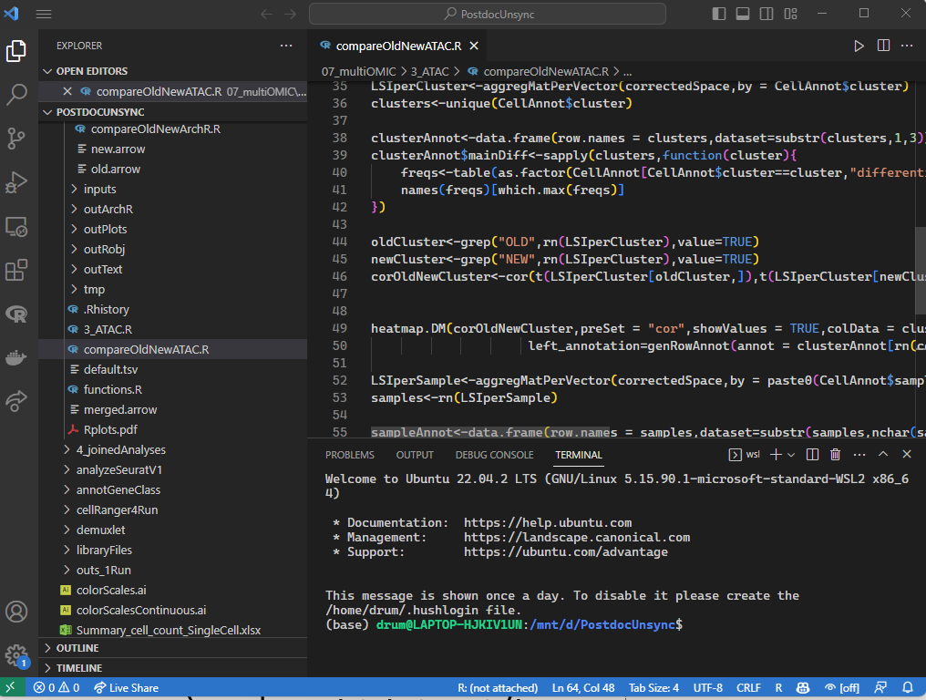
Puhti: introduction
Puhti is a limux computing cluster accessible via SSH (remote terminal) and SFTP (file transfer).
Access via SSH on a terminal:
ssh cscusername@puhti.csc.fi
Change ~/.ssh/config locally to just type ssh puhti
For connection via windows terminal, conce ssh config file set: settings/new profile/ command line:
ssh puhti
Access via SFTP:
Filezilla
With visual studio code (Desktop):
Install remote-ssh extension → click on double arrow → connect to host → puhti
By default, you arrive on a “login node”, the computer that interpret your commands is basic. For launching heavy computational task, Puhti is using a software: SLURM (Simple Linux Utility for Resource Management), which is a job scheduler. Equivalent of SGE on atlas. Launching a job on slurm is the only way to access to a “compute-node”

Slide 4
SLURM on Puhti
--partition=small
--partition=small
https://docs.csc.fi/computing/running/batch-job-partitions/
https://docs.csc.fi/computing/running/creating-job-scripts-puhti/
Two way of launching a job:
Interactive mode (I have directly a terminal on a compute-node), example:
sinteractive --partition==interactive --account project_2003986 --cores 8 --time 7-00:00:00 --mem 76000 --tmp 720
partition (set of parameter for SLURM, equivalent of queue for SGE). For interactive session, only test, small and interactive partition are available
“Normal mode”, as a script you launch.
Example: create a script name launchRscript.sh which contains
#!/bin/bash
#SBATCH --job-name=rscript
#SBATCH --account=project_2003986
#SBATCH --ntasks=1
#SBATCH --nodes=1
#SBATCH --cpus-per-task=16
#SBATCH --mem=96g
#SBATCH --time=04:00:00
#SBATCH --partition=small
source activate renv
Rscript $1
Then add execution rights to the script with chmod +x launchRscript.sh
Finally: ./launchRscript.sh myScript.R
Puhti.csc.fi for launching job on web browser! Super useful for launching Rstudio server, Jupyter or visual studio code on computation node!

Slide 5
Puhti Set-up
In ~/.bashrc (file read each time a terminal is launched), I add those lines:
if [ -f ~/.bash_aliases ]; then
source ~/.bash_aliases
fi
if [ -f ~/.bash_export ]; then
source ~/.bash_export
fi
To read files named bash_aliases for aliases and bash_export for modifying env variables each time terminal is launched.
Content of my bash_aliases:
alias ll='ls -alF'
alias la='ls -A'
alias l='ls -CF'
alias untar.gz='tar xvzf'
alias untar.bz2='tar xfvj'
alias untar='untar.gz'
alias filec='ls | wc -l'
alias sint='sinteractive --account project_2003986 --cores 8 --time 7-00:00:00 --mem 76000 --tmp 720'
alias sq='squeue -u dmeister'
alias qwatch='watch -n3 squeue -u dmeister’
Content of my bash_export:
export PATH=$PATH:$HOME/bin → script that I put in ~/bin will be accessible from everywhere
Create symbolic link in ~/. to project scratch and appl folders
ln -s /scratch/project_2008160 kpGeneralScratch
ln -s /projappl/project_2008160 kpGeneralAppl

Slide 6
Managing environments/install softwares
If tool already installed: module load toolname
Tykky for containerize conda environments with apptainer
Create yml file using anaconda.org
name: renv
channels:
- bioconda
- conda-forge
- defaults
dependencies:
- r-devtools
- r-base
- python
- trimap
- numpy
- leidenalg
- imagemagick
- geos
- cairo
- firefox
- r-xml
- r-httpgd
- r-languageserverp
Put activate and createEnv scripts in ~/bin and modify it to change install folder
createEnv renv.yml
source activate renv

Slide 7
Allas quick intro
Initialization:
Puhti: module load allas
Atlas (FIMM cluster): install via github
source allas_conf -k -p project_2008160 #kp proj
a-put myFile -c -b bucketName -o nameInBucket
a-put day20 -t $TMPDIR -c -b cellPainting2022

