Slide 1
Creating Applications and Activities

Slide 2
Inhoud
Onderdelen van een Android app
Activity
Manifest
Layout
Java class
Eventhandling
Intent
Application life cycle
Saving en restoring state

Slide 3
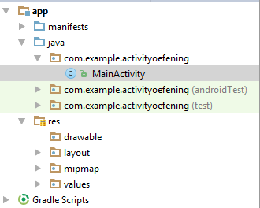
Onderdelen van een android applicatie
App
Manifests
AndroidManifest.xml: beschrijft de kenmerken van de app en definieert zijn componenten, zoals activities
java : De java source code files van het project. Bvb MainActivity.java source file, de activiteit die gestart wordt bij lanceren van de app
res : resources
res/drawable: Image files zoals .png, .jpg, .gif of XML gecompileerd worden naar bitmaps, state lists, shapes, animation drawable. In de code : R.drawable
res/layout:XML files voor definitie UI. In de code: R.layout
res/mipmap: app launcher icons
res/values : xml files die eenvoudige resources bevatten zoals strings, colors,…
Gradle Scripts
Build.gradle: auto-generated file die compileSdkVersion, buildToolsVersion, applicationId, minSdkVersion, targetSdkVersion, versionCode en versionName bevat
Notes:
values/
XML files that contain simple values, such as strings, integers, and colors. For example, here are some filename conventions for resources you can create in this directory −
arrays.xml for resource arrays, and accessed from the R.array class.
integers.xml for resource integers, and accessed from the R.integer class.
bools.xml for resource boolean, and accessed from the R.bool class.
colors.xml for color values, and accessed from the R.colorclass.
dimens.xml for dimension values, and accessed from the R.dimen class.
strings.xml for string values, and accessed from the R.string class.
styles.xml for styles, and accessed from the R.style class.

Slide 4
Onderdelen van een android applicatie
AndroidManifest: definieert structuur en metadata app
<manifest>: root element
package attribuut : de Java packagenaam
xml namespace android voor gebruik van de attributen in tal van de elementen
<uses-permission>: permissions zoals internet, camera,…
<application>: application meta data en zijn componenten
Attributen voor app meta data, bvb android-icon. Bij de waarden worden de notaties @string en @drawable gebruikt. Verwijzen naar bronnen in de map res . Dit wordt gebruikt door de XML Parser.
<activity> : Elke activity wordt vermeld in de manifest.
Maar ook Services, Content Providers en BroadcastReceivers (zie later) worden in manifest vermeld
Notes:
Whatever component you develop as a part of your application, you must declare all its components in a manifest.xml which resides at the root of the application project directory. This file works as an interface between Android OS and your application, so if you do not declare your component in this file, then it will not be considered by the OS. For example, a default manifest file will look like as following file −
Here <application>...</application> tags enclosed the components related to the application. Attribute android:icon will point to the application icon available under res/drawable-hdpi. The application uses the image named ic_launcher.png located in the drawable folders
The <activity> tag is used to specify an activity and android:name attribute specifies the fully qualified class name of the Activity subclass and the android:label attributes specifies a string to use as the label for the activity. You can specify multiple activities using <activity> tags.
The action for the intent filter is named android.intent.action.MAIN to indicate that this activity serves as the entry point for the application. The categoryfor the intent-filter is named android.intent.category.LAUNCHER to indicate that the application can be launched from the device's launcher icon.
The @string refers to the strings.xml file explained below. Hence, @string/app_name refers to the app_name string defined in the strings.xml file, which is "HelloWorld". Similar way, other strings get populated in the application.
To advertise which implicit intents your app can receive, declare one or more intent filters for each of your app components with an <intent-filter>element in your manifest file. Each intent filter specifies the type of intents it accepts based on the intent's action, data, and category. The system delivers an implicit intent to your app component only if the intent can pass through one of your intent filters.
Note: An explicit intent is always delivered to its target, regardless of any intent filters the component declares.
An app component should declare separate filters for each unique job it can do. For example, one activity in an image gallery app may have two filters: one filter to view an image, and another filter to edit an image. When the activity starts, it inspects the Intent and decides how to behave based on the information in the Intent (such as to show the editor controls or not).
Each intent filter is defined by an <intent-filter> element in the app's manifest file, nested in the corresponding app component (such as an <activity> element). Inside the <intent-filter>, you can specify the type of intents to accept using one or more of these three elements:
There are two types of intents:
Explicit intents specify the component to start by name (the fully-qualified class name). You'll typically use an explicit intent to start a component in your own app, because you know the class name of the activity or service you want to start. For example, you can start a new activity in response to a user action or start a service to download a file in the background.
Implicit intents do not name a specific component, but instead declare a general action to perform, which allows a component from another app to handle it. For example, if you want to show the user a location on a map, you can use an implicit intent to request that another capable app show a specified location on a map.

Slide 5
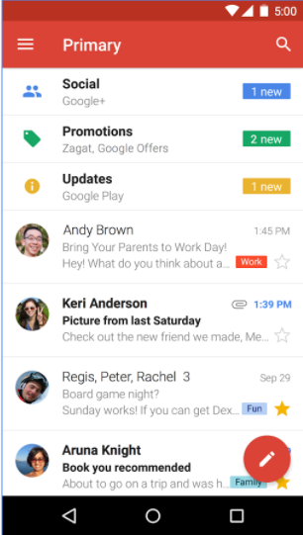
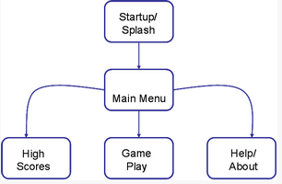
Activity
Bouwstenen van een app
Vaak komt dit overeen met een scherm
Een app bestaat in het algemeen uit meerdere activities
Notes:
De pijlen geven aan dat de control wordt overgegeven van de ene aan de andere activity. Bij dat overgeven van de control kunnen data worden meegegeven. Het overgeven van de control gebeurt met behulp van intents (die we apart zullen bespreken).
Er is op elk moment slechts één activity actief. "Vorige" activities blijven nog wel in het geheugen, zolang er voldoende geheugen is. Er ontstaat daardoor een zogenaamde activity stack:
If to compare with Windows, the application consists of windows, which are called Activities. Usually, only one Activity is displayed at a time and it occupies the whole screen. And application switches between Activities. We can explore mail app as an example. One Activity displays a list of messages, the second one - displays a specific message and the third one - mailbox settings. While working with mail you switch between these Activities.

Slide 6
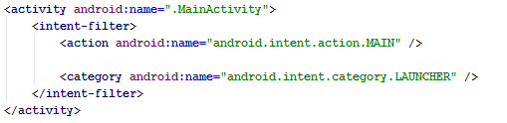
Activity
Een activity. Bvb Main_Activity
java/packagefolder/MainActivity.java : gedrag
res/layout/activity_main.xml : presentatie
Entry in AndroidManifest.xml
<activity>: Een activity moet voorkomen in de manifest anders kan deze niet gestart worden!
Attribuut name: de classname
Voor de activiteit die als hoofdactviteit van deze applicatie kan gestart worden voorzie je een <intent-filter> (di een impliciete intent, zie later). Als je dit niet vastlegt, kan de applicatie niet gestart worden.
Name: android.intent.action.MAIN: dit geeft aan dat de applicatie via deze activiteit kan gestart worden.
Category: bijkomende informatie over het type van de component die deze intent moet verwerken
CATEGORY_LAUNCHER: plaatst de applicatie in de LAUNCHER category. Hierdoor wordt de applicatie opgenomen in de lijst van applicaties die kunnen gestart worden.
Notes:
<intent-filter> voor impliciete intents, voor de activity die gestart dient te worden bij lanceren app :

Slide 7
Activity – layout file
Layout file in res/layout folder = de UI, het zichtbare deel van een activity
Scheiding van presentatie en gedrag
Meerdere xml layouts mogelijk rekening houdend met de verschillende screen sizes, talen,…
De structuur van de UI is duidelijker in XML (tree-based)
Elementen in XML => zijn ook klassen die met de Android API meegeleverd worden.
Attribute name => komt vaak overeen met method van de klasse, maar bvb Text attribute, get/setText methode
Notes:
The advantage to declaring your UI in XML is that it enables you to better separate the presentation of your application from the code that controls its behavior. Your UI descriptions are external to your application code, which means that you can modify or adapt it without having to modify your source code and recompile. For example, you can create XML layouts for different screen orientations, different device screen sizes, and different languages. Additionally, declaring the layout in XML makes it easier to visualize the structure of your UI, so it's easier to debug problems. As such, this document focuses on teaching you how to declare your layout in XML. If you're interested in instantiating View objects at runtime, refer to the ViewGroup and View class references.

Slide 8
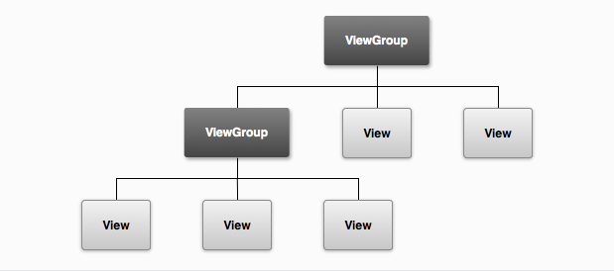
Activity – layout file
Opbouw
De layoutbeschrijving is een boomstructuur van views die vastleggen wat er in een activity wordt weergegeven.
ViewGroup: niet zichtbaar, voor organisatie van andere elementen. Vb ConstraintLayout,…
View: drawing content op het scherm. Vb TextView, Button,…
Notes:
The advantage to declaring your UI in XML is that it enables you to better separate the presentation of your application from the code that controls its behavior. Your UI descriptions are external to your application code, which means that you can modify or adapt it without having to modify your source code and recompile. For example, you can create XML layouts for different screen orientations, different device screen sizes, and different languages. Additionally, declaring the layout in XML makes it easier to visualize the structure of your UI, so it's easier to debug problems. As such, this document focuses on teaching you how to declare your layout in XML. If you're interested in instantiating View objects at runtime, refer to the ViewGroup and View class references.

Slide 9
Activity – layout file
View(Group)
Attributen
Sommigen specifiek aan een View(Group), anderen worden geërfd van View class
android:id: unieke id van View(Group) binnen de tree. Als de app gecompileerd wordt dan wordt ernaar verwezen adhv een int, maar in de xml file geef je een string op
@ : begin van een string die de XML parser moet parsen
+id: nieuwe resource name die moet worden toegevoegd aan R.java. Bij verwijzing naar een resource gebruik je +-teken niet!
android:text : @string : refereert naar string in res/values/string.xml (zie verder)
Notes:
The at-symbol (@) at the beginning of the string indicates that the XML parser should parse and expand the rest of the ID string and identify it as an ID resource. The plus-symbol (+) means that this is a new resource name that must be created and added to our resources (in the R.java file). There are a number of other ID resources that are offered by the Android framework. When referencing an Android resource ID, you do not need the plus-symbol, but must add the android package namespace, like so:
Dp : an abstract unit that is based on the physical density of the screen. These units are relative to a 160 dpi screen, so one dp is one pixel on a 160 dpi screen. The ratio of dp-to-pixel will change with the screen density, but not necessarily in direct proportion.
Scale-independent Pixels - this is like the dp unit, but it is also scaled by the user's font size preference. It is recommended you use this unit when specifying font sizes, so they will be adjusted for both the screen density and user's preference.
R.Java kan je vinden in de gen folder

Slide 10
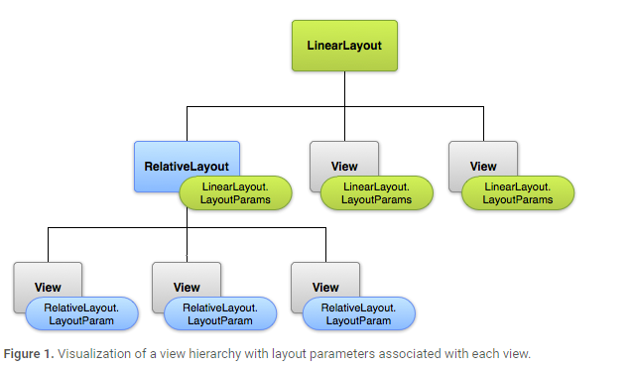
Activity – layout file
View(Group)
Attributen
Elke ViewGroup implementeert een inner klasse LayoutParams, met als base class ViewGroup.LayoutParams. LayoutParams bevat attributen voor het definieren van de grootte en positie van elke View(Group) binnen de betreffende ViewGroup.
Gebruik geen absolute waarden. Blijf onafhankelijk van schermgrootte en schermresolutie
Notes:
Note that every LayoutParams subclass has its own syntax for setting values. Each child element must define LayoutParams that are appropriate for its parent, though it may also define different LayoutParams for its own children.
All view groups include a width and height (layout_width and layout_height), and each view is required to define them. Many LayoutParams also include optional margins and borders.
You can specify width and height with exact measurements, though you probably won't want to do this often. More often, you will use one of these constants to set the width or height:
wrap_content tells your view to size itself to the dimensions required by its content.
match_parent tells your view to become as big as its parent view group will allow.
In general, specifying a layout width and height using absolute units such as pixels is not recommended. Instead, using relative measurements such as density-independent pixel units (dp), wrap_content, or match_parent, is a better approach, because it helps ensure that your application will display properly across a variety of device screen sizes. The accepted measurement types are defined in the Available Resources document.
Layout Position

Slide 11
Activity – layout file
View(Group)
Attributen
Layout parameters binnen een View(Group) zijn afhankelijk van de ViewGroup waarbinnen View(Group) valt.
De baseclass ViewGroup.LayoutParams definieert 2 attributen
layout-width: wrap-content, match-parent (bij ConstraintLayout : 0dp)
layout-height : idem
Elke viewgroup kan dan nog zijn eigen parameters definieren
layout_margin: witruimte
layout_gravity: allignering
layout-weight : gewicht (2 knoppen, 1 neemt 1/3 en 2de neemt 2/3 ruimte in, resp weight=1, en 2)
dp : density independant pixel, toont op alle resoluties even groot. Android doet de mapping. 1dp is 1 pixel op 160dpi screen.
sp: scale-independant pixels, gebruikt voor fonts
Notes:
http://startandroid.ru/en/lessons/208-lesson-7-layout-parameters-for-view-elements.html !!!

Slide 12

Activity – java class
Java class bevat de logica
Laden van de resource
Bij compilatie wordt elke XML Layout file gecompileerd in a View resource
setContentView in onCreate method laadt de resource. Het bevat een verwijzing naar de resource R.layout.layout_file_name
Notes:
The advantage to declaring your UI in XML is that it enables you to better separate the presentation of your application from the code that controls its behavior. Your UI descriptions are external to your application code, which means that you can modify or adapt it without having to modify your source code and recompile. For example, you can create XML layouts for different screen orientations, different device screen sizes, and different languages. Additionally, declaring the layout in XML makes it easier to visualize the structure of your UI, so it's easier to debug problems. As such, this document focuses on teaching you how to declare your layout in XML. If you're interested in instantiating View objects at runtime, refer to the ViewGroup and View class references.

Slide 13

Activity – java class
Toegang tot een resource in de java code
Voorbeeld 1
Voorbeeld 2
In res/values/strings.xml
Toegang tot een resource in XML
Notes:
The advantage to declaring your UI in XML is that it enables you to better separate the presentation of your application from the code that controls its behavior. Your UI descriptions are external to your application code, which means that you can modify or adapt it without having to modify your source code and recompile. For example, you can create XML layouts for different screen orientations, different device screen sizes, and different languages. Additionally, declaring the layout in XML makes it easier to visualize the structure of your UI, so it's easier to debug problems. As such, this document focuses on teaching you how to declare your layout in XML. If you're interested in instantiating View objects at runtime, refer to the ViewGroup and View class references.

Slide 14
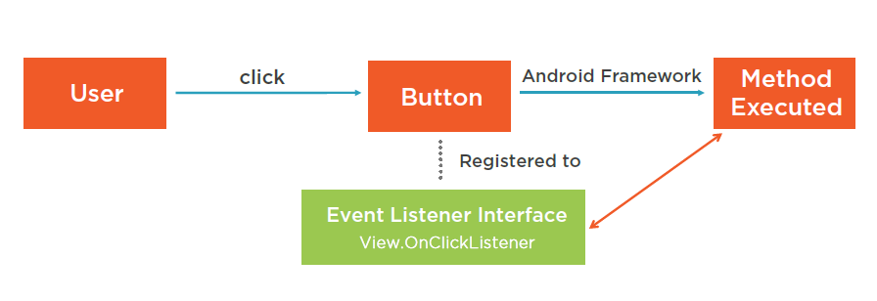
Activity - Eventhandling
Verschillende manieren om dit af te handelen
Via de XML layout
Instellen van de OnClickListener per View instance
Activity als een listener, implementeert OnClickListener interface (indien meerdere buttons)
Notes:
A button cannot process clicks on its own, it needs a listener for this, which is assigned using setOnClickListener method. When a button is clicked, listener reacts and runs the code from onClick method. It can be displayed like this:
one listener-object for both buttons, but on previous lesson - we had two listener objects, one for each button. There is a rule - the less objects you create the better, as memory is allocated for each object and it is a quite limited resource, especially for mobile devices. That’s why creating one listener for several Views is better from the optimization point of view. Also the amount of code is reduced and it becomes more readable.
MainActivity implements OnClickListener
public void onClick(View v) {
// define the button that invoked the listener by id
switch (v.getId()) {
case R.id.btnOk:
// ОК button
tvOut.setText("OK button was clicked");
break;
case R.id.btnCancel:
// Cancel button
tvOut.setText("Cancel button was clicked");
break;
}
}
btnOk.setOnClickListener(this);
btnCancel.setOnClickListener(this);

Slide 15
Activity - Eventhandling
Instellen van de OnClickListener per View instance
Eventhandling maakt gebruik van nested, anonymous klassen
Inner class : class gedefinieerd binnen een andere class
Bevat een referentie naar de class waarbinnen deze is gedefinieerd
Kan de methodes van de outer class aanroepen
Anonymous classes vereenvoudigen het gebruik van inner classes voor eventhandling
Eenvoudige manier om een interface te implementeren. declaratie en tegelijk instantiatie
Een anonymous class heeft toegang tot de members van zijn outer class.
Maar anonymous class heeft geen toegang tot locale variabelen van de outer class die niet final zijn.
Notes:
Java handles callbacks with single methods interfaces. Er zijn 2 belangrijke concepten nested classes en anonymous classes.
Nested class= class declared within another class
Anonymous class = class without a name
Nested class is class declared inside another class. A nested class gets a reference to their containing object and has access to things inside of it. Java callback werkt nu als volgt
Als de nested class nu een interface implementeert, een interface met 1 methode en ik wil dit doorgeven aan een ander object dan kan je een interface reference doorgeven aan een ander object. En dan kan de callback gebeuren via de implementatie van de interface. Zo kan het methodes van een ander object aanroepen. Door anonieme klassen kunnen we new met een interface name doen en java zal een klasse creeren.
An anonymous class has access to the members of its enclosing class.
An anonymous class cannot access local variables in its enclosing scope that are not declared as final or effectively final.
n this example, the method invocation btn.setOnAction specifies what happens when you select the Say 'Hello World' button. This method requires an object of type EventHandler<ActionEvent>. The EventHandler<ActionEvent> interface contains only one method, handle. Instead of implementing this method with a new class, the example uses an anonymous class expression. Notice that this expression is the argument passed to the btn.setOnAction method.
Because the EventHandler<ActionEvent> interface contains only one method, you can use a lambda expression instead of an anonymous class expression. See the section Lambda Expressions for more information.
Anonymous classes are ideal for implementing an interface that contains two or more methods.
Anonymous nested classes kunnen niet static zijn. Ze bevatten dus een verwijzing naar de outer class

Slide 16
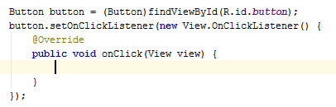
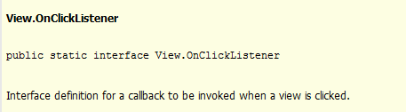

Activity - Eventhandling
Instellen van de OnClickListener per View instance
Notes:
Java handles callbacks with single methods interfaces. Er zijn 2 belangrijke concepten nested classes en anonymous classes.
Nested class= class declared within another class
Anonymous class = class without a name
Nested class is class declared inside another class. A nested class gets a reference to their containing object and has access to things inside of it. Java callback werkt nu als volgt
Als de nested class nu een interface implementeert, een interface met 1 methode en ik wil dit doorgeven aan een ander object dan kan je een interface reference doorgeven aan een ander object. En dan kan de callback gebeuren via de implementatie van de interface. Zo kan het methodes van een ander object aanroepen. Door anonieme klassen kunnen we new met een interface name doen en java zal een klasse creeren.

Slide 17
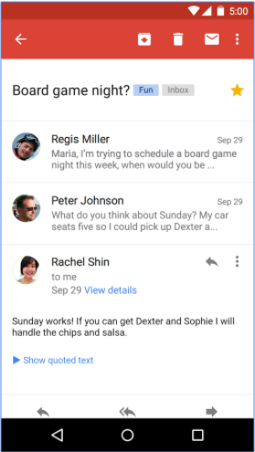
Activity - Intent
Een activiteit stuurt een intentie uit om een andere activiteit op de voorgrond te brengen
INTENT : op te starten activity + extra data
BACK: Resume eerste activity
Notes:
!!! http://startandroid.ru/en/lessons/229-lesson-22-intent-intent-filter-context-theory.html
Ook startActivityForResult als je een antwoord wil teruggeven
In our case Intent is an object in which we specify, which Activity we need to invoke. After it we pass this Intent-object to startActivity method, which finds the corresponding Activity and shows it. When creating an Intent we have used Intent(Context packageContext, Class cls) constructor with two parameters.
The first parameter is Context. If you remember, when we created View in one of our previous lessons, we have also used a Context object. Activity is a subclass of Context, that’s why we can use Activity as a Context object - this. To be short, Context is an object that grants access to basic application functions such as: access to resources, file system, Activity invocation, etc. I guess in future we will explore examples where we will see explicitly what Context is used for and how it is used.
The second parameter is a class name. I will remind that when creating Activity, we specify its class name in the manifest-file. Now if we specify the same class for Intent - the system will look up the corresponding Activity in the manifest-file and show it.
You can check it easily. We will delete the record about the Activity from the manifest-file and will try to invoke it afterwards. Open the project from previous lesson P0211_TwoActivity, open the manifest-file, Application tab and delete the record about ActivityTwousing the Remove button. Save everything, run the application and try to invoke Activity using "Go to Activity Two" button. An error will occur. If you check the log, we can see the following text:
ERROR/AndroidRuntime(367): android.content.ActivityNotFoundException: Unable to find explicit activity class {ru.startandroid.develop.p0211twoactivity/ru.startandroid.develop.p0211twoactivity.ActivityTwo}; have you declared this activity in your AndroidManifest.xml?
(Logs - LogCat tab in Eclipse. If it is not visible, go to Window -> Show View -> Other, Android folder -> LogCat)
System tells us, that it not found such Activity class and kindly hints us that it may be not declared in the manifest file. Register Activity in the manifest-file again, save everything and run the application. It must work now.

Slide 18
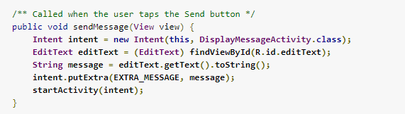
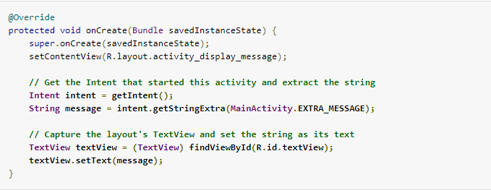
Activity - Intent
Activity 1
Activity 2

Slide 19
De mobile resource uitdaging
De mobile resource uitdaging
Het beheer van resources op mobile devices is belangrijker dan op andere OS
Resources zijn vrij beperkt
Geheugen
Power management

Slide 20
De mobile resource uitdaging
Traditional resource management
Resource lifetime gelinkt aan het proces/thread
De resources worden vastgehouden zelf als de applicatie niet actief is
Notes:
Op bord : https://app.pluralsight.com/player?course=android-dotnet-developers-android-studio&author=jim-wilson&name=android-dotnet-developers-android-studio-m4&clip=2&mode=live

Slide 21
De mobile resource uitdaging
Android resource management
Gekoppeld aan de gebruikers interactie
Een activiteit heeft recht op middelen als de gebruiker ermee interageert
Een activity verliest het recht op CPU als de gebruiker naar een andere activity gaat
Een activity kan zijn memory resources verliezen als de gebruiker naar een andere activity gaat
De gebruiker merkt dit niet
Een gebruiker moet kunnen switchen tussen activities
Het feit dat de resources worden vrijgegeven mag geen impact hebben op wat de gebruiker doet
Notes:
Android resource mgmt is niet langer gelinkt aan processen maar eerder aan wat de gebruiker aan het doen is
OP bord uitleggen : https://app.pluralsight.com/player?course=android-dotnet-developers-android-studio&author=jim-wilson&name=android-dotnet-developers-android-studio-m4&clip=4&mode=live

Slide 22
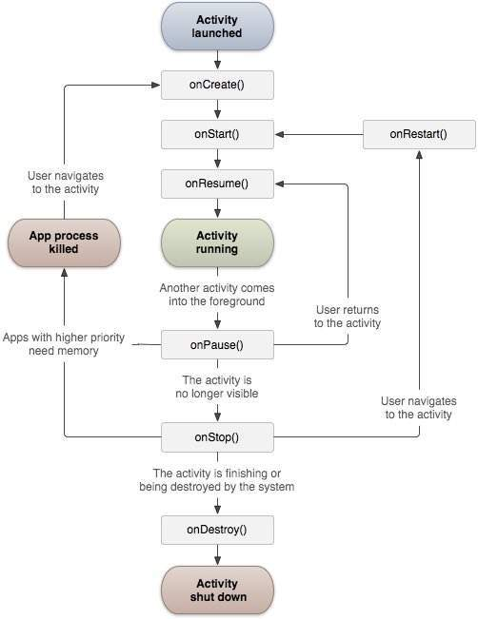
Activity - Lifecycle
onCreate(): de activiteit komt tot leven komt.
onRestart(): de activiteit wordt opnieuw gestart zonder dat die vernietigd was.
onStart(): de activiteit komt in het zichtbare gebied.
onResume(): de activiteit komt in de voorgrond en is er interactiviteit met de gebruiker.
onPause(): de activiteit wordt tijdelijk stilgelegd.
onStop():de activiteit wordt onzichtbaar.
onDestroy():de activiteit wordt compleet uit het geheugen verwijderd.
Notes:
Een Android applicatie kan opgebouwd worden uit meerdere activiteiten (Activity). Elke activiteit presenteert zijn visuele inhoud door middel van een view (View). Er is telkens slechts één activiteit zichtbaar in de voorgrond. Door de beperkte afmeting van het scherm kan er immers maar één activiteit per keer getoond worden. Door deze beperkte ruimte op de schermen hebben de ontwerpers van Android er voor gekozen om het werken met overlappende vensters weg te laten. Deze mogelijkheid zou ook lastig te bedienen zijn door de afwezigheid van een muis.
Applicaties op mobiele platformen hebben dus een totaal andere vorm van bediening. In een klassieke applicatie heb je nog meerdere vensters, bij een mobiele applicatie zie je maar één scherm per keer. Elk scherm is een activiteit binnen de Android applicatie. We krijgen dus een afwisseling van verschillende activiteiten, al dan niet van dezelfde applicatie. Activiteiten kunnen dus even van het toneel verdwijnen en kunnen zelfs compleet vernietigd worden. Dit betekent dat activiteiten een levenscyclus hebben. In Afbeelding 4.1, “De levenscyclus van een activiteit” zie je dat bij elke toestandsovergang een eigen methode hoort. Telkens als er een overgang is van de ene naar de andere toestand is, wordt de betrokken methode opgeroepe
Running state (of active of resumed state)
Activity heeft defocus, bovenaan de stack
Toegang tot alle resources
Wordt niet vernietigd
Paused state
Activity is zichtbaar maar heeft de focus niet
Behoudt zijn memory resources
Stopped state
Activity niet langer zichtbaar
Kandidaat om zijn resources te verliezen, dus sla data en UI state op
Activity bevat callback methodes die aangeven dat de toestand veranderd is

Slide 23
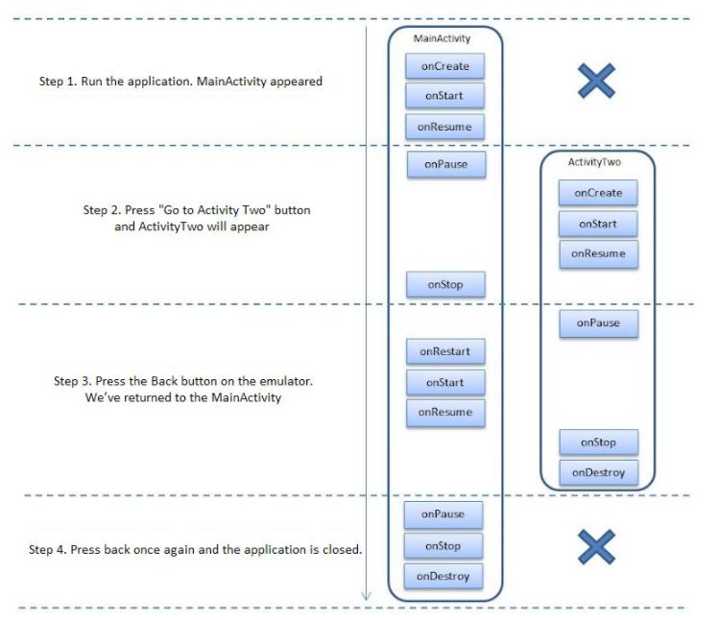

Slide 24
Activity - Saving en restoring activity state
Een gevolg van de levenscyclus van activiteiten is dat een activiteit en zijn objecten onverwacht uit het geheugen verwijderd kunnen worden
onCreate(): de activiteit komt tot leven.
Bundle parameter = hashmap (key/value) met de gegevens van een vorig leven. Zo kan de activiteit verder gaan vanaf het punt waarop de activiteit in een vorig leven gebleven was. Als een activiteit echt voor de eerste keer tot leven komt, is de Bundle parameter null.
onPause(): de activiteit wordt tijdelijk stilgelegd.
Toestand kan je hier opslaan in de Bundle.
Doe dit in methode onSaveInstanceState() : sla de toestand van de activiteit op op het moment dat die activiteit mogelijk uit het geheugen wordt verwijderd

Slide 25
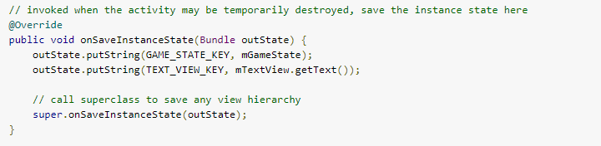
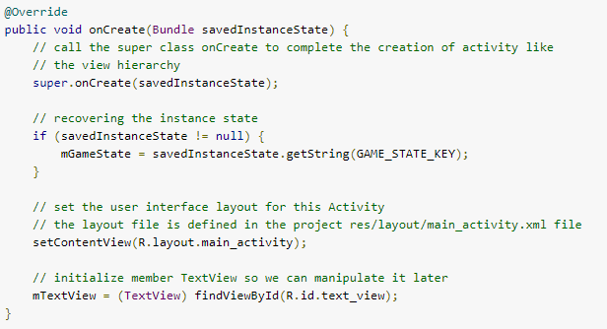
Activity - Saving en restoring activity state

