Slide 1
ITC6107 Big Data Architecture Winter 2024
Presented by
Paraskevi BAIRAMI
Dimitris LEZOS

Slide 2
Goal
Create a Blockchain emulator using Python, Spark, Kafka & MongoDB
Transaction Generator
Block Miner
Block Listener
Block Query
Kafka
Topic “Blocks”, Partition: 0, Partition: 1
MongoDB
db: “itc6107”,
Collection: “blocks”
Notes:
How presentation will benefit audience: Adult learners are more interested in a subject if they know how or why it is important to them.
Presenter’s level of expertise in the subject: Briefly state your credentials in this area, or explain why participants should listen to you.

Slide 3
Architecture
Transaction Generator
Block Miner
Block Query
Socket localhost:9999
Kafka
MongoDB
db: itc6107
collection: blocks
Blocks
Partition 0
Partition 1
Block Listener
Block Listener
Notes:
Lesson descriptions should be brief.

Slide 4
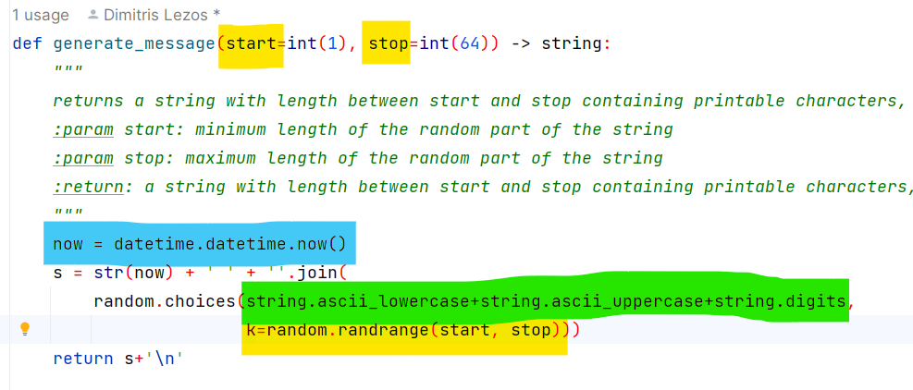
Transaction Server
Transactions
Unique
Random Length
Random Text
Notes:
Example objectives
At the end of this lesson, you will be able to:
Save files to the team Web server.
Move files to different locations on the team Web server.
Share files on the team Web server.

Slide 5
Transaction Server
Random Interval
Notes:
Example objectives
At the end of this lesson, you will be able to:
Save files to the team Web server.
Move files to different locations on the team Web server.
Share files on the team Web server.

Slide 6
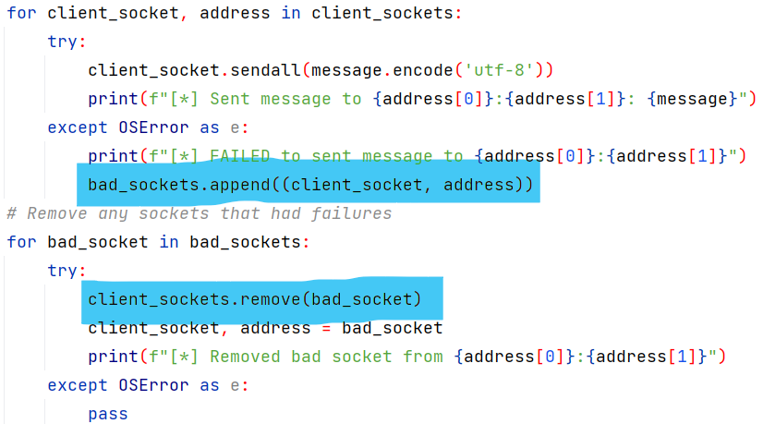
Transaction Server
Bad Socket Removal
Notes:
Example objectives
At the end of this lesson, you will be able to:
Save files to the team Web server.
Move files to different locations on the team Web server.
Share files on the team Web server.

Slide 7
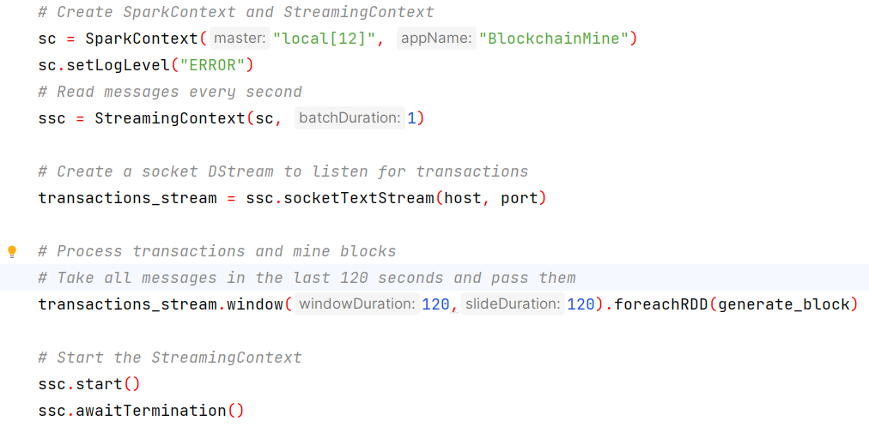
Block Miner
Very simple Spark pipeline
One RDD every 120 seconds
Notes:
Example objectives
At the end of this lesson, you will be able to:
Save files to the team Web server.
Move files to different locations on the team Web server.
Share files on the team Web server.

Slide 8
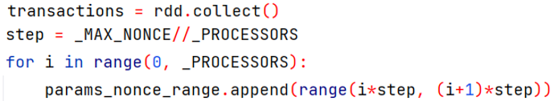
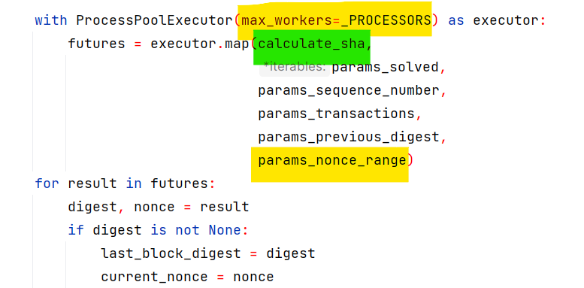
Block Miner
ProcessPoolExecutor
Notes:
Example objectives
At the end of this lesson, you will be able to:
Save files to the team Web server.
Move files to different locations on the team Web server.
Share files on the team Web server.

Slide 9
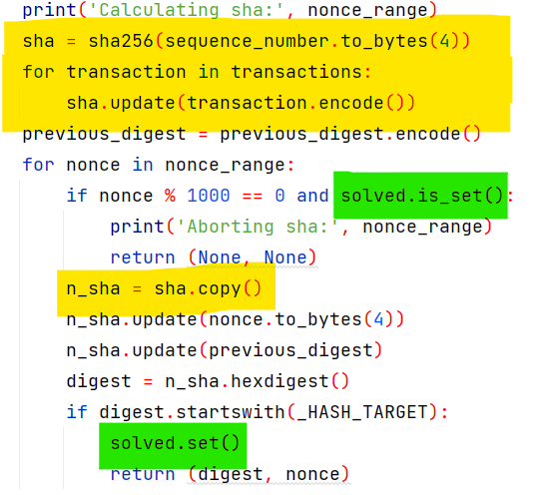
Block Miner
ProcessPoolExecutor
threading.Event
Early Stop
Notes:
Example objectives
At the end of this lesson, you will be able to:
Save files to the team Web server.
Move files to different locations on the team Web server.
Share files on the team Web server.

Slide 10
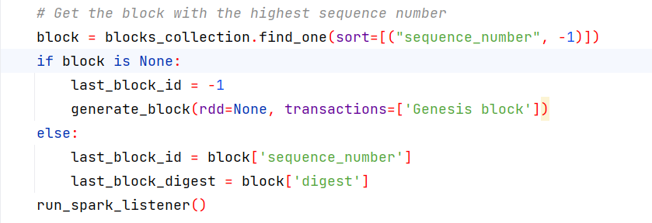
Block Miner
Genesis Block
Notes:
Example objectives
At the end of this lesson, you will be able to:
Save files to the team Web server.
Move files to different locations on the team Web server.
Share files on the team Web server.

Slide 11
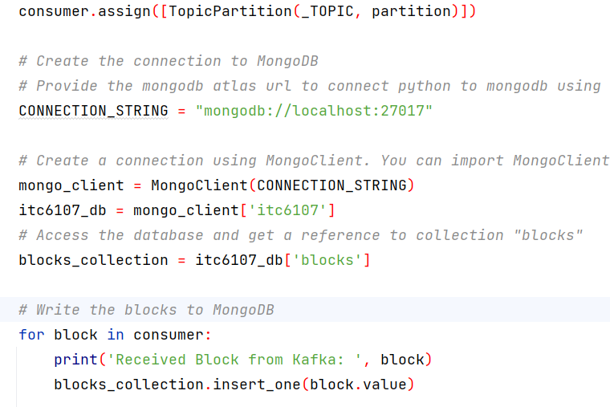
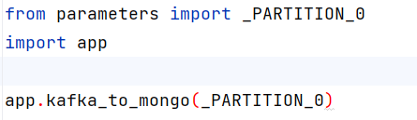
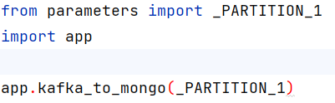
Block Listener
Single Code for both partitions
app0.py:
app1.py:
Notes:
Example objectives
At the end of this lesson, you will be able to:
Save files to the team Web server.
Move files to different locations on the team Web server.
Share files on the team Web server.

Slide 12
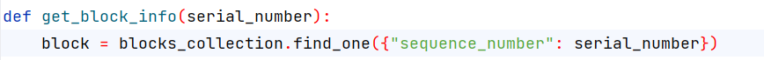
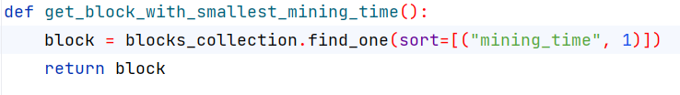
Block Query
Find by Serial Number
Smallest Mining Time
Notes:
Example objectives
At the end of this lesson, you will be able to:
Save files to the team Web server.
Move files to different locations on the team Web server.
Share files on the team Web server.

Slide 13
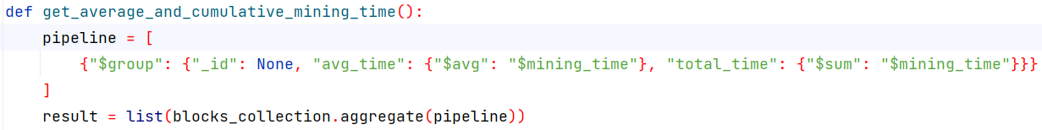
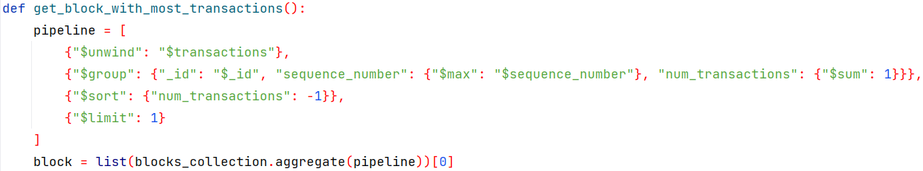
Block Query
Average and Cumulative Mining Time
Block with most Transactions
Notes:
Example objectives
At the end of this lesson, you will be able to:
Save files to the team Web server.
Move files to different locations on the team Web server.
Share files on the team Web server.

Slide 14
Q&A
Notes:
Example objectives
At the end of this lesson, you will be able to:
Save files to the team Web server.
Move files to different locations on the team Web server.
Share files on the team Web server.

Slide 15
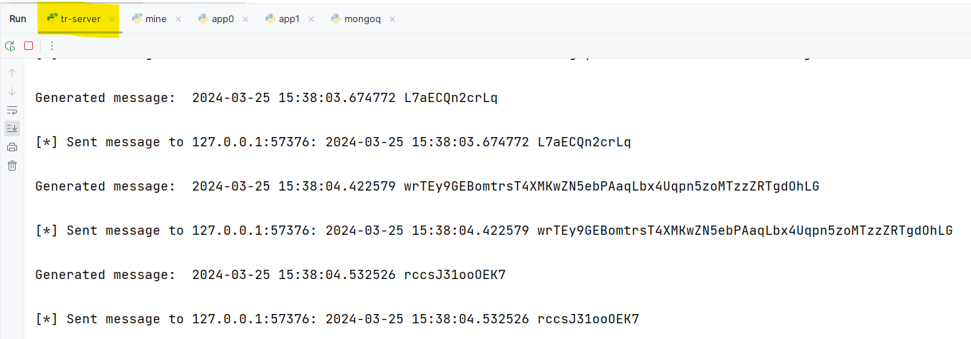
Screenshots

Slide 16
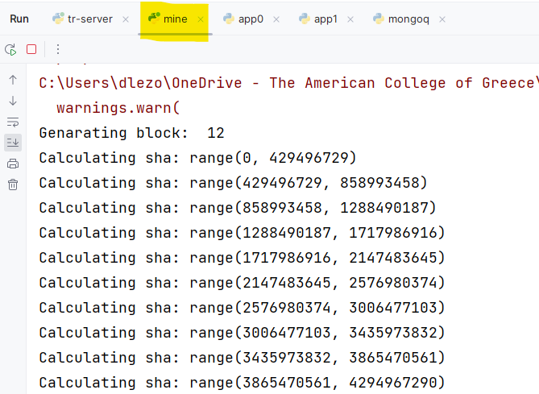
Screenshots

Slide 17
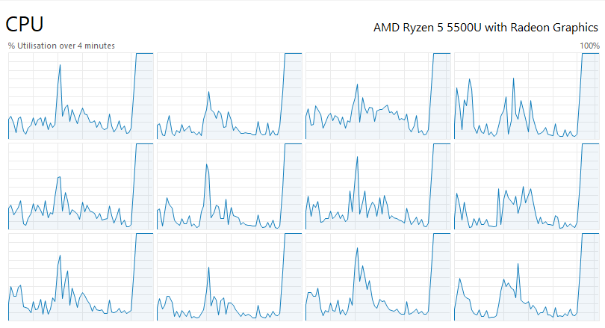
Screenshots

Slide 18
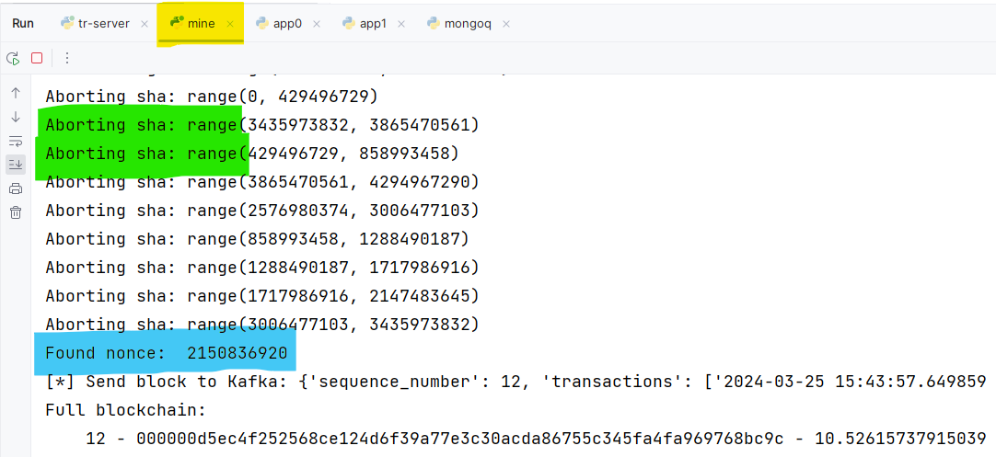
Screenshots

Slide 19
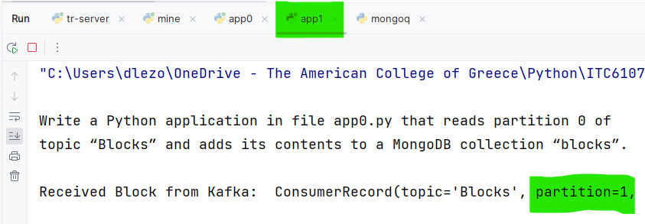
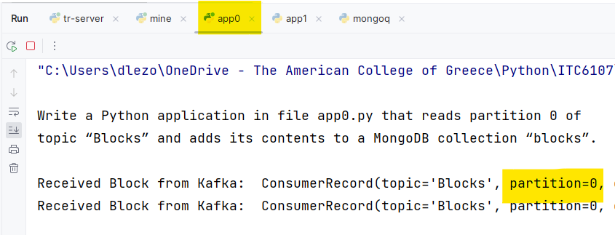
Screenshots

Slide 20
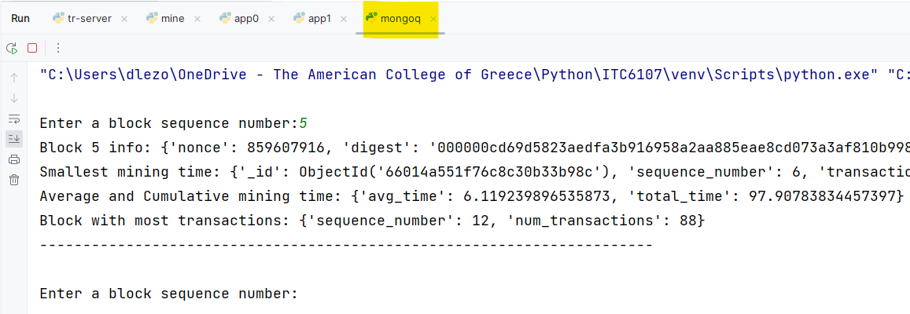
Screenshots

