Slide 1
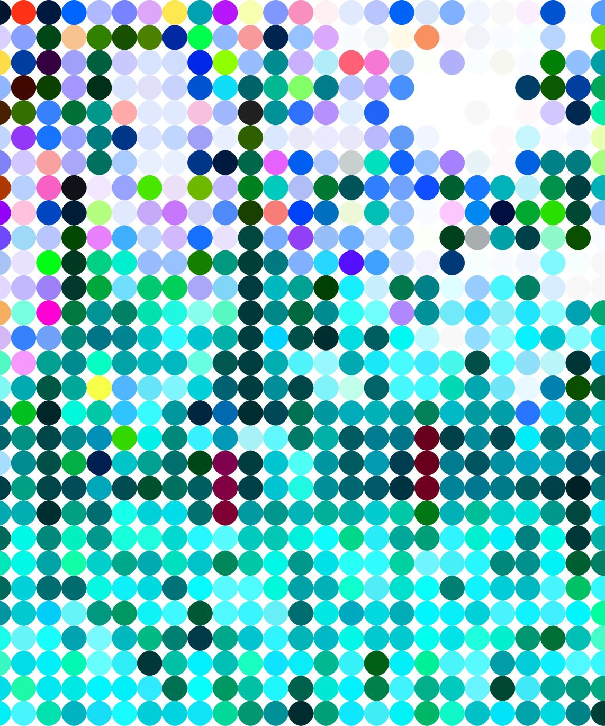
Comparing Human and Machine Randomness
Data analysis 2024/2025
Dimitrios Chantzis

Slide 2

Introduction and Background
This project will investigate how random sequences of symbols generated by humans and large language models like chagpt compare with actually random ones
It is easy to write a sequence where the number of ones and zeros is balanced
It is hard not to bias your results at all
The approaches taken to analyze this problem are
Using the entropy of the strings
Using a basic neural network
Hypothesis: We can reliably tell the two cases apart

Slide 3
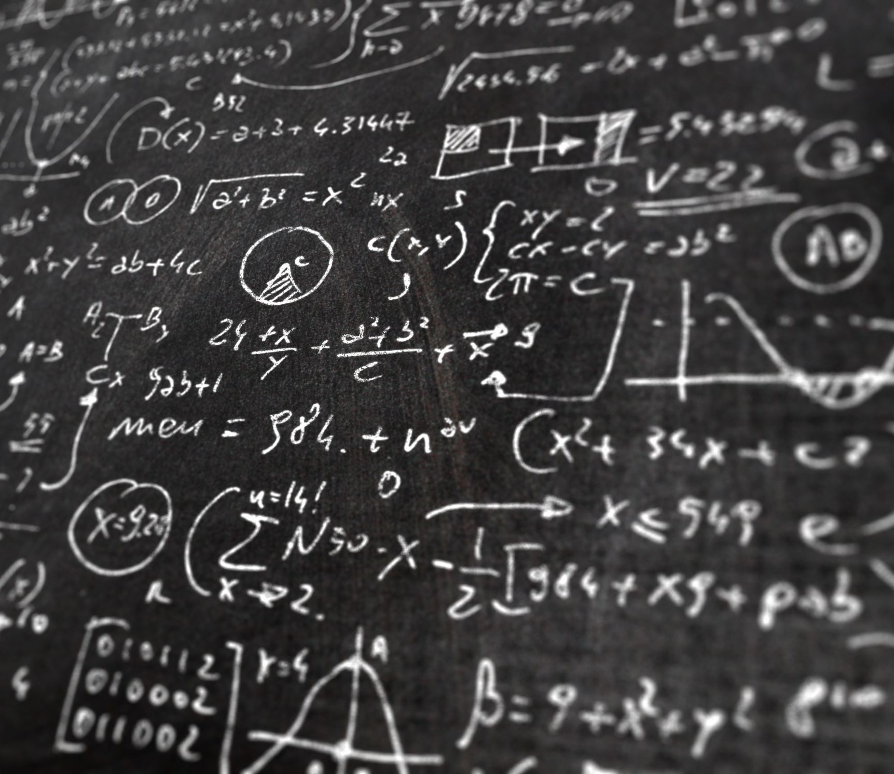
Method 1: Entropy

Slide 4
Defining what the “entropy” of a sequence means
There are many possible measures of the entropy we can use. We prefer one with two inputs
For the one I chose:
For all possible subsequences of a given length, we calculate the chance this has of occurring in the sequence under examination.
Then calculate the cross entropy of the resulting distribution

Slide 5
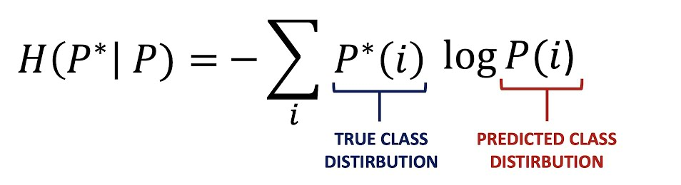
The cross entropy of two distributions

Slide 6
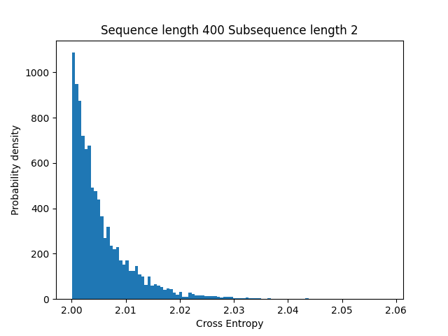
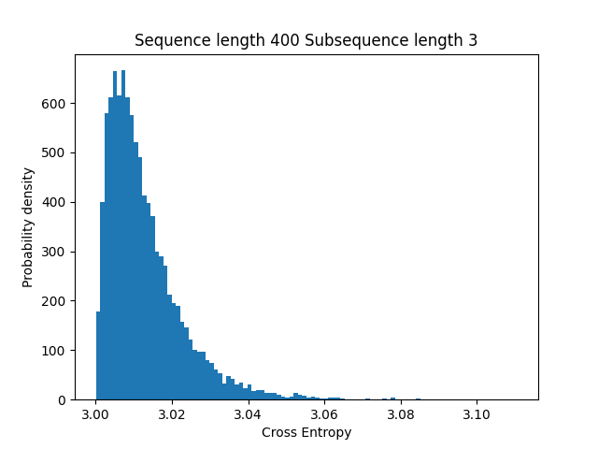
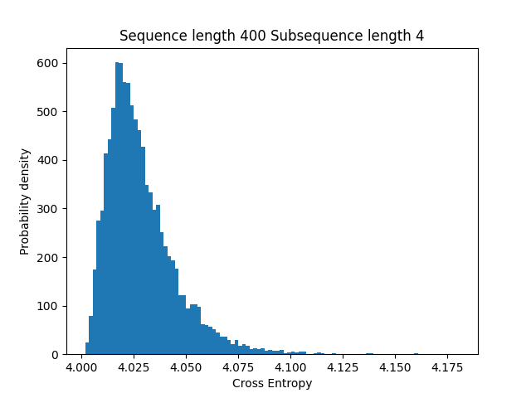
The distribution of cross entropies

Slide 7
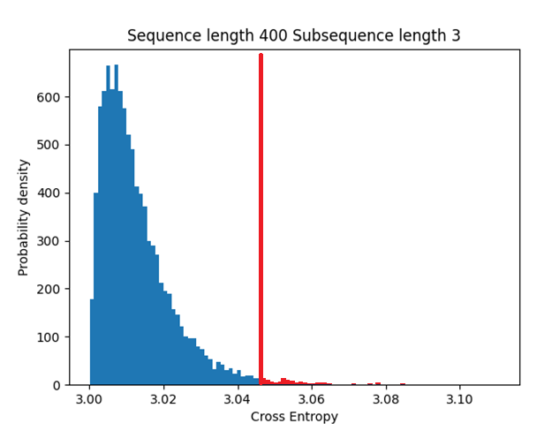
Calculating the p value
Calculate the probability the cross entropy being equal to or higher than the examined sequence
Assuming truly random distribution
Knowledge of the analytical distribution not essential
The red area

Slide 8
Some results
With a length 2 subsequence:
For a chatgpt sequence of length 135, p=0.009
For a sequence of length 135 written by me, p=0.0001
For a sequence of length 135 written by me trying to cheat the system, p=0.34
With a length 3 subsequence:
For a chatgpt sequence of length 135, p=0.005
For a sequence of length 135 written by me, p=0.0001
For a sequence of length 135 written by me trying to cheat the system, p=0.35
With a length 3 subsequence:
For a sequence of length 135 written by me trying to cheat the system, p=0.18
For a sequence of length 84 with three symbols and a length 2 subsequence generated by me, p=0.004

Slide 9
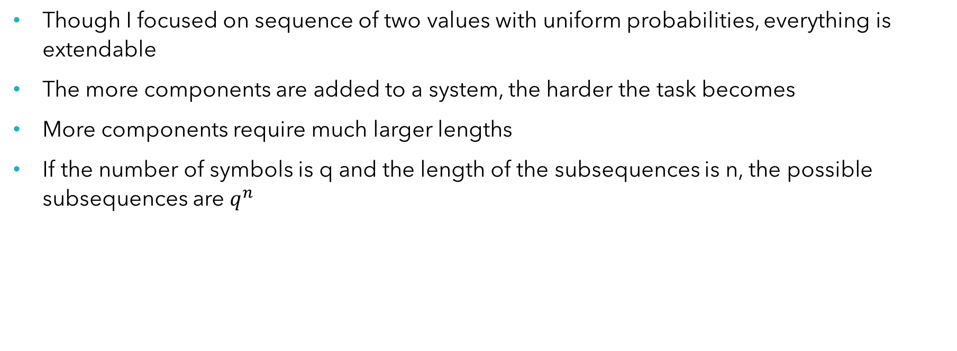
Discussion
Though I focused on sequence of two values with uniform probabilities, everything is extendable
The more components are added to a system, the harder the task becomes
More components require much larger lengths
If the number of symbols is q and the length of the subsequences is n, the possible subsequences are $q^{n}$

Slide 10
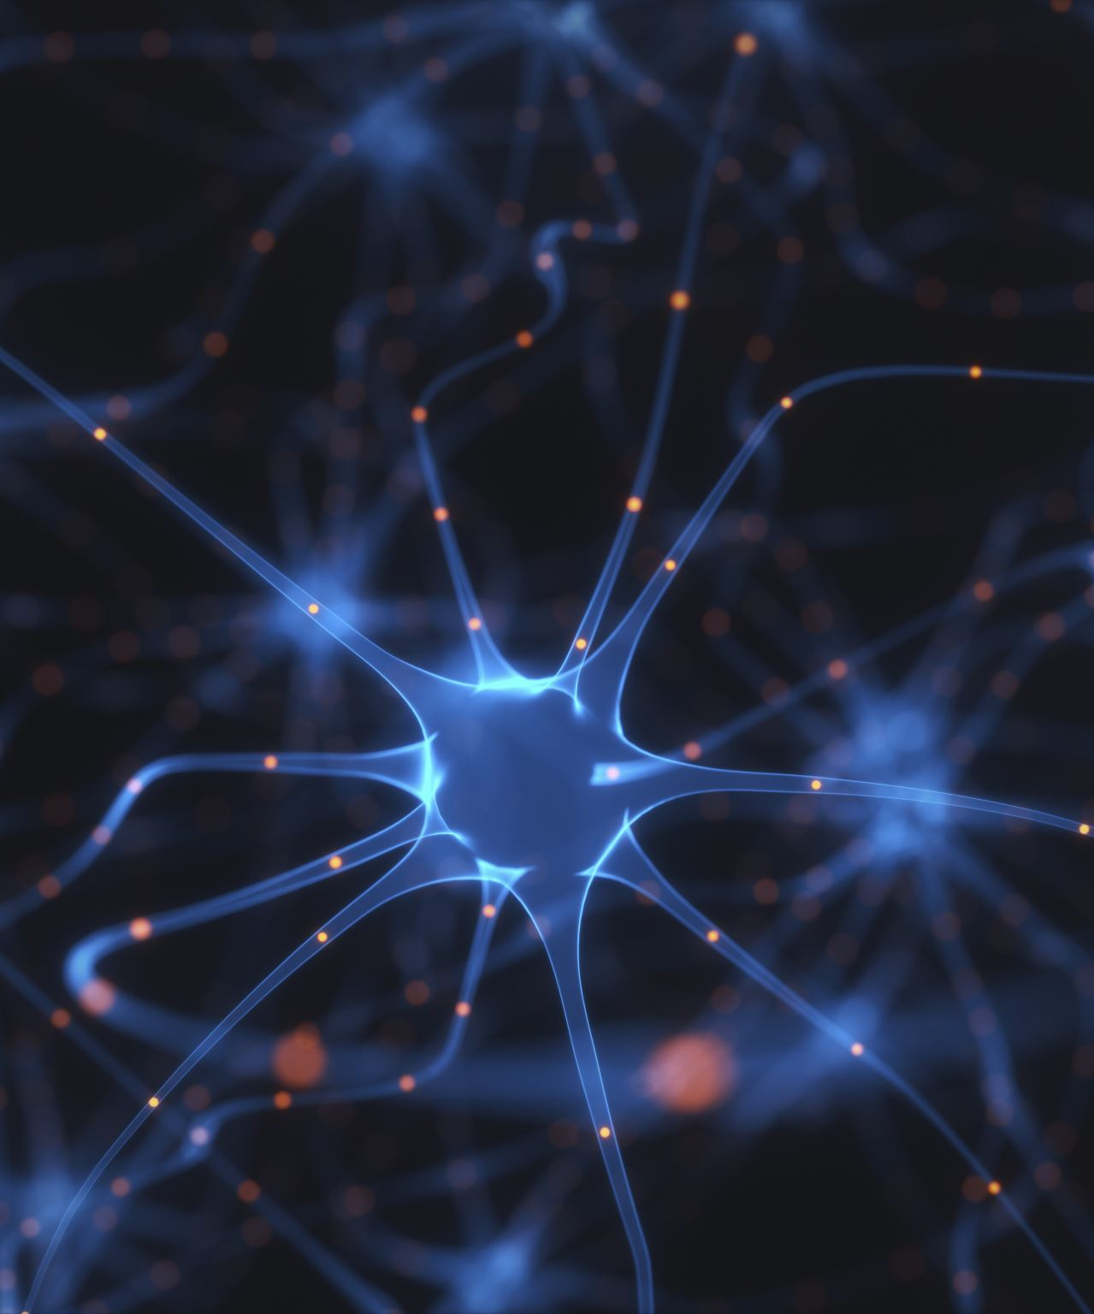
Method 2: Neural Network

Slide 11
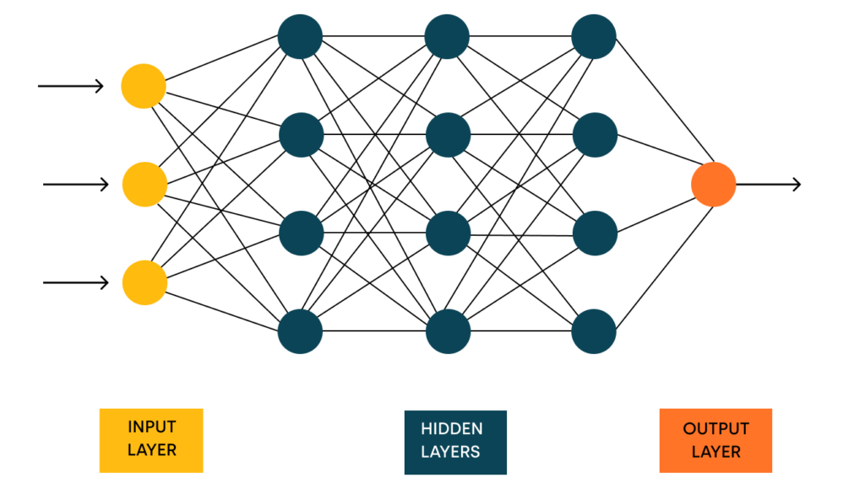
Simple explanation of the model

Slide 12
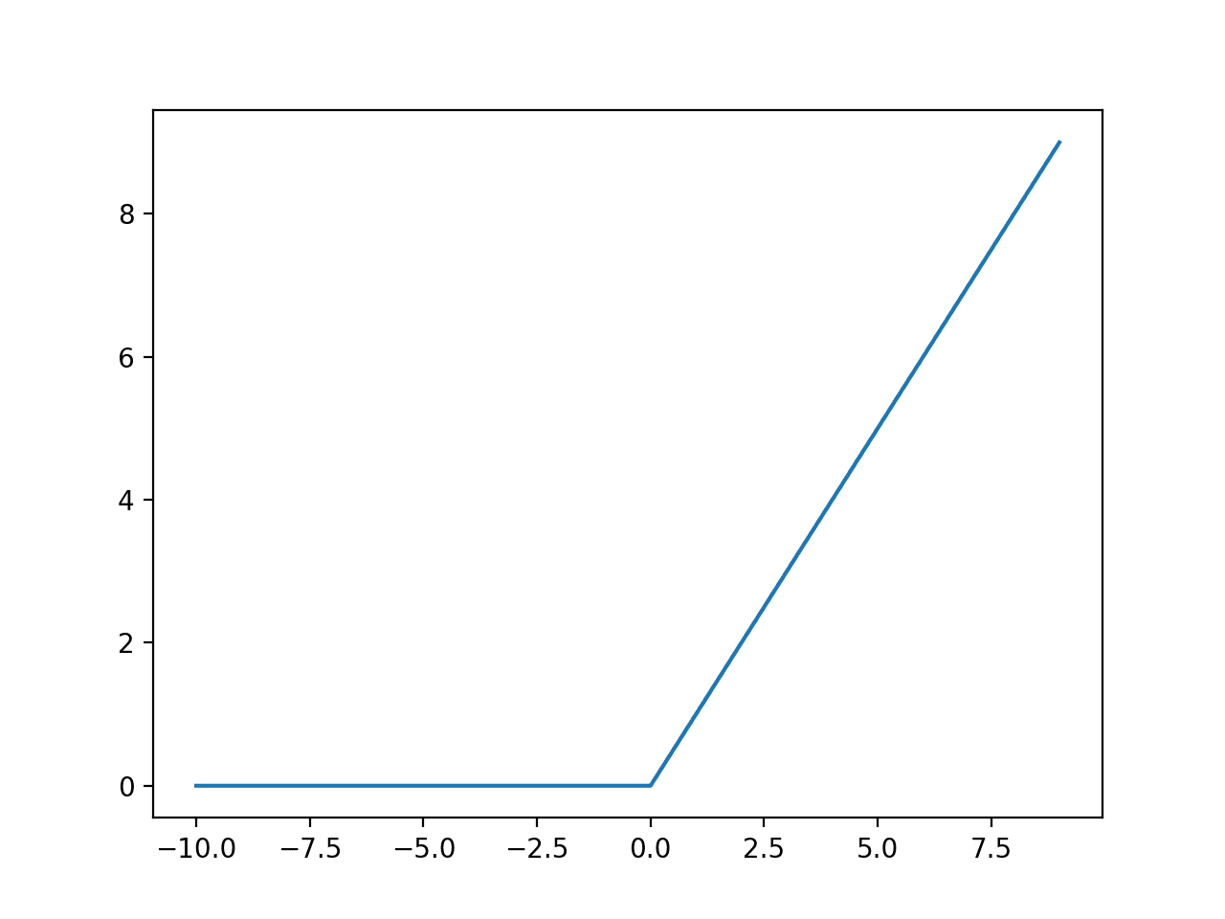
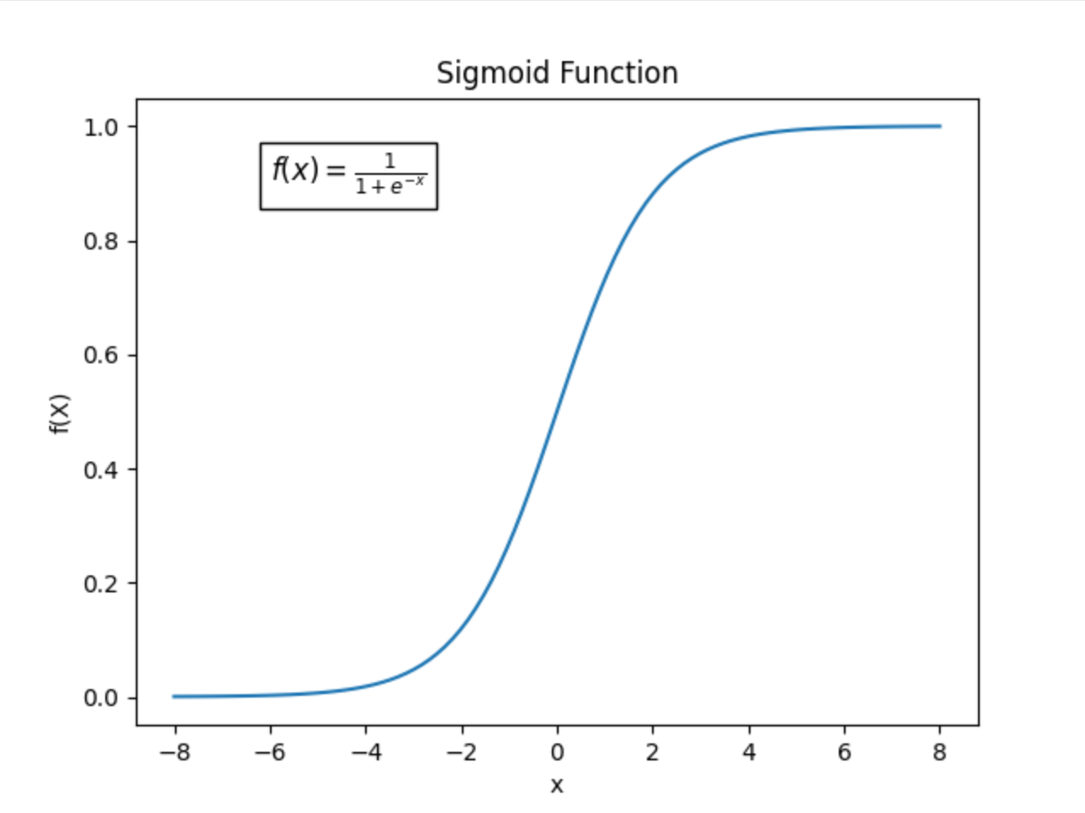
Non-linearity

Slide 13
Performing the training
The “human” data was generated by asking ChatGPT
We quantify the loss by comparing the prediction for each datum to reality
The model can indicate varying degrees of confidence
Perform Gradient descend to optimize the parameters
Calculate the accuracy by a different unused dataset

Slide 14
Results for neural network
Hyperparameters used:
First layer: 200 nodes and ReLU non-linearity
Second layer: 40 nodes and ReLU non-linearity
Final layer: 1 node with Sigmoid non-linearity
Final accuracy: 85%
False positive rate: ~7%

Slide 15
Final Discussion
Both methods in indicate there is a significant difference in the two types of data
Both can be improved
The entropy-based approach seems to produce better results
The entropy-based approach is more flexible, and more understandable
The neural network has the highest ceiling for improvement

Slide 16

Thanks for Watching

