Slide 1

Explainable and Reliable Prediction
Research Project Presentation 3
Group 11
Supervisor
Evgueni Smirnov
Sotirios Ftiakas
Dimitris Feizai
Coordinator
Menica Dibenedetto
Giannis Triantafyllou

Slide 2
Introduction

Slide 3
Introduction
Machine learning is greatly used in improving products, decision making processes and research.
A user of a ML system has to be able to decide whether to trust any individual prediction provided by the system.
Notes:
Nowadays, (Just imagine how much ML systems are used, social media, smart devices, self-driving cars)
However, we can’t just blindly trust their decisions.

Slide 4
Problem Description
Scenario:
Person A and Person B feel slight discomfort in the chest area, and they request hospitalization. (The hospital has only 1 slot available.)
- Which patient should the hospital accept and which one to reject?
- Can the doctor provide an explainable and reliable decision, based on the system?
Notes:
Assume that the hospital uses an ML system that helps assess the severity of a patient’s condition and decide whether to admit them or not.

Slide 5
Why is this important?
Explainability:
Contributes to a user’s trust in a cognitive sense.
Reliability:
Contributes to a user’s trust in a statistical sense.
Notes:
Provides explanations as to why we take a decision
Provides confidence in our decisions
At present, ML systems use two separate sub-systems, one for the reliability and a second for the explainability

Slide 6
Research Questions

Slide 7
Research Questions
Question 1
Can we build a model that provides explainability and reliability simultaneously?
Question 2
Is validity preserved?
Question 3
Does our model provide information efficiency?
Notes:
Q1: Simultaneously = At the same time (Because most of the models today use 2 separate subsystems, one for explainability and one for reliability)
Q2:
Q3: Is the predictions of our model useful? (because you can imagine that a model that predicts all possible labels to a problem is not useful at all)

Slide 8
Background

Slide 9
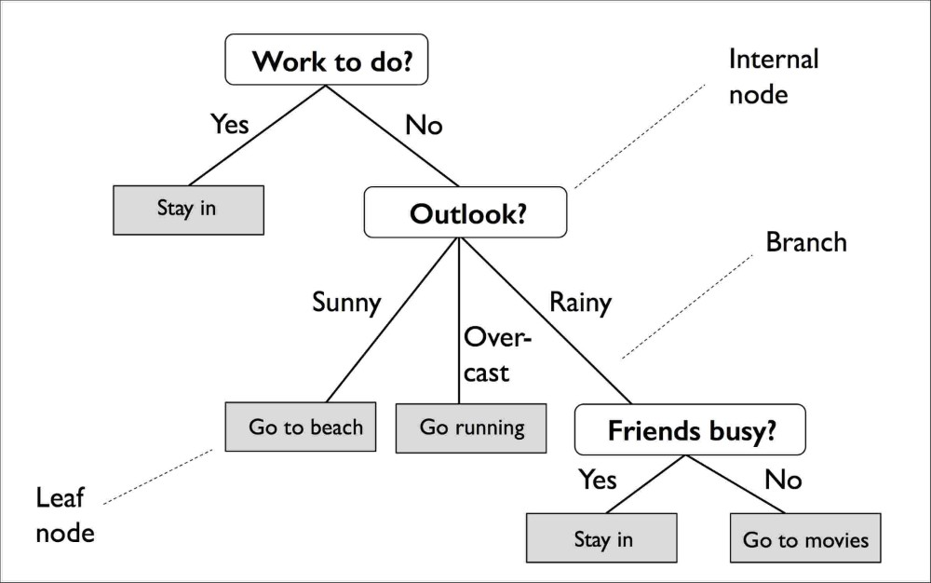
Decision Tree
ML model that uses data features as decision rules in a tree like structure.
Internal Nodes: Store features as decision rules
Branches: Path based on feature value
Leaf Nodes: Store prediction outcome
FIGURE: Decision Tree structure example
Notes:
Simple to understand and to interpret.
Internal Nodes = Decision Nodes
Leaf Nodes = Prediction Nodes

Slide 10
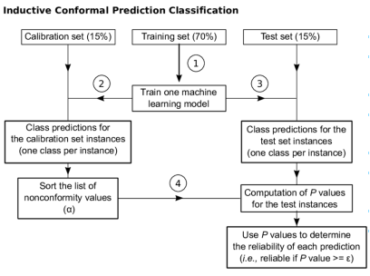
Inductive Conformal Predictor (I.C.P.)
Returns prediction regions – intervals for regression problems and sets of labels for classification problems.
Training – Calibration – Test set: The percentage split of each set can differ.
Nonconformity function: Μeasures how unusual an example looks relative to previous examples
FIGURE: Inductive Conformal Predictor structure example for classification

Slide 11
Reliable Decision Trees (ReDT) Our Approach

Slide 12
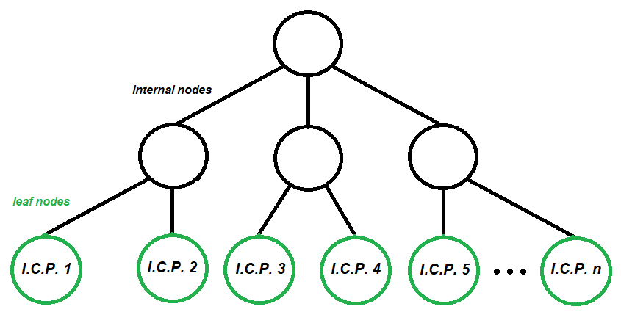
Reliable Decision Trees (ReDT)
Hybrid prediction model
Normal decision tree structure
I.C.P. at leaf nodes
FIGURE: Decision Tree with I.C.P.s at leaf nodes
Notes:
We propose a hybrid prediction model that combines a decision tree with many inductive conformal predictors.
We first divide the feature space up by a normal classification tree, and then use inductive conformal prediction just among those training and calibration items in the same leaf node as the test item.

Slide 13
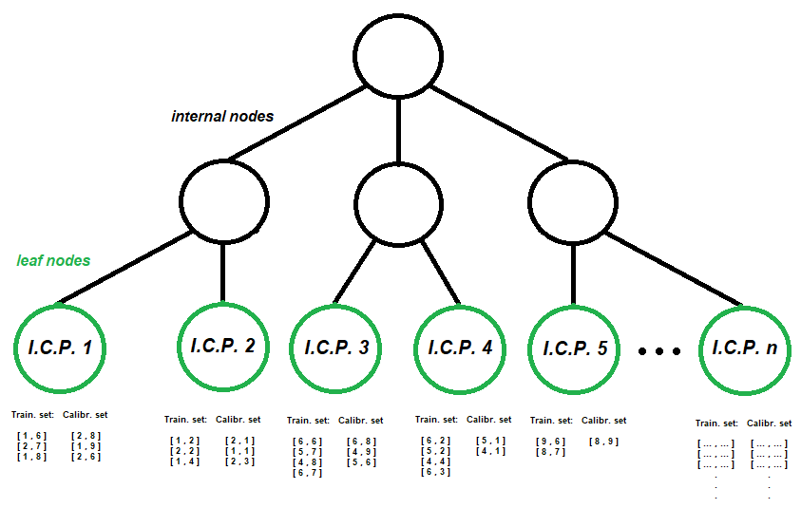
Training Process
1) Grow tree with training set
2) Send training examples through the tree
3) Send calibration examples through the tree
FIGURE: Training and calibration instances at leaf nodes

Slide 14
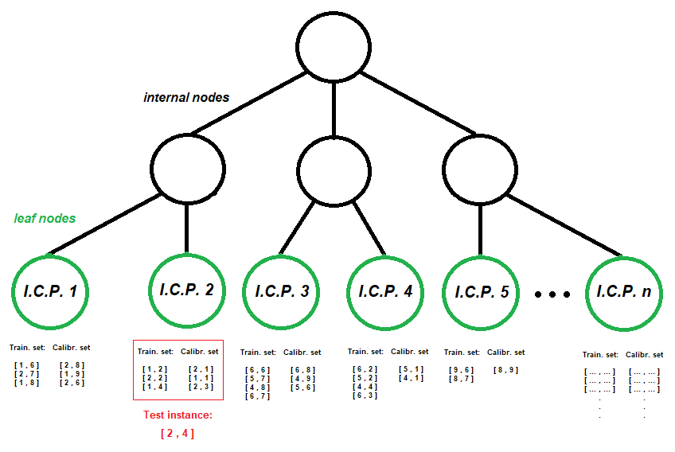
Classification Process
1) Send test example through the tree
2) Once the test instance reaches a leaf node, perform conformal prediction among those training and calibration items in the same leaf as the test instance.
FIGURE: Leaf-specific inductive conformal predictor

Slide 15
New Pruning Method

Slide 16
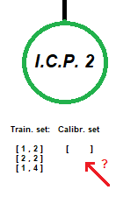
Why Pruning?
1) What if there is no calibration set on a leaf node?
2) What if there are only few calibration examples in a leaf node?
Solution: Prune paths that lead to nodes with no/few calibration instances.
FIGURE: Leaf node with no calibration set
Notes:
Why do we perform pruning?
Well, during our experiments, 2 essential questions arised.
What … no cali? → We can’t perform I.C.P.
What … few cali? → We might get really weak I.C.P.s in these leaf nodes.
Pruned based on a minimum number of calibration examples, a threshold that is either a fixed number of instances, for example 10, or a percentage of the initial dataset, for example 5%.

Slide 17
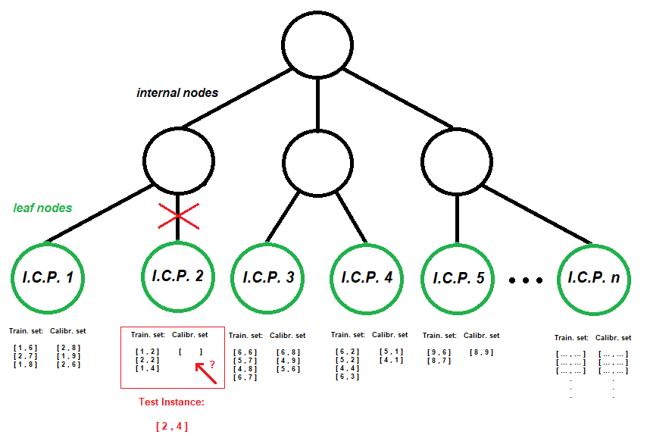
Pruning Process

Slide 18
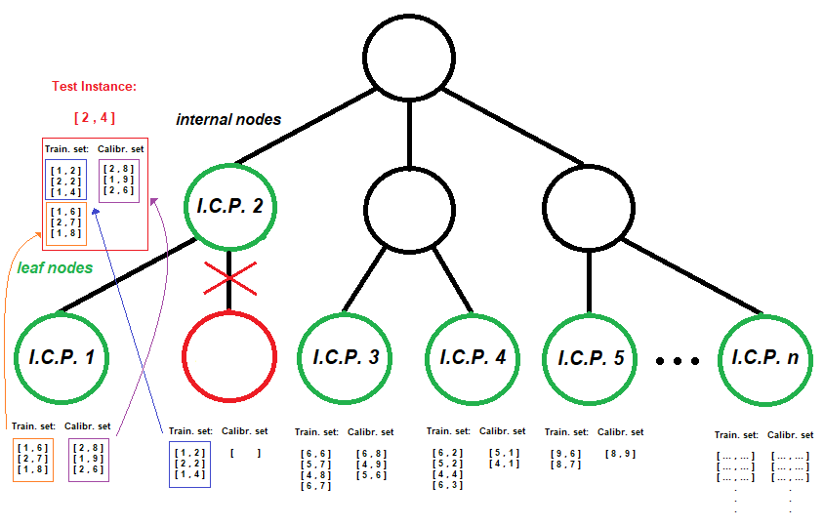
Pruning Process

Slide 19
Experimental Settings

Slide 20
Datasets
Dataset Characteristics
Datasets | Instances | Attributes | Classes
Heart Disease | 920 | 11 | 2
Iris | 150 | 4 | 3
Census Income | 32565 | 12 | 2
Red Wine | 1600 | 11 | 2
Postures | 74975 | 15 | 5
Notes:
2 of them are big datasets, 3 are smaller ones
We tested both binary and multi-class classification problems

Slide 21
Dataset Split
In our experiments, we randomized the datasets and performed 2 kinds of splits:
1. Holdout Method
sdds
Proper Training Set 60% - Proper Calibration Set 20% - Test Set 20% (60-20-20)
Proper Training Set 40% - Proper Calibration Set 40% - Test Set 20% (40-40-20)
Proper Training Set 20% - Proper Calibration Set 60% - Test Set 20% (20-60-20)
2. K-fold Cross Validation
Notes:
Read the first sentence as it is
The first is a holdout method, where we tested our datasets with 3 different holdout splits: 60 proper training set, 20 proper calibration set and 20 test set, then 40-40-20 split, and finally a 20-60-20 split.
We also tried a k-fold cross validation to test how our performance varies with different training and test sets.

Slide 22
Experiment Parameters
Normally, ReDT trees are developed like regular Decision Trees.
High depth and many leaf nodes, based on the dataset.
For demonstration purposes, we restrict our ReDT trees to only 3 leaf nodes.
Easier to compare and spot patterns between leaf I.C.P.s.
Notes:
Normally, our ReDT trees are developed like regular Decision trees, which means probably high depth and many leaf nodes, depending on the dataset of course.
For demonstration purposes only, we restrict… because it is going to be easier to compare, spot patterns between them and communicate them to you.

Slide 23
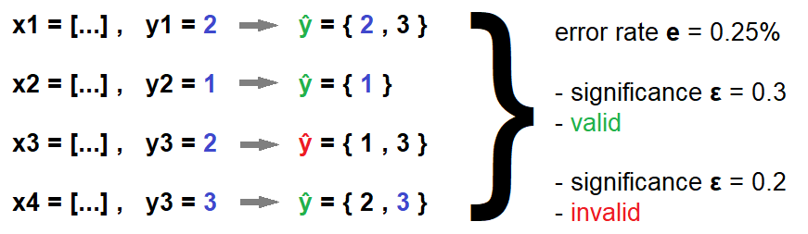
Metrics – Validity
To test the validity of a conformal set predictor we use the error rate e.
The error rate e for a significance level ε is defined as the proportion of test instances whose predicted prediction-sets do not contain the correct class.
To test the I.C.P. validity, we need to show that for any significance level ε ∈ [0, 1] we have e ≤ ε.
FIGURE: Validity example
Notes:
Now let us introduce our metrics. We have metrics for validity and information efficiency. To test the validity…(1^{η} και 2^{η} πρόταση όπως τις βλέπεις.)
To check that an I.C.P. is valid, we need to show that …
For example, assume the scenario where we have these 4 instances where y1,y2,y3,y4(ορθογραφικο) are the true classes and y^ are the predictions of our model. As we can see, we have ¼ false predictions, so a 0.25% error rate. If significance ε=0.3, then no problem, but if significance ε=0.2 validity is violated

Slide 24
Metrics – Information Efficiency
To test the informational efficiency of a conformal set predictor, for a given significance level ε we employ three main metrics:
The rate r^{e} of empty prediction sets
The rate r^{s} of singleton prediction sets
The rate r^{m} of multiple prediction sets.
We need both validity and information efficiency.
Prediction sets as small as possible but NOT empty.
Notes:
Now, moving on to information efficiency, we want to know how valuable information a model gives us. For example, a model that predicts all possible classes for all test instances is going to be valid, but has no value at all to us. That’s why for a given significance level ε, we define these 3 main metrics:…
A good reliable model should be both valid, and have information efficiency.
For this reason, we want our prediction sets to be as small as possible, but NOT empty.

Slide 25
Results

Slide 26
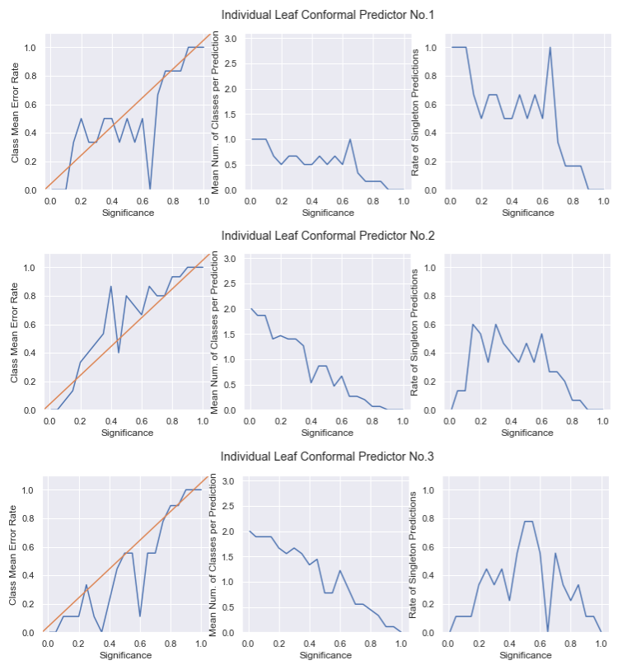
Iris Dataset
1st column:
Error rate e / Significance level ε
2nd column:
Mean prediction sets size / Significance level ε
3rd column:
Rate r^{s} of singleton prediction sets / Significance level ε
FIGURE: Plots for validity and information efficiency (leaf nodes)
Notes:
40-40 split.
Explain the graphs.
There is a lot of variation in the graphs when we compare the 3 leaves. Also, the first graph with the orange diagonal line is the most important graph we need to look at, as we want our line graph to be bounded by the diagonal for validity to be preserved.
As we notice, individually the 1st and definitely the 2nd leaf nodes do not pass the validity test, even though the 3rd one does. This means that local validity is only achieved at some nodes only. Let’s however take into account that this is a very small dataset, and each leaf consists of only around 10 test instances.

Slide 27
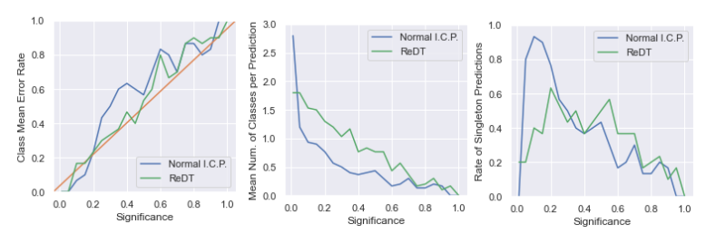
Iris Dataset
FIGURE: Comparison of Normal I.C.P. vs ReDT leaf I.C.P.s
Notes:
Moving on to the comparison of a normal ICP built on the whole dataset, vs the average performance of all the ICPs at our ReDT tree’s leaf nodes.
The first thing I want to draw your attention on is the 2nd graph. As you can tell, for the most part, our ReDT tree has a higher average number of classes per prediction, meaning that our prediction sets usually contain more classes than the regular ICP. Someone would say that for this reason, our model has less information efficiency than the normal I.C.P.
However, now let’s take a look at what happens at the error rate of our model. It is significantly lower for the most part, which brings our model closer to validity than the normal I.C.P. Which is really cool, because at this point we have managed to make a model that not only is explainable but also less prone to errors than the normal I.C.P in general.

Slide 28
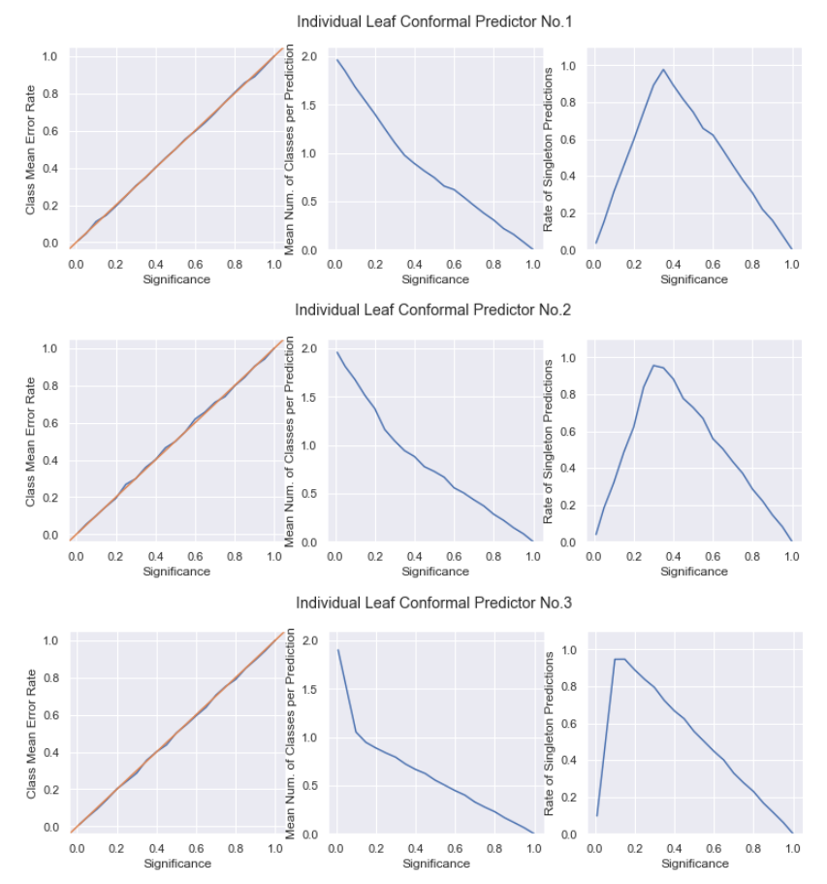
Census Income
1st column:
Error rate e / Significance level ε
2nd column:
Mean prediction sets size / Significance level ε
3rd column:
Rate r^{s} of singleton prediction sets / Significance level ε
FIGURE: Plots for validity and information efficiency (leaf nodes)
Notes:
Here, the evaluation happened on three leaf nodes, with 4000,2000,8000 proper training and proper calibration examples in each leaf node. We can slightly notice that the second leaf with the least amount of examples seems like it is the only one with some small fluctuations above the diagonal line of validity. However these small fluctuations are okay with validity. We can see that compared to the iris dataset where there was a really low amount of test examples, now local validity seems to be preserved in all 3 nodes, and as you can guess, since all leaves achieve local validity, the global validity is also preserved.

Slide 29
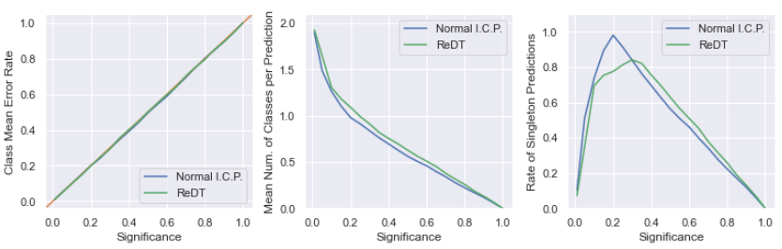
Census Income
FIGURE: Comparison of Normal I.C.P. vs ReDT leaf I.C.P.s
Notes:
No major differences between the two models when it comes to the mean error rate. Also, both are considered valid models, as they are bounded exactly by the orange diagonal, with some minor fluctuations.
On the second graph, we can conclude that our model predicts just slightly bigger prediction sets than the normal I.C.P., however on the third graph we notice that our model has an average slightly higher rate of singleton predictions than the normal model. This means that for the most part, our model is more likely to predict singleton and multiple prediction sets, than empty prediction sets compared to the normal model. This is a general behavior that we noticed our model follows, meaning that it is kind of an optimistic model, because it prefers to give multiple answer, than no answer at all. This can be considered a good thing or bad thing, according to perspective of course.

Slide 30
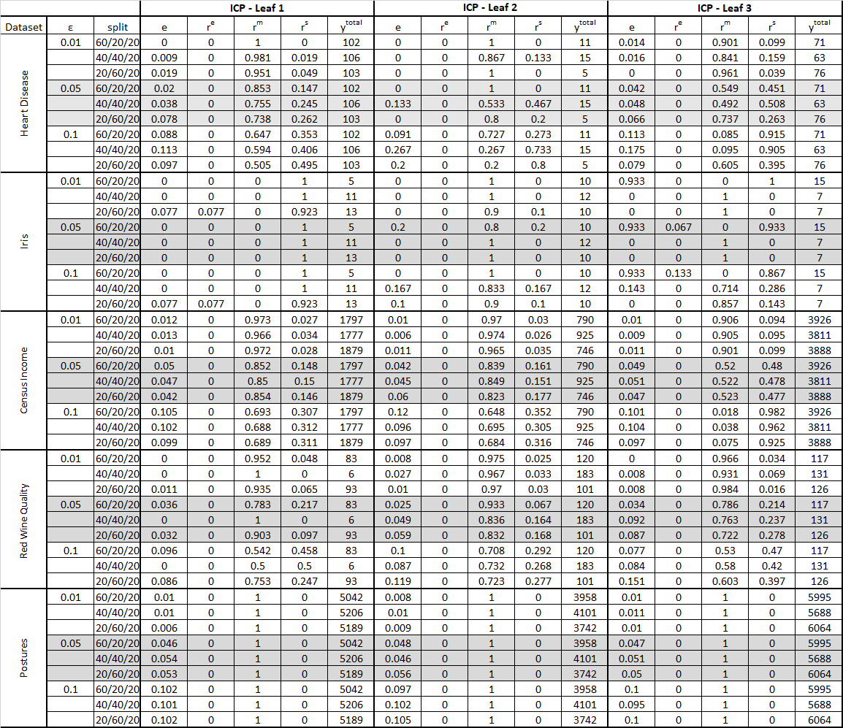
TABLE: Results in all datasets (Leaf I.C.P.s only)

Slide 31
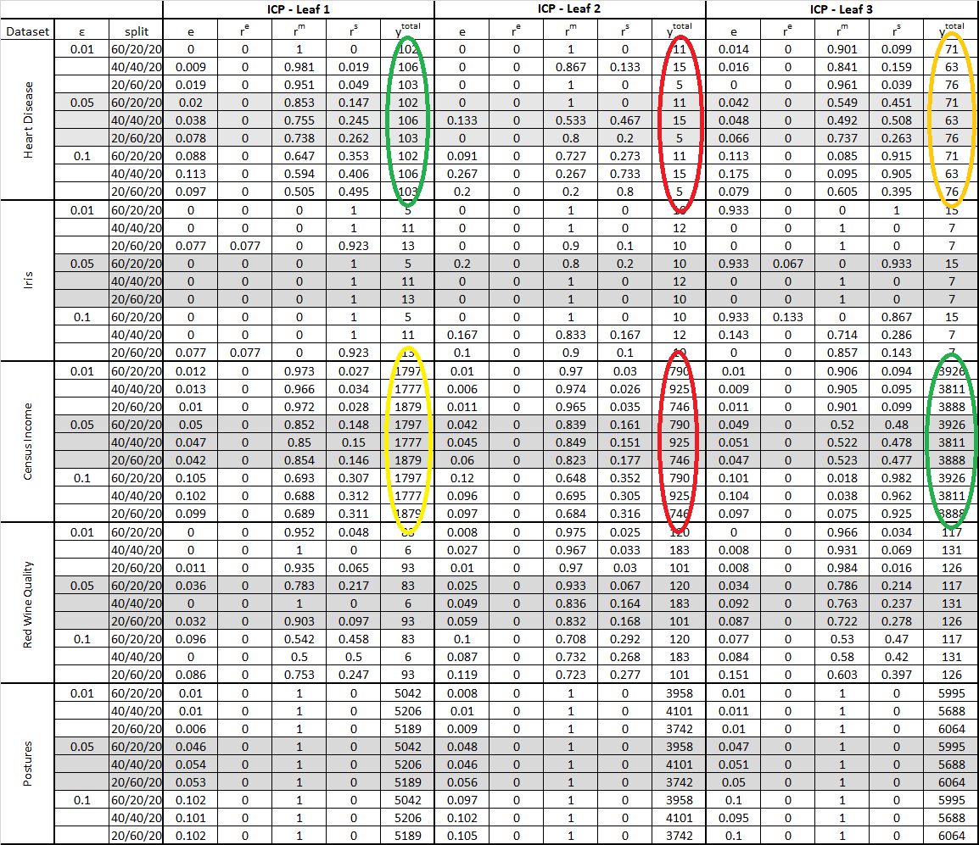
TABLE: Results in all datasets (Leaf I.C.P.s only)

Slide 32
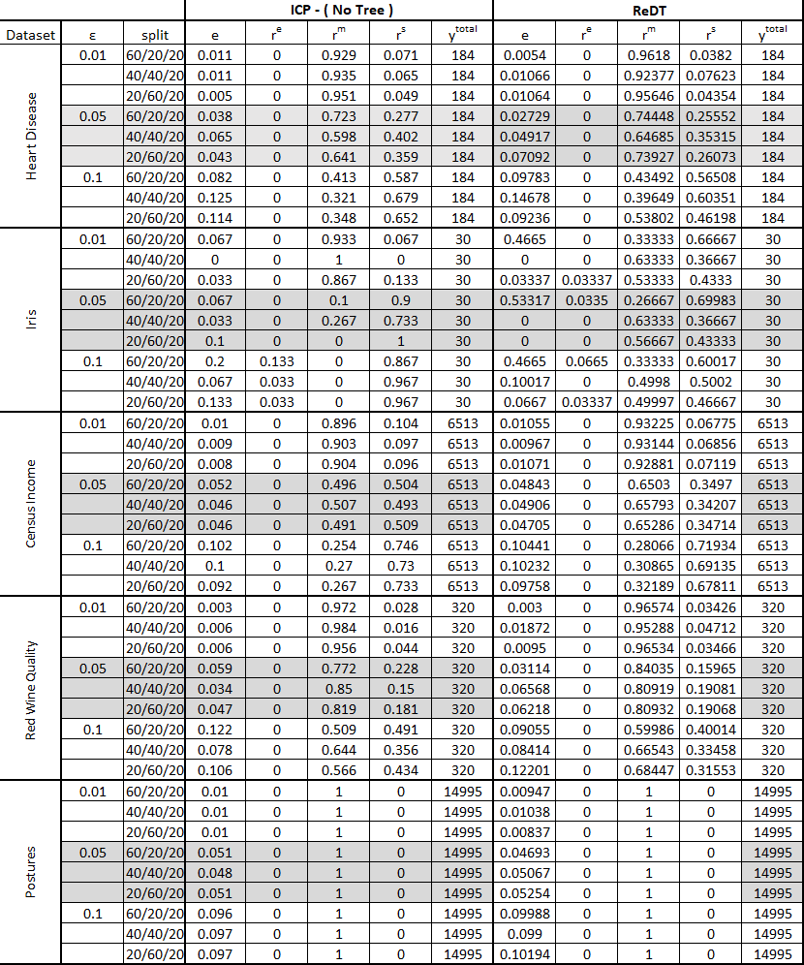
TABLE: Results in all datasets (Normal I.C.P. vs ReDT)

Slide 33
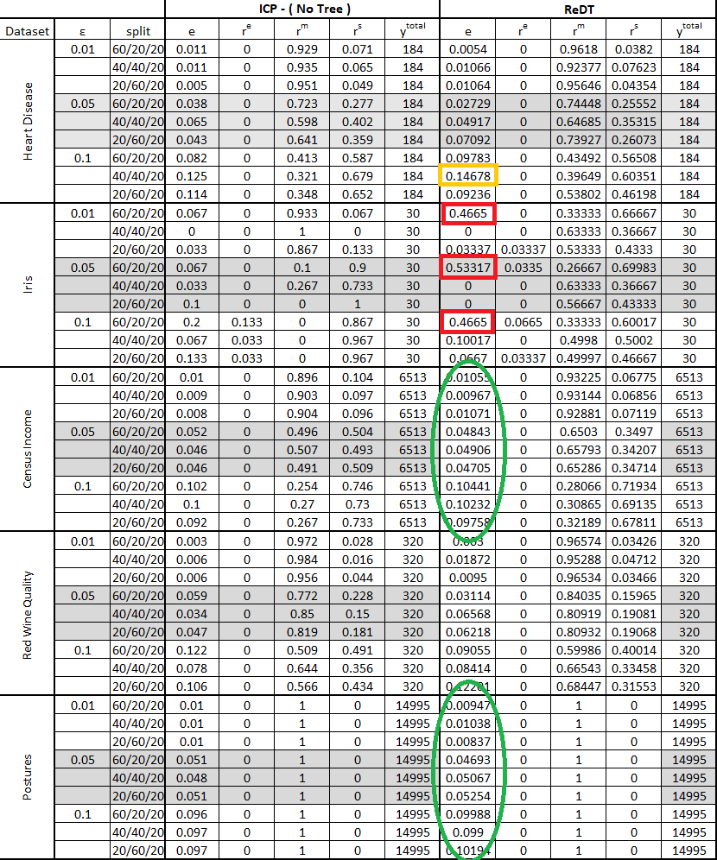
TABLE: Results in all datasets (Normal I.C.P. vs ReDT)

Slide 34
Project Conclusion

Slide 35
Project Conclusion
We proposed a new algorithm that combines explainability and reliability
We proposed a new pruning algorithm for our ReDT trees
Given enough data, validity can be preserved, both locally at leaf node level, and globally as a whole.
Similar performance to the regular I.C.P., plus explanations!

Slide 36
Thank you for your attention!
Any questions?

