Slide 1


Presentation of 1st assignment - ece437
Dimitrios Tsalapatas
03246
Algorithm cad 1
13/11/2023

Slide 2
Concept
The main concept of HW_1 is to create a working TCL shell that supports:
Tab-completion for all commands
History of commands
GNU Readline features
System Commands
The program runs an infinite loop where reads commands from User and execute them correct.
If User types “quit” the program ends!

Slide 3
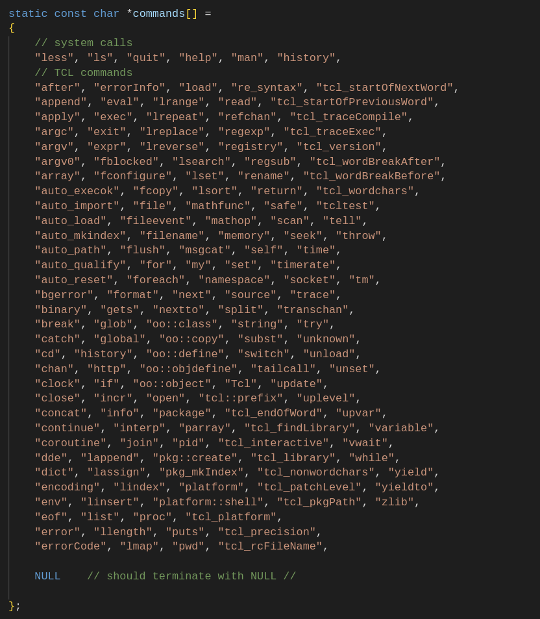
Tab Completion
To create the tab completion we use the GNU Readline Library.
Using as guide the manual of library we create
Global array of type char *commands[], where we store all the comands for system calls and for TCL.
The last element should be NULL!

Slide 4
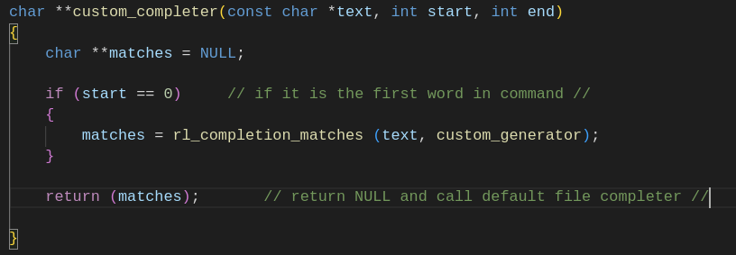
Tab Completion
The function char **custom_completer, which has three default arguments from library.
If the command is the first word, do custom_completion for commands
Else return NULL, to call the default filename_completer

Slide 5
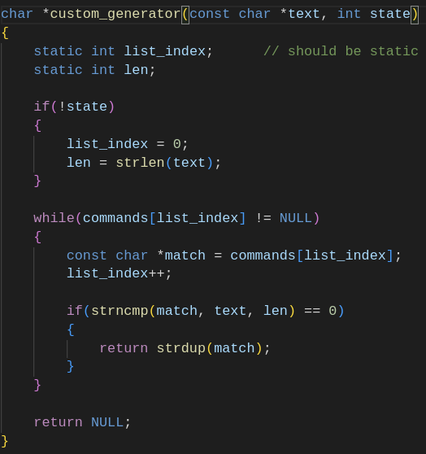
Tab Completion
The function char *custom_generator, which has two default arguments from library.
It searches the global array for matches and if it finds one it returns a copy of it (match)
Variables list_index and len should be static to keep previous value in all iterations, while state != 1

Slide 6
Tab Completion
The function char *custom_generator, which has two default arguments from library.
It searches the global array for matches and if it finds one it returns a copy of it (match)
Variables list_index and len should be static to keep previous value in all iterations, while state != 1

Slide 7
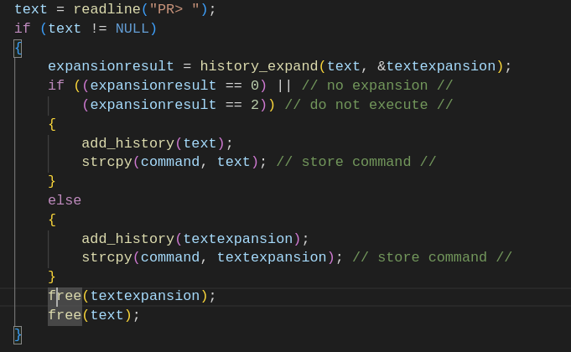
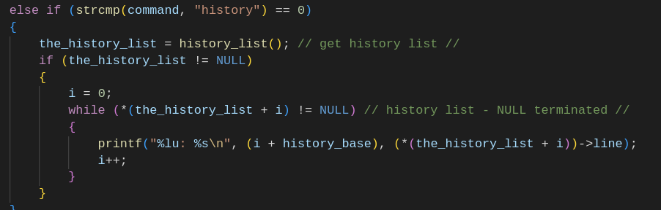
History
When we write a command, we need to store it in correct format in the history, in order to have access later
When we write history, we get a list of all previous commands

Slide 8
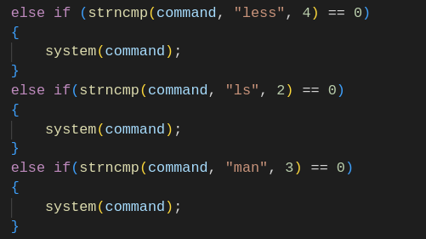
System commands
For system commands, program supports: ls, less, man
In order to execute these commands we use library stdlib.h and pass them to function system()
We use strncmp to check exact the length of command

Slide 9
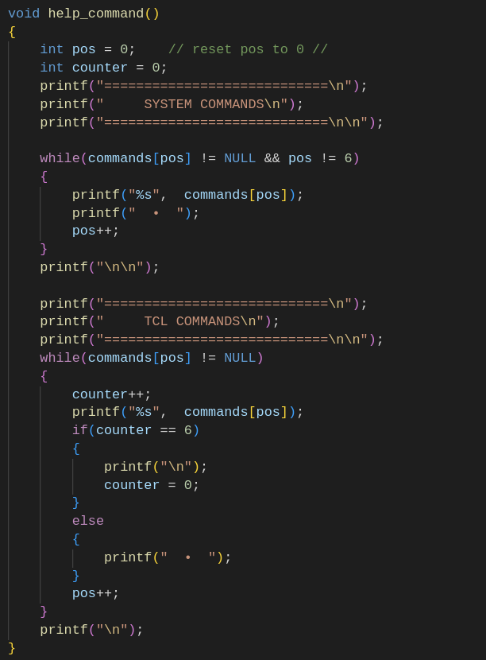
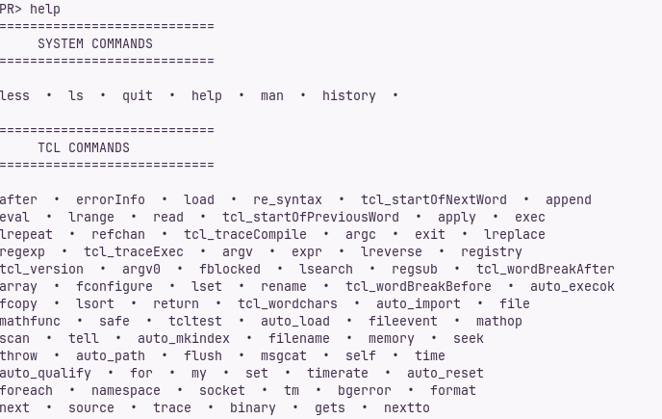
Custom Commands
A custom command, just to print all available commands on User

Slide 10
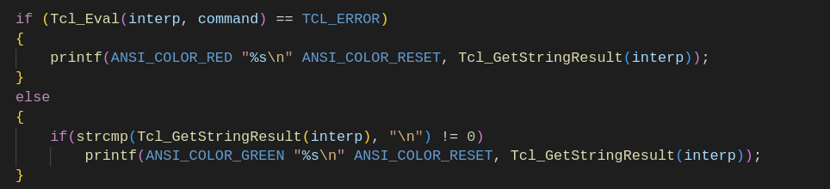
TCL Commands
In order to support TCL commands, we need to use library tcl.h and set a tcl_interpreter
We pass all other commands in Tcl_Eval and if it is wrong, tcl prints the correct format
After that we can call function Tcl_Eval() and evaluate all tcl_commands.
Then we print the result using Tcl_GetStringResult(interp)

Slide 11

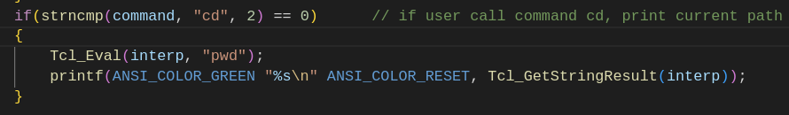
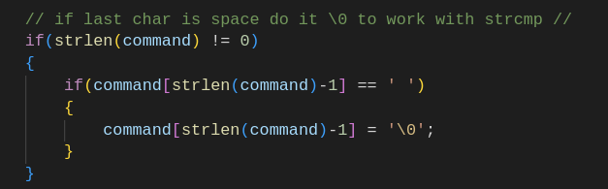
Extras
Print errors of tcl_commands with red color and answers with green color, in order to be more user-friendly
When user call command “cd”, also call command “pwd” to show him the current path
In commands if last character is ‘ ‘ change it with ‘\0’ to be able to call correctly, quit and history commands

Slide 12
Thanks for your time!
Do you have any questions?

