Slide 1
Vim
Gentle Introduction
Ahmed Yasser
Tony Medhat

Slide 2
Agenda
Text Editors and IDEs
Vim and NeoVim
Vim Modes
Vim Interface
Vim Motions
Vim Grammer
Break
Vim Modes (cont.)
:Help
LSP and DAP
NeoVim Distributions

Slide 3
Text Editors and IDEs

Slide 4
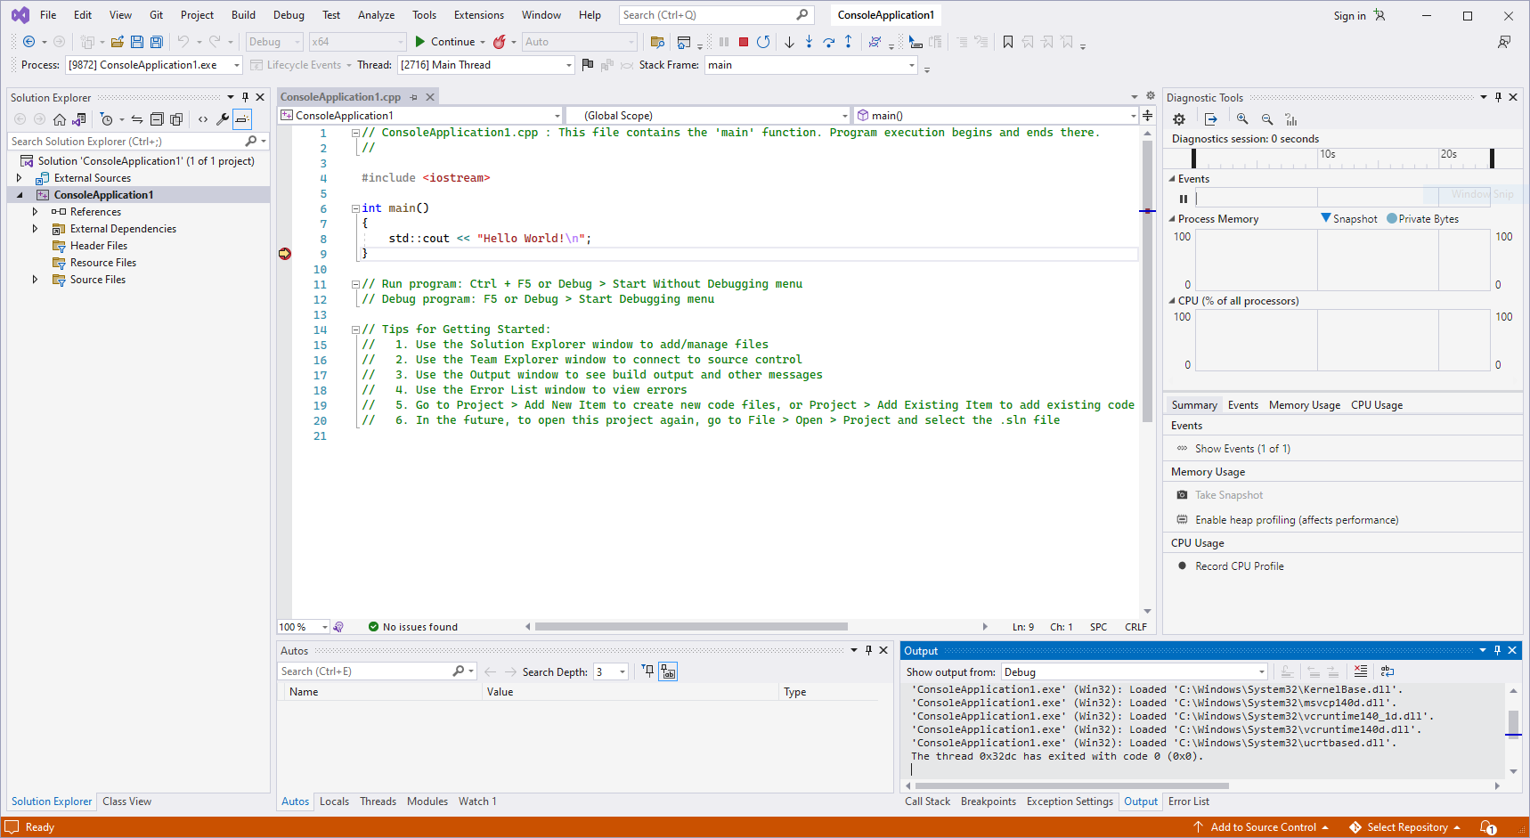
Integrated Development Environments

Slide 5
Integrated Development Environments (IDEs)
Specialised
Resource Heavy
Plug and Play

Slide 6
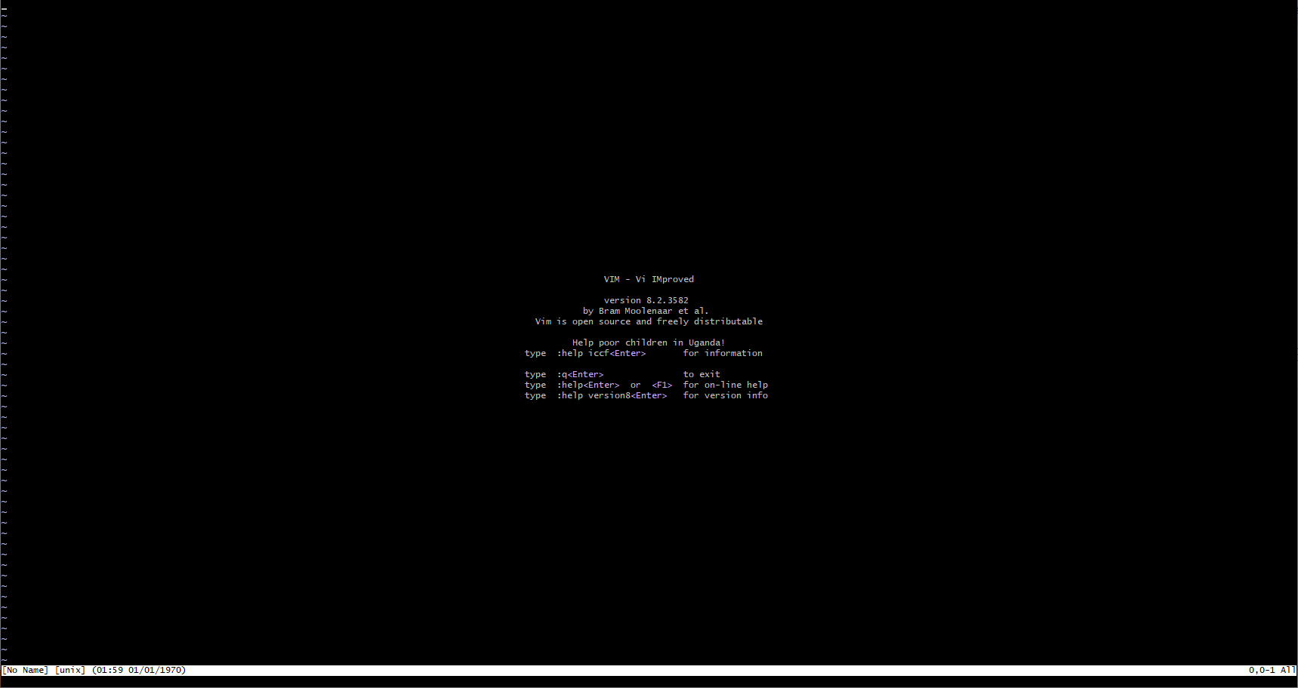
Text Editor (Default)

Slide 7
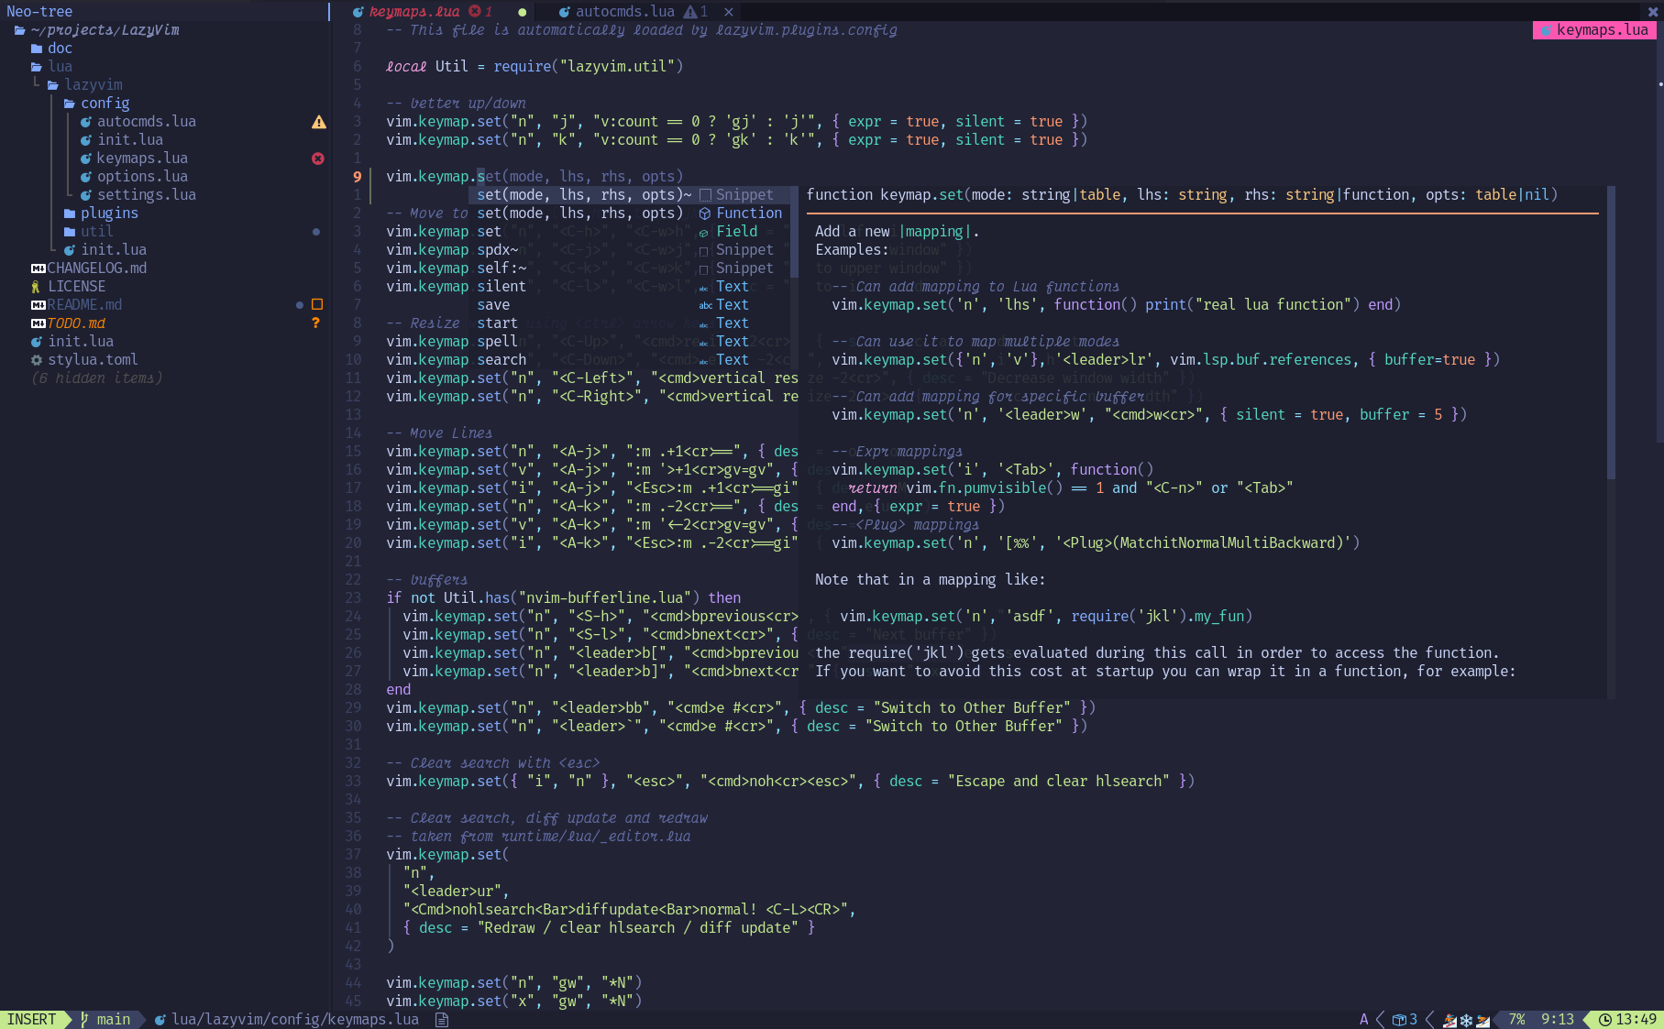
Text Editor (LazyVim)
https://www.lazyvim.org/

Slide 8
Text Editors
Lightweight
Extensions
Very efficient
Command Line Integration
Can be configured to work with any language

Slide 9
Editing Experience
Intellisense (Autocomplete)
Code actions
Diagnostics (i.e. errors, warnings, …)
Highlights
Command line integration
Refactoring

Slide 10
Vim

Slide 11
Vim
Vim is a highly configurable text editor built to make creating and changing any kind of text very efficient.
It is included as "vi" with most UNIX systems and LINUX.
Initial release 2 November 1991; 32 years ago

Slide 12
NeoVim

Slide 13
NeoVim
NeoVim is a hyperextensible Vim-based text editor.
Initial release 1 November 2015; 8 years ago
Builtin LSP client for semantic code inspection and refactoring (go-to definition, "find references", format, …)
Modern terminal features such as cursor styling, focus events, bracketed paste.
Uses Lua for configuration.

Slide 14
Vim Modes and Interface

Slide 15
Vim Modes
A mode is just a way to tell Vim how it should interpret your keystrokes.
Most Common Modes:
Normal
Insert
Visual
Cmdline

Slide 16
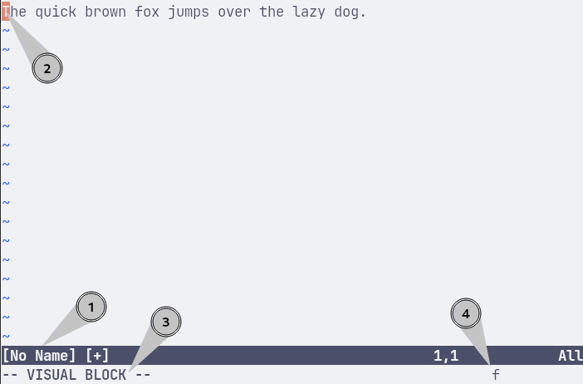
Vim Interface
Buffer Name (File Name).
Buffer Contents (File Contents).
Active Mode.
Active Command.

Slide 17
Moving in Vim

Slide 18
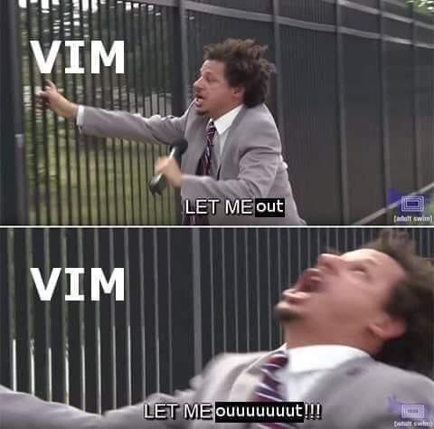
Quick Start
i Enter insert mode
<ESC><ESC> Return to normal mode
:q Quit

Slide 19
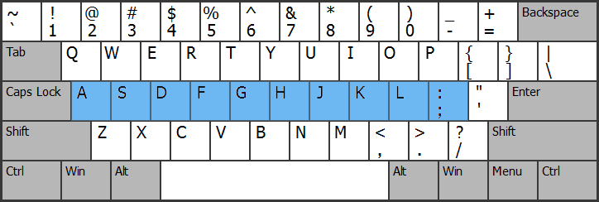
Moving in Vim
Vim is optimized for the touch typist.
Keep your fingers on the Home Row
https://kompirumpi.blogspot.com/2017/01/mengenal-home-row-keys-top-row.html

Slide 20
Moving in Vim
h Arrow-Left
j Arrow-Down
k Arrow-Up
l Arrow-Right

Slide 21
Horizontal Movement

Slide 22
Horizontal Movement
w Move forward to the beginning of the next word
W Move forward to the beginning of the next WORD
b Move backward to the beginning of the previous word
B Move backward to the beginning of the previous WORD
e Move forward to the end of the next word
E Move forward to the end of the previous WORD
ge Move backward to the end of the previous word
gE Move backward to end of the previous WORD
word - A word consists of a sequence of letters, digits and underscores, or a sequence of other non-blank characters, separated with white space
Word - A WORD consists of a sequence of non-blank characters, separated with white space. An empty line is also considered to be a WORD.

Slide 23
Horizontal Movement
f {char} Move forward to the given {char}
F {char} Move backward to the given {char}
t {char} Move forward to before the given {char}
T {char} Move backward to before the given {char}
; Repeat the last search in the same line using the same direction
, Repeat the last search in the same line using the opposite direction

Slide 24
Vertical Movement

Slide 25
Vertical Movement
gg Go to the first line
G Go to the last line
{ Jump to the previous paragraph
} Jump to the next paragraph
Ctl-d Scroll down half a page
Ctl-u Scroll up half a page

Slide 26
Editing

Slide 27
Basic Editing Commands
r Replace character under cursor
x Delete character under cursor
X Delete character before cursor
p Put the clipboard after cursor
P Put the clipboard before cursor

Slide 28
Vim Grammer

Slide 29
VERBS
Verbs are operators.
An operator just perform an action on some text.
These are the most used ones.
y Yank text (copy)
d Delete text and save to register
c Delete text, save to register and start insert mode
gU Convert text to UPPERCASE
gu Convert text to lowercase

Slide 30
NOUNS (Motions)
Nouns can be Motions.
Motions are used to move around in Vim.
This is a list of popular Vim motions.
w Move forward to the beginning of the next word
} Jump to the next paragraph
$ Jump to the end of the line
0 Jump to the beginning of the line
^ Jump to first char in the beginning of the line

Slide 31
Vim Grammer
Verb + Noun
Suppose you have this expression:
const learn = “vim”;
y$ To yank everything from your current location to the end of the line
dw To delete from your current location to the beginning of the next word

Slide 32
NOUNS (Motions)
Motions also accept count number as argument.
y2h Yank the next two characters to the left
d2w Delete the next two words
c2j Change the next two lines down

Slide 33
NOUNS (Text Objects)
Texts often come structured (“ ”, ( ), <h1>tag<h1>, Word, P,...)
Vim has a way to capture this structure with text objects.
Text objects are used with operators, same as motions.
There are two types of text objects: inner and outer text objects.

Slide 34
NOUNS (Text Objects)
i + object Innertext object (Exclusive)
a + object Outer text object (Inclusive)

Slide 35
NOUNS (Text Objects)
Inner text object selects the object inside without the white space or the surrounding objects.
Outer text object selects the object inside including the white space or the surrounding objects.
di( Delete innertext without deleting the parentheses
da( Delete innertext and parentheses

Slide 36
NOUNS (Text Objects)
w A word
p A paragraph
( or ) A pair of ( )
{ or } A pair of { }
[ or ] A pair of [ ]
< or > A pair of < >
t XML Tag
“ A pair of “ “
‘ A pair of ‘ ‘
` A pair of ` `
diw Delete word under cursor
daw Delete word under cursor and the space after/before
cit Change text inside tag
cat Change text inside tag and the tag itself

Slide 37
Basic Editing Commands
d Delete up to {Motion|Text-Object}
y Yank up to {Motion|Text-Object}
c Change up to {Motion|Text-Object}
s Delete character under cursor, then enter insert mode

Slide 38
Basic Editing Commands
In general, by typing an operator command twice, Vim performs a linewise operation for that action.
yy Yank (copy) line under cursor
dd Delete line under cursor
cc Change line under cursor
gUgU UPPERCASE line under cursor
gugu lowercase line under cursor

Slide 39
Basic Editing Commands
Y (y$) Yank (Copy) from cursor to the end of the line
D (d$) Delete from cursor to the end of the line
C (c$) Change from cursor to the end of the line

Slide 40
Basic Editing Commands
> Indent one shiftwidth up to {Motion|Text-Object}
>> Indent line under cursor by one shiftwidth
< De-indent up to {Motion|Text-Object} by one shiftwidth
<< De-indent line under cursor by one shiftwidth
= Auto indent up to {Motion|Text-Object}
== Auto indent line

Slide 41
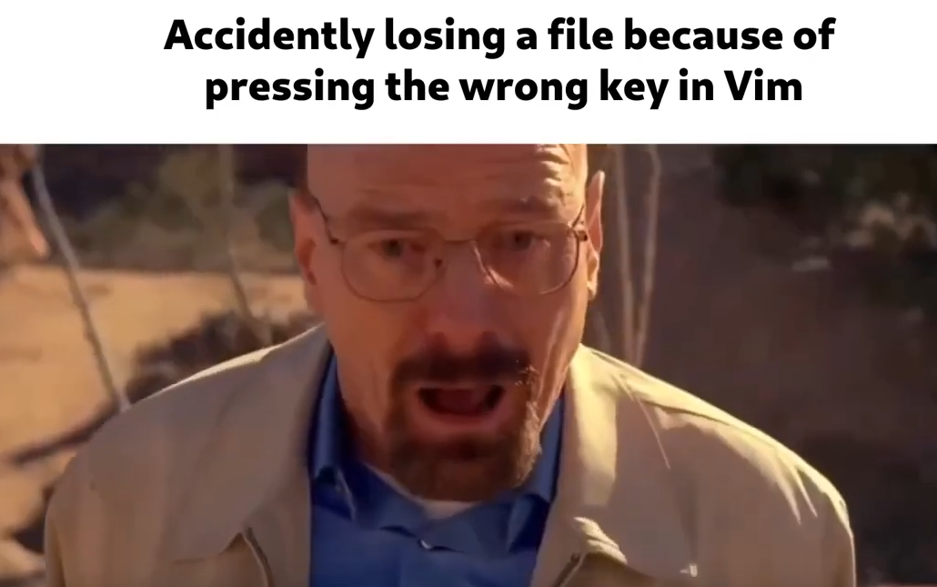

Slide 42
Undo and Redo

Slide 43
Undo and Redo
Vim undo chunks
A chunk is just the text you write when you go to insert mode until you return back to normal mode
It my be single character or multiple lines or a whole file
U Undo change
Ctl-r Redo change

Slide 44
Insert Mode

Slide 45
INSERT Mode
Insert mode is like most editors.
What you type is what you get.

Slide 46
INSERT Mode
i Insert text before cursor
I Insert text before the first non-blank character
a Append text after cursor
A Append text at the end of line
o Begin a new line below the cursor, then enter insert mode
O Begin a new line above the cursor, then enter insert mode
s (Substitute) Delete character under cursor, then enter insert mode
S (Substitute) Delete line under cursor, then enter insert mode
gi Insert text in same position where the last insert mode was stopped
gI Insert text at the start of line (column 1)

Slide 47
INSERT Mode
You can exit insert mode using <Esc> key.
When you make a typing mistake, you don’t need to type <Backspace> repeatedly.
You can also delete several characters at a time while in insert mode.
Ctl-h Delete one character to the left
Ctl-w Delete one word
Ctl-u Delete from the current cursor position to the beginning of the line

Slide 48
INSERT Mode
Vim can execute a normal mode command while in insert mode.
When you press <Ctl-o> while you are in insert mode, you will be able to perform one normal mode command.
For example:
Ctl-o zz Center cursor
Ctl-o D Delete from current location to the end of the line

Slide 49
Dot Command

Slide 50
Dot Command
Our work is repetitive by nature.
Vim is optimized for repetition.
We can always replay the last change with a single keystroke.

Slide 51
Dot Command
The Dot command lets us repeat the last change.
Any time you update (add, modify, or delete) the content of the current buffer, you are making a change.

Slide 52
Break

Slide 53
Cmdline Mode

Slide 54
Cmdline Mode
In Cmdline mode, you can execute a wide range of commands to control various aspects of your editing session and manipulate the text in your files.
Common tasks you can perform in Cmdline mode:
File operations.
Search and Replace.
Copy, Cut and Paste.

Slide 55
Cmdline Mode
It provides a way to interact with the editor through a command-line interface rather than using the traditional visual interface.
Cmdline mode is invoked by typing ‘:’ in normal mode, followed by entering the desired commands.

Slide 56
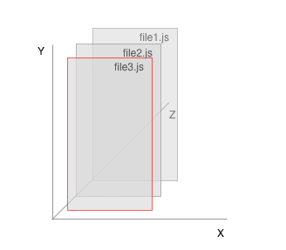
Windows and Buffers
:e[dit] {filename} Opens {filename} to edit
:r[ead] {filename} Inserts the content of {filename} into the current buffer.
:ls List all opened buffers
:b [N] Edit buffer [N] from the buffer list.
:bn[ext] Go to next buffer in buffer list.
:bp[revious] Go to previous buffer in buffer list.
view window
buffers (files)
https://dev.to/iggredible/using-buffers-windows-and-tabs-efficiently-in-vim-56jc

Slide 57
Windows and Buffers
:q[uit] Quit current window (fails if buffer has unsaved changes)
:q[uit]! Quit current window, Discard any changes
:qa[ll] Exit Vim (fails if buffer has unsaved changes changed)
:w[rite] Write buffer to disk
:wa[ll] Write all open buffers to disk
:wq Write buffer to dist and quit
:wqa[all] Write buffer to disk and quit all open buffers

Slide 58
Visual Mode

Slide 59
Visual Mode
Vim has three different visual modes:
v Character-wise visual mode (Visual mode)
V Line-wise visual mode (Visual Line mode)
Ctl-v Blockwise visual mode (Visual Block mode)

Slide 60
Visual Mode
Character-wise visual mode works with individual characters.
Line-wise visual mode works with lines.
Block-wise visual mode works with rows and columns.

Slide 61
Visual Mode
While you are inside a visual mode, you can switch to another visual mode by pressing either v, V, or <Ctl-V>.
For example, if you are in line-wise visual mode and you want to switch to blockwise visual mode, run <Ctl-V>.
While in a visual mode, you can expand the highlighted text block with Vim motions.

Slide 62
Visual Mode
The visual mode shares many operations with normal mode.
the grammar rule from normal mode, verb + noun, does not apply.
The grammar rule in visual mode is:
Noun + Verb

Slide 63
:help

Slide 64
:help
Open a window and display the help file in read-only mode.
:h[elp] {keyword} Open help for {keyword}

Slide 65
User Manual
Read the user manual.
:help user-manual

Slide 66
Language Server Protocol (LSP)

Slide 67
Language Server Protocol (LSP)
Adding features like auto complete, go to definition, or documentation on hover for a programming language takes significant effort.
Traditionally this work had to be repeated for each development tool.
A Language Server provides language-specific smarts and communicates with development tools.

Slide 68
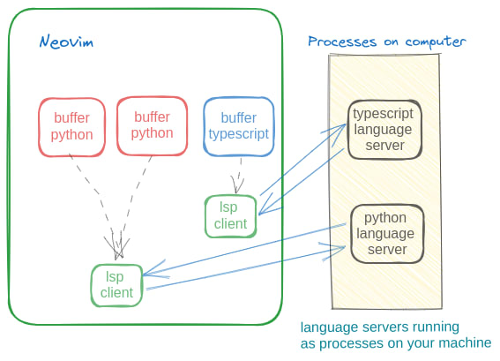
Language Server Protocol (LSP)
https://dev.to/rishavmngo/how-to-setup-lsp-in-neovim-nh1

Slide 69
Debug Adapter Protocol

Slide 70
Debug Adapter Protocol (DAP)
The Debug Adapter Protocol makes it possible to implement a generic debugger for a development tool.
Communicates with different debuggers via Debug Adapters.
Debug Adapters can be re-used across multiple development tools.

Slide 71
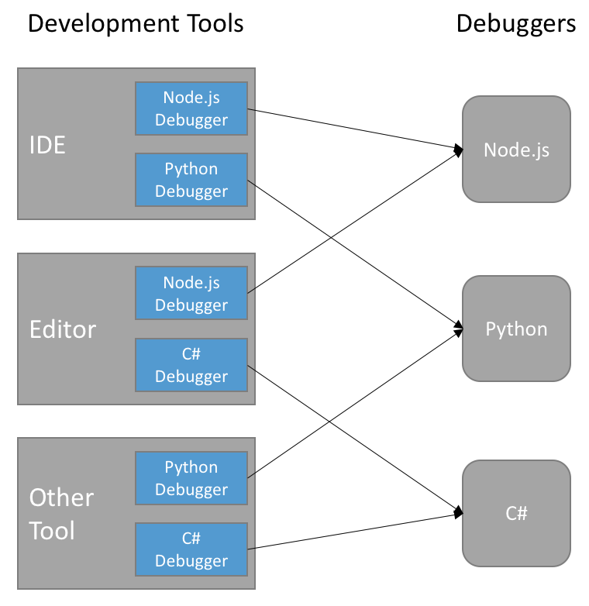
Debug Adapter Protocol (DAP)
https://microsoft.github.io/debug-adapter-protocol/overview

Slide 72
NeoVim Distributions

Slide 73
NeoVim Distributions
Provides excellent starting points for crafting your own custom configuration.
Provides an out-of-the-box setup that can be used effectively without modification.
Examples:
LazyVim
NvChad
LunarVim
AstroNvim
Kiskstart

Slide 74
The Vimmer Guide

Slide 75
The Vimmer Guide
User-manual
Vimtutor
Vim Cheat Sheet
Getting Started With Lua
ThePrimagean Youtube Channel
JetBrains’ IdeaVim
VSCode Neovim Plugin

Slide 76

Thanks

