Slide 1
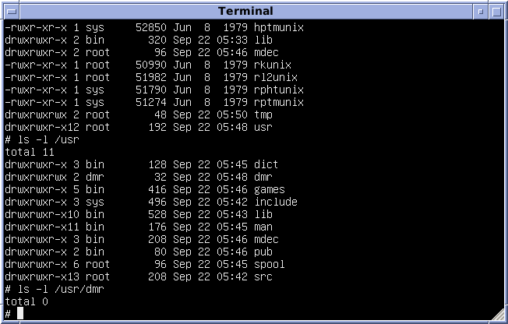

Unix, Linux and the command line
Professor Mark Pallen

Slide 2
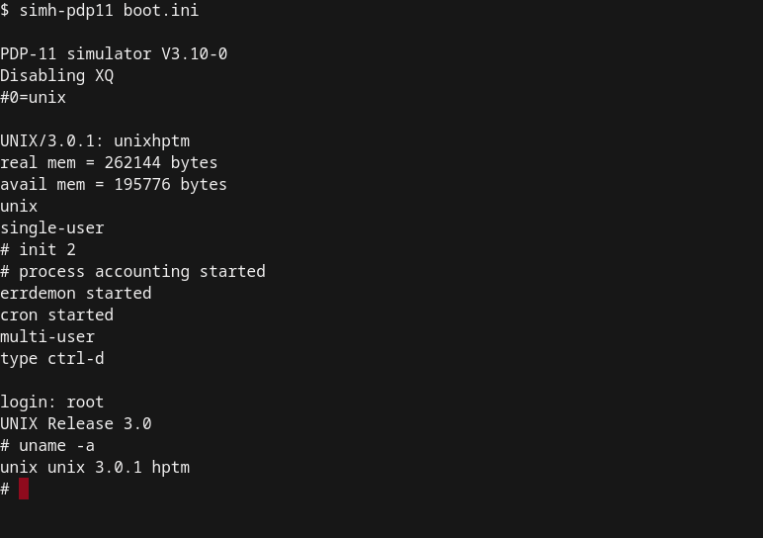

What is UNIX?
Family of multitasking, multiuser operating systems
Developed in 1960s at Bell Labs
Orchestrates components of computer
processor, on-board memory, disk drives, keyboards, monitors, etc. to perform useful tasks
Accessed through command line interface on a terminal
https://en.wikipedia.org/wiki/Unix

Slide 3

Unix evolves
In 1970s and 1980s, fragmented into numerous proprietary flavours
Unix wars
e.g. BSD, Solaris
In 1991, Linus Torvalds created Linux
a free open source Unix-like OS
Linux distributions
Ubuntu, Red Hat/Fedora, SUSE etc
Most bioinformatics software freely available on Linux
Linus Torvalds : "Software is like sex: it's better when it's free".
https://en.wikipedia.org/wiki/History_of_Unix
https://en.wikipedia.org/wiki/Linux

Slide 4
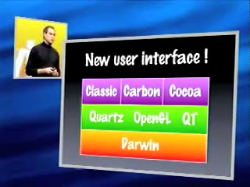


Unix evolves
In 2000, Steve Jobs adopted BSD Unix as basis for MacOS
with a core named Darwin “because it’s about evolution”
later built into iOS on iPhones
Android phones running Linux since 2008
ChromeOS

Slide 5
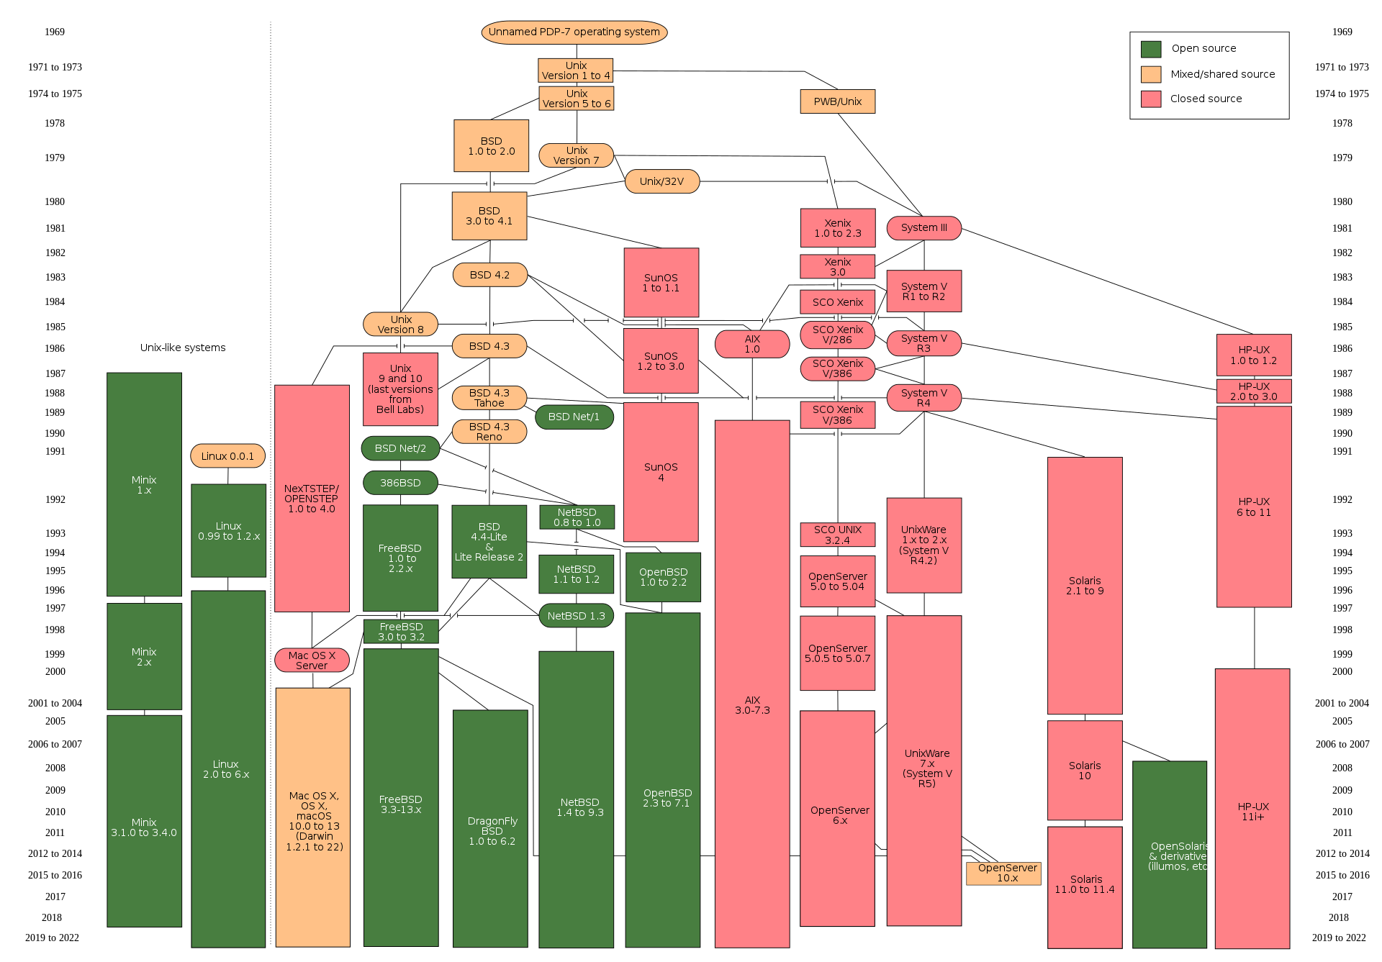
Macs and iPhones run on Unix
Android phones run on Linux!
https://en.wikipedia.org/wiki/History_of_Unix

Slide 6
Why use Unix-like systems
good for automation of computer tasks
fast and efficient
performing complex operations with very few key strokes
operating on large number of objects
comprised of
the kernel (with commands to interact with it)
standard utility programs/services
system configuration files

Slide 7
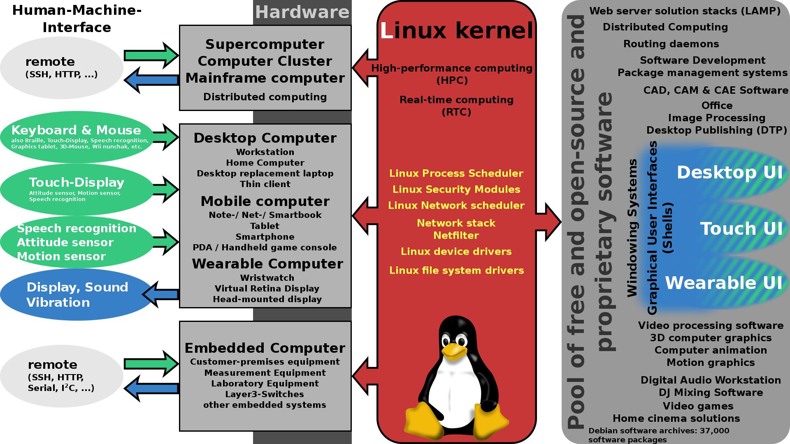
https://en.wikipedia.org/wiki/Linux_distribution

Slide 8
How do I interact with Linux?
using a command line interface you explicitly type commands and have Linux execute them (using a shell)
what is a shell?
program that interprets the commands we wish to have executed by Linux
default is often “bash”
Bourne again Shell
PS: most Linux distributions have a GUI too!

Slide 9
Command line v. Graphical User Interface
Command line
have to remember commands
powerful and versatile
easy to write code for
easy to create pipelines
cutting edge of bioinformatics
GUI
intuitive, easy to use
less power and versatility
hard to write programs for
hard to create pipelines
lag time in development

Slide 10
Linux commands and file names
Case sensitive, so:
Exit is not the same as exit
Bowtie is not the same as BOWTIE
Gate is not the same as gatE
In Linux you use forward slash “/” as directory separator
Unlike Windows, which has “\” as the directory separator
Linux file names can be descriptive; do not require a file extension, but usually do have one; spaces not allowed
origin_of_species.txt

Slide 11
Files and Linux
Linux users are working with
applications
files
different file types/usage in Linux
Basic files text or binary type files (sequence files, etc.)
Executable files (programs). Programs such as bowtie, gate, ls, cp, cd, etc.

Slide 12
Basic command structure
Basic form of a Unix command is:
command [-options] [arguments]
Example: ls -l /tmp
“ls” is the command. It lists contents of a directory
“-l” is option or flag: modifier of default for command
“/tmp” is the argument. Contents of this directory are shown

Slide 13
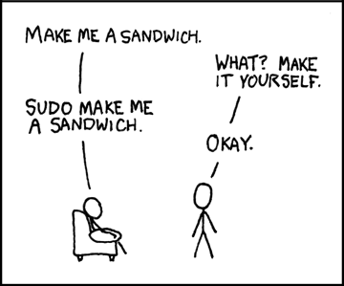
Basic command structure
Aborting a shell command
most Unix systems allow to abort the current command by typing Control-C or Control-Z
Forcing a command to work:
sudo

Slide 14
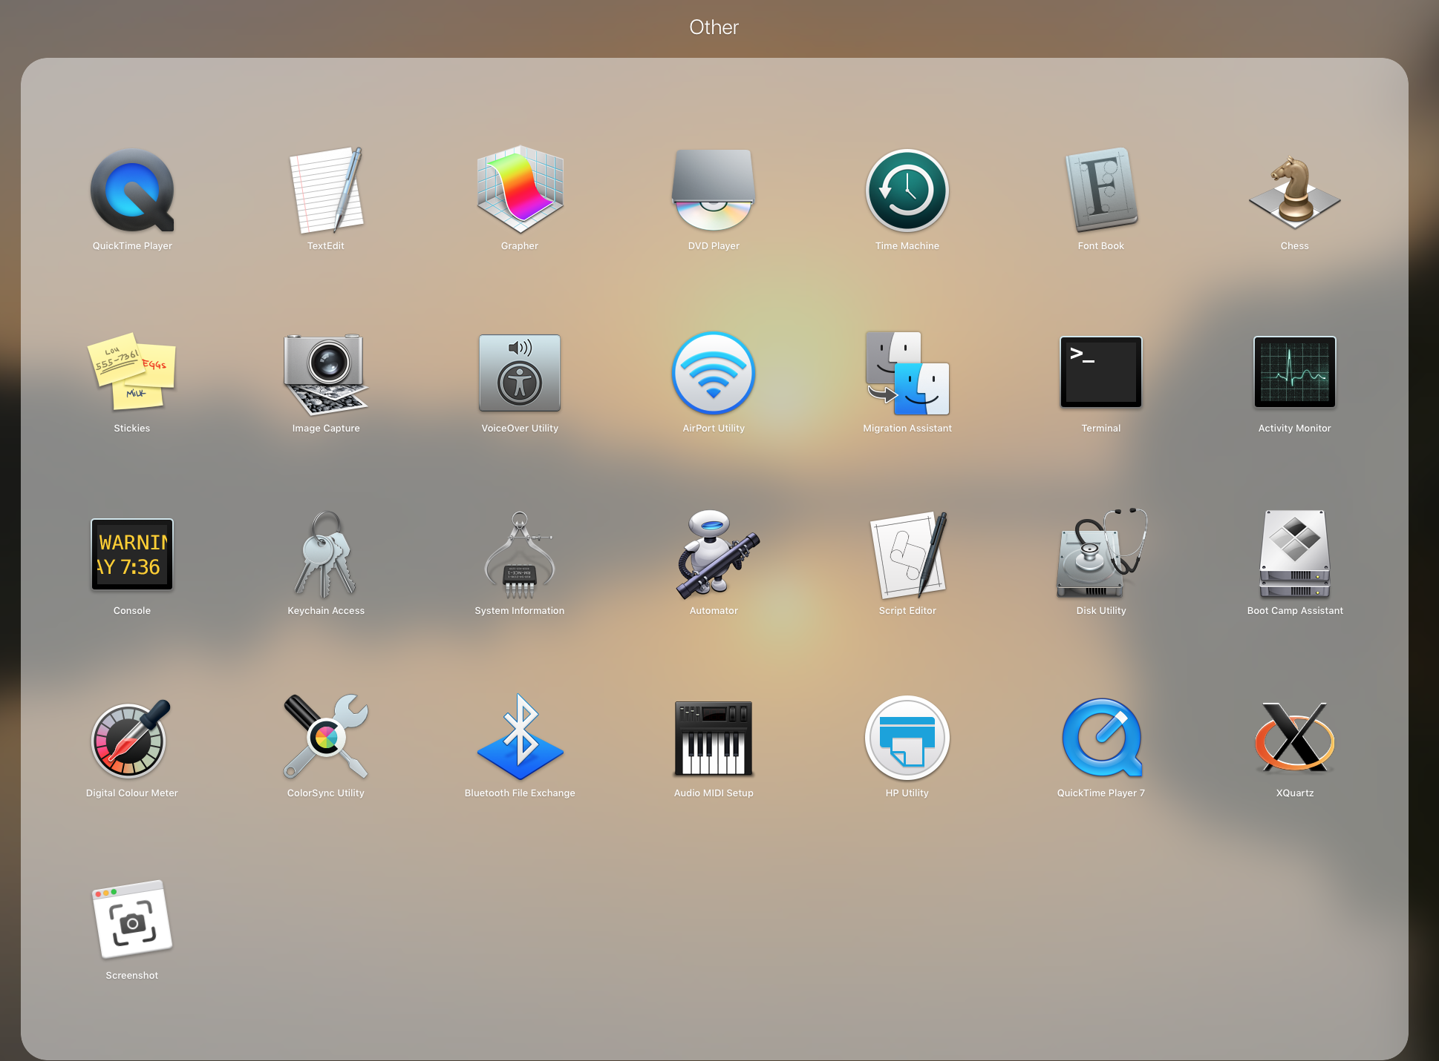
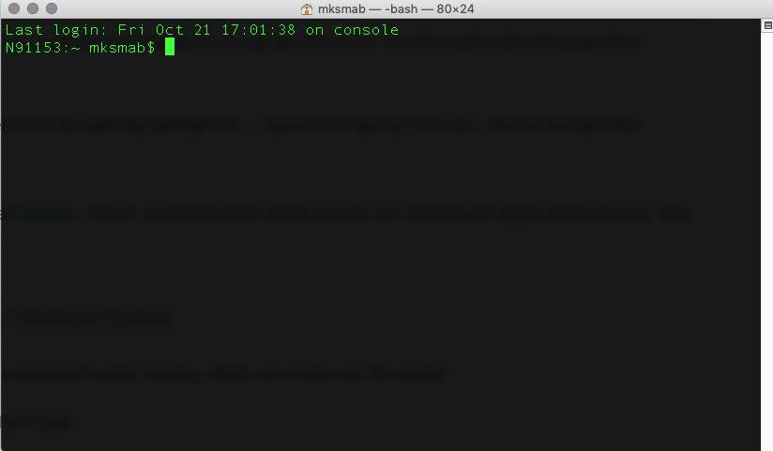
Using the Terminal

Slide 15
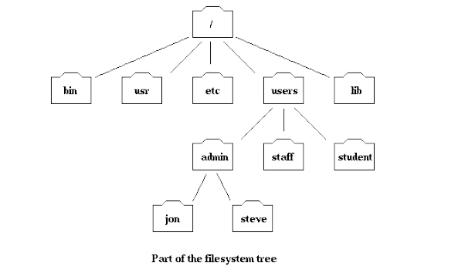
Filesystem: Relative and Absolute Path
Linux file system is hierarchical, resembles a tree
user in the “admin” directory can access “steve” directory by specifying the
relative path “steve”
absolute path “/users/admin/steve”.
“users” can be accessed by specifying “../users” or “/users”

Slide 16
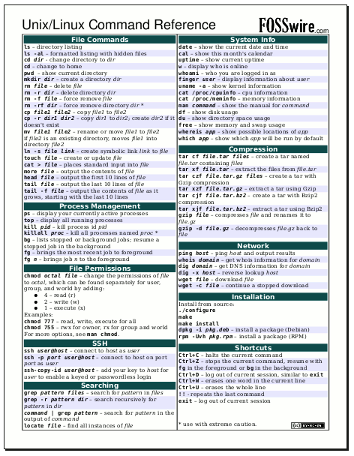

Unix cheat sheets
https://fosswire.com/post/2007/08/unixlinux-command-cheat-sheet/

Slide 17
Working on a Linux Computer
Linux can run on a personal workstation
Linux/Unix is often run on a server (multi-user)
Three pieces of information – user name, password and server name or IP address
Use the Terminal on your Mac
remote login may not allow display of graphics - text mode interaction only
Linux runs on Virtual Machines that we use as servers

Slide 18


Everybody hates Linux!
There are two major products of Berkeley, CA -- LSD and UNIX. We don't believe this to be strictly by coincidence.
UNIX was not designed to stop you from doing stupid things, because that would also stop you from doing clever things.
Unix is user-friendly. It's just picky about who its friends are.
There is no place like ~
https://en.wikipedia.org/wiki/Worse_is_better

Slide 19
Fun commands
yes you_must_stop_this_using_Ctrl_Z
nc towel.blinkenlights.nl 23
Say I hate Unix already, let me out of here

