Slide 1
What makes a successful protest?
Data Science project, 2020
Dima Nirenshteyn 321371072

Slide 2
Table of contents
Violent/Non-violent protests success – analyzing the relationship between
violent / non-violent protests and their success
Protests size and success – analyzing the relationship between protest size and success
Protest Success Prediction – building model to predict a successful protest.
Conclusions
* Check notebooks in github to see further information

Slide 3
The datasets
The datasets are taken from online sources (links in github readme).
I choose to take those datasets and not to scrap my own because I wanted to analyze
a dataset which has a lot of features, based on interesting real events .
‘World Population’ was used to merge the two datasets and get the total population
of certain country in a certain year.
‘NAVCO’ - a dataset of violent and non-violent campaigns and their outcomes.
‘World Population’ - a dataset of population of each country, 1960-2018

Slide 4
Violent/Non-violent protests success
questions:
Is there a difference in violent / non violent protests success rate
What is the average use of violence for both violent and non violent protests
What is the violent / non violent protests success rate throughout the years
Is there a relationship between protest size and violence
What is the violence mean of successful and failed protests

Slide 5
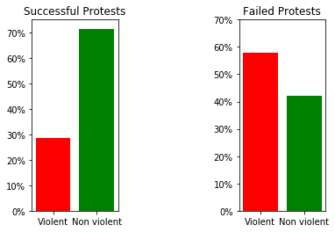
Violent/Non-violent protests success
results:
Most of the successful protests were non violent
Most of the failed protests were violent

Slide 6
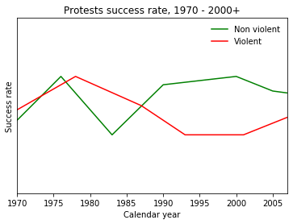
Violent/Non-violent protests success
results:
Non violent protests have higher success rate than violent protests in the past years

Slide 7
Violent/Non-violent protests success
results:
Violent protests average participants: 188,000
Non violent protests average participants: 575,000
The non violent protests attracted around 3 times as many participants as the average
violent protest.
From the top 25 largest protests
22 were nonviolent
3 were violent

Slide 8
Violent/Non-violent protests success
results:
Successful protest average use of violence: 0.38
While total protests average use of violence: 0.81
Conclusion:
- Successful protests use less violence.
- Larger protests are more likely to be non violent.
- For a protest to achieve its final goal, it better be non violent.

Slide 9
Protests size and success
questions:
What is the difference between large protests and small ones
Are certain amount of participants is enough for a protest to achieve final goal
Is there a relationship between number of participants and success
Is it possible to compare protests with the George Floyd and BLM protests

Slide 10
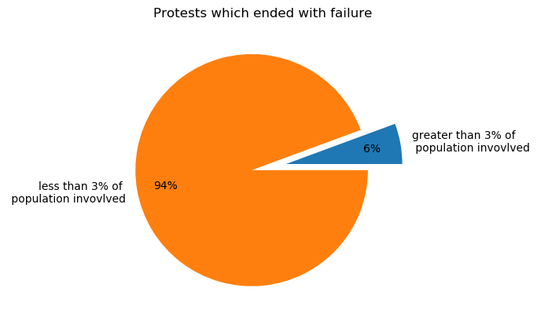
Protests size and success
results:
Perc of total mean = ~3
That will be our limit, separate protests by 3%
Most of failed protests were
less than 3% of total population

Slide 11
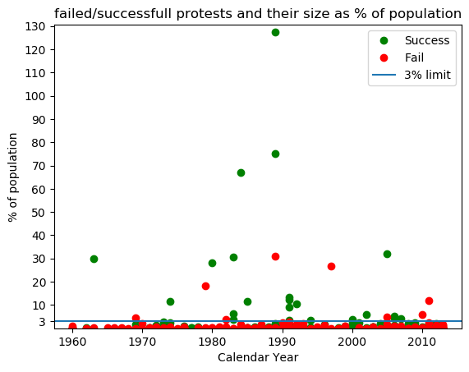
Protests size and success
results:
Most of failed protests had less than 3% of population.
Most of protest with greater than 3% of population achieved final goal.

Slide 12
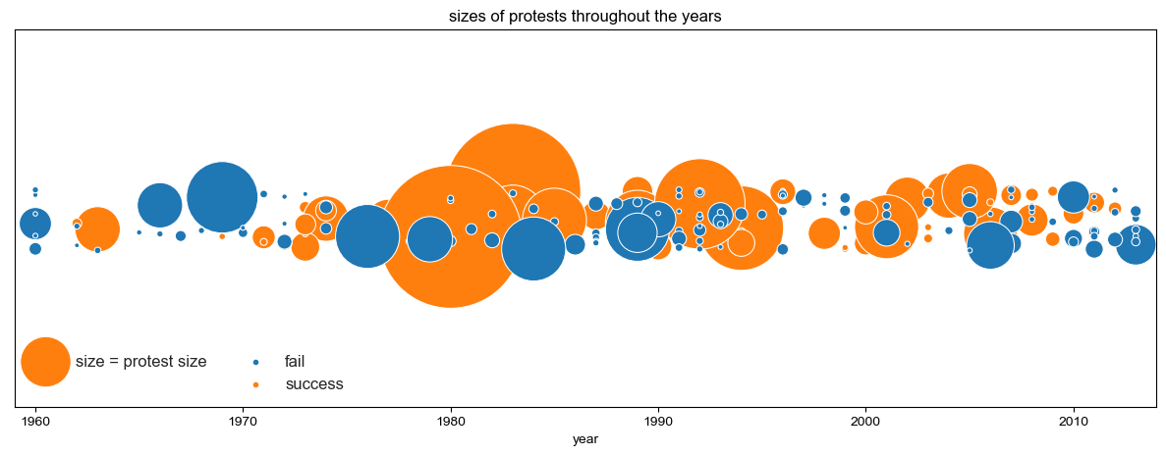
Protests size and success
Conclusions:
Based on the data, a protest has more chances to achieve success if the number of
participants is higher than 3% of the total population.

Slide 13
Protests size and success
question:
If this is the case, how much is 3% of US population?
George Floyd and Black Lives Matter Movement worldwide is a recent campaign that
started in the US and by now is worldwide.
The rise of social media has made protests more accesable. Movements can now spread at very high speeds. If we count the activism in social media, the number of participants in this campaign may be surprisingly high.
BLM movement worldwide – 5,000,000
Pew Research found that #BlackLivesMatter hashtag was used roughly 47,000,000 times on Twitter.
The social media streaming app TikTok has recently surpassed 10,500,000,000 views on the #BlackLivesMatter hashtag.

Slide 14
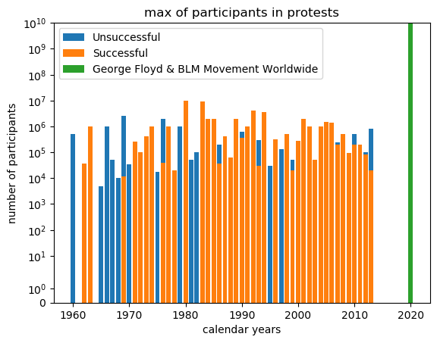
Protests size and success
results:
There is a huge difference between the max amount of participants in BLM campaign vs rest of the protests.
- Note that the y axis scale is
‘symlog’ with base 10

Slide 15
Protest success predict
questions:
Is it possible to predict a successful protest based on 2 factors
Building a model that gets ‘violence’ and ‘above 3%’ to predict successful protests
X = ‘violence’ and ‘above 3%’
y = ‘success’
What is the prediction
What is the best accuracy

Slide 16
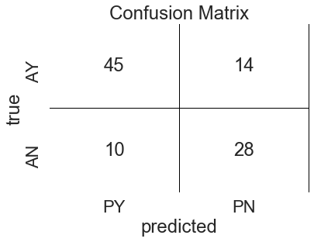
Protest success predict
results:
Trying to predict successful protests using logistic regression
Models confusion matrix:
Model predicted most of successful
protests : 45/59
And most of failed protests : 28/38

Slide 17
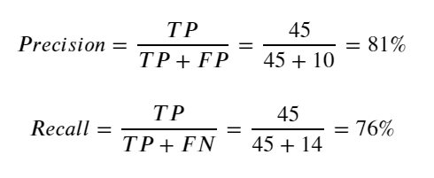
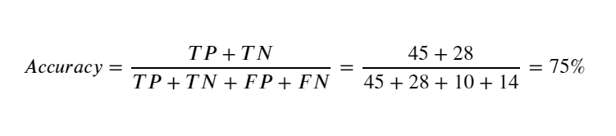
Protest success predict
results:
Precision
Recall
Accuracy

Slide 18
Final Conclusion
Although the exact result for the question what makes a successful protest will depend
on many factors, this model was not bad at predicting successful and failed protests.
Overall we saw that based on this project:
- Non violent protests have more chances to achieve their final goals than violent protests.
- Non violent protests are more likely to attract more participants.
- Protests with participants number higher than 3% of total population are less likely to fail.

