Slide 1
What makes a successful protest?
Data Science project, 2020
Dima Nirenshteyn 321371072

Slide 2
Table of contents
Violence & Success – analyzing the relationship between violent / non-violent protests and their success
Size & Success – analyzing the relationship between protest size and success
Protest Success Prediction – building model to predict a successful protest.
Each step contains test, and result

Slide 3
The datasets
The datasets are taken from online sources (links in github readme).
I choose to take those datasets and not to scrap my own because I wanted to analyze
a dataset which has a lot of features, based on interesting real events .
‘World Population’ was used to merge the two datasets and get the total population
of certain country in a certain year.
‘NAVCO’ - a dataset of violent and non-violent campaigns and their outcomes.
‘World Population’ - a dataset of population of each country, 1960-2018

Slide 4
Violent/Non-violent protests success
test:
Separated protests by violent / non violent
Average use of violence for both violent and non violent protests
Violent / non violent protests success rate throughout the years
Relationship between protest size and violence
Violence mean of successful and failed protests

Slide 5
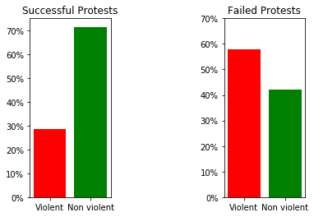
Violent/Non-violent protests success
result:
Most of the successful protests were non violent
Most of the failed protests were violent

Slide 6
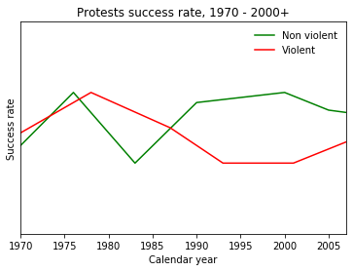
Violent/Non-violent protests success
result:
Non violent protests have higher success rate than violent protests in the past years

Slide 7
Violent/Non-violent protests success
result:
Violent protests average participants: 188,000
Non violent protests average participants: 575,000
The non violent protests attracted around 3 times as many participants as the average
Violent protest.
From the top 25 largest protests
22 were nonviolent
3 were violent

Slide 8
Violent/Non-violent protests success
result:
Successful protest average use of violence: 0.38
While total protests average use of violence: 0.81
Conclusion:
- Successful protests use less violence.
- Large protests are more likely to be non violent.
- For a protest to achieve its final goal, it better be non violent.

Slide 9
Protests size and success
test:
New ‘% of total’ feature for each protest
Separated protests by ‘% of total’ feature
Relationship between ‘% of total’ and success
Compared protests with George Floyd and BLM protests to see differences

Slide 10
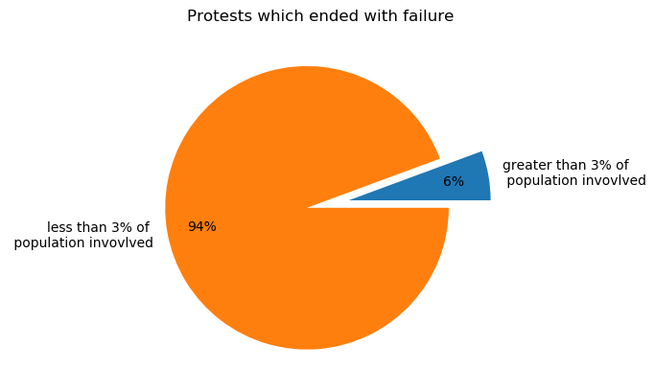
Protests size and success
result:
‘% of total’ mean = ~3
That will be our limit, separate protests by ‘% off total’ = 3
Most of failed protests were
less than 3% of total population

Slide 11
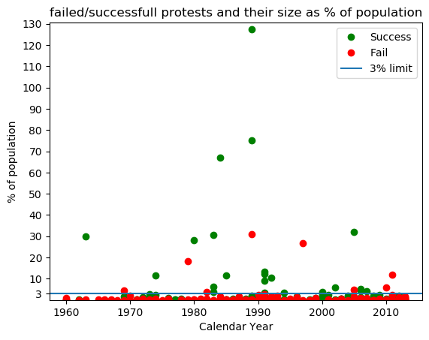
Protests size and success
result:
Most of failed protests had less than 3% of population.
Most of protest with greater than 3% of population achieved final goal.

Slide 12
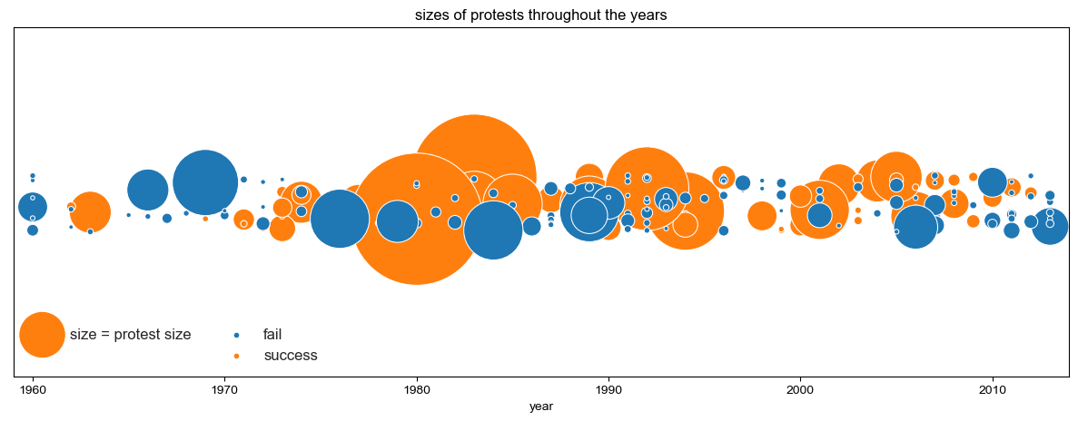
Protests size and success
result:
Conclusions:
Based on the data, a protest has more chances to achieve success if the number of
participants is higher than 3% of the total population.

Slide 13
Protests size and success
result:
If this is the case, how much is 3% of US population?
George Floyd and Black Lives Matter Movement worldwide is a recent campaign that
started in the US and by now is worldwide.
The rise of social media has made protests more accesable. Movements can now spread at very high speeds. If we count the activism in social media, the number of participants in this campaign may be surprisingly high.
BLM movement worldwide – 5,000,000
Pew Research found that #BlackLivesMatter hashtag was used roughly 47,000,000 times on Twitter.
The social media streaming app TikTok has recently surpassed 10,500,000,000 views on the #BlackLivesMatter hashtag.

Slide 14
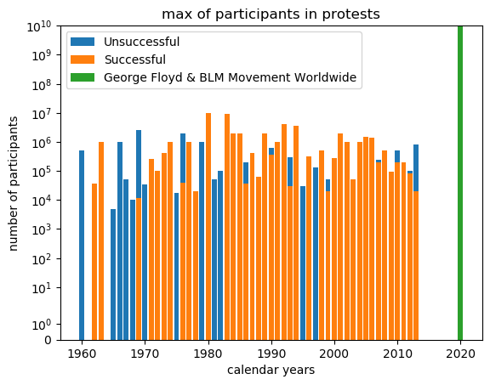
Protests size and success
result:
There is a huge difference between the max amount of participants in BLM campaign vs rest of the protests.
- Note that the y axis scale is
‘symlog’ with base 10

Slide 15
Protest success predict
test:
Build model using logistic regression
Model gets ‘violence’ and ‘above 3%’ to predict successful protests
X = ‘violence’ and ‘above 3%’
y = ‘success’
Check best accuracy

Slide 16
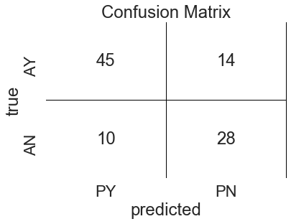
Protest success predict
result:
Models confusion matrix:
Model predicted most of successful
protests : 45/59
And most of failed protests : 28/38

Slide 17
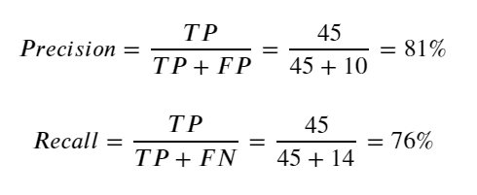
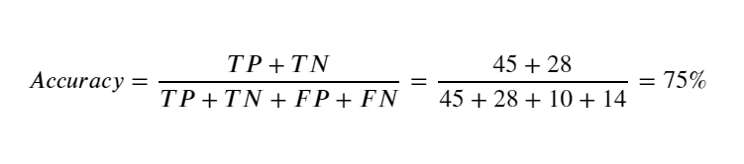
Protest success predict
result:
Precision
Recall
Accuracy

Slide 18
Final Conclusion
Although the exact result for the question what makes a successful protest will depend
On many factors, this model was not bad at predicting successful and failed protests.
Overall we saw that based on this project, non violent protests with participants number higher than 3% of total population are more likely to achieve final goals,
While violent protest with participants number less than 3% of total population are more likely to fail.

