Slide 1
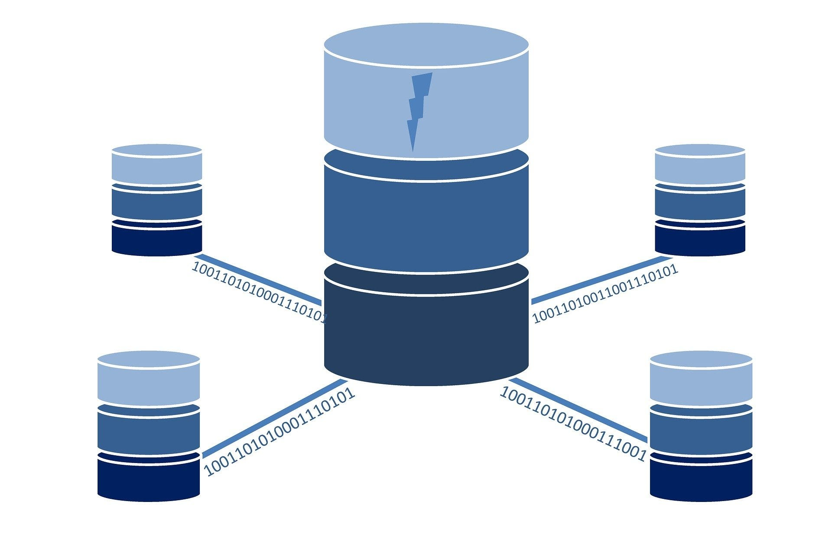
Database: what is it, and how does it work?​
To understand what a database is, it is important to first understand what data is. Simply put, it is information that can be linked to any object. They can take many different forms: numbers, bytes, images, and text files…
Thus, a database is an organized collection of structured data. Usually stored electronically on a computer, it allows for easy access, management, manipulation, and updating of data. Databases simplify data management. In other words, a database is a place where data is stored. It can be compared to a library, where the data would act as books.

Slide 2
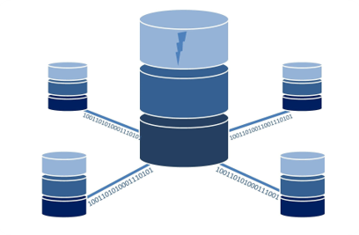
An example of this is an online telephone directory. Such a platform uses a database to store data about people, phone numbers, and other contact information.
Typically, a database is controlled by a DataBase Management System (DBMS). The data, the DBMS, and the associated applications form a “database system” which is often abbreviated to “database”.
In the most common types of databases, the data is organized in rows and columns in a series of tables. This format makes it easy to process the data and formulate queries. On most databases, queries are performed in SQL
(Structured Query Language).

Slide 3
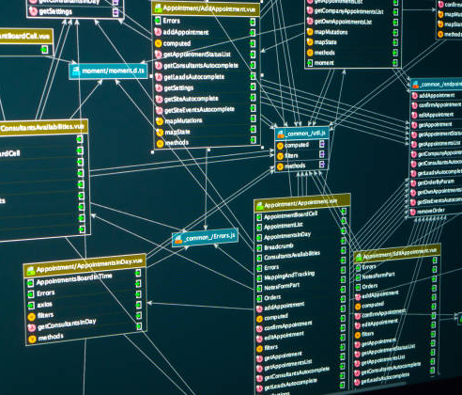

What are the different types of databases?
There is a wide variety of databases. One of the most common is the relational database, predominant since the 1980s. In it, data is organized in the form of a set of tables with columns and corridors.
In object-oriented databases, data is represented in the form of objects. In distributed databases, two or more files located at different sites are brought together and the database can be stored on multiple computers distributed at different physical locations.
A NoSQL or non-relational database allows the storage and manipulation of unstructured data. This type of database is gaining popularity with the rise of web applications.
These are just a few examples, as there are many different types of databases. We can also mention data warehouses, OLTP databases, or even cloud databases.
Some categories of databases are specifically designed for use in science, finance, or other sectors. Technological developments and advances, such as the Cloud or automation, are also giving rise to new types of databases.

Slide 4

A database consists of five main components: hardware, software, data, procedure, and database access language.
The hardware consists of electronic devices such as computers and storage systems. The software part is a set of programs used to manage and control the database.
It includes the database software, the operating system, the network software for sharing the data, and the applications that access the data.
Data is the raw information that is stored in the database. It can be in a variety of formats, such as text, images, or video.
The procedure is a set of rules and instructions for using the DBMS. Finally, the database access language is used to access the data, enter new data, update existing data, or retrieve it via queries.

Slide 5
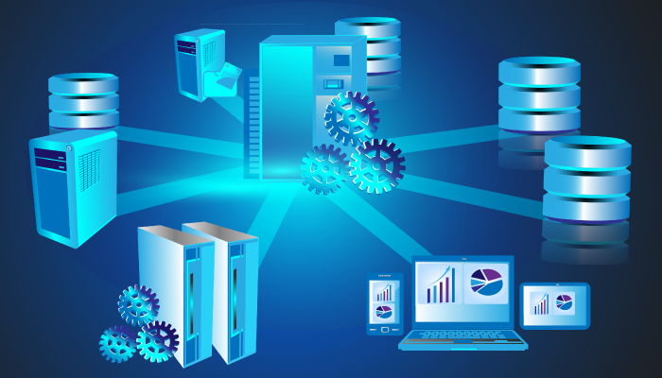
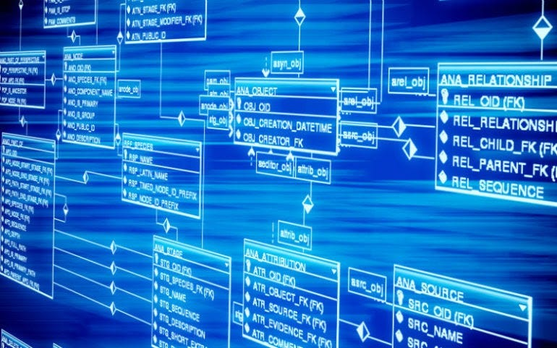
What is a DBMS?
A DBMS is a DataBase Management System. It is a set of programs that allow users to access databases, manipulate data, generate reports, and represent data. This system also helps control access to the database.
It is the interface between the database and the end users or programs. It also allows performance monitoring, backup, restore, or database configuration. Among the most popular examples are MySQL, Microsoft Access, Microsoft SQL Server, Oracle Database, FileMaker Pro, or dBase.

Slide 6

What is SQL?
Structured query language (SQL) is a programming language for storing and processing information in a relational database. A relational database stores information in tabular form, with rows and columns representing different data attributes and the various relationships between the data values. You can use SQL statements to store, update, remove, search, and retrieve information from the database. You can also use SQL to maintain and optimize database performance.

Slide 7
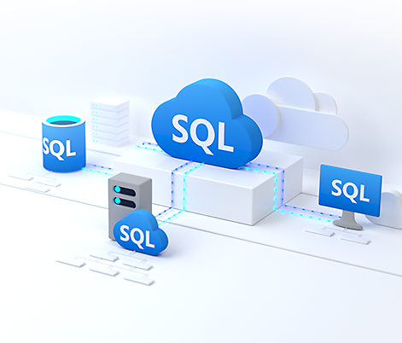
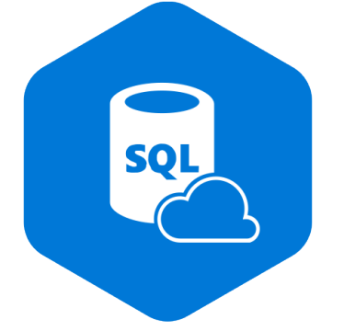
Why is SQL important?
Structured query language (SQL) is a popular query language that is frequently used in all types of applications. Data analysts and developers learn and use SQL because it integrates well with different programming languages. For example, they can embed SQL queries with the Java programming language to build high-performing data processing applications with major SQL database systems such as Oracle or MS SQL Server. SQL is also fairly easy to learn as it uses common English keywords in its statements.

Slide 8
How does SQL work?
Structured query language (SQL) implementation involves a server machine that processes the database queries and returns the results. The SQL process goes through several software components, including the following.
Parser​
The parser starts by tokenizing, or replacing, some of the words in the SQL statement with special symbols. It then checks the statement for the following:​
Correctness​​
The parser verifies that the SQL statement conforms to SQL semantics, or rules, that ensure the correctness of the query statement. For example, the parser checks if the SQL command ends with a semi-colon. If the semi-colon is missing, the parser returns an error.​​
​
Authorization​​
The parser also validates that the user running the query has the necessary authorization to manipulate the respective data. For example, only admin users might have the right to delete data.

Slide 9
Relational engine
The relational engine, or query processor, creates a plan for retrieving, writing, or updating the corresponding data in the most effective manner. For example, it checks for similar queries, reuses previous data manipulation methods, or creates a new one. It writes the plan in an intermediate-level representation of the SQL statement called byte code. Relational databases
use byte code to efficiently perform database searches and modifications.
Storage engine
The storage engine, or database engine, is the software component that processes the byte code and runs the intended SQL statement. It reads and stores the data in the database files on physical disk storage. Upon completion, the storage engine returns the result to the requesting application.

Slide 10

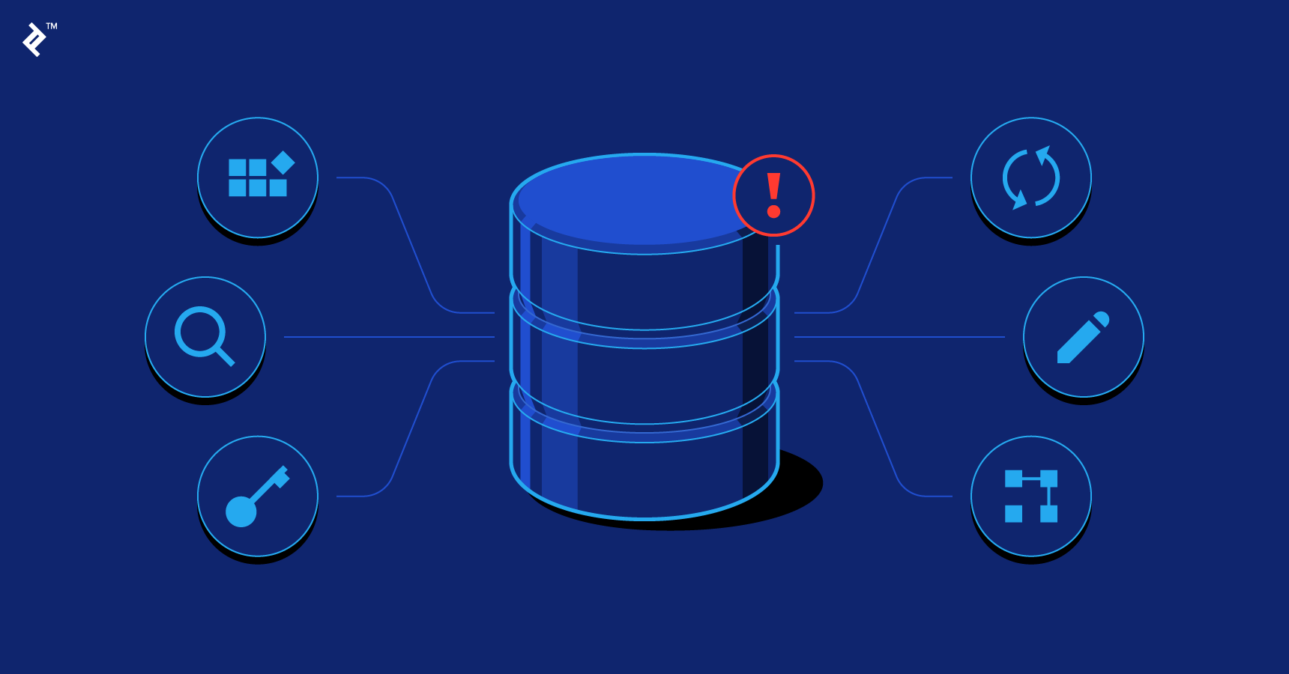
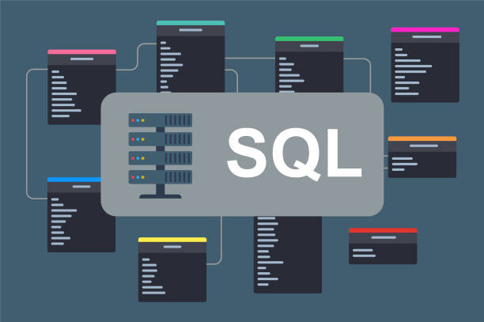
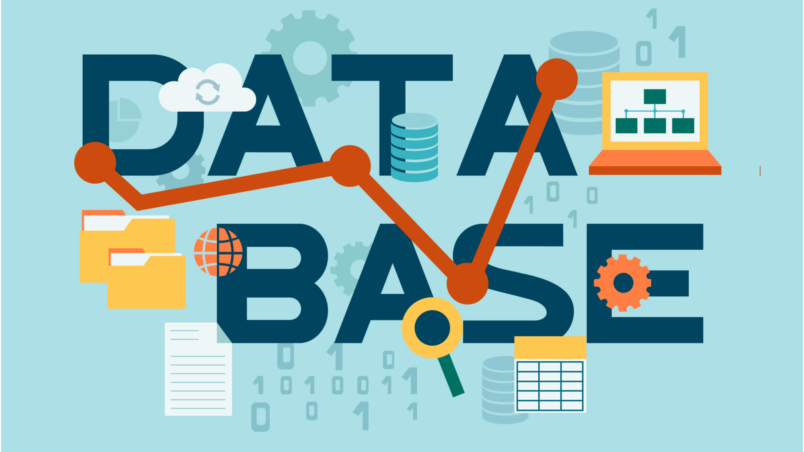
Thanks for attention

Slide 11
WORDS:
Simplify - спростовувати
Linked - посилатися на щось
Management - управління
Thus - таким чином
Query - запит
DBMS – Database Management System
Row - рядок
Column - колонка
Distributed - розподілений
Data warehouses – сховища даних
Set of rules - набір правил
Raw information - вихідна інформація
A variety of formats - різноманітність форматів
Retrieve - отримати
15. Via - через
16. Report - звіт
17. Represent - представляти
18. Backup - резервне копіювання
19. Tabular form - таблична форма
20. SQL(structured query language) - мова структурованих запитів
20. SQL statement - оператор SQL
21. Maintain - підтримувати, зберігати
22. Frequently - часто
23. Fairly easy - досить легко
24. Verify - перевіряти
25. Respective data - відповідні дані

