Slide 1
ORTHOPAEDIC RECONSTRUCTION | TECHNOLOGY PLATFORM
CITadel
Temporary Internal Stabilisation (TIS)
for Critical Long-Bone Defects
Modular intramedullary system for staged reconstruction
Maksym Baida, PhD
Founder & Clinical Lead
citadelimplant.com

Slide 2
CLINICAL PROBLEM
Critical long-bone defects remain a major unmet clinical need
1
High infection rates
2
No internal solutions
High rates of infection and mechanical complication
No effective internal solutions for staged reconstruction
3
External fixation burden
4
High costs
External fixation leads to patient burden and pin-tract infections
Prolonged hospitalisation and increased healthcare costs

Slide 3
CURRENT TREATMENT LIMITATIONS
Current treatments do not effectively support
staged reconstruction
No solution addresses the full clinical pathway
External fixation
Internal fixation (plates / nails)
Bone transport / Ilizarov
• High infection risk
• Patient discomfort
• Prolonged treatment duration
• Not designed for large defects
• Limited modularity
• Limited adaptability to complex cases
• Technically complex procedures
• Long learning curve
• High complication rates

Slide 4
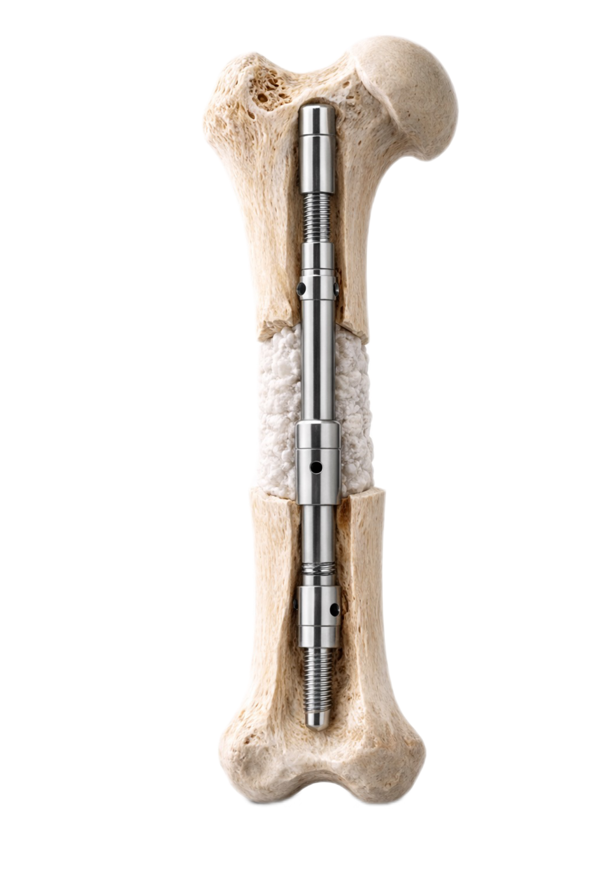
SOLUTION
CITadel is a modular system for staged internal stabilization of critical long-bone defects
✓ Modular intramedullary platform
✓ Designed to integrate with existing fixation systems
✓ Minimises reliance on external fixation
✓ Adaptable to different defect sizes and anatomies
✓ Compatible with standard surgical workflows

Slide 5
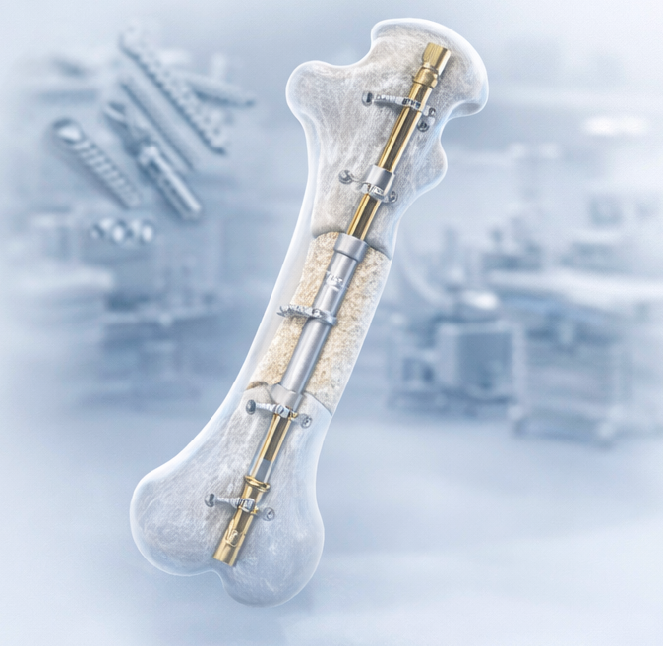
STRATEGIC VALUE
Why it matters for industry
Strategic value for orthopaedic and medtech companies
▸ Addresses an unmet need in complex trauma and infection cases
▸ Expands clinical indications for intramedullary fixation systems
▸ Enables a new procedural category (staged internal reconstruction)
▸ Integrates with existing implant portfolios and surgical workflows
▸ Enables new revenue stream in high-value cases

Slide 6
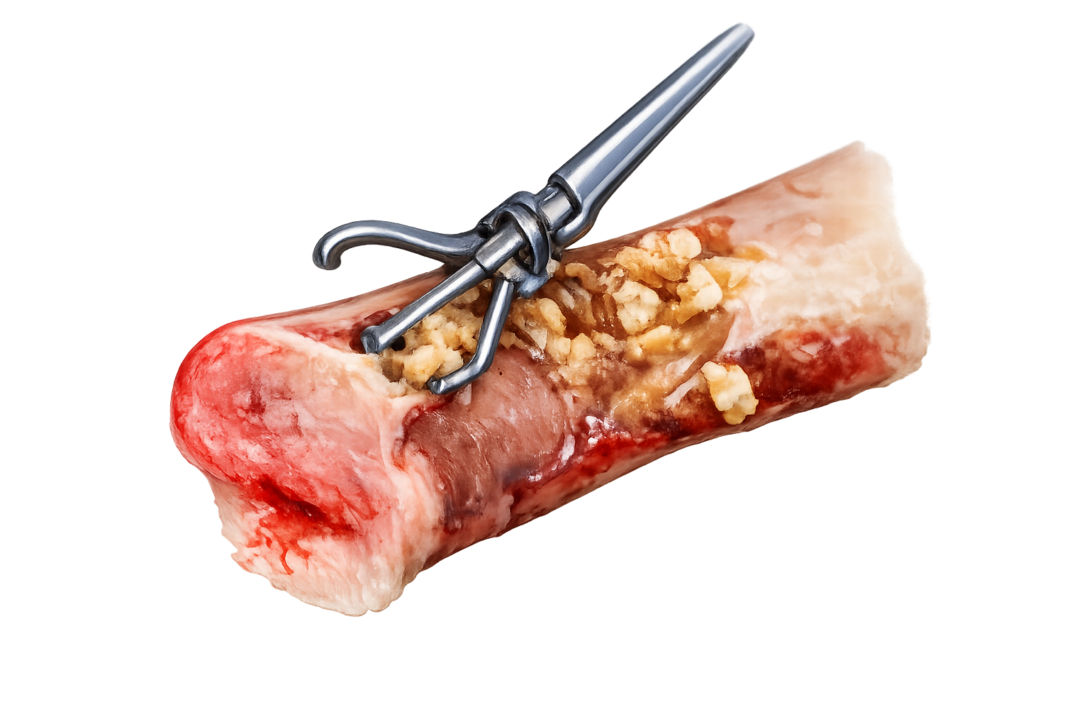
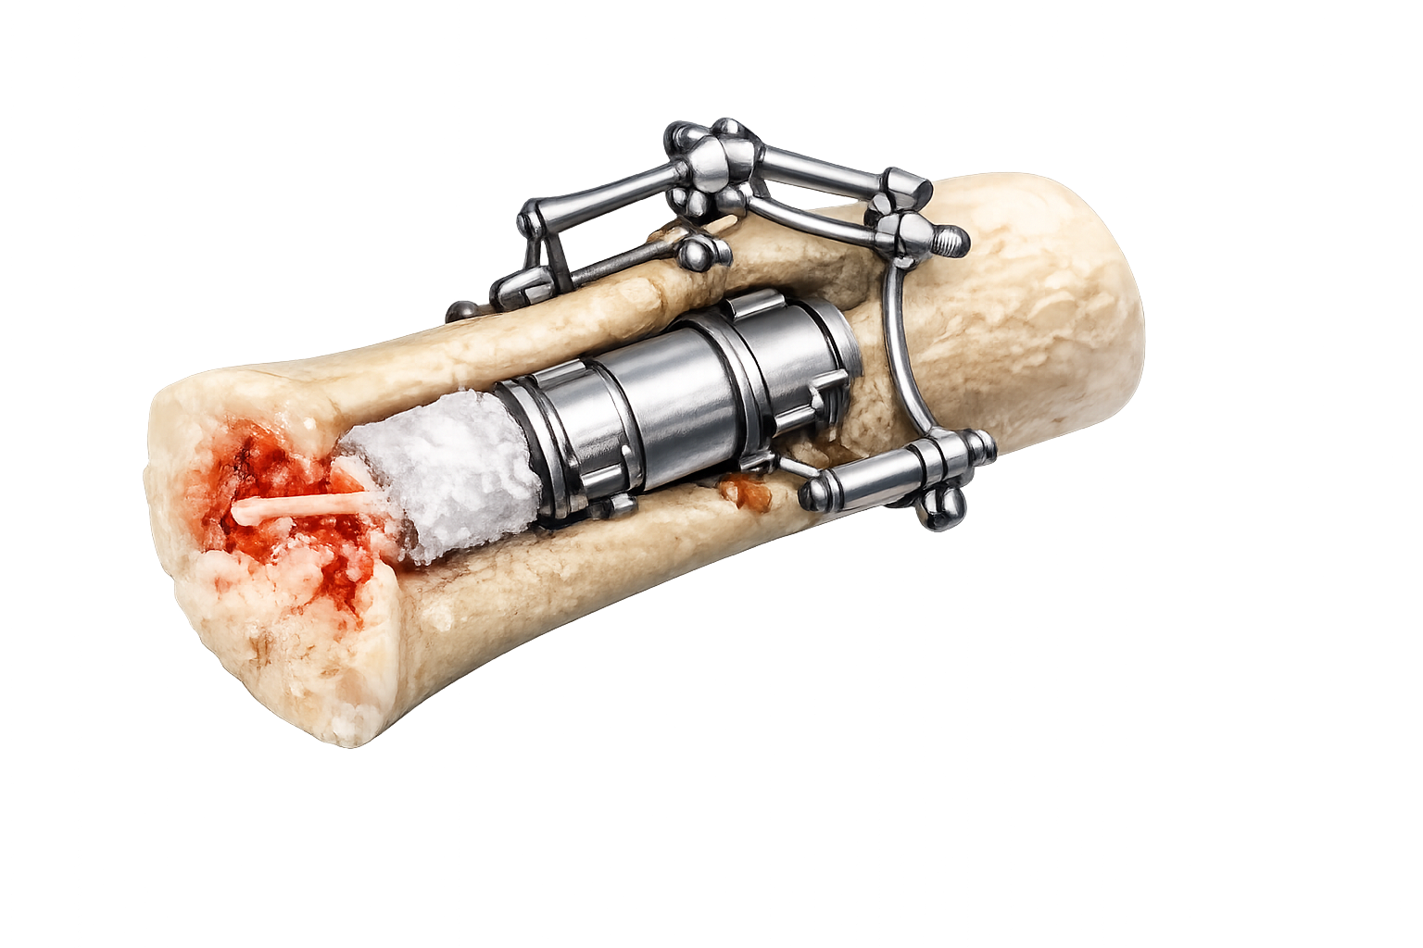
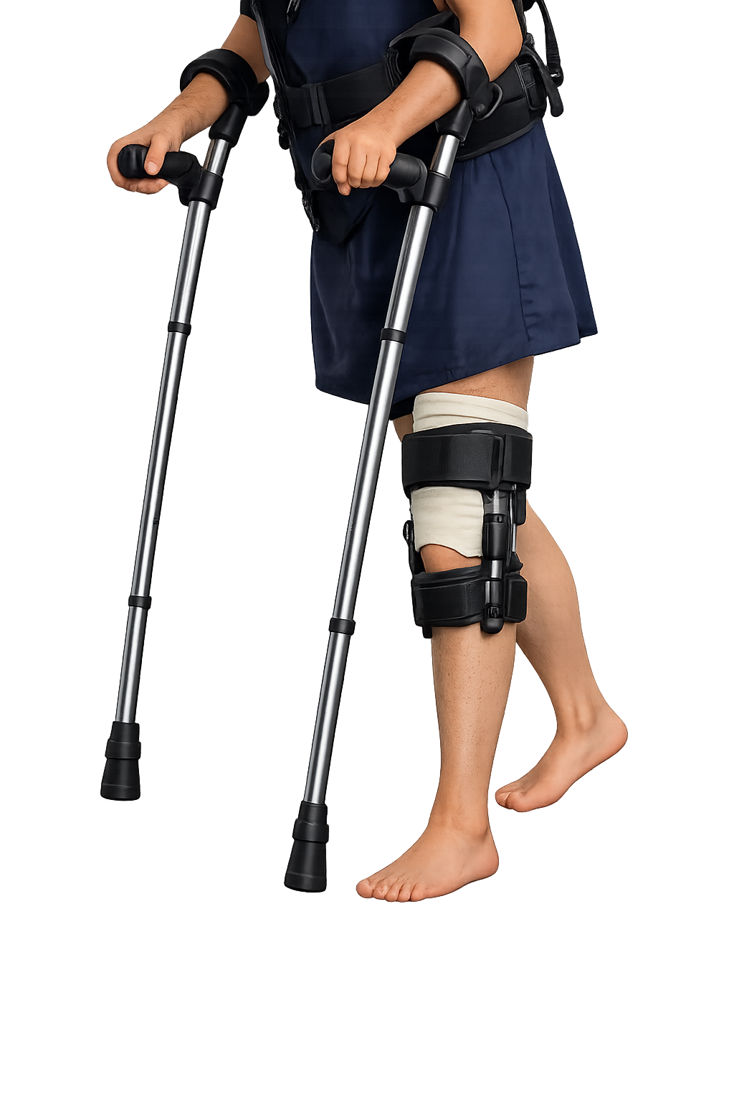
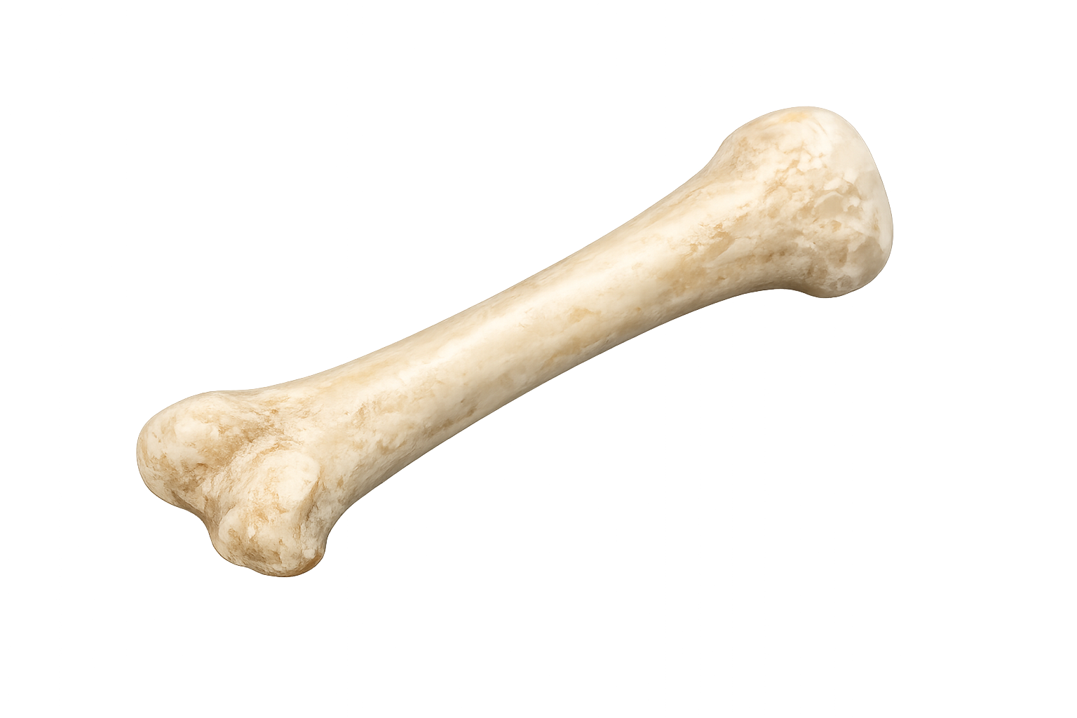
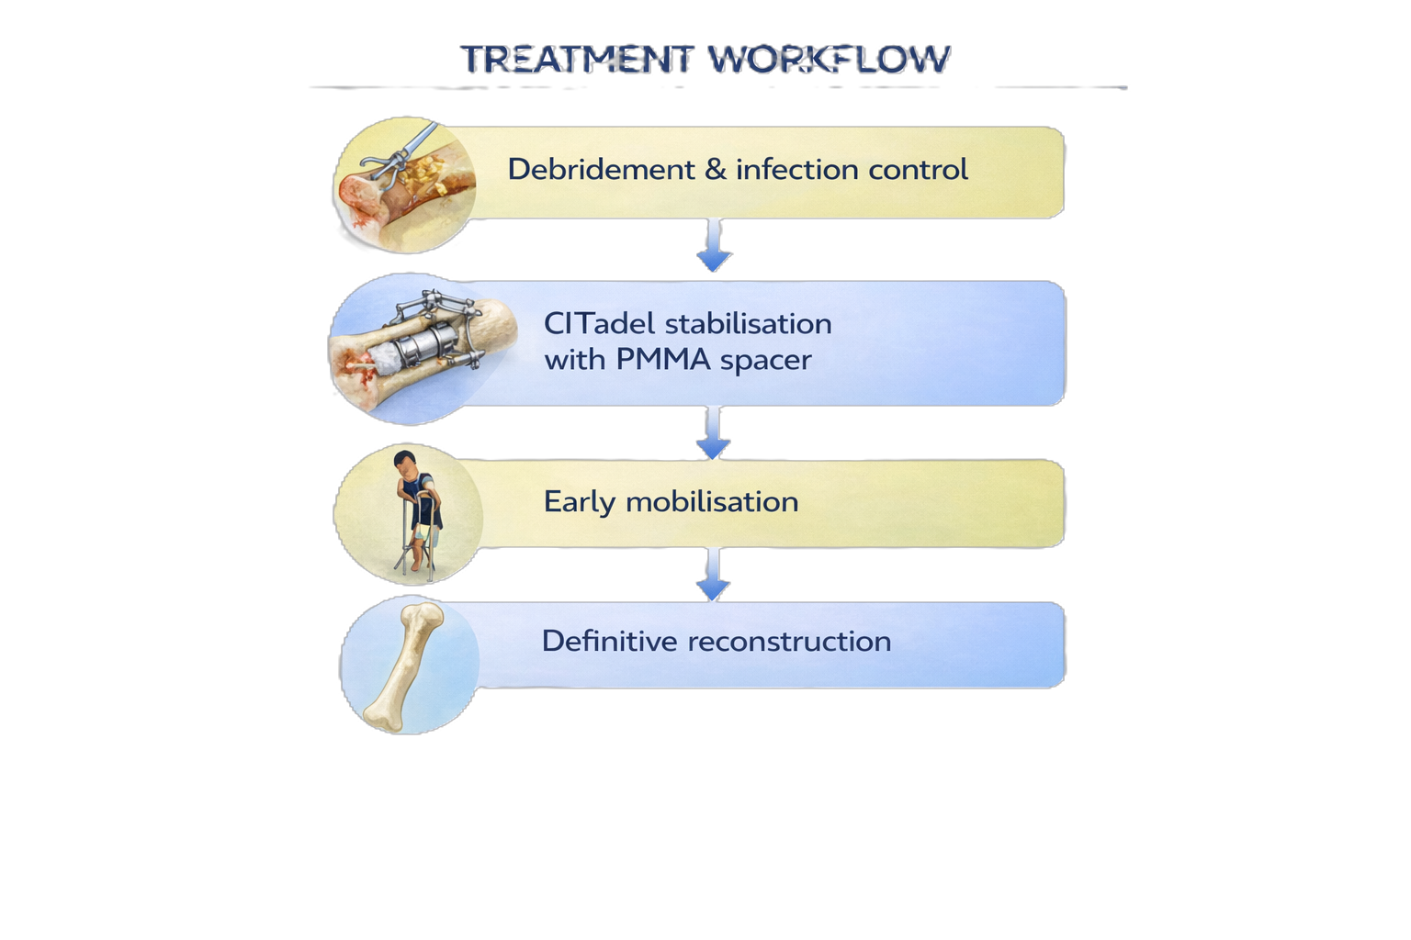
HOW IT WORKS
Staged reconstruction workflow
Debridement
Debridement & initial stabilisation
1
Removal of infected / damaged tissue | Initial stabilisation of the bone
CITadel TIS
2
CITadel internal stabilisation
Modular intramedullary system implantation | Provides stable internal fixation | Maintains defect space and supports soft tissue recovery
Mobilisation
3
Early mobilisation
Enables early weight-bearing and rehabilitation
4
Definitive reconstruction
Reconstruction
Bone grafting or regeneration | Restoration of bone continuity

Slide 7
CLINICAL VALUE
Improved outcomes across the treatment pathway
Infection control
Patient experience
• Reduces infection risk
• Eliminates external hardware
• No external fixation required
• Improved comfort
• Early mobilisation
Surgical efficiency
Healthcare impact
• Modular system enables intraoperative adaptability
• Streamlined surgical workflow
• Reduced complication rates
• Shorter hospital stays
• Lower overall healthcare costs

Slide 8
MARKET OPPORTUNITY
Growing market driven by complex bone defects and staged reconstruction
TAM
SAM
SOM
Total Addressable Market
Serviceable Available Market
Serviceable Obtainable Market
• Millions of long-bone fractures annually
• 5–10% progress to non-union or critical defects
• High clinical and economic burden
• Complex fractures and infections
• Non-unions and critical bone defects
• Cases requiring staged reconstruction
• Trauma centres and specialised hospitals
• Early adopters in orthopaedic surgery
• Initial market entry in EU and US

Slide 9
CLINICAL VALIDATION
Early clinical use demonstrates feasibility and safety
Clinical experience
Technology readiness
• 2 clinical cases completed
• Successful implantation of CITadel system
• Early outcomes demonstrate feasibility and safety
• Functional prototype developed
• Successfully used in clinical setting
• Design validated in early clinical use
Development progress
IP & funding
• Iterative design improvements ongoing
• Feedback from clinical use incorporated
• Next development steps defined
• Patent application filed (Ukraine)
• Currently under examination
• Preparation for international patent filing
• Grant application under review

Slide 10
BUSINESS MODEL
Procedure-based business model of orthopaedic reconstruction
Product
Customers
• Modular intramedullary fixation system
• Procedure-based, single-use components
• Designed for staged reconstruction
• Hospitals and trauma centres
• Orthopaedic departments
• Specialised reconstruction units
Revenue model
Go-to-market
• Per-procedure revenue model
• Implant system sales per case
• Recurring revenue across staged procedures
• Direct engagement with key surgeons
• Initial adoption in specialised trauma centres
• Clinically driven adoption strategy

Slide 11
COMPETITION
Bridging stability and infection control
Current solutions address either stability or infection — not both
External fixation
Internal fixation
Spacer-based techniques
CITadel
• Strong stabilisation
• High infection risk
• Poor patient comfort
• Good mechanical stability
• Limited use in infection
• Risk of implant-related complications
• Infection control
• Limited mechanical stability
• Requires multiple procedures
✓ Combines stability and infection control
✓ Enables staged reconstruction
✓ Supports early mobilisation

Slide 12
ROADMAP
Clear path to clinical adoption and EU market entry
Current status
Next 12 months
Regulatory & validation
Market entry
• Functional prototype validated
• Initial clinical cases completed
• Patent application under examination
• Expanded clinical case series
• Design optimisation and system iteration
• Preparation for regulatory submission
• Clinical study design and initiation
• Regulatory strategy (EU / US)
• Documentation and compliance
• First clinical partner hospitals onboarded
• Initial market entry (EU)
• Early commercial traction

Slide 13
TEAM
Clinician-founder with real-world validation and early network
Founder
Clinical environment / support
Future team build
• Orthopaedic trauma surgeon
• Experience in complex bone reconstruction
• Inventor of the CITadel concept and system
• Validation in initial clinical cases
• Access to clinical cases
• Active surgical collaboration
• Real-world validation environment
• Expansion in engineering and regulatory capabilities
• Clinical and commercial partnerships
• Scaling towards full operational team

Slide 14
PARTNERSHIP & FUNDING
Open to strategic partnerships to accelerate clinical and market progress
What we are looking for
Partnership options
Use of resources
Expected outcomes
• Strategic partners across orthopaedics and medtech
• Support in regulatory and market access
• Clinical and commercial collaboration
• Technology licensing
• Co-development with implant manufacturers
• Clinical collaboration and validation
• Investment to support growth
• Clinical validation and case expansion
• Product development and optimisation
• Regulatory pathway execution
• Preparation for market entry
• Expanded clinical evidence
• Regulatory readiness
• Initial market entry
• Early commercial traction

Slide 15
Open to partnerships and strategic collaboration
Maksym Baida
Founder, CITadel
citadelimplant.com
partnership@citadelimplant.com
+380 66 766 70 94

