Slide 1
Campaign Analysis
Dimosthenis Theofilopoulos
Case Study for Junior Business Intelligence Analyst

Slide 2
Topics
Introduction-Assumptions
KPI demonstration
Campaign Evaluation
Summary-Comments

Slide 3
Introduction-Assumptions
The campaign is focused on ages between 25-40 and customers that are in Segment B. The campaign ran for 11 days. From 25-01-2020 until 04-02-2020.

Slide 4
KPI demonstration

Slide 5
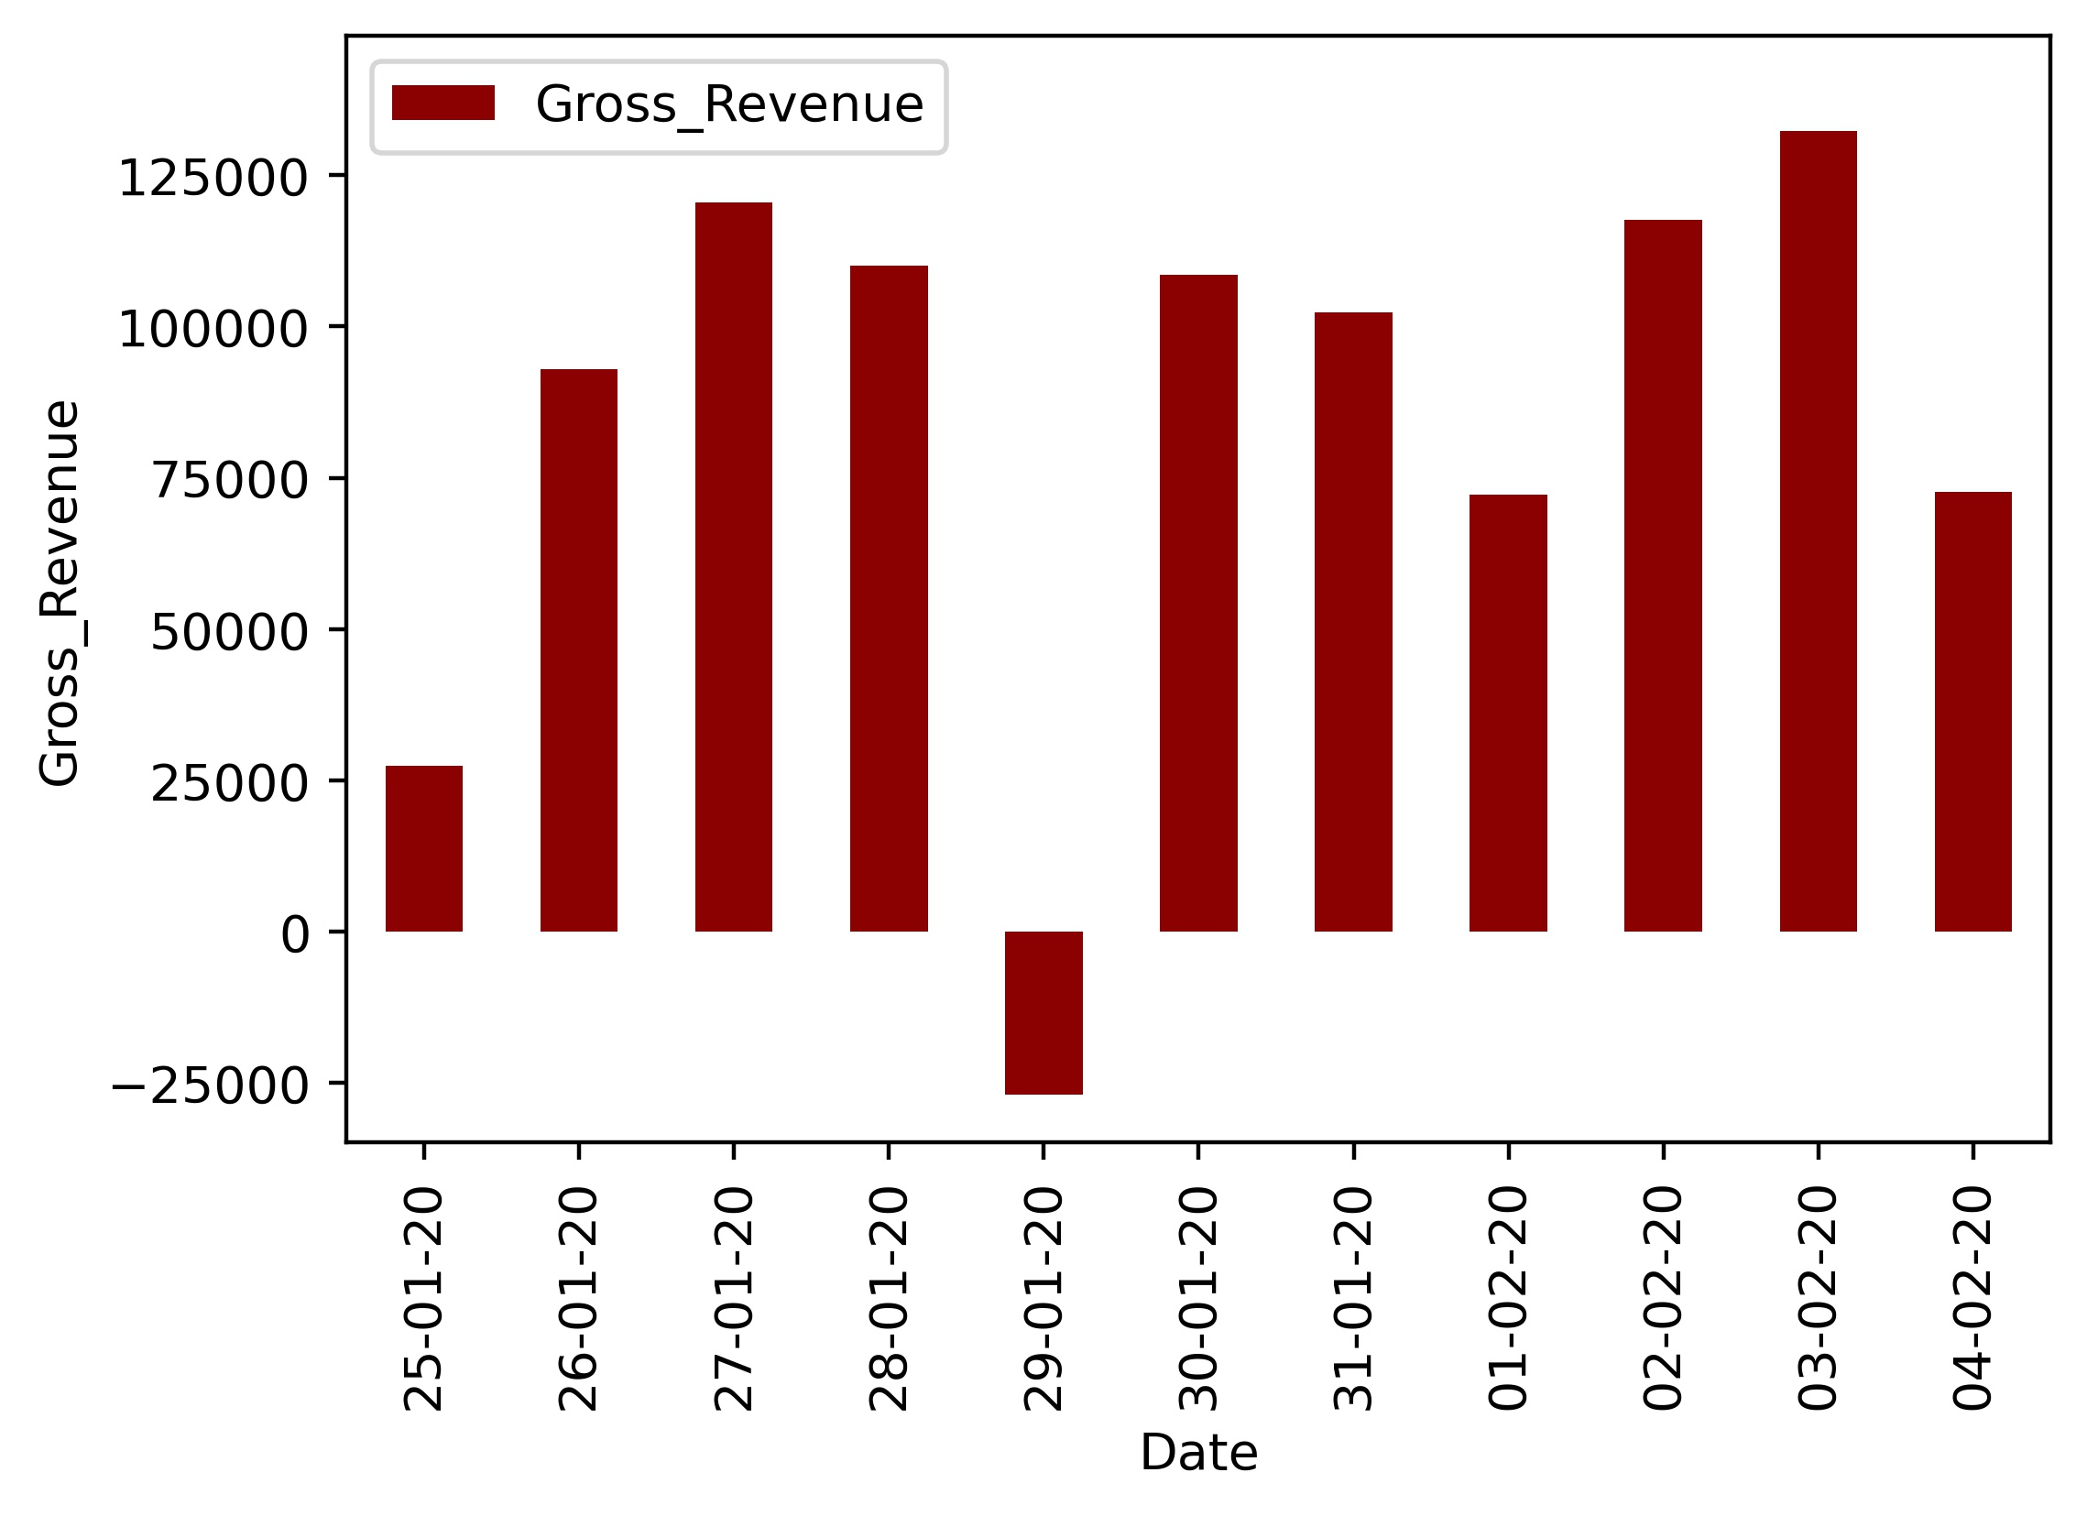
Casino Gross Revenue
The gross revenue after the first day of the campaign has increased and remained at this same value with small fluctuations. The loss on 29-01 may be due to inadequate data.

Slide 6
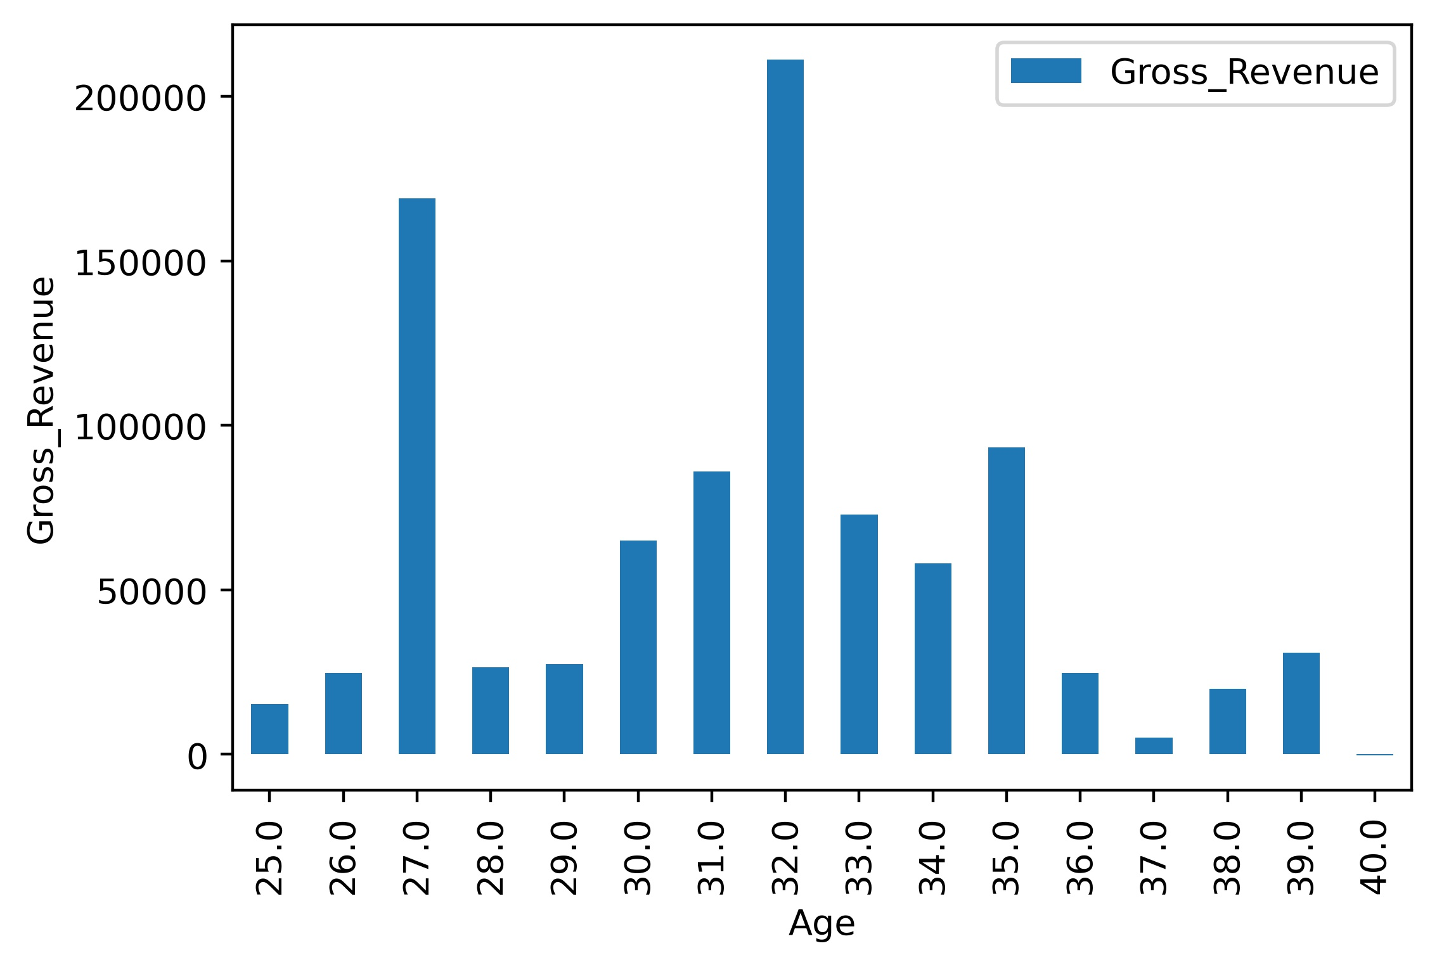
Casino Gross Revenue and Age
Although we see that the customers of 32 years old produced the highest gross revenue, it is not clear that there are specific age groups that produce particular gross.
There isn’t any linear relation between age and gross revenue.
The diagrams could approximate a normal distribution
with 32 years old as mean but much more data is required
Due to the spike in Age=27

Slide 7
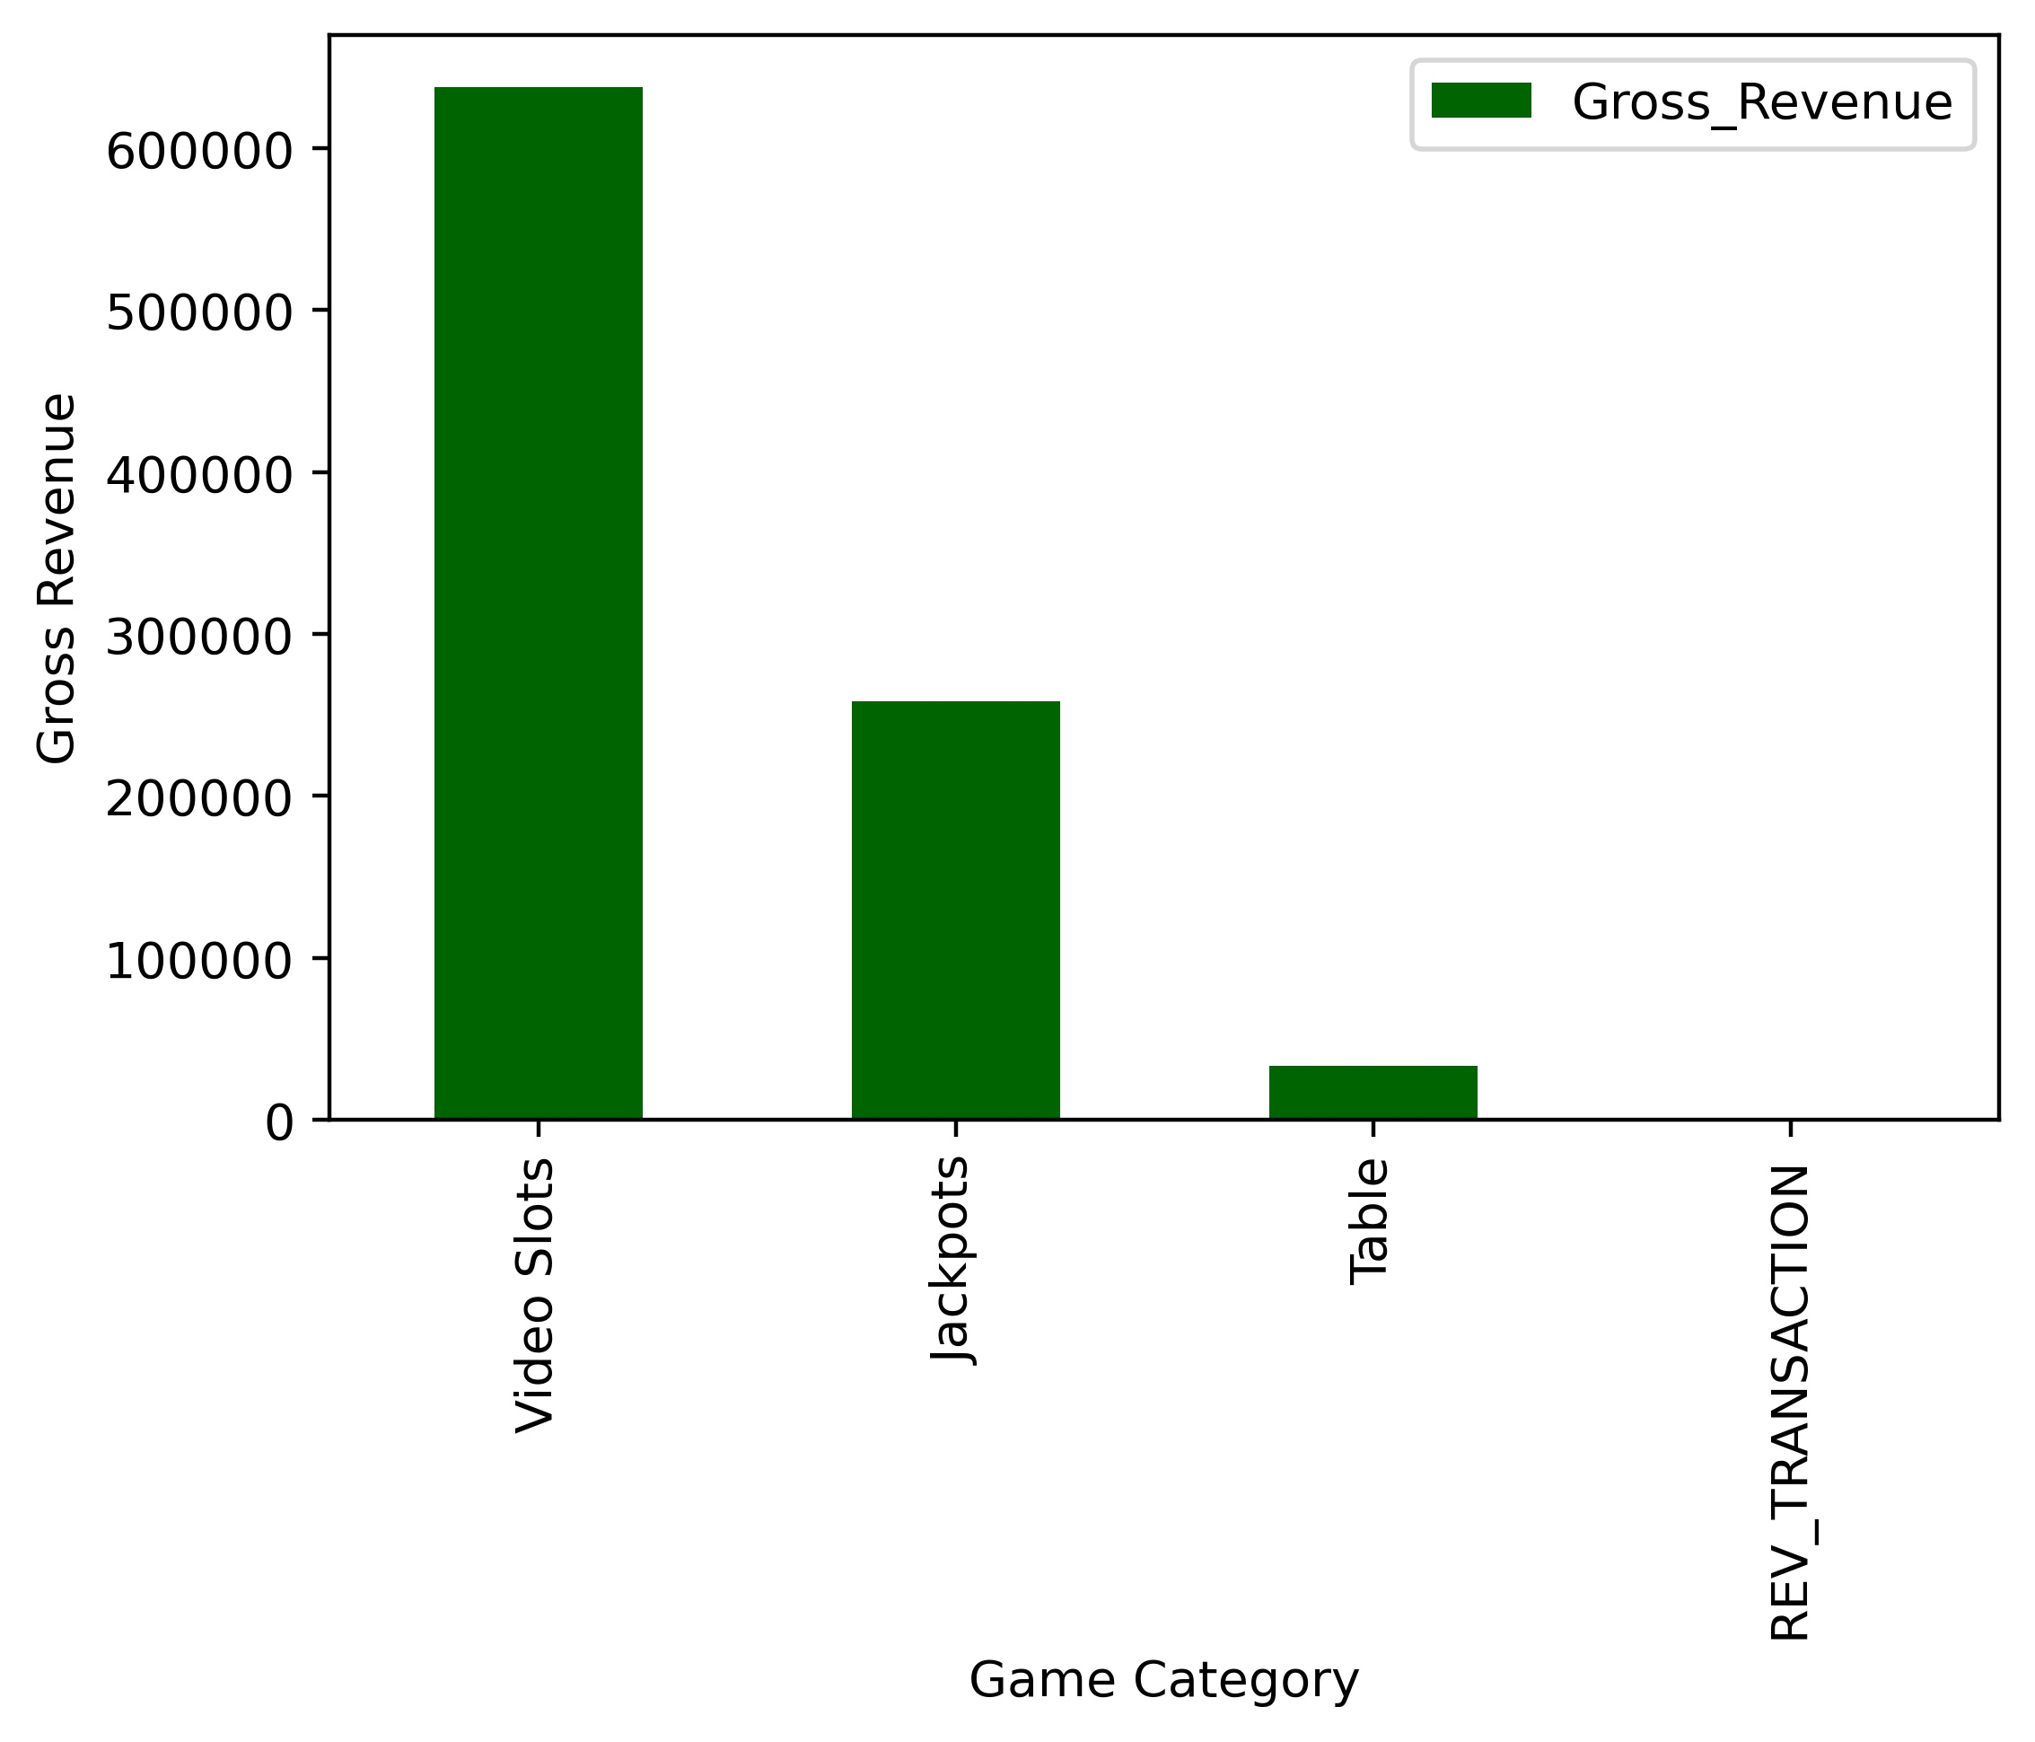
Gross revenue and Games
Video Slots are by far the type of games that produce the highest Gross revenue. Reversal transaction produced no Gross Revenue.

Slide 8
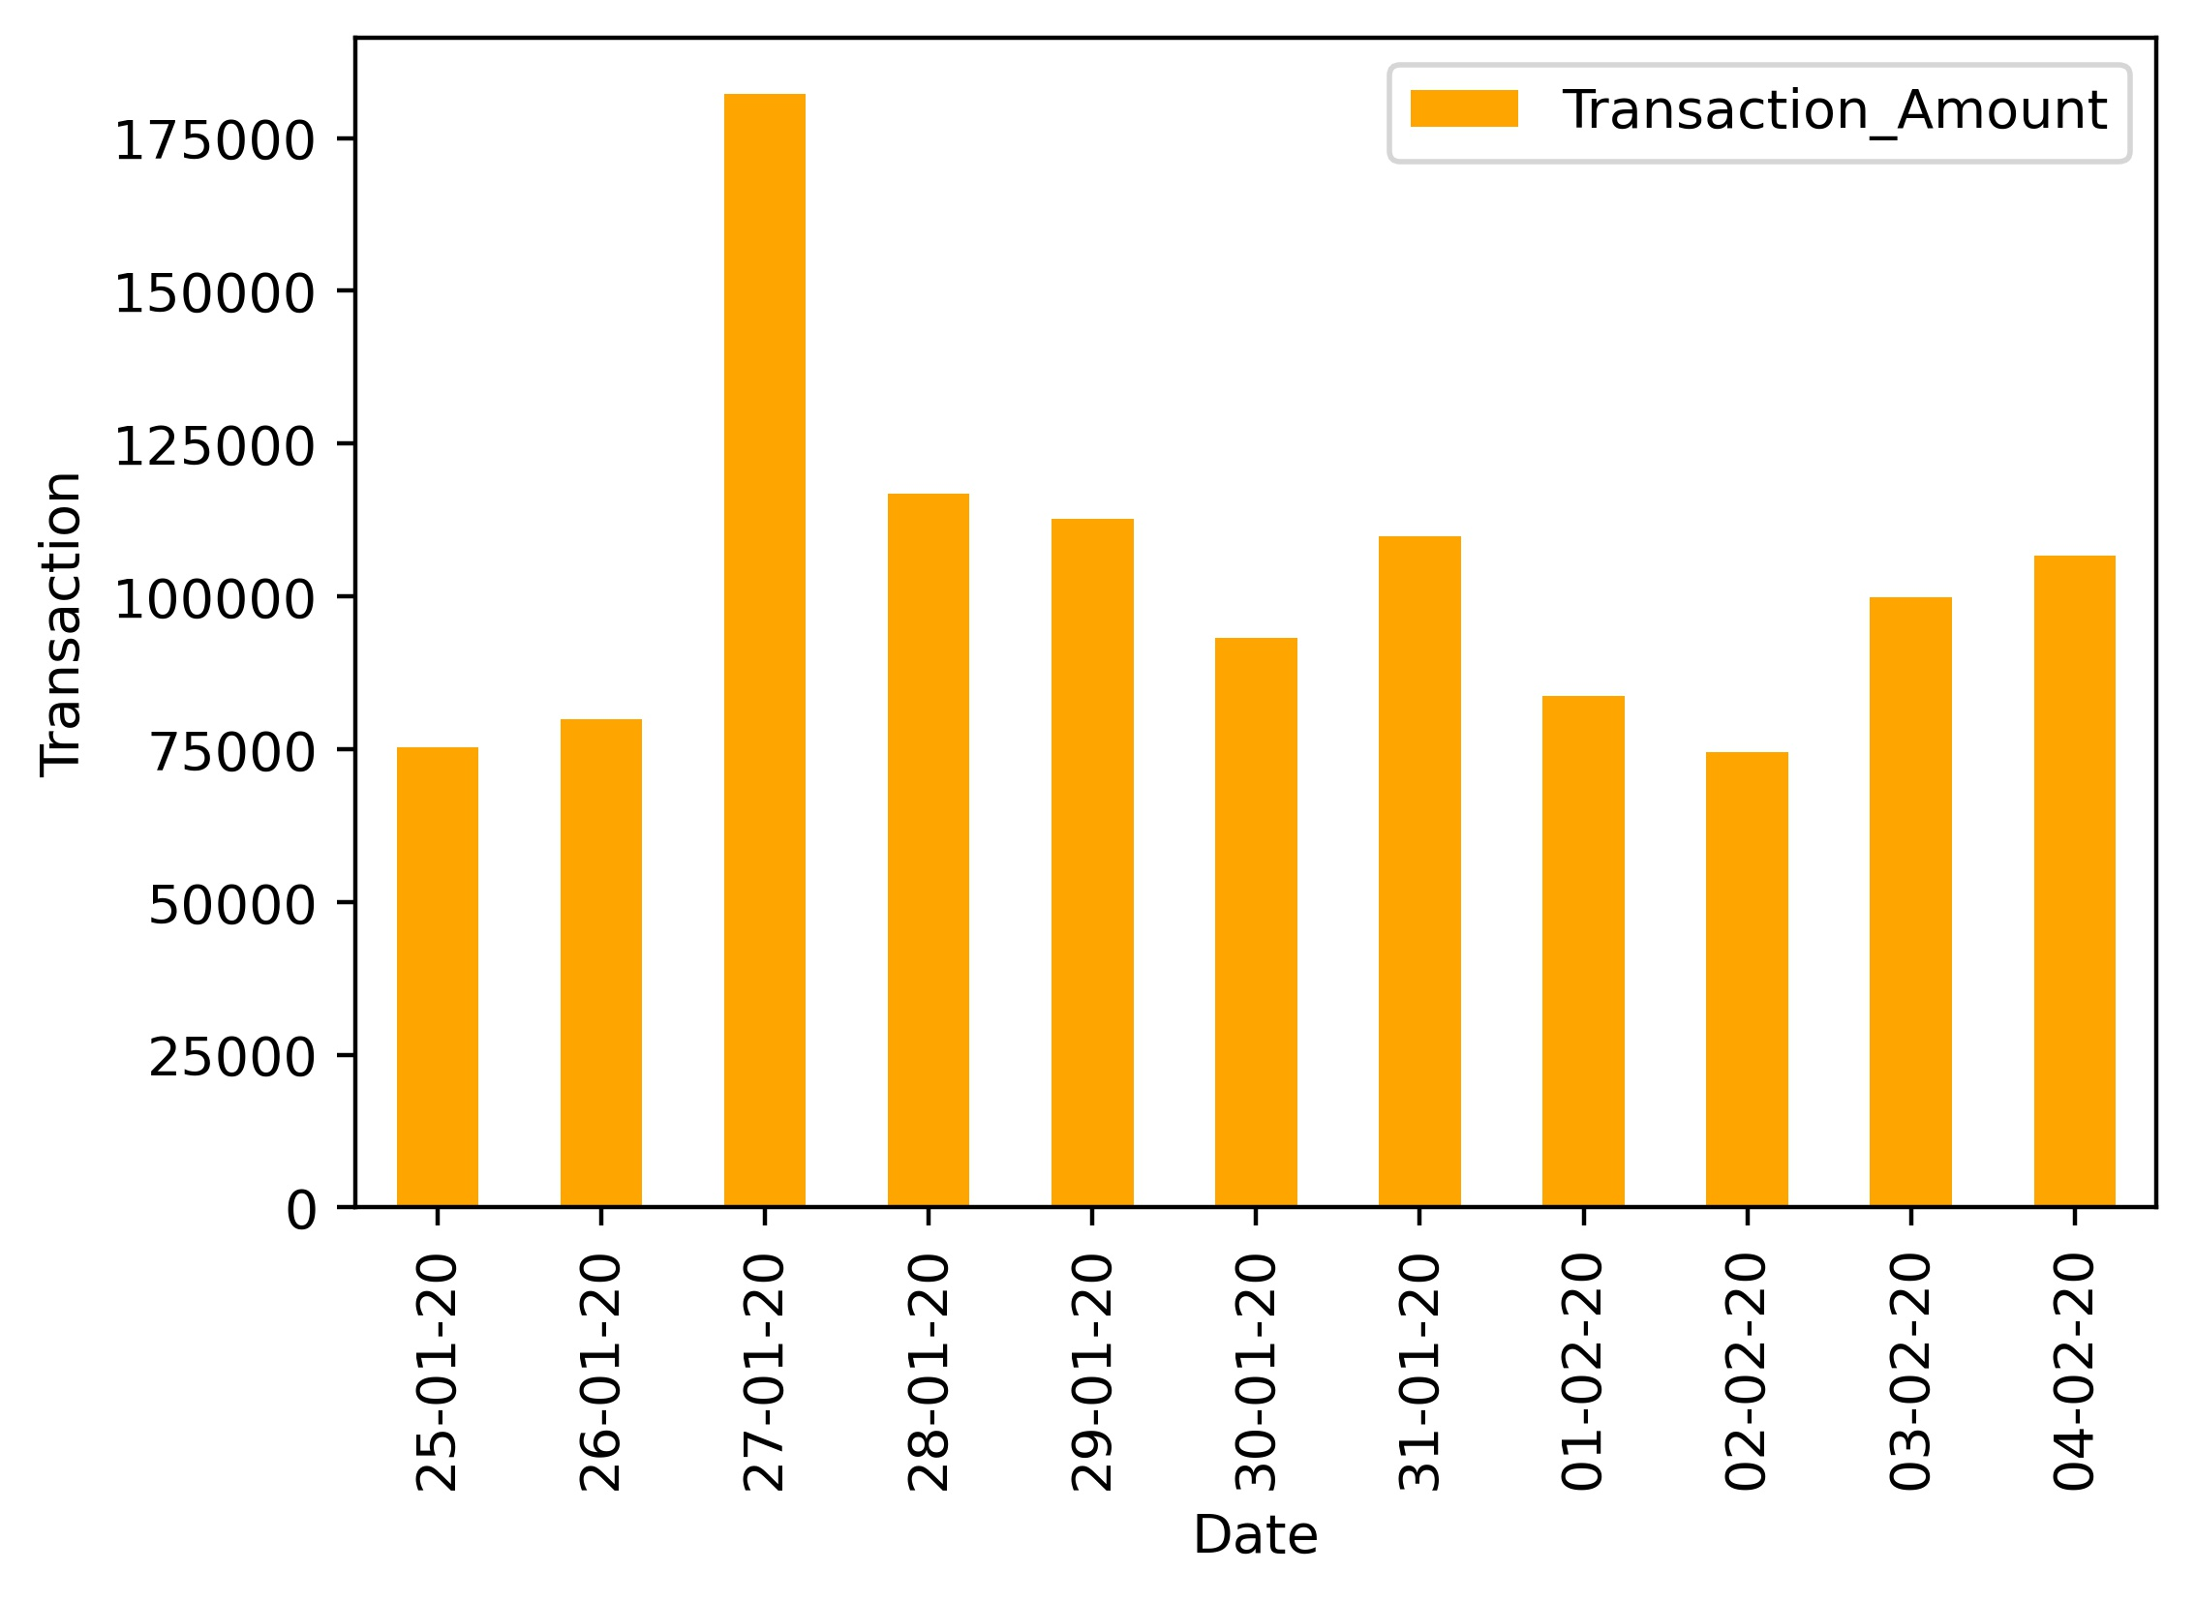
Transactions during Campaign
The amount of transaction had small fluctuations and remained above 50000 during the campaign with a significant spike on 27-01-20 (Monday).

Slide 9
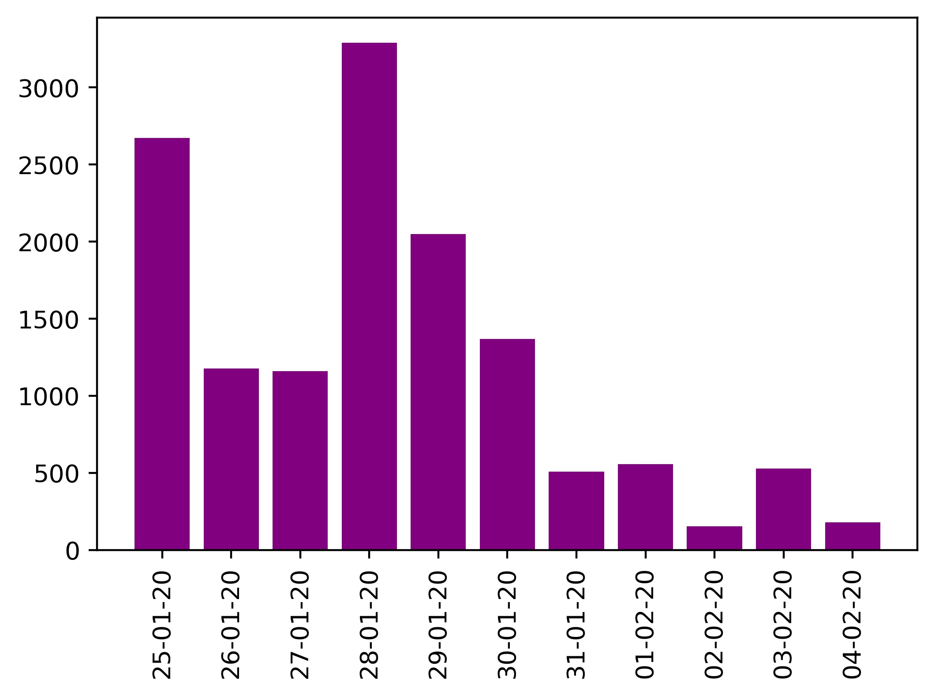
New Customers during Campaign
The first day of the campaign there has been a significant number of new customers with the highest peak after 4 days. From that day on, we observe a decrease with the lowest point on 02-02-20.

Slide 10
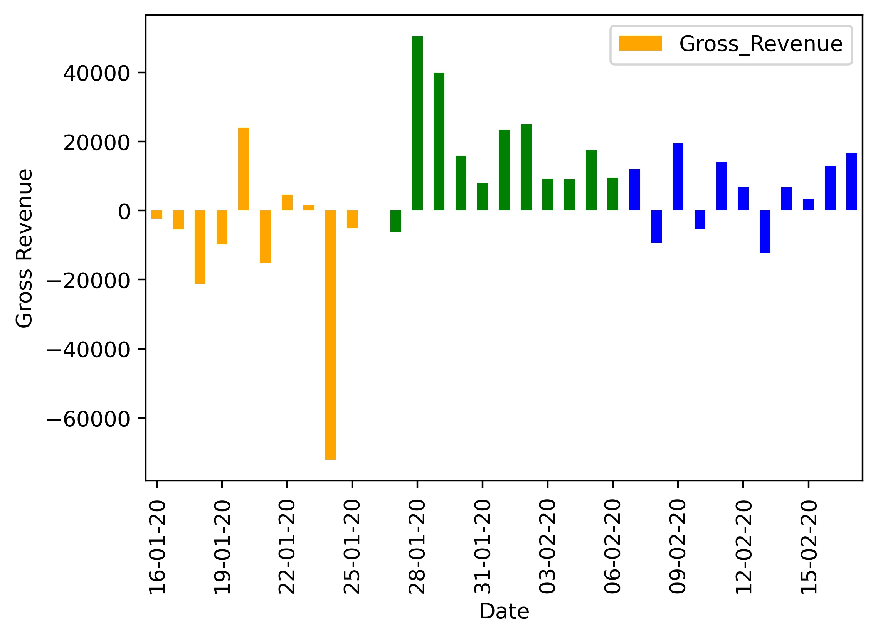
Campaign Evaluation
To get a better insight of the effects of the campaign we will present various KPIs and how they evolved before, during and after the campaign.
Gross Revenue
We see that during the campaign, the gross revenue was higher than the periods before and after the campaign.

Slide 11
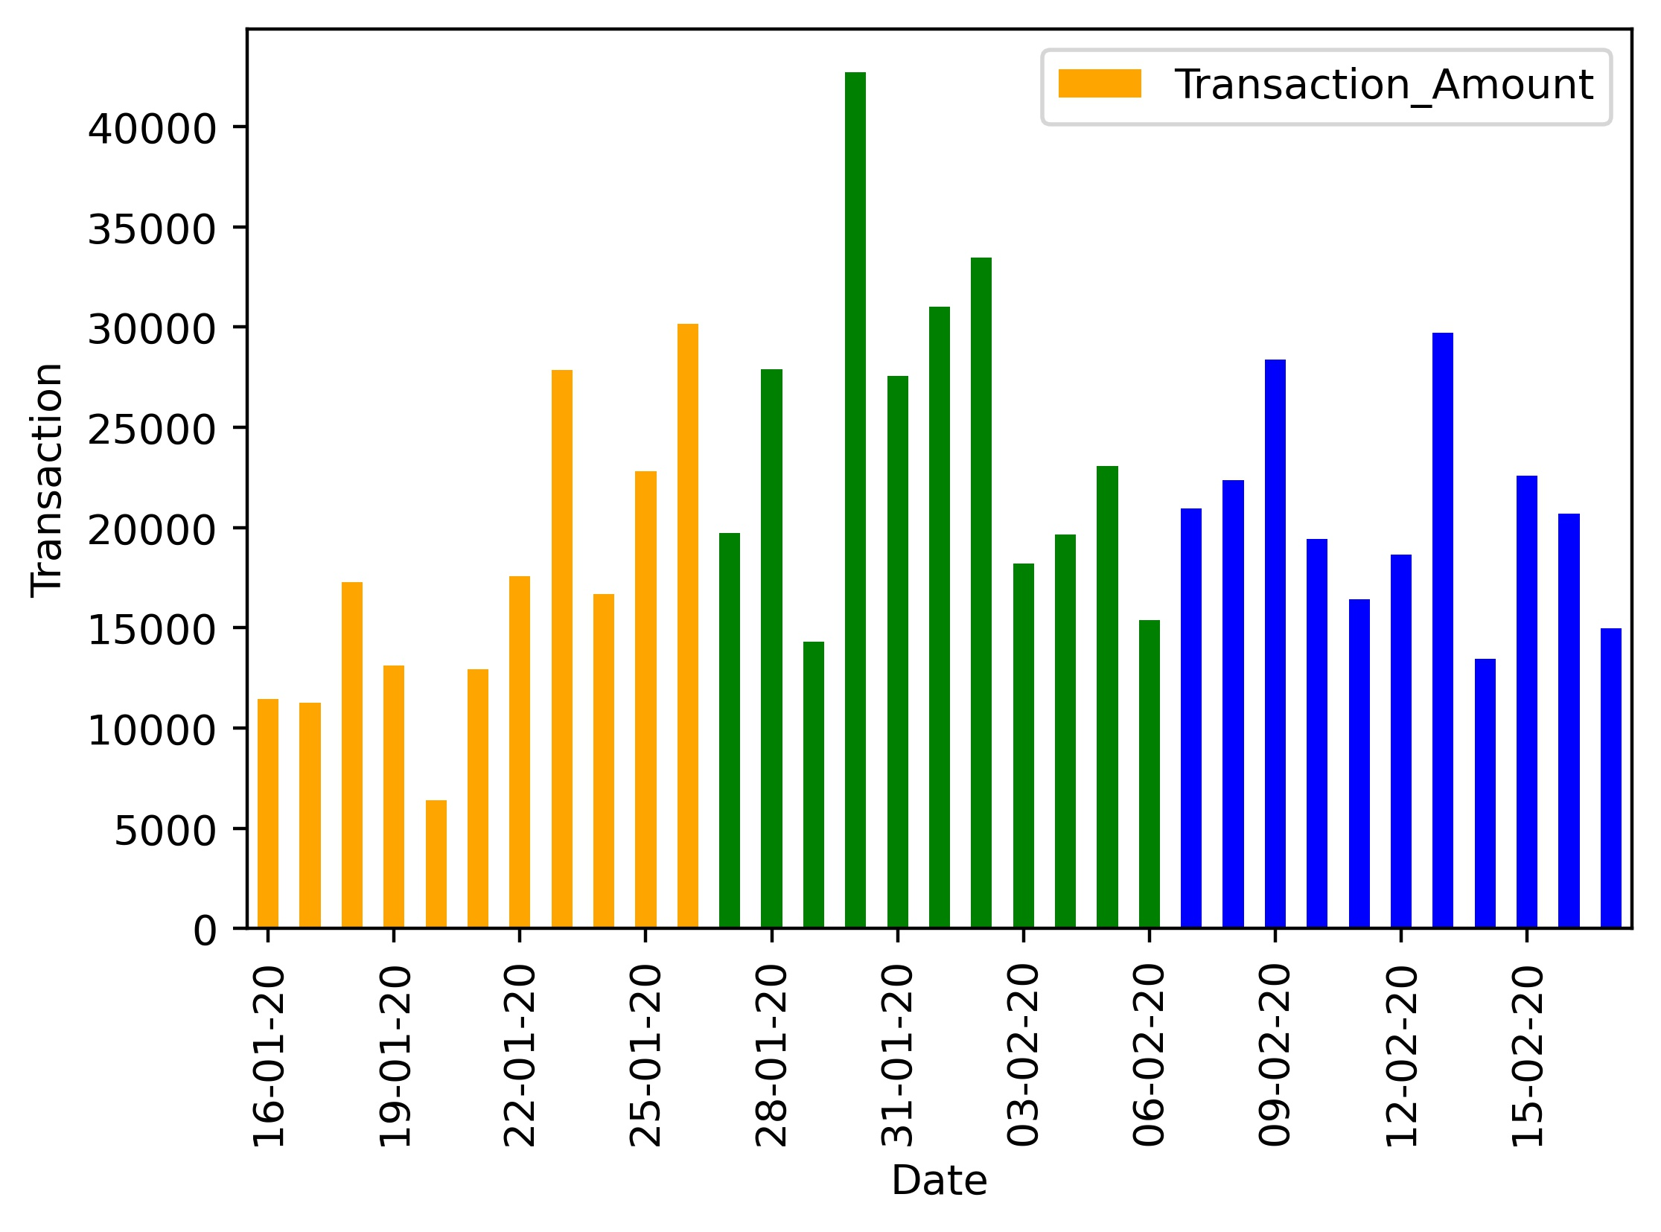
Campaign Evaluation
Transactions
Although the peak of the transactions was during the campaign, in general there isn’t a clear trend regarding the amount of the transactions and the period they were made.

Slide 12
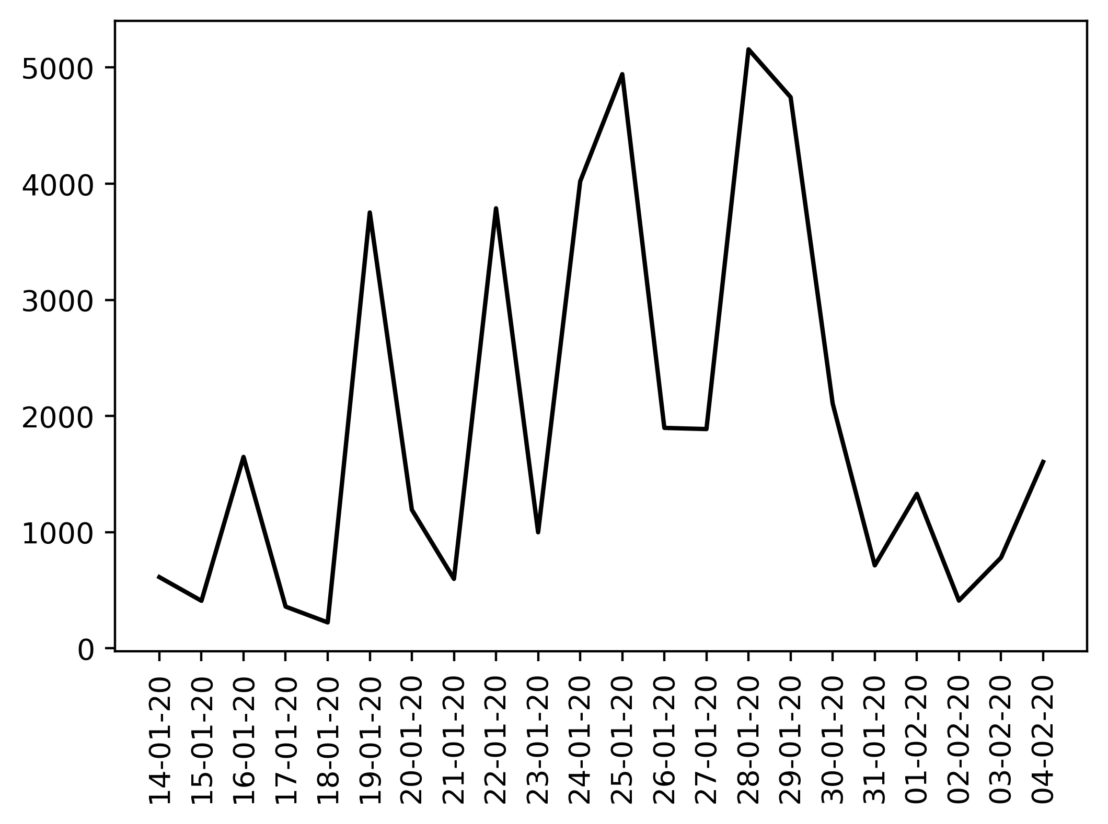
Campaign Evaluation
New Customers
There is a high peak the day before the campaign started (24-01). Maybe it is due to advertisement of the campaign or a relative reason. Moreover the two highest peaks can be found during the campaign. One on the first day and one near the last days.

Slide 13
Summary-Comments
In general, there are some clear trends that seem to happen due to the campaign as we have pointed out. Mainly regarding the Gross Revenue and the new customers.
Nationality and gender could be two parameters that will shed more light to the analysis. Moreover, it would be useful if we could analyze if the new customers due to the campaign, remained active in the casino the following months.

Slide 14
Thank you!
Dimosthenis Theofilopoulos
dimostheof@gmail.com

