Slide 1

N-body Simulations
by Dimo Dimov

Slide 2
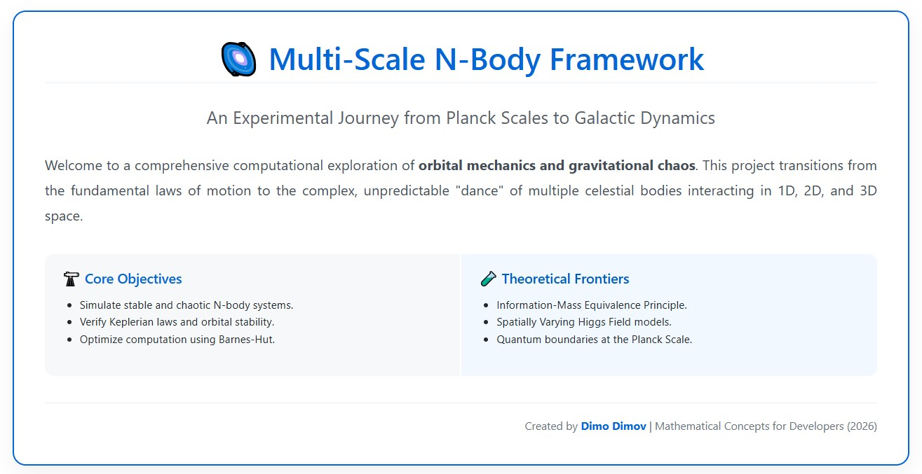

Slide 3
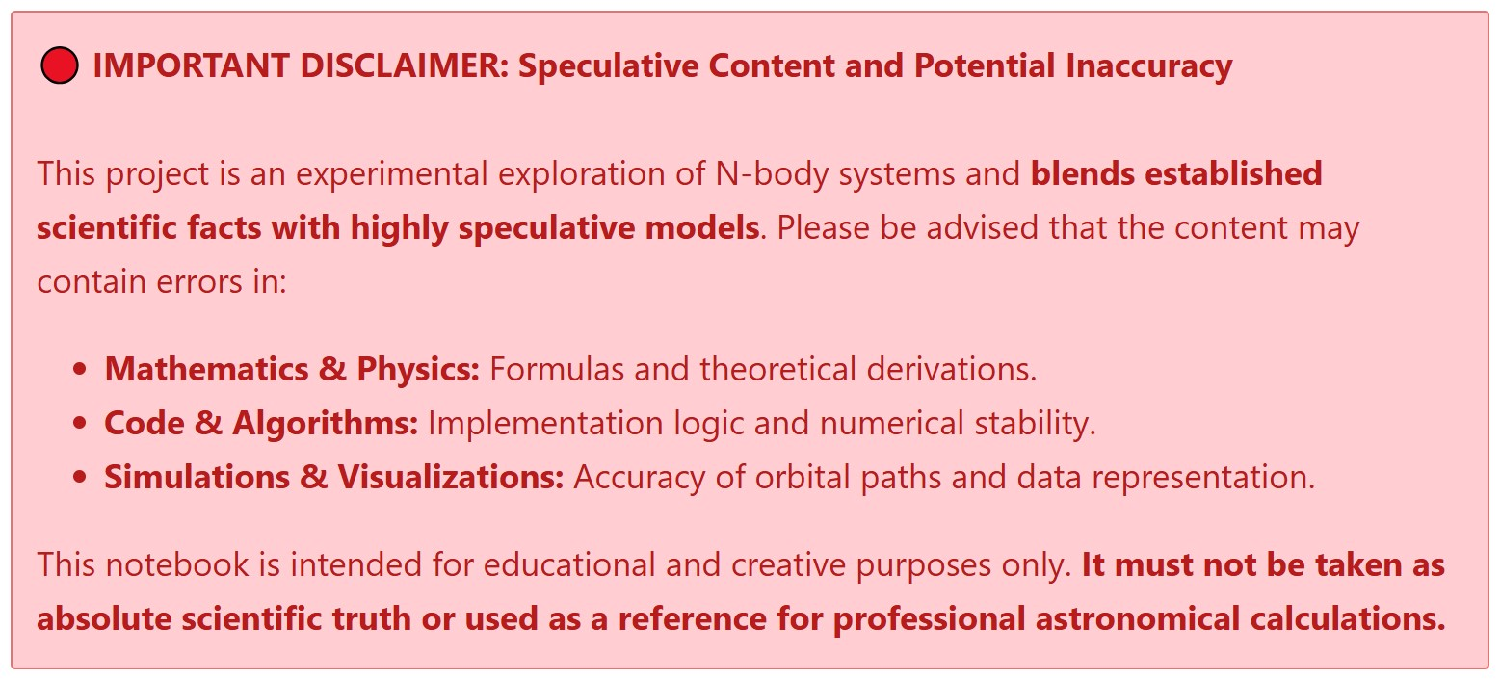

Slide 4
The O(N^2) Barrier
The quadratic scaling (O(N2)) of gravitational force calculations renders
direct summation computationally prohibitive for large-scale systems.

