Slide 1
MACHINE LEARNING PREDICTION SYSTEM
Employee Attrition Prediction
Predicting employee turnover using supervised Machine Learning algorithms
Team Members
Dimple Sharma
Vaibhav Magar
Team Assignment | Machine Learning Prediction System

Slide 2
Problem Statement
Employee attrition — when valued employees leave an organization — drives up recruitment costs, disrupts productivity, and weakens team continuity.
16.1%
Goal: Predict whether an employee is likely to leave the company (Attrition = Yes/No) using HR-related features such as age, job role, income, overtime, and job satisfaction.
of employees in the dataset
left the company (Attrition)
This is framed as a binary classification problem — Attrition = 1 (left) or 0 (stayed).
83.9%
stayed with the organization
Employee Attrition Prediction — Machine Learning Prediction System
2

Slide 3
Objectives
Collect & Understand Data
Preprocess the Dataset
1
2
Study a real-world HR dataset and its attrition target variable.
Handle missing values, duplicates, encoding, and feature scaling.
Explore the Data
Train Multiple Models
3
4
Run EDA to uncover patterns and relationships behind attrition.
Build and compare five classification algorithms.
Evaluate Performance
Derive Insights
5
6
Use Accuracy, Confusion Matrix, Precision, Recall, and F1 Score.
Identify the best model and actionable HR insights.
Employee Attrition Prediction — Machine Learning Prediction System
3

Slide 4
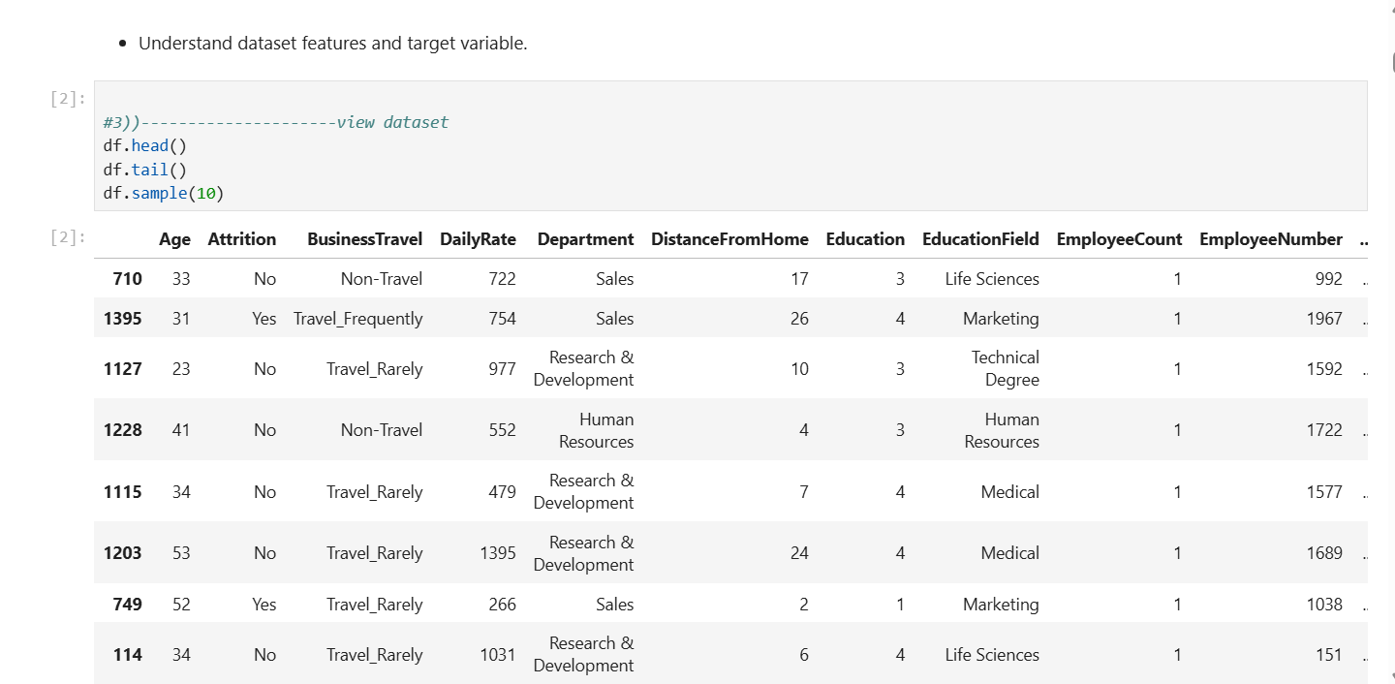
Dataset Overview
IBM HR Analytics Employee Attrition Dataset
1,470
35
26 + 9
0
Employee Records
Total Columns
Numerical + Categorical Features
Missing Values
Sample Features
Numerical: Age, MonthlyIncome, TotalWorkingYears, DistanceFromHome, YearsAtCompany Categorical: BusinessTravel, Department, Gender, JobRole, MaritalStatus, OverTime
Fig — Dataset preview (df.head())
Target Variable
Attrition — whether the employee left the company (Yes / No)
Employee Attrition Prediction — Machine Learning Prediction System
4

Slide 5
Data Preprocessing
Missing Values
Checked with df.isnull().sum() — none found; no imputation required.
1
Duplicate Records
Checked with df.duplicated().sum() — no duplicates found.
2
Categorical Encoding
LabelEncoder converted text columns (BusinessTravel, Department, Gender, JobRole, etc.) into numeric form.
3
Feature Scaling
StandardScaler standardized numerical features to mean ≈ 0, std ≈ 1 for fair model training.
4
Employee Attrition Prediction — Machine Learning Prediction System
5

Slide 6
Machine Learning Models
Five classification algorithms trained on an 80/20 train-test split (random_state = 42)
LR
DT
RF
SVM
KNN
Logistic Regression
Decision Tree
Random Forest
Support Vector Machine
K-Nearest Neighbors
Linear baseline classifier
Rule-based, interpretable tree model
Ensemble of trees to reduce overfitting
Margin-based classifier on scaled features
Distance-based instance learning
Employee Attrition Prediction — Machine Learning Prediction System
6

Slide 7
Model Evaluation
Accuracy comparison across all five models
Best Model
SVM
88.44%
accuracy — highest among all five models tested
LR, RF & KNN also performed strongly, all above 87% accuracy.
Decision Tree trailed the group at 76.19%.
Employee Attrition Prediction — Machine Learning Prediction System
7

Slide 8
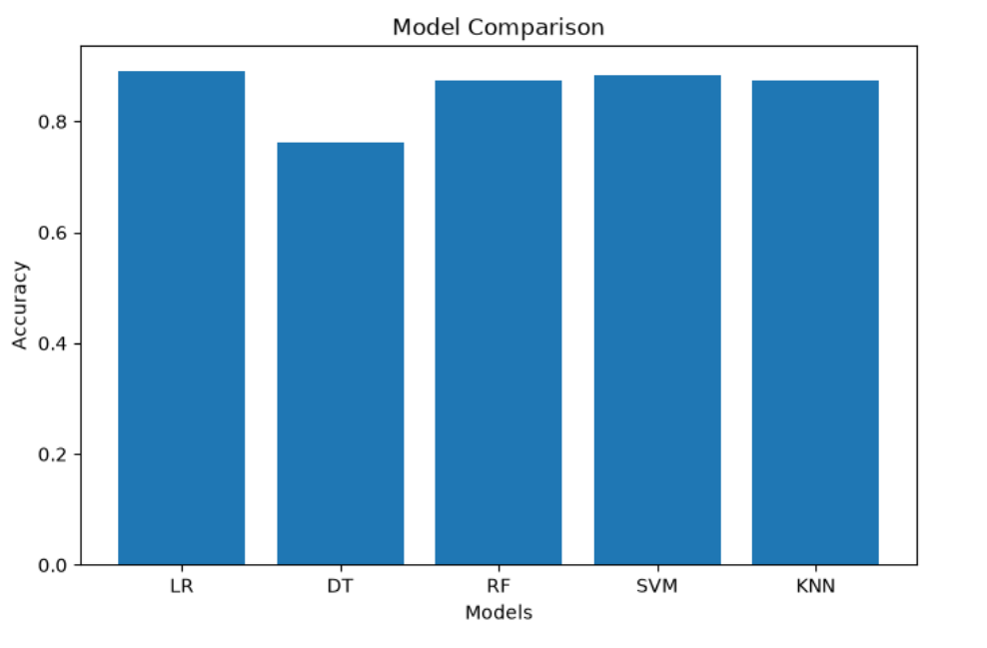
Model Evaluation
Confusion Matrix & Metrics — Random Forest
0.75
Precision
Correct most of the time when it predicts “leaves”
0.077
Recall
Misses many employees who actually leave
0.140
F1 Score
Low — reflects the recall shortfall
Fig — Confusion matrix (Random Forest)
Class imbalance (16.1% attrition) means high accuracy alone doesn't guarantee the model catches employees at risk of leaving.
Employee Attrition Prediction — Machine Learning Prediction System
8

Slide 9
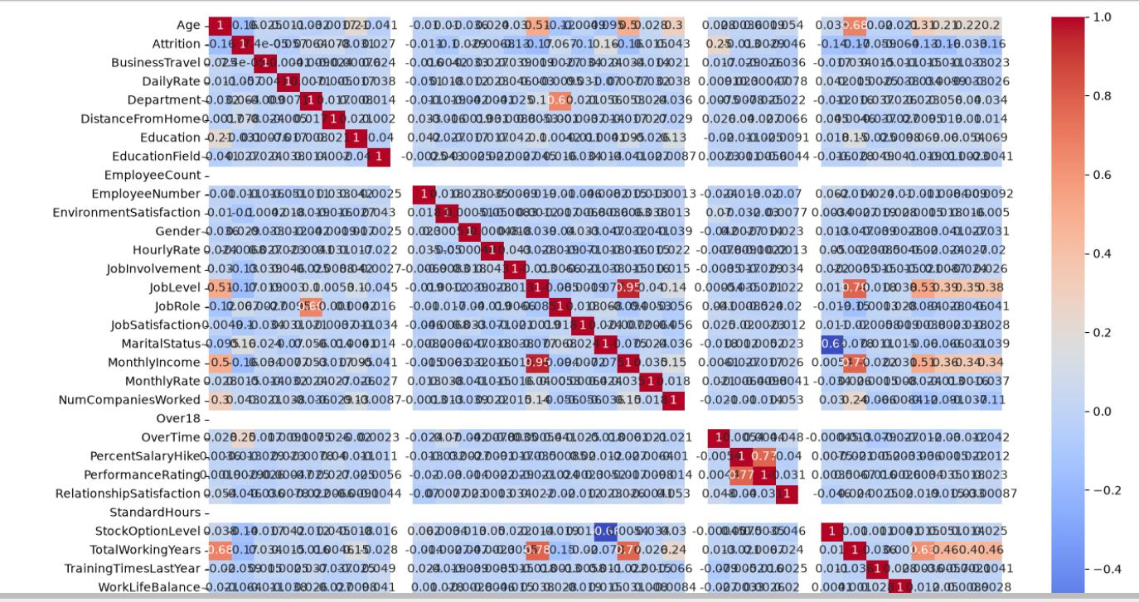
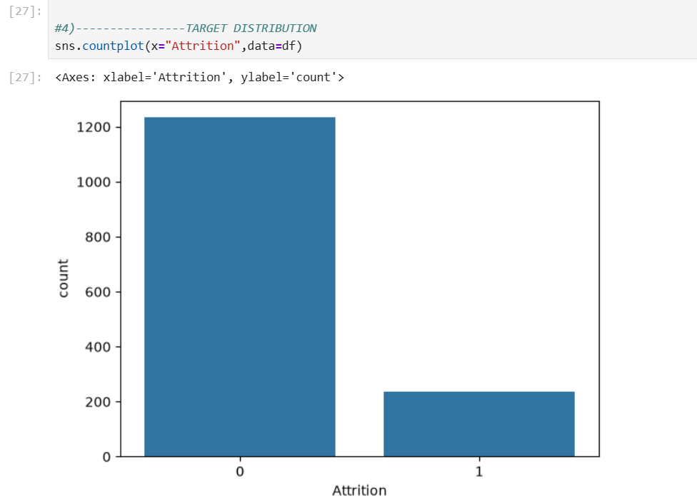
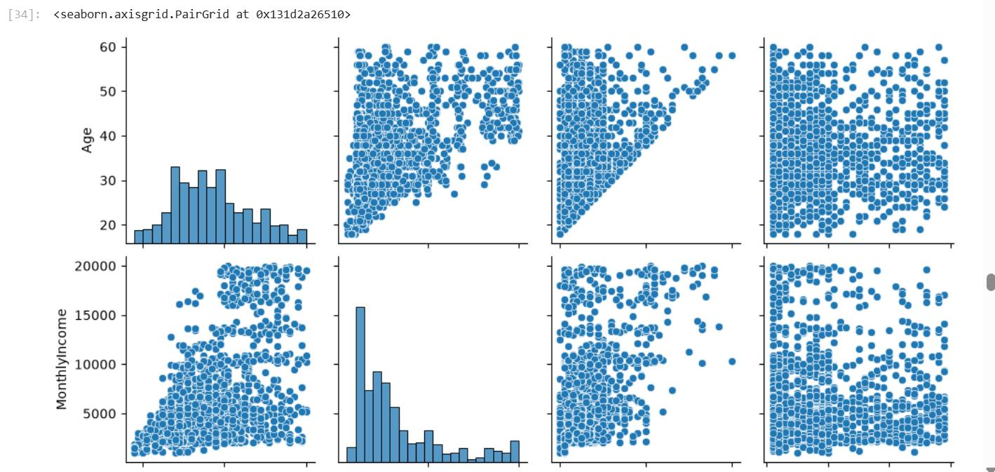
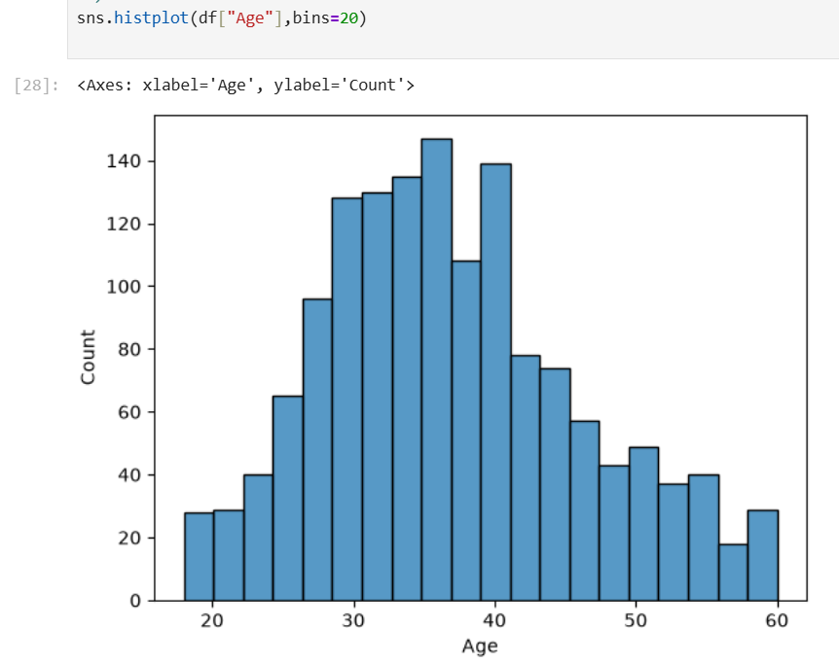
Project Demonstration
Exploratory Data Analysis in action
Fig — Income vs attrition
Fig — Attrition
count
Fig — Feature correlation heatmap
Fig — Age distribution
Attrition = 16.1% of employees • Age has a strong positive correlation with Total Working Years • Lower income is associated with higher attrition
Employee Attrition Prediction — Machine Learning Prediction System
9

Slide 10
GitHub Collaboration
Repository:
[ Insert GitHub Repository Link Here ]
✓
One Shared Repository
✓
Commits from Both Members
A single GitHub repository was created for the full project.
Dimple Sharma and Vaibhav Magar each contributed via Git commits.
✓
Divided Tasks
✓
Reviewed & Merged Together
Preprocessing & EDA vs. model building & evaluation, split evenly.
Code was reviewed and merged collaboratively before finalizing.
✓
README Maintained
✓
Regular Check-ins
A README.md documents the setup, dataset, and workflow.
Frequent discussions were held to track progress and resolve issues.
Employee Attrition Prediction — Machine Learning Prediction System
10

Slide 11
Challenges & Learning Outcomes
Challenges Faced
Learning Outcomes
Handling class imbalance in the attrition target variable
Choosing the right preprocessing for mixed categorical & numerical HR data
Comparing five classifiers fairly on the same train-test split
Interpreting evaluation metrics beyond raw accuracy
Coordinating GitHub merges between two contributors
End-to-end ML workflow: collection → preprocessing → modeling → evaluation
Practical use of Label Encoding and Standard Scaling
EDA techniques using Matplotlib and Seaborn
Trade-offs between accuracy, precision, recall & F1 on imbalanced data
Collaborative development using Git and GitHub
Employee Attrition Prediction — Machine Learning Prediction System
11

Slide 12
Conclusion
This project successfully built a complete Employee Attrition Prediction System, from raw HR data to a compared, evaluated set of five ML models.
88.44%
The Support Vector Machine (SVM) achieved the best accuracy at 88.44%, showing how ML can help organizations spot at-risk employees and act early on retention.
Best accuracy (SVM)
Future work: address class imbalance (e.g. SMOTE), tune hyperparameters, and explore advanced ensembles to improve recall on the minority attrition class.
5
ML models trained & compared
1,470
employee records analyzed
Dimple Sharma & Vaibhav Magar

