Slide 1
NEXT LEVEL
GAMING & ESPORTS ARENA
Website and Mobile App Design
Team Members
1. Dimpho Kgohloane – ST10527228
2. Andy Mafhiri – ST10529452
3. Tshegofatso Moabi – ST10524985
Module: XHAW5112
Date: 15 October 2026

Slide 2
Overview
The scenario we has chosen collectively is Next Level Gaming and Esports Arena. This presentation explains the design of our website and mobile application, the reasons behind our visual choices, our wireframe structure and how the finished product supports the user journey. Our team members are Dimpho (Website developer), Andy (Coordinator) and Tshegofatso (Mobile App developer).
Next Level is a gaming and Esports venue concept covering PC and console gaming, virtual reality, tournaments, parties and corporate events. The digital products should help visitors understand what is available and find the next step, such as exploring an experience, reviewing membership information, checking fees or contacting the venue.

Slide 3
We focused on three user needs: finding out what the venue offers, comparing experiences and membership information and taking action. Our design priorities are clear navigation, a consistent visual scheme, readable and visible content. These priorities help users move through the site without having to guess where information is.

Slide 4
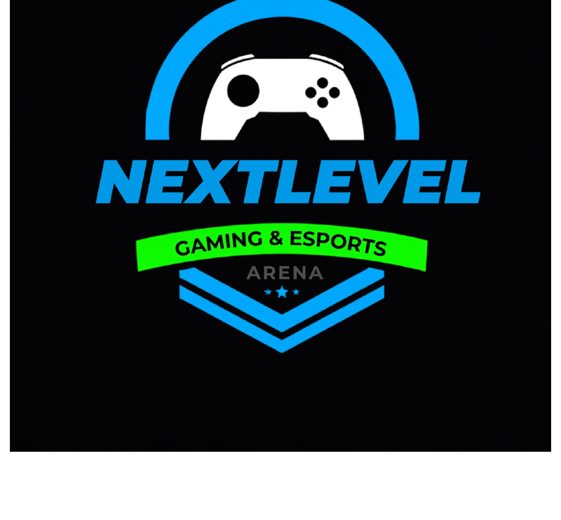
Logo Design
The logo concept combines a controller symbol with the idea of levelling up. The controller represents gaming, while the level-up idea shows progress and achievement. Electric blue is used as the main colour, neon green adds energy and dark grey and white provides contrast. We chose a simple concept so it can accomodates a website header and mobile app icon.

Slide 5
WireFrames
Wireframes show the structure before visual styling is applied. The website wireframe reserves space for navigation, the main message, the primary action and experience cards. The mobile wireframe follows a vertical layout with stacked sections. This stage helps us organize information and prioritizes user tasks before focusing on color, imagery and typography. These are explanatory wireframes, not exports from our source design file.
The navigation structure starts with the home page and links to About, Experiences, Gamer Pass, Fees or Booking, and Contact. These sections separate general discovery from practical information and user actions. Keeping the labels consistent across both platforms helps users build a familiar mental model and find important sections more quickly.

Slide 6
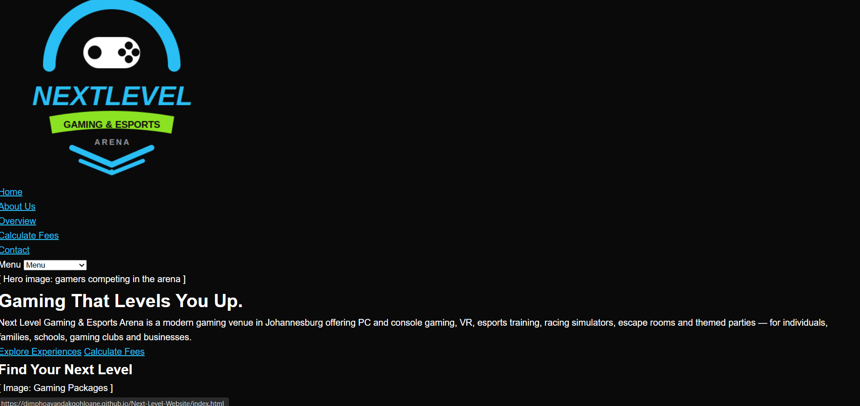
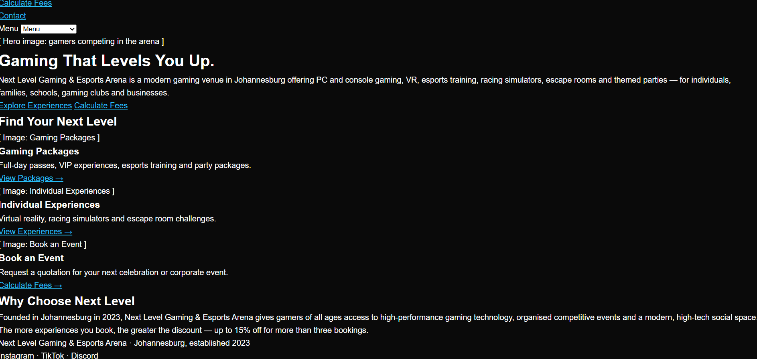
Website Design
The website is designed to make the venue and its experiences understandable. The navigation groups important destinations, while the hero area communicates the main message and provides a clear action. Cards help users scan different offerings. The dark and blue palette supports the gaming identity, while spacing and hierarchy keep the layout organised.

Slide 7
Mobile App design
The mobile app needs to work on a smaller screen, so content should be arranged in a clear vertical flow. Larger touch targets, short labels and obvious navigation make it easier to use on a phone. Repeating the same colors and labels across the website and app helps users recognize that both products belong to the same service. We should demonstrate the actual app and confirm that text, buttons and scrolling work well on a real device or emulator.

Slide 8
Conclusion
In conclusion, our website and mobile app aims to provide one consistent experience for customers exploring Next Level Gaming and Esports Arena. The visual scheme supports the gaming theme, the information architecture keeps the main destinations organized, and the responsive design supports different devices. Thank you for listening. We are ready for questions.

Slide 9
THANK YOU

