Slide 1

Demand-Based Bus Scheduling Using Booking Data
Arpan Naskar
Dimpi Gupta
Subhandu Ghosh
Under the Supervision of
Prof. Dr. Pritha Banerjee
Notes:
A: Topic name, own name
B: Own name
R: Own name, supervisor

Slide 2
Index
Introduction | Booking System(simple webpage)
Our approach | Cost analysis(for operator)
Previous work | When to use
Proposed algorithm | Future Work
Application in use
7/3/2024
Notes:
R: Index

Slide 3

Introduction
Our project, *Demand-Based Bus Scheduling Using Booking Data*, aims to revolutionize the way urban bus systems operate. By leveraging booking data, users can book rides from one point to another with a specific booking time, enabling a more efficient and user-centered approach to public transportation.The core of our system involves analyzing booking data to determine the optimal number of buses required between various stops and identifying strategic points where buses should be halted. Each bus stop is designed with ample space to accommodate multiple buses in advance, ensuring readiness and flexibility.The primary goal of our project is twofold: to reduce operating costs for bus operators and to minimize the need for extra buses at any given location, thereby helping to alleviate traffic congestion. By aligning bus availability with actual demand, we aim to create a more efficient, cost-effective, and user-friendly public transportation system.
7/3/2024
Notes:
R: Introduction

Slide 4
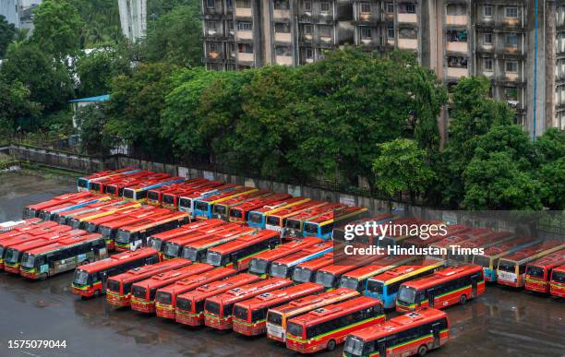
Our Approach
Our approach provided in this project handles the given problem in its own way.(static booking)
-Gather all booking data by 12am for next-day bus allocation. - Analyze booking data to determine demand between various bus stoppages.
- Allocate and halt buses based on the analyzed demand to ensure optimal coverage. - Stock extra buses at strategic stoppages to handle demand and ensure readiness.
-It provides a static bus allocation approach benefits towards bus operator to reduce overall expense also help in reducing road traffic to some extend
7/3/2024
Notes:
B: Our approach

Slide 5

Previous Works
London iBus System
London's iBus system is a intelligent transportation system that enhances bus service efficiency through continuous communication and data analysis.
Implementation and Impact: The iBus system in London leverages GPS technology and real-time communication between buses. This allows for the continuous monitoring of bus locations and traffic conditions across the city. The control centers use this information to optimize bus routes and schedules dynamically, responding to traffic incidents, roadworks. The system also provides passengers with real-time updates on bus arrival times and service changes. Since its implementation, the iBus system has contributed to more reliable and efficient bus services, reducing delays and enhancing passenger convenience.

Slide 6
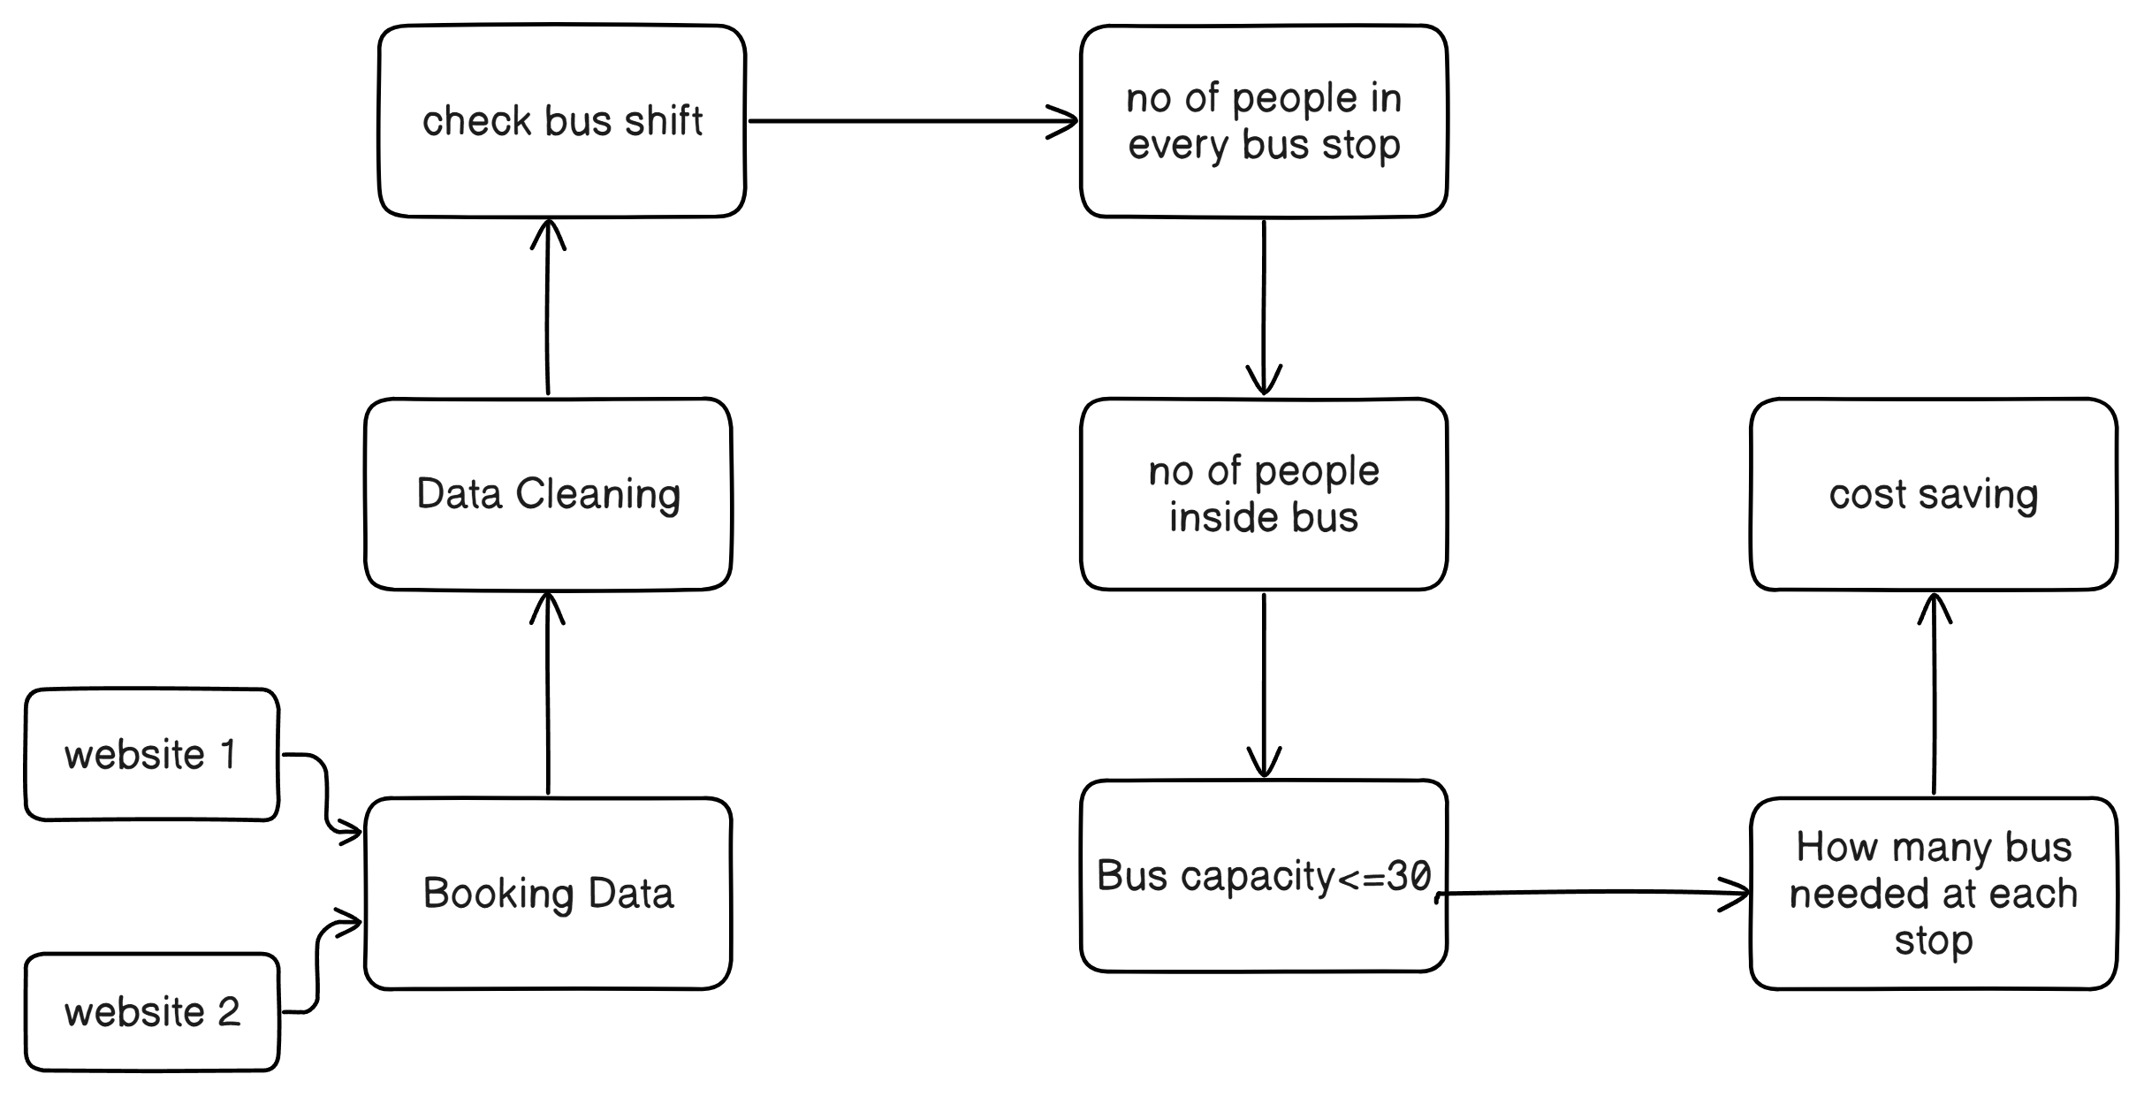

PROPOSED ALGORITHM
7/3/2024
Notes:
A: Proposed algorithm

Slide 7

Analysis:
Python: organising all booking information to provide optimal Bus requirement at each stopage.
For booking
Html,css,js: To create simple a webpage
Python flusk : to collect Booking data from website
Application in use

Slide 8
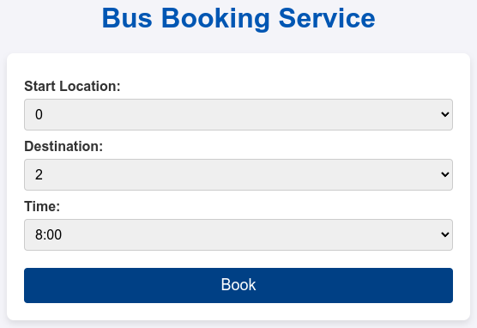
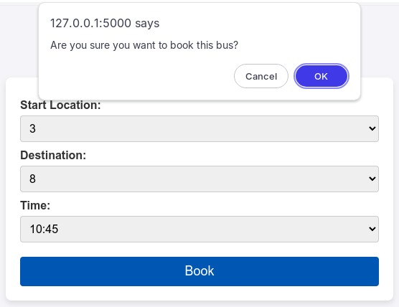
Booking System(simple webpage)

Slide 9
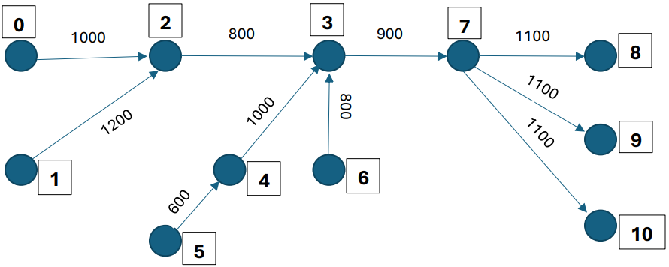
Our Example route
Gap between all bus terminals: 15 min
Condition : no of people inside the bus <= 30

Slide 10
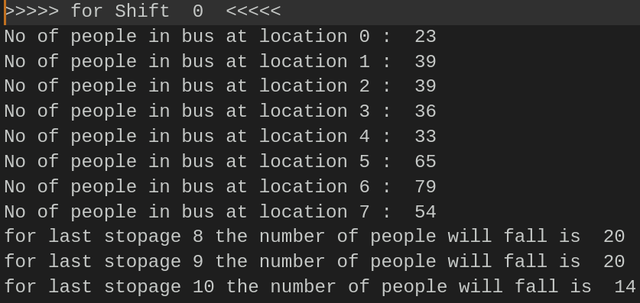
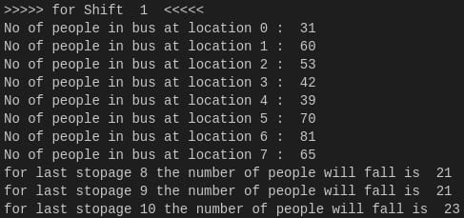
Shift 0 :
Bus start
8Am : 0 1 5
8:15Am : 6
Shift 1:
Bus start
8:15Am : 0 1 5
8:30Am : 6

Slide 11
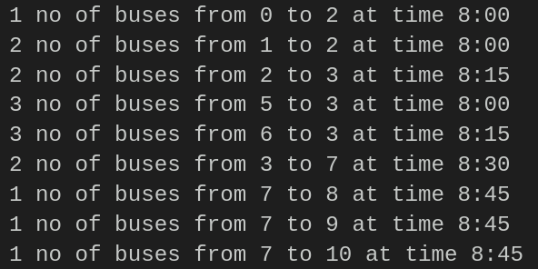
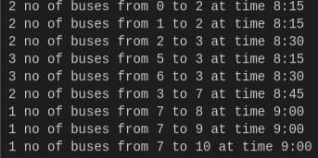
Bus requirement calculation
Shift 0
Shift 1

Slide 12
Without any optimisation
Shift 0
With Our Optimisation
0, 1, 5, 6(all bus with go to end terminal)
Bus route | Bus Required
0 -> 2 | 1 bus
1 -> 2 | 2 Bus
2 -> 3 | 2 Bus
5 -> 3 | 3 Bus
6 -> 3 | 3 Bus
3 -> 7 | 3 Bus
7 -> 8 | 1 Bus
7 -> 9 | 1 Bus
7 -> 10 | 1 Bus
0 -> 1000 + 800 + 900 +1100 = 3800rs (1 bus)
1 -> 1200 +800 +900 + 1100 = 4000rs (2 bus)
5 -> 600 +1000 +900 + 1100 = 3600rs ( 3 bus)
6 -> 800 + 900 + 1100 = 2800rs (3 bus)
*Total cost*
(3800*1) + (4000*2) + (3600*3) + (2800*3) = 31000rs
Total cost:
1000+(1200*2)+(800*2)+(1600*3)+(800*3)+(900*3)+(1100*1)+(1100*1)+(1100*1) = 18200rs
Total Cost Saving :
(31000 – 18200) = 12800rs

Slide 13
Without any optimisation
Shift 1
With Our Optimisation
0, 1, 5, 6(all bus with go to end terminal)
Bus route | Bus Required
0 -> 2 | 2 bus
1 -> 2 | 2 Bus
2 -> 3 | 2 Bus
5 -> 3 | 3 Bus
6 -> 3 | 3 Bus
3 -> 7 | 2 Bus
7 -> 8 | 1 Bus
7 -> 9 | 1 Bus
7 -> 10 | 1 Bus
0 -> 1000 + 800 + 900 +1100 = 3800rs (2 bus)
1 -> 1200 +800 +900 + 1100 = 4000rs (2 bus)
5 -> 600 +1000 +900 + 1100 = 3600rs ( 3 bus)
6 -> 800 + 900 + 1100 = 2800rs (3 bus)
*Total cost*
(3800*2) + (4000*2) + (3600*3) + (2800*3) = 34800rs
Total cost:
(1000*2)+(1200*2)+(800*2)+(1600*3)+(800*3)+(900*2)+(1100*1)+(1100*1)+(1100*1) = 21600rs
Total Cost Saving :
(34800 – 21600) = 13200rs

Slide 14

Why this approach
Our approach is implemented as a standalone website for booking.
Python and flux made this road creation and calculation easy.
This website create booking data and save it as csv.
As its on a webpage we can book from any platform.
7/3/2024
Notes:
R

Slide 15
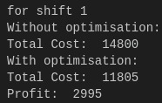
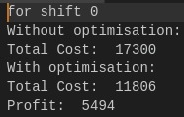
End Result
Notes:
B

Slide 16
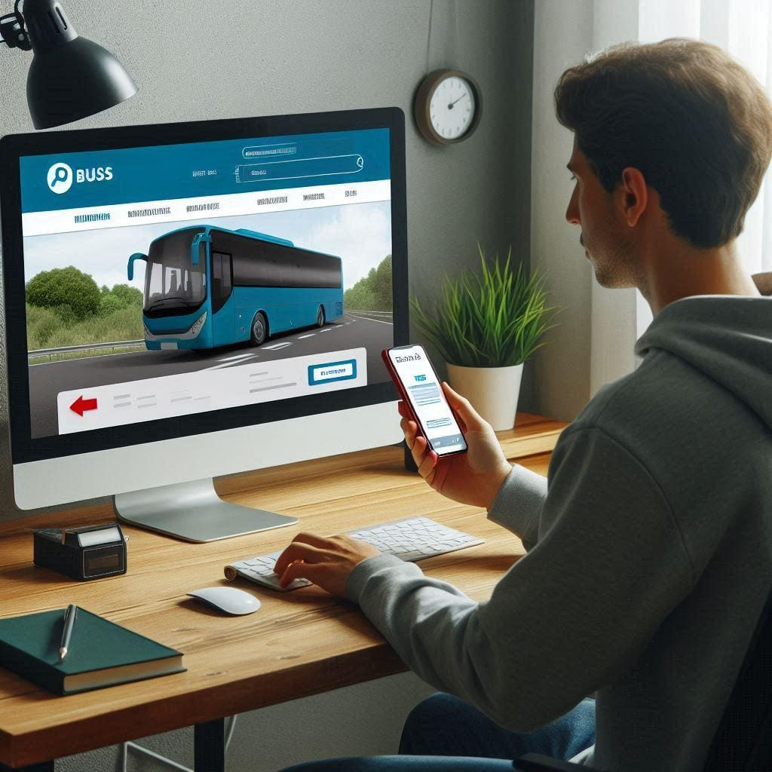
Uses and Future Work
When to Use this approach:
Bus operator has plenty off buses to store in a specific stoppage.
Large Bus stoppage area to store multiple number of buses.
One or two bus stoppage have most no of booking.
7/3/2024
Notes:
R

Slide 17
Future Work
Simulation and Scenario Analysis:
Conduct extensive simulations to analyze the performance of the algorithm under various scenarios, including peak hours, special events, and emergencies. This can help identify potential bottlenecks and improve the robustness of the algorithm.
Dynamic Passenger Prediction:
Implement machine learning models to predict passenger bookings and patterns based on historical data, weather conditions, special events, and time of day. This predictive approach can enhance the algorithm's proactive management of bus routes.

Slide 18
Conclusion
The proposed algorithm for private bus reduction effectively minimizes the number of buses required to fulfill all bookings, thereby significantly reducing traffic congestion. By optimizing bus schedules and consolidating routes, the algorithm ensures efficient utilization of resources and enhances the overall transportation system's sustainability. Implementing this solution will lead to decreased operational costs, improved traffic flow, and a positive environmental impact due to reduced emissions. This approach not only addresses the current challenges of urban mobility but also paves the way for a smarter, more efficient future in public transportation.
7/3/2024
Notes:
A

Slide 19

THANK YOU
7/3/2024

