Slide 1


Fall 2019
Northeastern University, Seattle
College Of Engineering
INFO6210
Charita Madduri
Dimple Bapna
Soumyajeeth Patra
Sachin Kumar

Slide 2
Content
Introduction
Final ERD
Database Implementation
Column Level Constraints
Computed Columns
Encrypted Columns
Functions and Triggers
Views
PowerBI Report

Slide 3
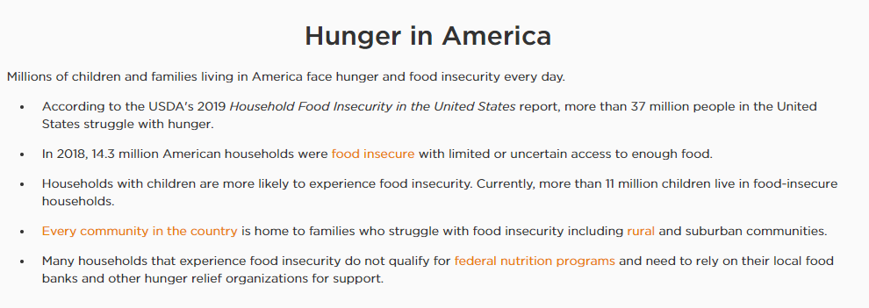
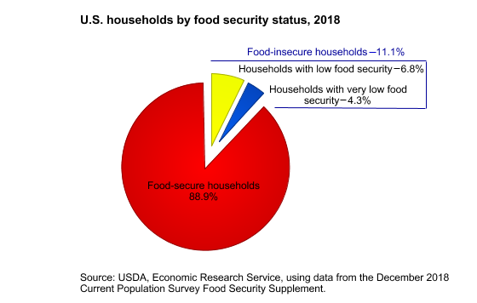

Slide 4
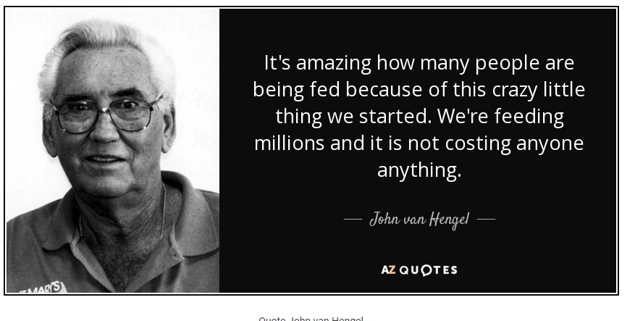

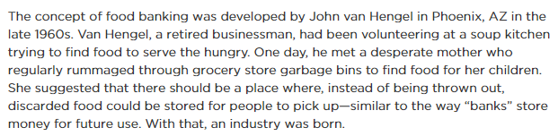

Slide 5
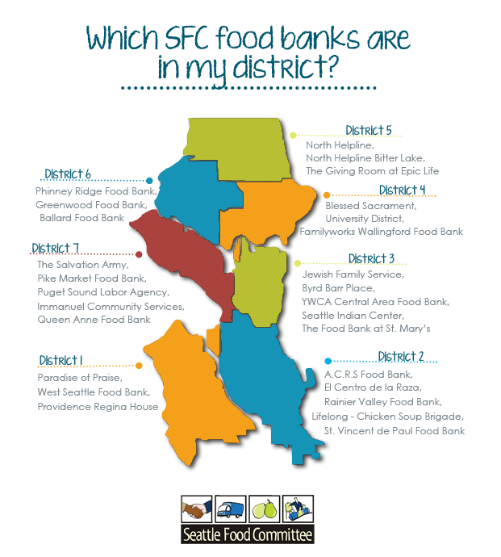

Slide 6


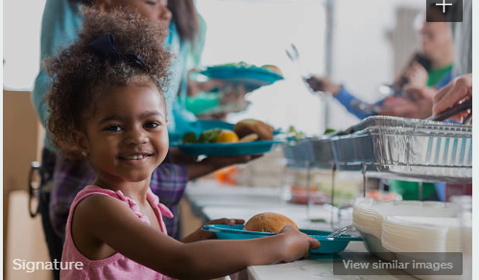


Slide 7
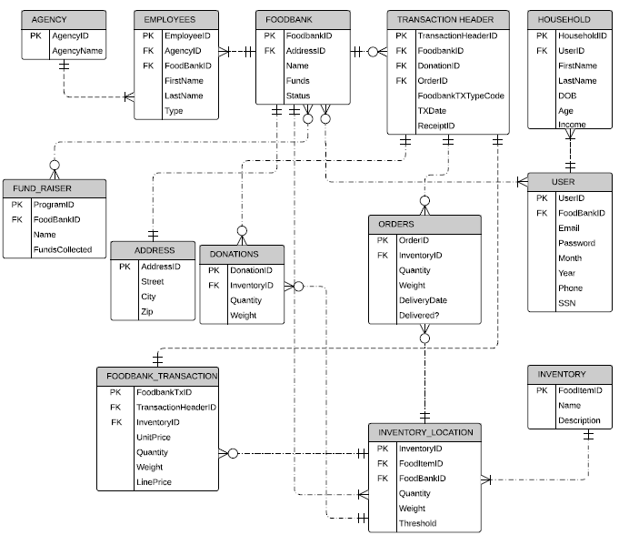
Foodbank entity relationship diagram

Slide 8
Our Data Base system was implemented in SQL Server Management Studio
Data was imported into the database using the data import wizard of SSMS
We used Create tables command to create all tables and SQL DDL commands were used to implement the database
Database implementation

Slide 9
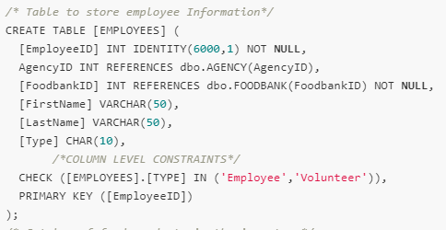
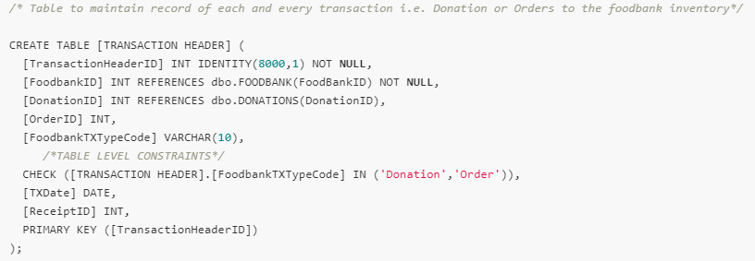
COLUMN LEVEL CONSTRAINTS
Column level Constraints lets us perform validations on field values. Our Database implements it as follows !
Our Check only allows Employee.Type to be from either of the two values and not anything else !
Our Second Constraint only allows transaction type to be either “Donation” or “Order” !

Slide 10
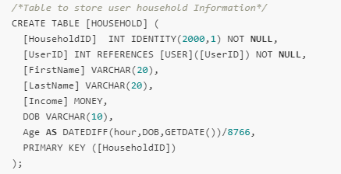
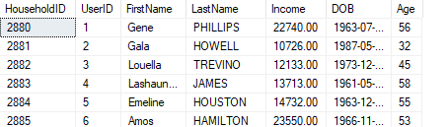
COMPUTED COLUMNS
Computed Columns add an extra level of insight into the database and help in automatic calculation of values on proper data insertion. Below examples implemented in our database proves it !!
This line of code helps reduce overhead of updating age manually every year, thereby preventing manual data updation every year !!
All it needs it’s a DOB and Voila!! Age gets populated automatically

Slide 11

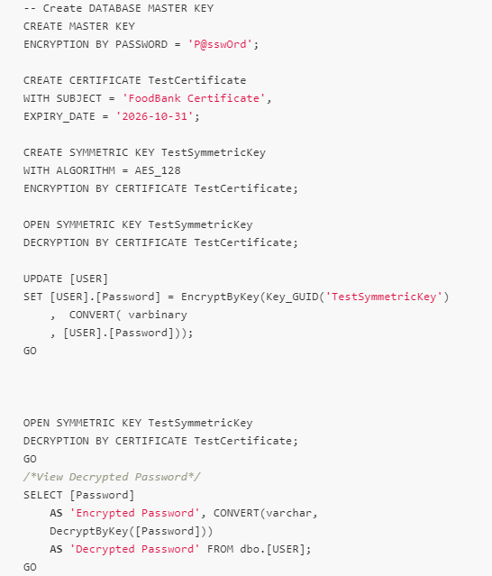
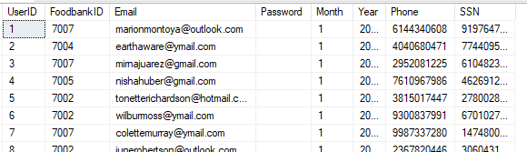
ENCRYPTED COLUMNS
Column level encryptions enables us to keep our secret columns encrypted and protect anyone else from snooping into our database!
This very long code provides a very subtle effect
Whooosh! All passwords invisible !!

Slide 12
Functions and triggers
FUNCTION CalcLinePrice
It appends a computed column line price to the table Foodbank Transaction which provides a item wise, order or donation value according to the unit( Weight or Quantity) in which they are ordered or donated
ALTER TABLE FOODBANK_TRANSACTIONADD LinePrice AS (dbo.fn_CalcLinePrice(FoodbankTxID));
FUNCTION AllowOrders
This function adds a constraint on the Orders table, which prevents an order when order amount is greater than the quantity available in the inventory, is placed
ALTER TABLE ORDERS ADD CONSTRAINT BanOrders CHECK (dbo.AllowOrders(InventoryID, Quantity, Weight) != 0);
FUNCTION AllowDonation
This table level constraint prevents donations on an inactive foodbank
ALTER TABLE DONATIONS ADD CONSTRAINT BanDonation CHECK (dbo.AllowDonation(InventoryID) != 0);
TRIGGER AddFunds ON FUND_RAISER AFTER INSERT
Updates funds column in Foodbank entity on new entry in fundraiser entity

Slide 13
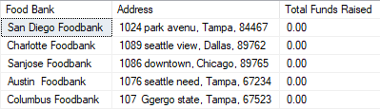
VIEWS
vDisplayInActiveFoodBanks : This View displays the inactive Food Banks in the database and help us in identifying Inactive Foodbanks that can be filtered out from day to day operations
CREATE VIEW vDisplayInActiveFoodBanks
AS
SELECT fb.Name AS 'Food Bank', CONCAT(addr.Street,', ', addr.City,', ', addr.Zip) AS 'Address', fb.Funds AS 'Total Funds Raised'
FROM FoodBank fb
JOIN Address addr
ON fb.AddressID = addr.AddressID
WHERE fb.Status = 'Inactive';
GO;

Slide 14
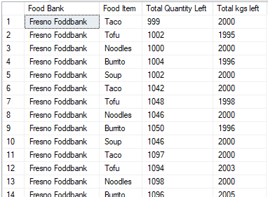
vFoodItemsLeft: What is a foodbank Inventory management system without a view that tracks Food bank Inventory
Provides comprehensive tracking of food item of a particular kind remaining in the inventory of particular food bank !
CREATE VIEW vFoodItemsLeft
AS
SELECT foo.Name AS 'Food Bank', inv.Name AS 'Food Item',
(ISNULL(il.Quantity,0) - ISNULL(SUM(od.Quantity),0) + ISNULL(SUM(do.Quantity),0)) AS [Total Quantity Left],
(ISNULL(il.Weight,0) - ISNULL(SUM(od.Weight),0) + ISNULL(SUM(do.Weight),0)) AS [Total kgs left]
FROM INVENTORY_LOCATION il
FULL JOIN ORDERS od
ON il.InventoryID = od.InventoryID
FULL JOIN DONATIONS do
ON il.InventoryID = do.InventoryID
JOIN INVENTORY inv
ON inv.FoodItemID = il.FoodItemID
JOIN FOODBANK foo
ON foo.FoodbankID = il.FoodbankID
GROUP BY il.FoodBankID, il.Quantity, il.Weight, inv.Name, foo.Name;
GO;

Slide 15
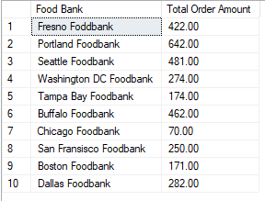
vTotalOrderAmount : This view displays the Total order amount for each food bank in terms of monetary value and thus helps us keep track of the expenditure of the food bank !
CREATE VIEW vTotalOrderAmount
AS
SELECT fb.Name AS 'Food Bank', SUM(LinePrice) AS 'Total Order Amount'
FROM FoodBank fb
JOIN [TRANSACTION HEADER] th
ON fb.FoodbankID = th.FoodbankID
JOIN FOODBANK_TRANSACTION ft
ON ft.TransactionHeaderID = th.TransactionHeaderID
WHERE fb.Status = 'Active'
AND th.OrderID IS NOT NULL
GROUP BY fb.Name, fb.FoodbankID;
GO;

Slide 16
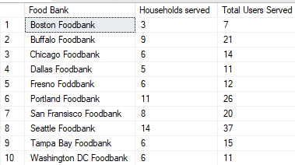
vUsersServed : This view helps us gather insight onto the number of Users and Households served by each of the Food Banks !
CREATE VIEW vUsersServed
AS
WITH TEMP
AS
(SELECT UserID, COUNT(HouseholdID) AS 'Total_Members' FROM HOUSEHOLD
GROUP BY UserID)
SELECT fb.Name AS 'Food Bank', COUNT(us.UserID) AS 'Households served', SUM(Total_Members) AS 'Total Users Served'
FROM dbo.[USER] us
JOIN FoodBank fb
ON us.FoodbankID = fb.FoodbankID
JOIN TEMP t
ON t.UserID = us.UserID
GROUP BY fb.Name;
GO;

Slide 17
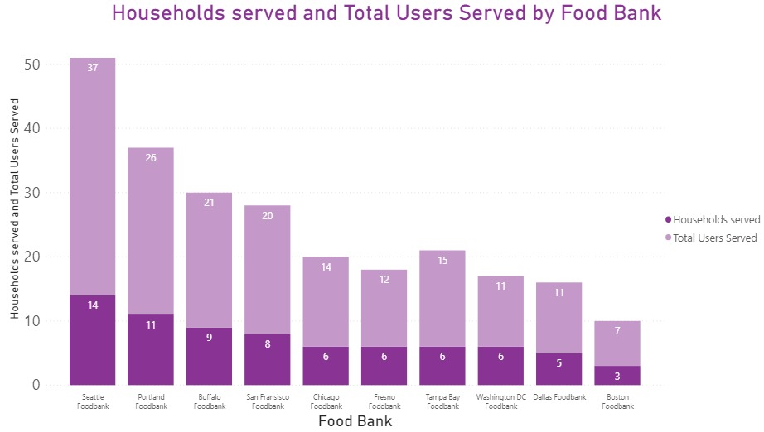

Slide 18
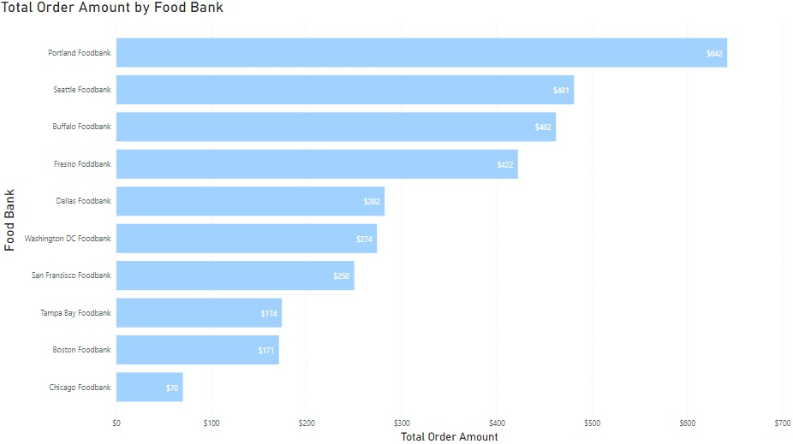

Slide 19
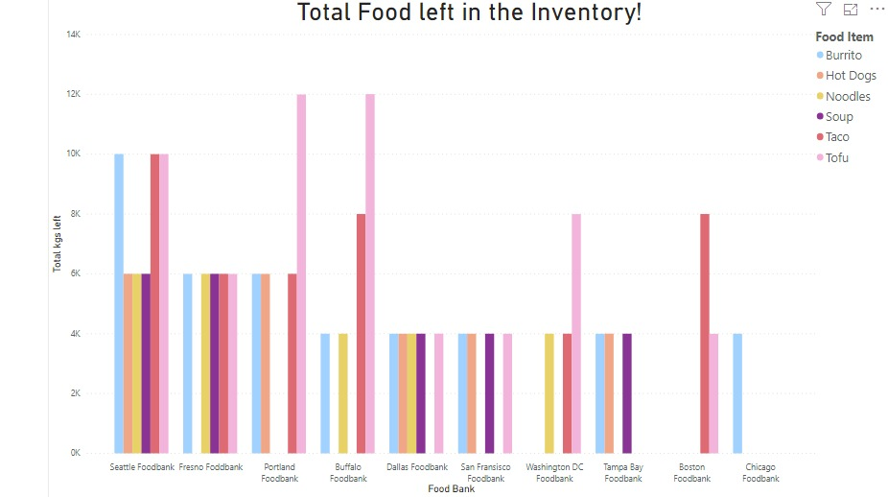

Slide 20
THANK YOU
Any Questions?

