Slide 1
Product Recommender System and Sentiment Analysis Course: INFO6105 52106 Data Science Engineering Methods SEC 03
Team Members - Harshad Jaju (NUID: 001439898) - Dimple Zatkia (NUID: 001474071) - Aman Kapoor (NUID: 001448282) - Pallavi Dalvi (NUID: 001442156)

Slide 2
Introduction
We are building Product Recommender System and Sentiments Analysis using Machine Learning tools and methods.
We have divided project in 2 parts:
Recommendation Engine
Sentiment Analysis

Slide 3
Data definition
Data Source: http://snap.stanford.edu/data/amazon/productGraph/categoryFiles/reviews_Cell_Phones_and_Accessories_5.json.gz
Data type: JSON file format consisting of reviews and ratings on Amazon’s Mobile phone and Accessories data
Data size: ~194,439 records
Note: It is used for both recommendation system and sentiment analysis

Slide 4
Recommendation System
Algorithm used: KNN (K-nearest neighbor) with item-item collaborative filtering approach
Steps taken:
Aggregation on ratings column to get overall rating by different users on a product
Vectorization on text of the reviews against ratings and cleaned it
Split train-test data on scale of 75-25 and 85-15
Hit and trial on the values of K to ensure best value for model accuracy

Slide 5
Result Analysis
We predicted the rating score of the product by taking number of neighbors = 3 and test train split of 75-25. The accuracy of the model was 0.8653846153846154 and the MSE was 0.1346153846153846
Then we predicted the rating score of the product by taking number of neighbors = 5 and test train split of 75-25. The accuracy of the model was 0.9038461538461539 and the MSE was 0.09615384615384616
Further, we predicted the rating score of the product by taking n_neighbors = 5 and test train split of 85-15. The accuracy of the model was 0.90625 and the MSE was 0.09375
Note: Changing the test train split size did not make much difference for model evaluation but changing the value of K (number of neighbors) did affect the model very much. Based on this dataset and the way KNN is implemented here, the best value for K would be 5

Slide 6
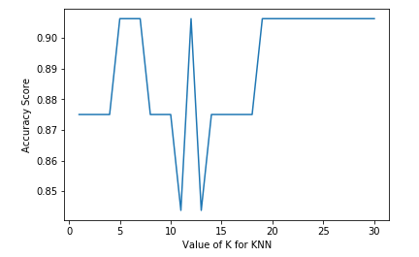
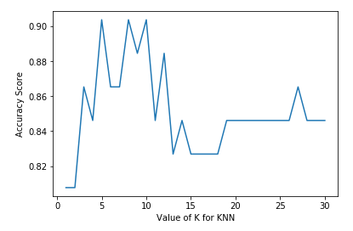
Visualization of K against accuracy score
Data split – 85-15
Data split – 75-25

Slide 7
Sentiment Analysis
It is based on number of ratings and reviews to anlayse user‘s behaviour
Algorithms used:
Logistic Regression
Naïve Bayes
KNN

Slide 8
Logistic Regression
Goal is to evaluate positive and negative words from the reviews
Steps taken:
Applied countvectorizer to tokenize the reviews
Distributed data into train-test data set
Achieved top 20 positive and negative words from the reviews
Also, implemented logistic regression model with TFIDF and N-Grams

Slide 9
Result Analysis
Logistic Regression
Model Accuracy: 0.7825662672476398
Logistic Regression with TFIDF
Model Accuracy: 0.9281726579520697
Logistic Regression with TFIDF + ngrams
Model Accuracy: 0.9222267610748003

Slide 10
Naïve Bayes
Steps taken:
Applied regex to clean the reviews
Visualized words using word cloud on the reviews
Implemented model with TFIDF to train and test the model on data
Used classifiers:
Multinomial Naïve Bayes
Binomial Naïve Bayes (BernoulliNB)

Slide 11
KNN for sentiment analysis
Steps taken:
Used regex to clean-up the data
Distributed data into train-test data set
Hit and trial on the values of K to ensure best value for model accuracy

Slide 12
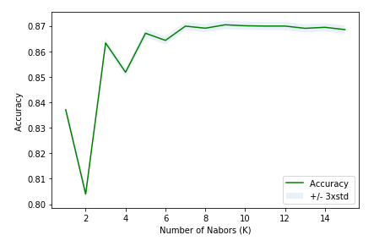
Graph representation of K against accuracy

Slide 13
Thank you!

