Slide 1
Marketing Campaign Insights Analysis
June 2025

Slide 2
Overview
Analyzing marketing campaigns is critical to understanding their effectiveness and optimizing future efforts to develop personalized content and advertising for customers. The idea behind the project is to demonstrate the effectiveness of various marketing campaigns and the performance of product groups and platforms using any marketing analytics data set.
Dataset: Marketing Analytics dataset from kaggle.com

Slide 3
Project objective:
Answers for key business questions
Which marketing campaigns yielded the highest result?
How does spending vary across product categories?
Who are the most valuable customers, and how do they respond to campaigns?
Which platforms drive the most engagement and conversions?

Slide 4
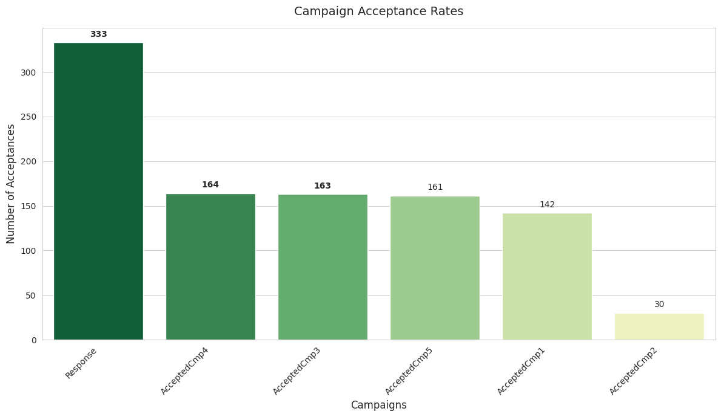
Campaign success rates & top performers

Slide 5
Conclusions
The target campaign (Response) was most
effective.
The other three (Campaigns 3,4,5) go by small margins.
The worst was Campaign 2.

Slide 6
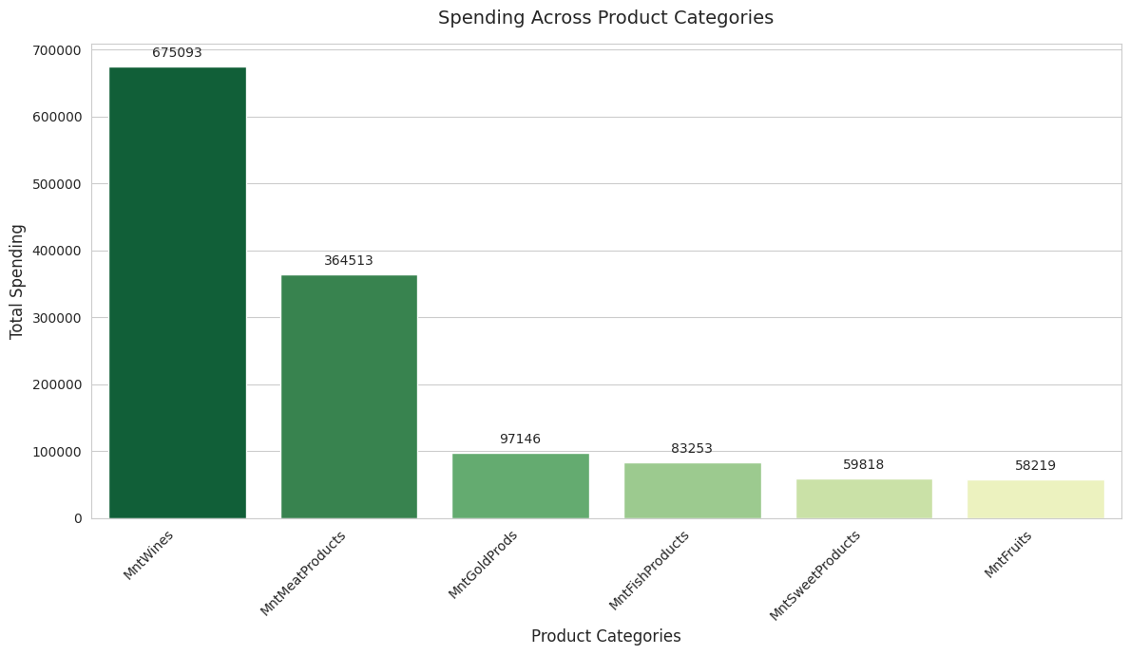
Spending across product categories

Slide 7
Conclusions
Wine is the most popular product category among customers.
Meat products are also a popular product category among customers.
Fruits, fish products, and sweets are less popular among customers.

Slide 8
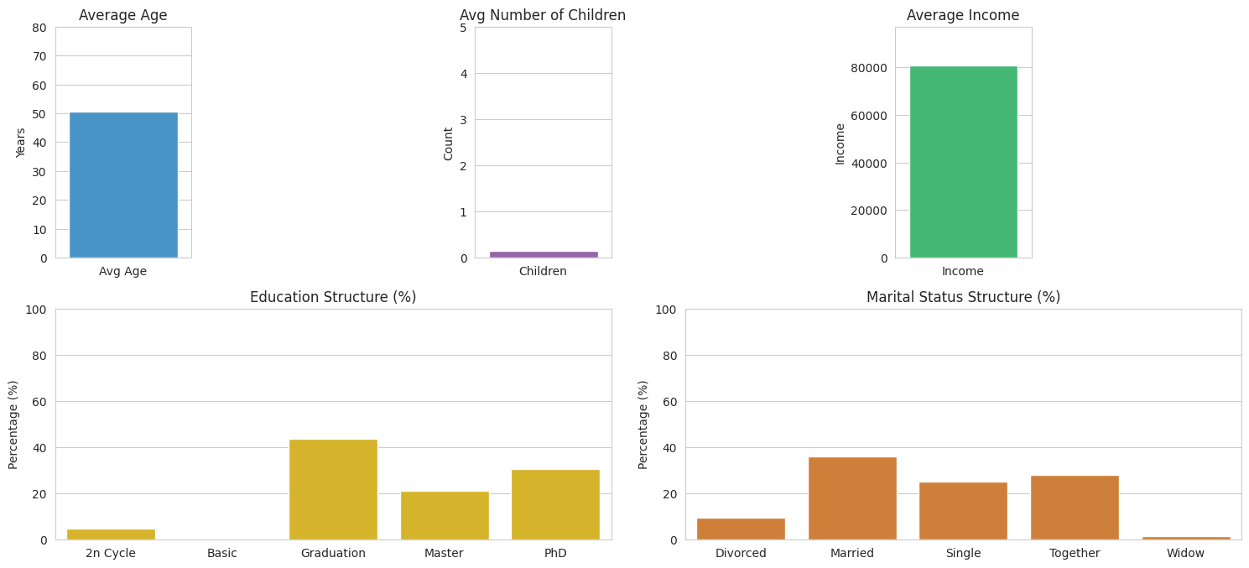
Most valuable customers - who are they?

Slide 9
Conclusions
Valued customer profile
Age: 50
Children at home: 0
Income: 80 000$
Education: Graduation or higher
Marital status: мarried or together аnd a little less single

Slide 10
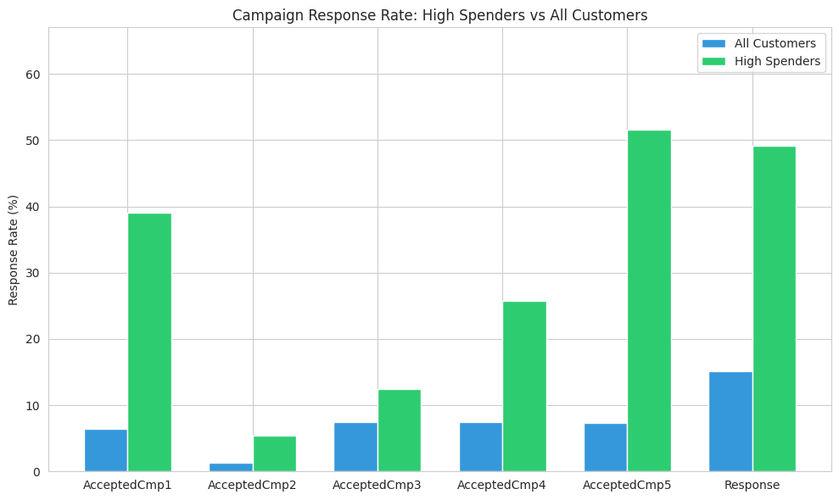
Valuable customers and their responds to campaigns

Slide 11
Conclusions
The most valuable customers respond well to all campaigns.
The fifth campaign and the target campaign are particularly successful.

Slide 12
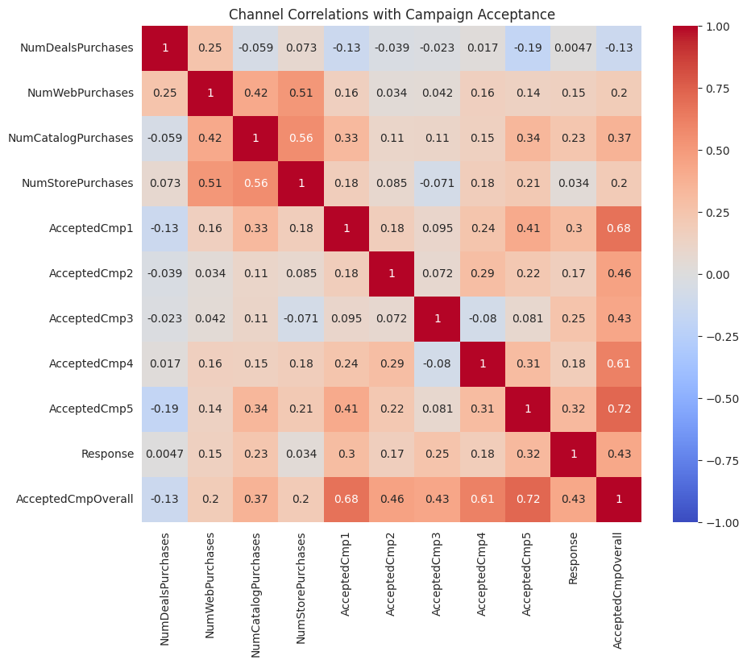
Channel correlations with campaign acceptance

Slide 13
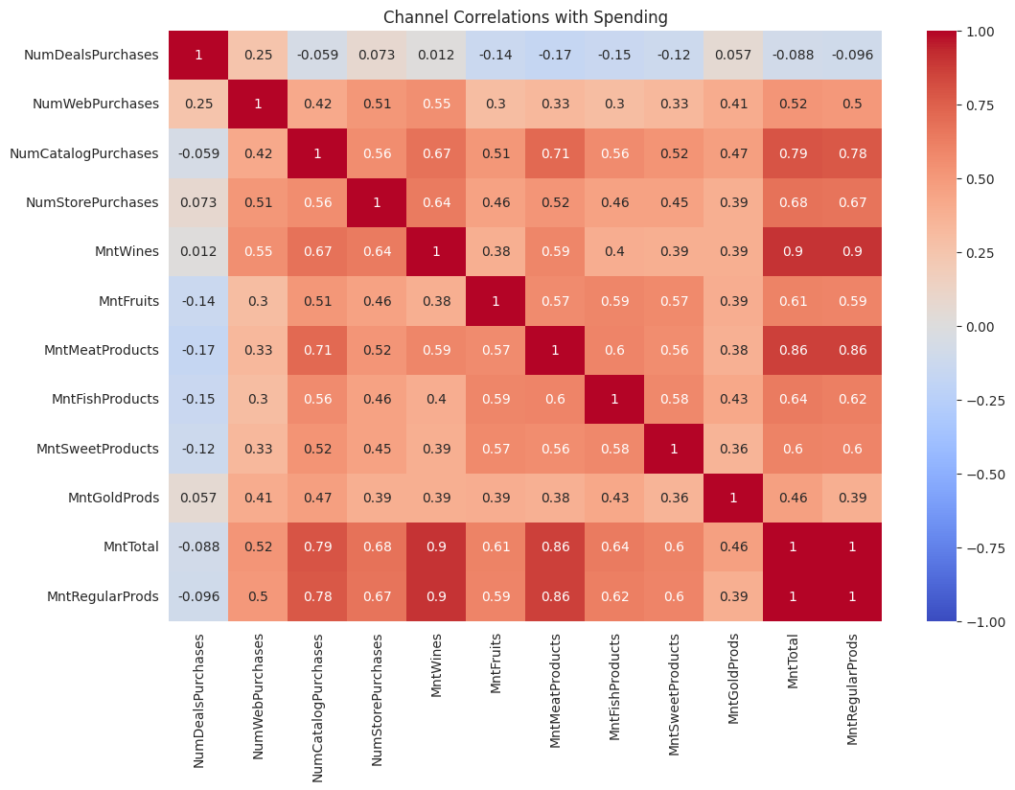
Channel correlations with spending

Slide 14
Conclusions
Offline сhannels are most valuable: store purchases and catalog purchases show the strongest positive correlation with both high overall spending and marketing campaign acceptance.
This suggests that customers utilizing these channels are a prime audience for revenue growth and marketing effectiveness.

Slide 15
Brief explanation
1
These customers spend more money and are more responsive to our marketing efforts.

Slide 16
Conclusions
"Deal" shoppers are a lower-value segment: (purchases made through deals/discounts) have a negative correlation with both overall spending and campaign acceptance.

Slide 17
Brief explanation
2
Discount-seeking customers spend less and are less receptive to general marketing campaigns, requiring a distinct strategy.

Slide 18
Conclusions
Interrelation in category spending: there is a strong positive correlation among spending on wines, meat, fish, and sweet products.

Slide 19
Brief explanation
3
Customers purchasing one of these categories often buy others, presenting cross-selling opportunities.

Slide 20

Report prepared by
Dmytro Sokhin
Data Analyst

