Slide 1
Customers segmentation
September 30, 2025

Slide 2
Overview
This project is an online retail data analysis using SQL and Python. The data is stored in an SQLite database, and queries are executed directly from Python with subsequent visualization of the results using the Plotly. The main goal of the project is to answer key business questions related to customer behavior and sales, and to present the findings in a clear, visual format.

Slide 3
Business questions addressed in this analysis
Q 1
Q 2
Q 3
Q 4
What is the distribution of order values across all customers in the dataset?
How many unique products has each customer purchased?
How many customers have only made a single purchase from the company?
Which products are most commonly purchased together by customers in the dataset?

Slide 4
Distribution of order values across all customers

Slide 5
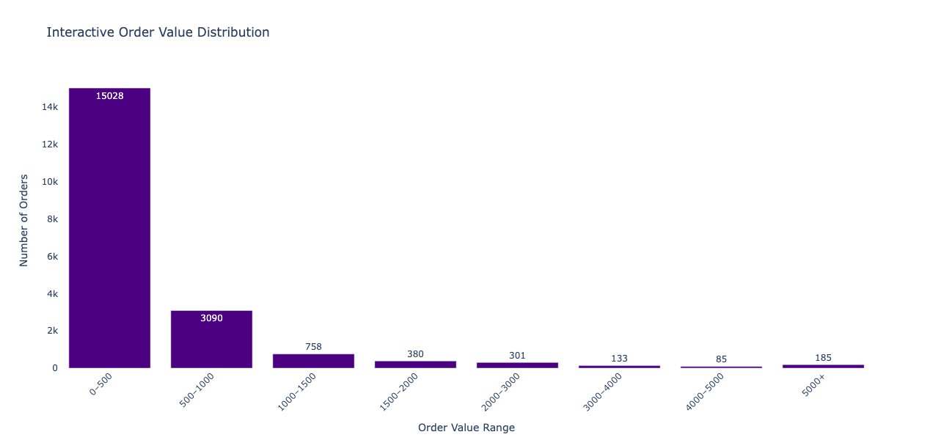

Slide 6
The range is highly skewed: most orders are small, but there are a few very large ones.
Outliers (extremely large orders) likely represent wholesale or corporate clients.
The histogram/boxplot shows a strong long-tail distribution.
Conclusion: Sales follow a long-tail pattern — a small number of large orders significantly impact total revenue.

Slide 7
Number of unique products purchased by customers

Slide 8
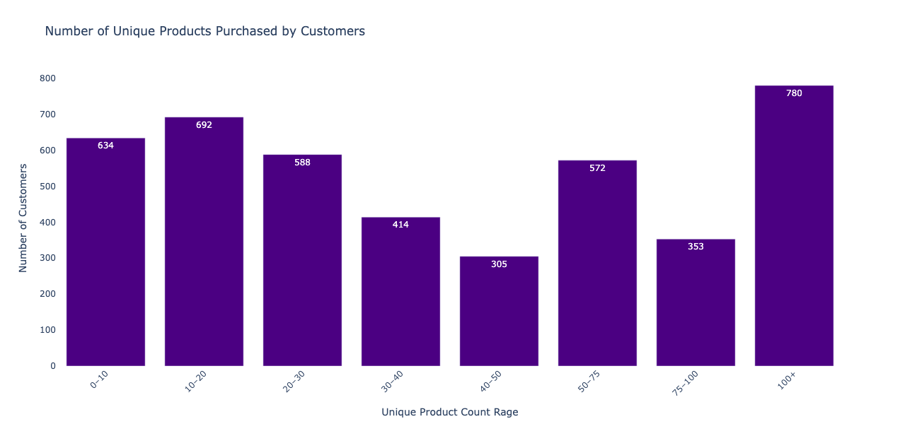

Slide 9
Most customers purchase only a small number of distinct products (1–10).
A smaller group of customers buy a wide variety of products (tens or even hundreds).
Conclusion: Customers can be split into “niche buyers” (low diversity, repeat the same products) and “variety seekers” (broad range of products).

Slide 10
Customers by number of purchases

Slide 11
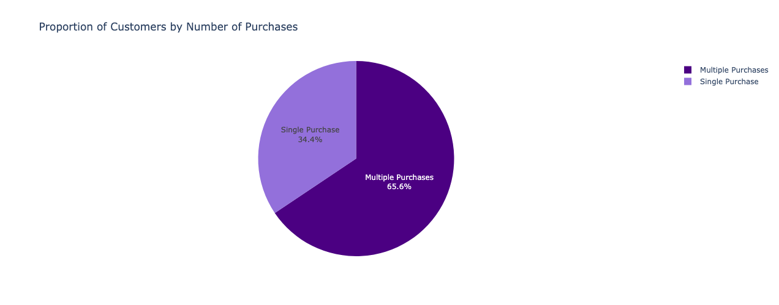

Slide 12
A significant share of customers falls into this category (commonly 40–60% in retail).
This is a critical group for customer retention strategies.
Conclusion: A high percentage of one-time buyers suggests challenges with repeat sales and indicates room for retention improvement.

Slide 13
Most commonly purchased products pair

Slide 14
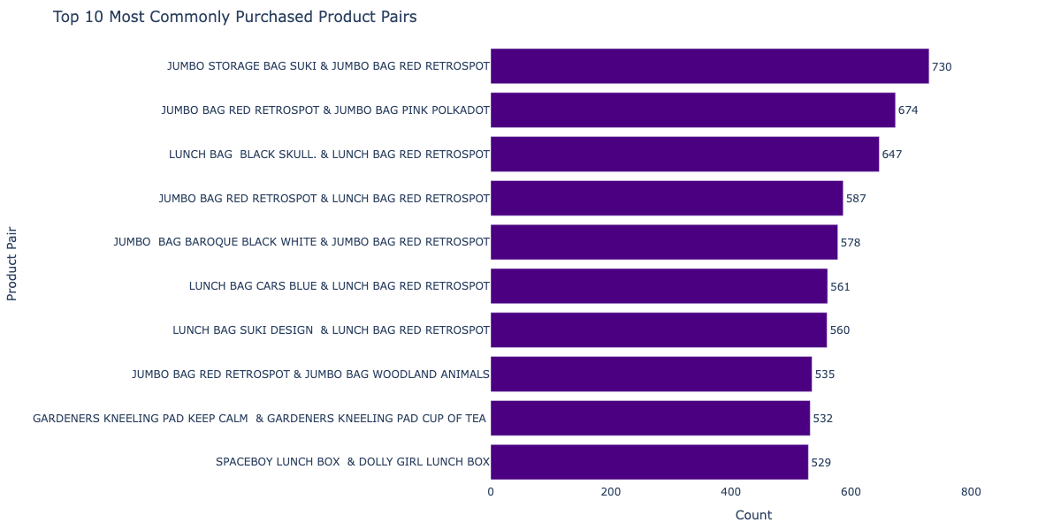

Slide 15
The top-20 pairs reveal strong associations between certain items.
This knowledge can guide cross-selling and product placement strategies.
Conclusion: Frequent co-purchases highlight natural product bundles and opportunities for recommendation systems.

Slide 16
Final dashboard

Slide 17
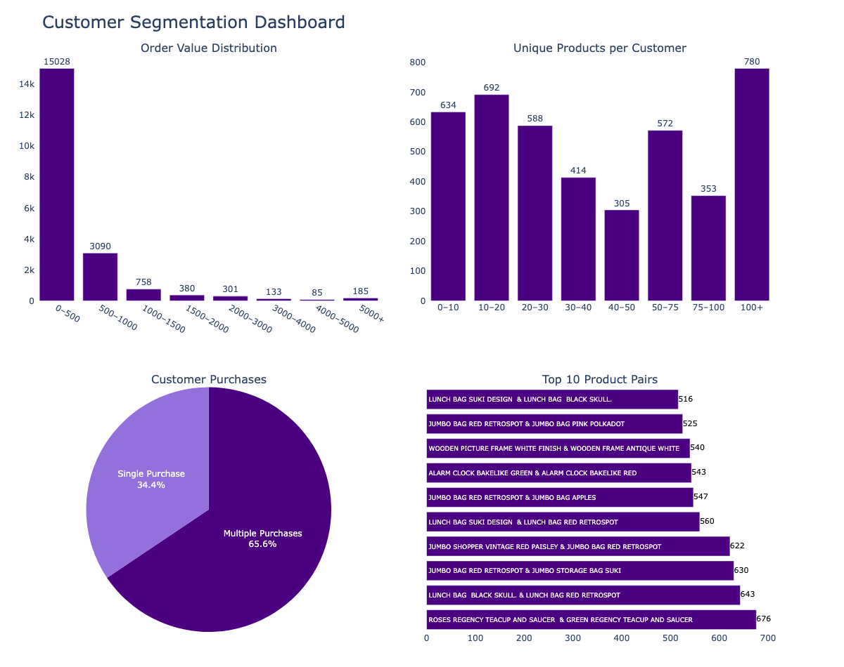

Slide 18
Overall conclusions
Sales are unevenly distributed: dominated by many small orders and a few very large ones.
A large proportion of customers are one-time buyers → retention is a major growth opportunity.
Strong product pairings exist → useful for cross-selling and recommendations.
Customer segmentation by product diversity shows different shopping behaviors worth targeting separately.

