Slide 1
DevOps Pipeline
————[11/30/2017]————
Dian Ding | Kai Lu | Xiangqing Ding | Fuxing Luan

Slide 2



checkbox.io Repo
iTrust Repo
Dependency
Run Application
Post-Build
AWS EC2
(checkbox.io instance)
Ansible Script
Post-Build
Jenkins Server
Installment
Plugins
Build Jobs
Dependency
Run Application
AWS EC2
(iTrust instance)
Configuration Management & Build

Slide 3



Analysis Script
(Esprima, Visitor pattern)
checkbox.io Repo
iTrust Repo
checkbox.io
configuration file
Test & Analysis

Slide 4

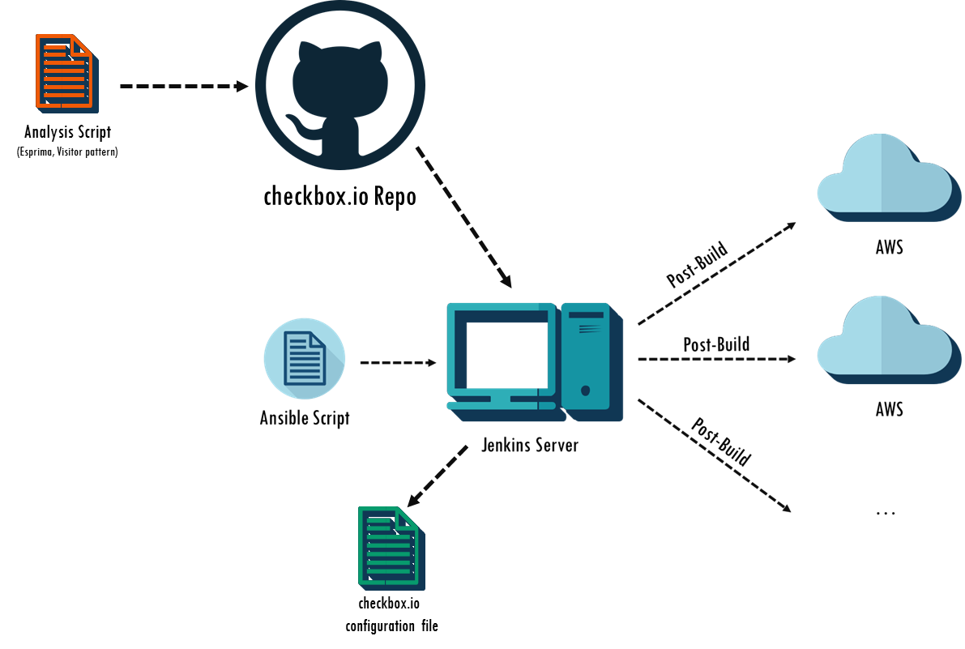
Git Hook
AWS EC2
Master
AWS EC2
Checkbox.io instance
AWS EC2
Checkbox.io instance
AWS EC2
Checkbox.io instance
Server.js
Deployment

Slide 5
Special

