Slide 1
DevOps Pipeline
————[11/30/2017]————
Dian Ding | Kai Lu | Xiangqing Ding | Fuxing Luan

Slide 2



checkbox.io Repo
iTrust Repo
Dependency
Run Application
Post-Build
AWS EC2
(checkbox.io instance)
Ansible Script
Post-Build
Jenkins Server
Installment
Plugins
Build Jobs
Dependency
Run Application
AWS EC2
(iTrust instance)
Configuration Management & Build

Slide 3
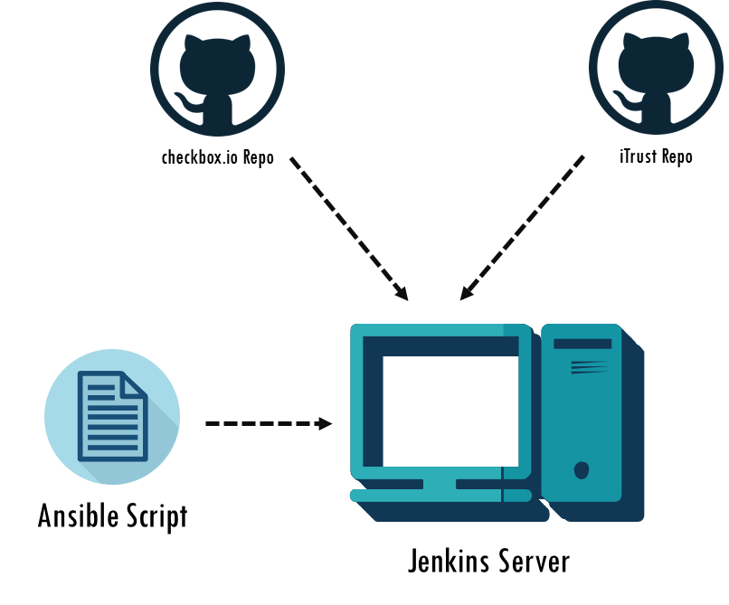






Fuzzer Branch
Analysis Script
(Esprima, Visitor pattern)
411/1164
Test & Analysis
Commit Fuzzer
(Java, Bash)
junitResult.xml
Useless Detector Script
(Python)

Slide 4
Redis Server
Load Balancer (Nginx)
Shared MongoDB
Git Hook
AWS EC2
Master
Server.js
AWS EC2
Checkbox.io instance
AWS EC2
Checkbox.io instance
AWS EC2
Checkbox.io instance
Redis Client
Feature Flag
Nomad Cluster
AWS EC2
iTrust instance
AWS EC2
iTrust instance
Deployment

Slide 5


Our pipeline
Special

Slide 6


Git Hook
(Pre-commit)
Traffic Monitoring
Regression Analysis
Auto Scaling
Clean Code
Customized Style
Save time
AWS EC2
iTrust instance
AWS EC2
iTrust instance
Special

Slide 7
Thank You!

