Slide 1

Mobile and Performance Testing Project
Team Members: [Nisreen Elaian]
[Dina AbuQare]
[Bashir Rimawi]
NE
Date: [15.5.2025]
Notes:
Nisreen

Slide 2

Agenda Overview
Introduction
Project scope and objectives
Mobile Testing
Overview, process, tools, challenges, results
Performance Testing
Overview, process, tools, challenges, results
Conclusion & Recommendations
Key takeaways and next steps
Notes:
Dina

Slide 3
Introduction to Mobile Testing
Definition
Importance
App Types
Test apps for functionality, usability, consistency
Ensures optimal user experience and reliability
Native
Web
Hybrid
Notes:
Bashir

Slide 4

Application Under Test: Sauce Labs Sample App
Features Tested
Platform
Android
Login, Add to Cart, Remove from Cart
Testing Approach
Automation Testing
Notes:
Dina

Slide 5
Mobile Testing Process & Tools
Process Steps
Tools Used
APK Acquisition
Appium
Emulator Setup
Android Emulator
Appium Server Configuration
Eclipse IDE
Test Script Development
UIAutomator Viewer
Test Execution
Sauce Labs
Result Analysis
Notes:
Dina

Slide 6

Challenges in Mobile Testing
APK Compatibility
Finding working APK for emulator
Emulator Performance
Lag and crashes during tests
Capabilities Setup
Time-consuming device configuration
Tool Integration
Issues integrating Appium with Eclipse
Notes:
Nisreen

Slide 7
Mobile Testing Results
Test Cases
Success Rate
Login
Login fails in some functionalities
Add to Cart works as expected
Add to Cart
Remove from Cart
Remove from Cart works as expected
Notes:
Nisreen

Slide 8
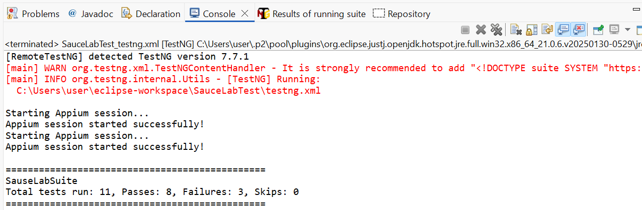
Mobile Testing Results
Notes:
Nisreen

Slide 9
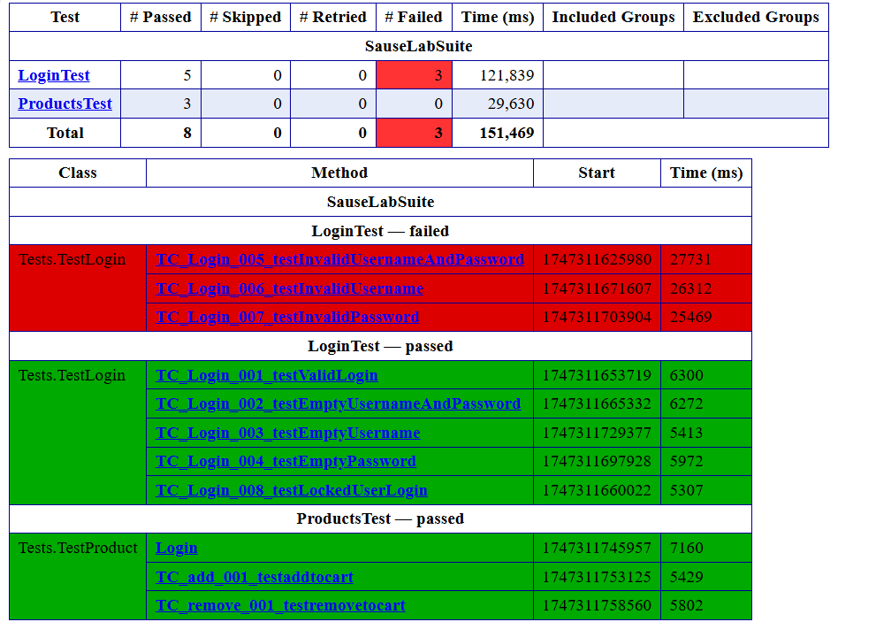
Mobile Testing Results
Notes:
Nisreen

Slide 10
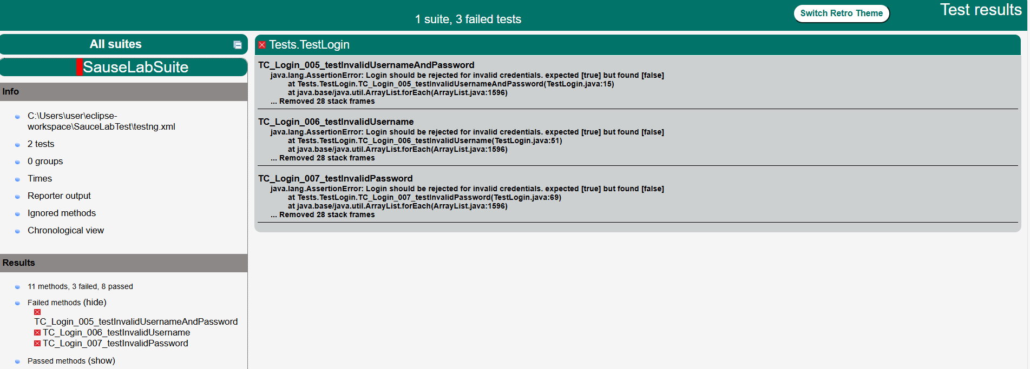
Mobile Testing Results
Notes:
Nisreen

Slide 11
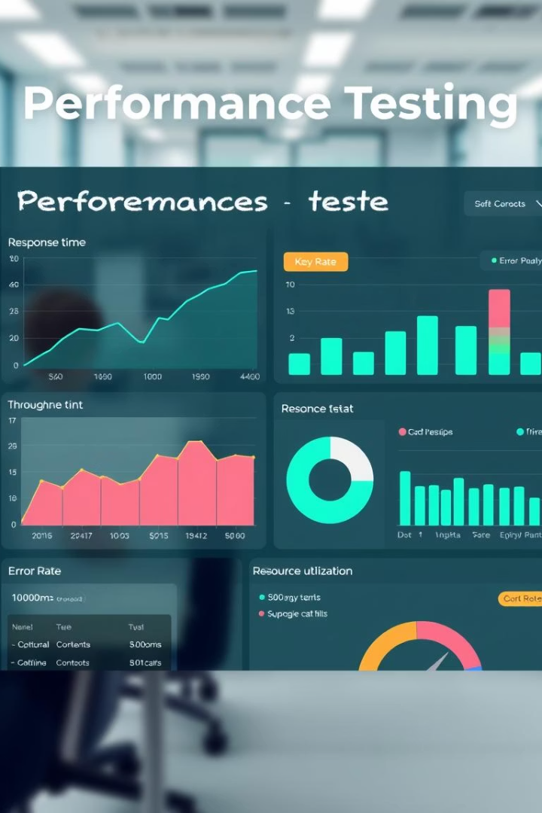
Introduction to Performance Testing
Definition
Importance
Evaluate responsiveness, stability, scalability
Ensure app handles expected user traffic
Test Types
Load Testing
Notes:
Bashir

Slide 12


Performance Testing Application
Website
Testing Tool
Reqres.in API
Apache JMeter
Endpoints Tested
GET All Users
GET Single User
POST Create User
PUT Update User
DELETE User
Notes:
Bashir

Slide 13
Performance Testing Process & Tools
Process Steps
Tools Used
Test Plan Creation
Apache JMeter
Thread Group Configuration
JSR223 PostProcessor
Sampler Setup
View Results Tree
Timer Implementation
Summary Report
Assertion Addition
Graph Results
Listener Configuration
Assertion Results
Test Execution
Result Analysis
Notes:
Dina

Slide 14
Challenges in Performance Testing
Unauthorized Access Errors: Encountered 401 errors due to missing Header Manager.
Assertion Failures: Incorrect status code expectations led to test failures.
Timer Configuration: Determining appropriate delays for realistic simulation.
Notes:
Dina

Slide 15
Performance Testing Results
Test Configuration:
Users: 10
Ramp-Up Period: 30
secondsLoop Count: 20
Timers Implemented:
GET All Users: Constant Timer (1000ms)
GET Single User: Uniform Random Timer (500-1000ms)
POST Create User: Gaussian Random Timer (700ms offset, 300ms deviation)
PUT Update User: Constant Timer (800ms)
DELETE User: Constant Timer (600ms)
Notes:
Dina

Slide 16
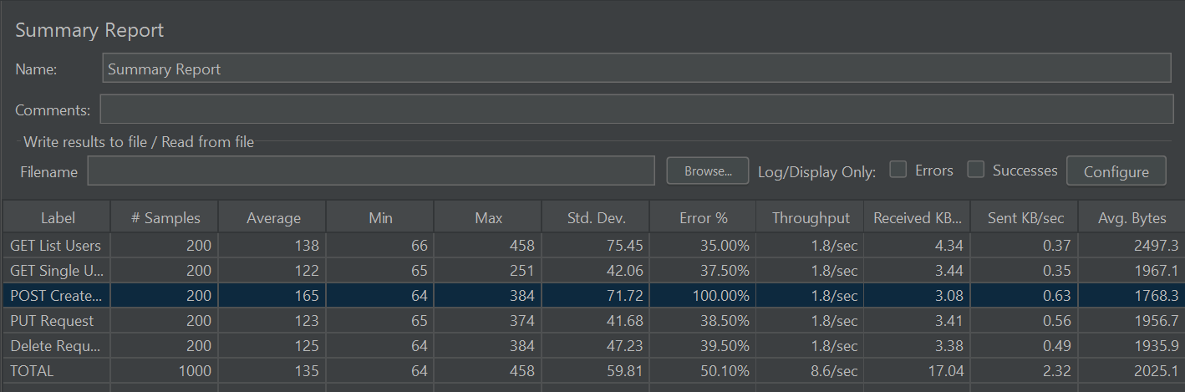
Performance Testing Results
Notes:
Dina

Slide 17
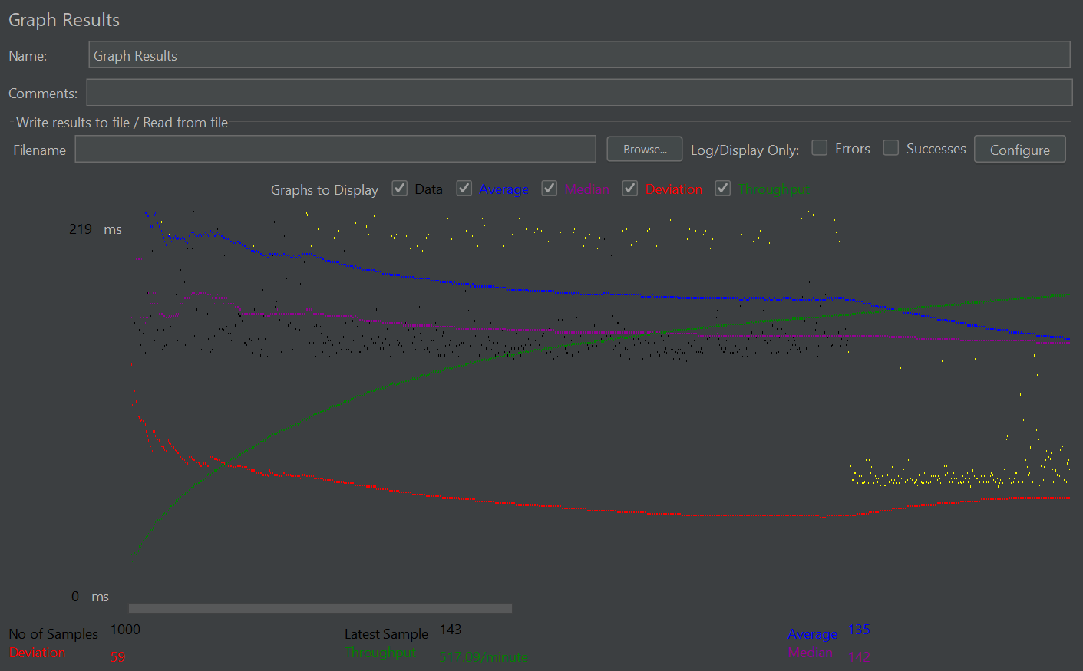
Performance Testing Results
Notes:
Nisreen

Slide 18
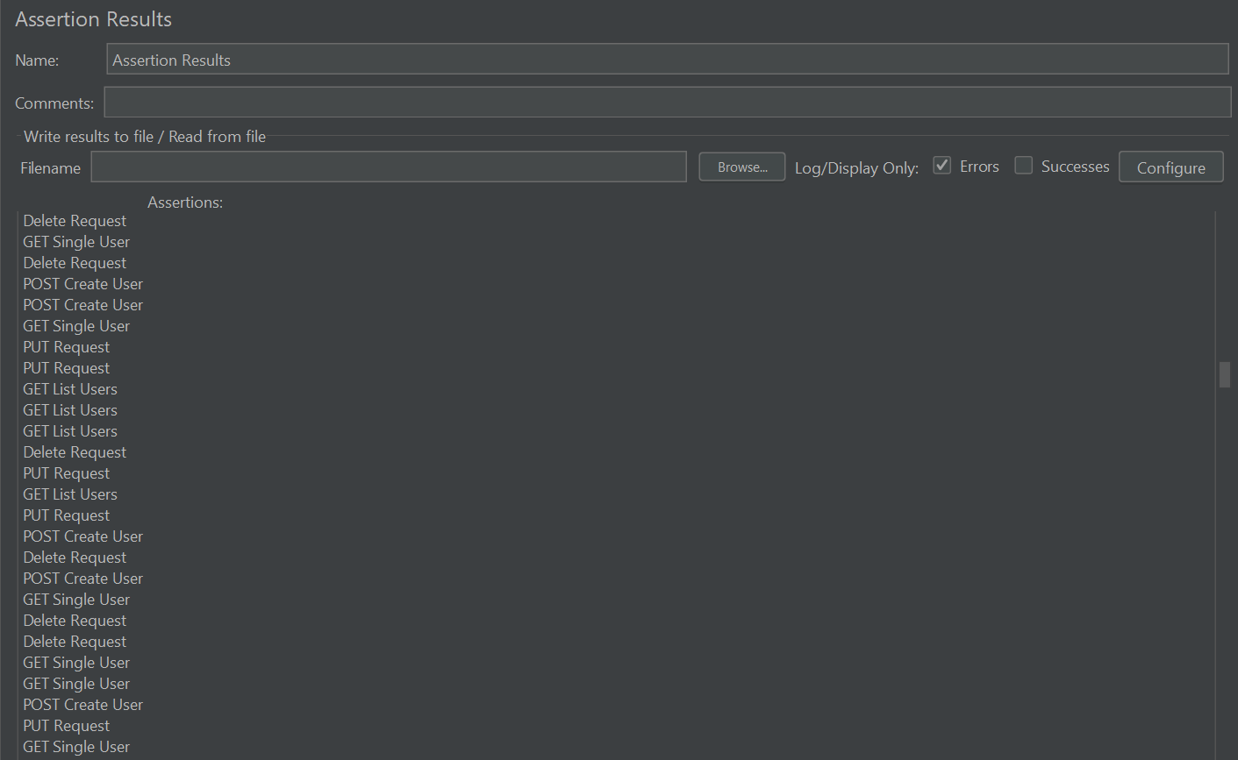
Performance Testing Results
Notes:
Nisreen

Slide 19
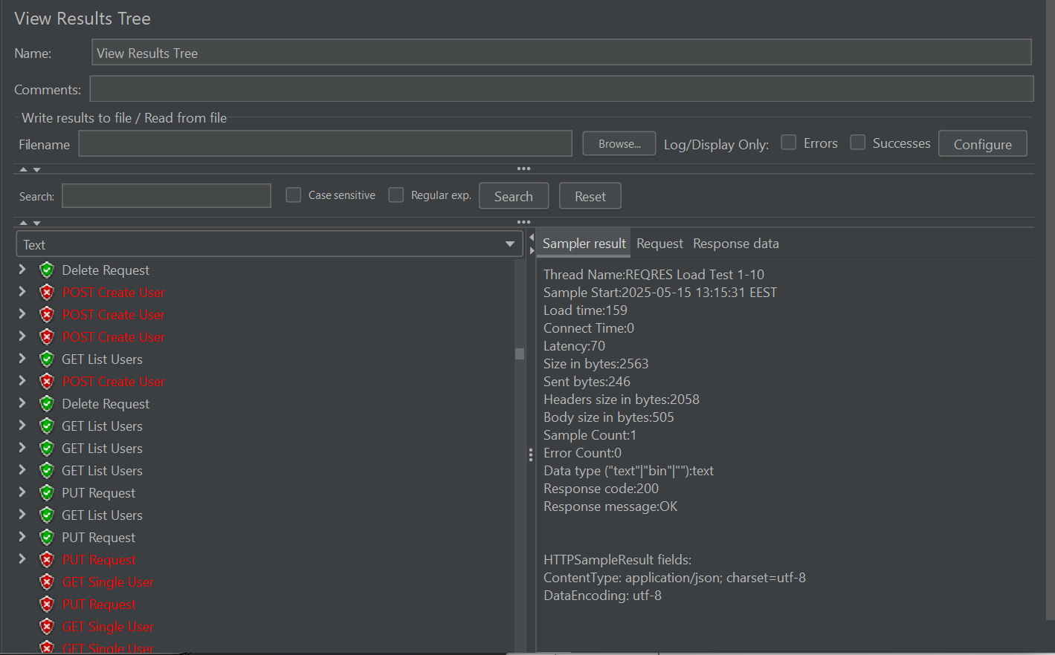
Performance Testing Results
Notes:
Nisreen

Slide 20
Conclusion & Recommendations
Mobile Testing:
Ensure emulator compatibility with APKs.
Optimize desired capabilities for different devices.
Performance Testing:
Include necessary headers to prevent unauthorized errors.
Validate assertion conditions to match expected outcomes.
General Recommendations:
Regularly update testing tools to the latest versions.
Document test cases and results for future reference.
Notes:
Bashir

Slide 21
Q&A
Open the floor for questions and discussions
Notes:
Nisreen

