Slide 1

FinVast
Social Media Performance Report
February 2025
Generated by AI Automation - Python | 2025-04-24

Slide 2
Executives Summary
Followers
Post
Reach
17135254
38.0%
83
113%
334366.475
183%
...
Generated by AI Automation - Python | 2025-04-24

Slide 3
Executive summary
{table_sentiment_month}
{table_sentiment_by_topic}
{table_sentiment_by_channel}
{table_sentiment_by_channel_topic}
Generated by AI Automation - Python | 2025-04-24

Slide 4
Executive summary
{table_sow}
{table_kpi}
{strategy_kpi_sow}
Generated by AI Automation - Python | 2025-04-24

Slide 5
Instagram
Generated by AI Automation - Python | 2025-04-24

Slide 6
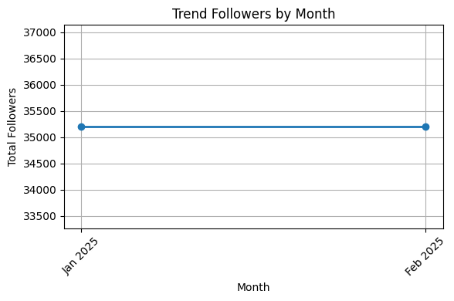
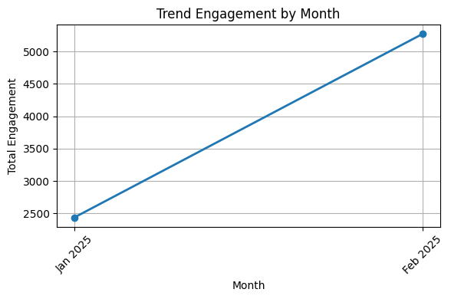
Perfomance Instagram
month | followers | followers_growth | total_post | total_post_growth | reach | reach_growth | engagement | engagement_growth | profile_visit | profile_visit_growth | post_save_rate | CTR
2025-02 | 35200 | 0.0 | 43 | 95 | 162439.475 | 195 | 5269.0 | 116 | 0 | 0 | 0.0 | nan
Generated by AI Automation - Python | 2025-04-24

Slide 7
{category_video}
Popular Post
Top Posts
...
...
Engagement: 656.0
Media type: Video
URL: https://www.instagram.com/p/DFsOLLhKI_z/
Bottom Posts
Engagement: 656.0
Media type: Video
URL: https://www.instagram.com/p/DFsOLLhKI_z/
...
Engagement: 25.0
Media type: Video
URL: https://www.instagram.com/reel/DGUzcEgPQNm/
Generated by AI Automation - Python | 2025-04-24

Slide 8
Tagged Post
Tagged Post
{total_tagged_post} post
Tagged Post User
{total_tagged_user} users
TOP ENGAGEMENT
{url}
{url}
{url}
{table_engagement}
{table_engagement}
{table_engagement}
Generated by AI Automation - Python | 2025-04-24

Slide 9
Sentiment Analysis
{table_sentiment_month}
{table_trend_sentiment}
{wordcloud}
{strategy_sentiment}
Generated by AI Automation - Python | 2025-04-24

Slide 10
Topics Analysis
{table_topic_month}
{table_trend_topic}
{strategy_topics}
Generated by AI Automation - Python | 2025-04-24

Slide 11
Brand Association
{brand_association_graph}
{brand_association_weight}
Generated by AI Automation - Python | 2025-04-24

Slide 12
TikTok
Generated by AI Automation - Python | 2025-04-24

Slide 13
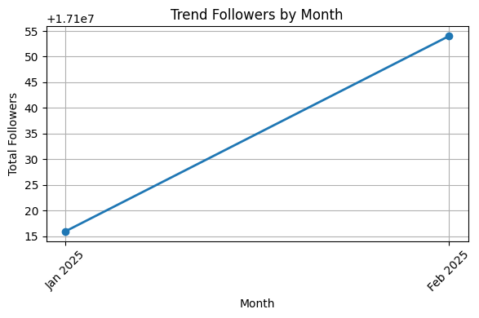
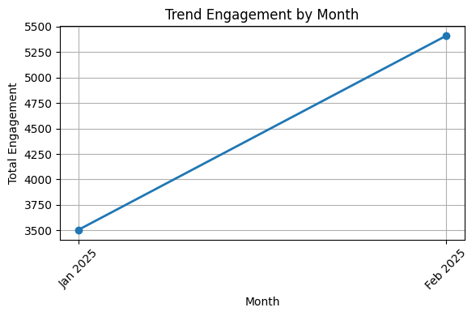
Perfomance Tiktok
month | followers | followers_growth | total_post | total_post_growth | reach | reach_growth | engagement | engagement_growth | profile_visit | profile_visit_growth | post_save_rate | CTR
2025-02 | 17100054 | 38.0 | 40 | 135 | 171927 | 172 | 5410.0 | 54 | 0 | 0 | 4.825 | nan
Generated by AI Automation - Python | 2025-04-24

Slide 14
{category_video}
Popular Post
Top Posts
...
...
Engagement: 1396.0
Media type: video
URL: https://www.tiktok.com/@vinfastindonesia/video/7473817932301225234
Bottom Posts
Engagement: 1693.0
Media type: video
URL: https://www.tiktok.com/@vinfastindonesia/video/7464127097393450247
...
Engagement: 12.0
Media type: video
URL: https://www.tiktok.com/@vinfastindonesia/photo/7470783805247327506
Generated by AI Automation - Python | 2025-04-24

Slide 15
Tagged Video
Tagged Video
{total_tagged_post} videos
Tagged Video User
{total_tagged_user} users
TOP ENGAGEMENT
{url}
{url}
{url}
{table_engagement}
{table_engagement}
{table_engagement}
Generated by AI Automation - Python | 2025-04-24

Slide 16
Sentiment Analysis
{table_sentiment_month}
{table_trend_sentiment}
{wordcloud}
{strategy_sentiment}
Generated by AI Automation - Python | 2025-04-24
Notes:
Wordcloud displit per category sentiment.

Slide 17
Topics Analysis
{table_topic_month}
{table_trend_topic}
{strategy_topics}
Generated by AI Automation - Python | 2025-04-24
Notes:
Topik yang mandatori (spesifik). Dan ada topik baru juga dimasukkin.
Diawal topik= kategori.

Slide 18
Brand Association
{brand_association_graph}
{brand_association_weight}
Generated by AI Automation - Python | 2025-04-24

Slide 19
Competitor Landscape
{table_competitor}
{strategy_competitors}
Generated by AI Automation - Python | 2025-04-24

Slide 20
Strategy insight & recommendation
Generated by AI Automation - Python | 2025-04-24

