Slide 1
OLAP(online
analytical processing)
By :
Bassant Mahmoud
Basma Hassan
Eman Mohamed
Hanan Hassona
Aya Rafat
Dina Essam

Slide 2
Overview
Disadvantage of relational database.
Appearance of OLAP.
WHAT IS OLAP?
Uses of OLAP.
Leading products of OLAP.

Slide 3
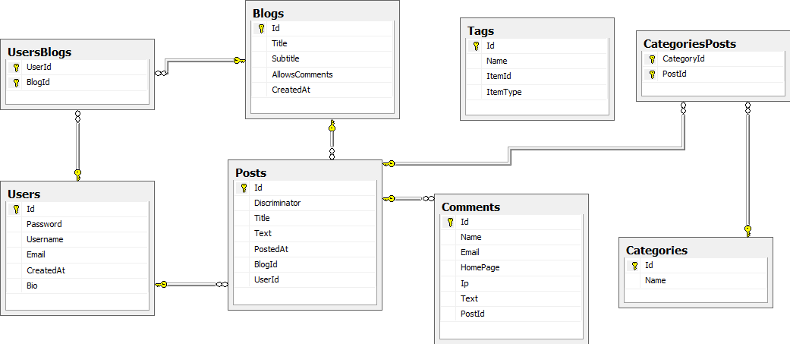

Disadvantage of relational database

Slide 4
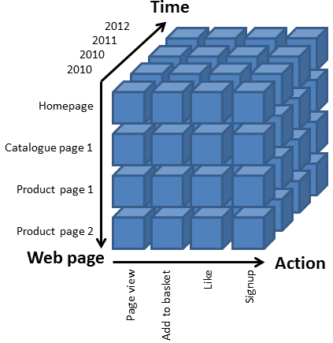
Appearance of OLAP

Slide 5
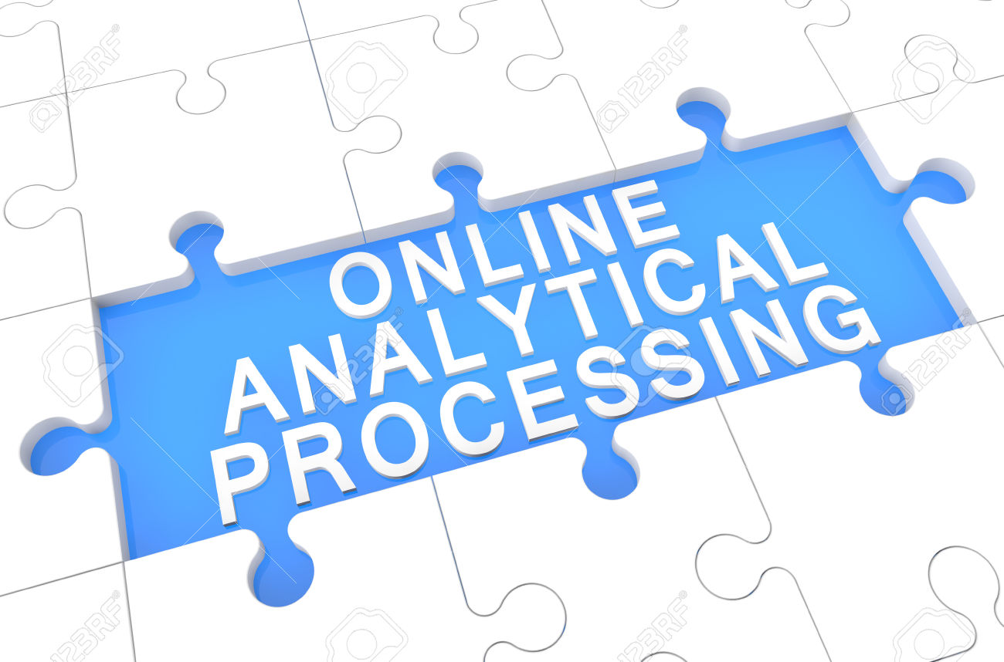
WHAT IS OLAP?
O l A P

Slide 6
Uses of OLAP
Data Mining
Knowledge Discovery
Database

Slide 7


Leading products of OLAP
Oracle’s express server
Hyperion solution’s ESSbase

