Slide 1
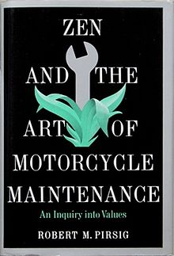
What to do when the program doesn’t work
Zen and the art of debugging

Slide 2

We ALL make mistakes when we code….
1999: A disaster investigation board reports that NASA's Mars Climate Orbiter
burned up in the Martian atmosphere because engineers failed to convert units
from English to metric.
The $125 million satellite was supposed to be the first weather observer on
another world. But as it approached the red planet to slip into a stable orbit
Sept. 23, the orbiter vanished. Scientists realized quickly it was gone for good.
https://www.wired.com/2010/11/1110mars-climate-observer-report/
For info: 1 Pound (force) = 4.44822 Newtons

Slide 3
We ALL make mistakes when we code….
Try things like printing out contents variables – does the output match what we expected?
Can get very tedious when a lot of variables & data structures are involved
Use writing values to a text file
Can output many variables – still somewhat tedious to inspect
Track which bits of code are being executed and in what order by printing messages
Better but can get messy and doesn’t scale well

Slide 4
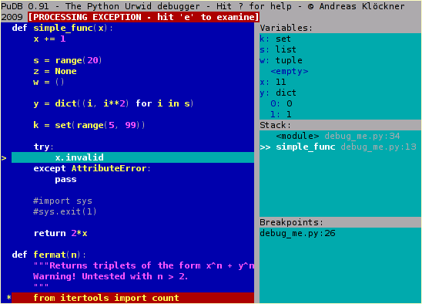
We ALL make mistakes when we code….
Try things like printing out contents variables – does the output match what we expected?
Can get very tedious when a lot of variables & data structures are involved
Use writing values to a text file
Can output many variables – still somewhat tedious to inspect
Track which bits of code are being executed and in what order by printing messages
Better but can get messy and doesn’t scale well
Using a debugger tool (Article https://www.digitalocean.com/community/tutorials/how-to-use-the-python-debugger )
Many programming languages have tools like this
They basically ‘step’ through your code stopping at ‘breakpoints’ and displaying a dump of the values of the variables
They can take time to learn to use and to get the best out of them

Slide 5
We ALL make mistakes when we code….
Try things like printing out contents variables – does the output match what we expected?
Can get very tedious when a lot of variables & data structures are involved
Use writing values to a text file
Can output many variables – still somewhat tedious to inspect
Track which bits of code are being executed and in what order by printing messages
Better but can get messy and doesn’t scale well
Using a debugger tool (Article https://www.digitalocean.com/community/tutorials/how-to-use-the-python-debugger )
Many programming languages have tools like this
They basically ‘step’ through your code stopping at ‘breakpoints’ and displaying a dump of the values of the variables
They can take time to learn to use and to get the best out of them
Other tools like the Online Python tutor http://pythontutor.com/visualize.html#mode=edit
This is a web-based tool that visualizes what is going on in your program
Not suited for large or complex programs so e.g. test modules in it #betterprogramming

Slide 6
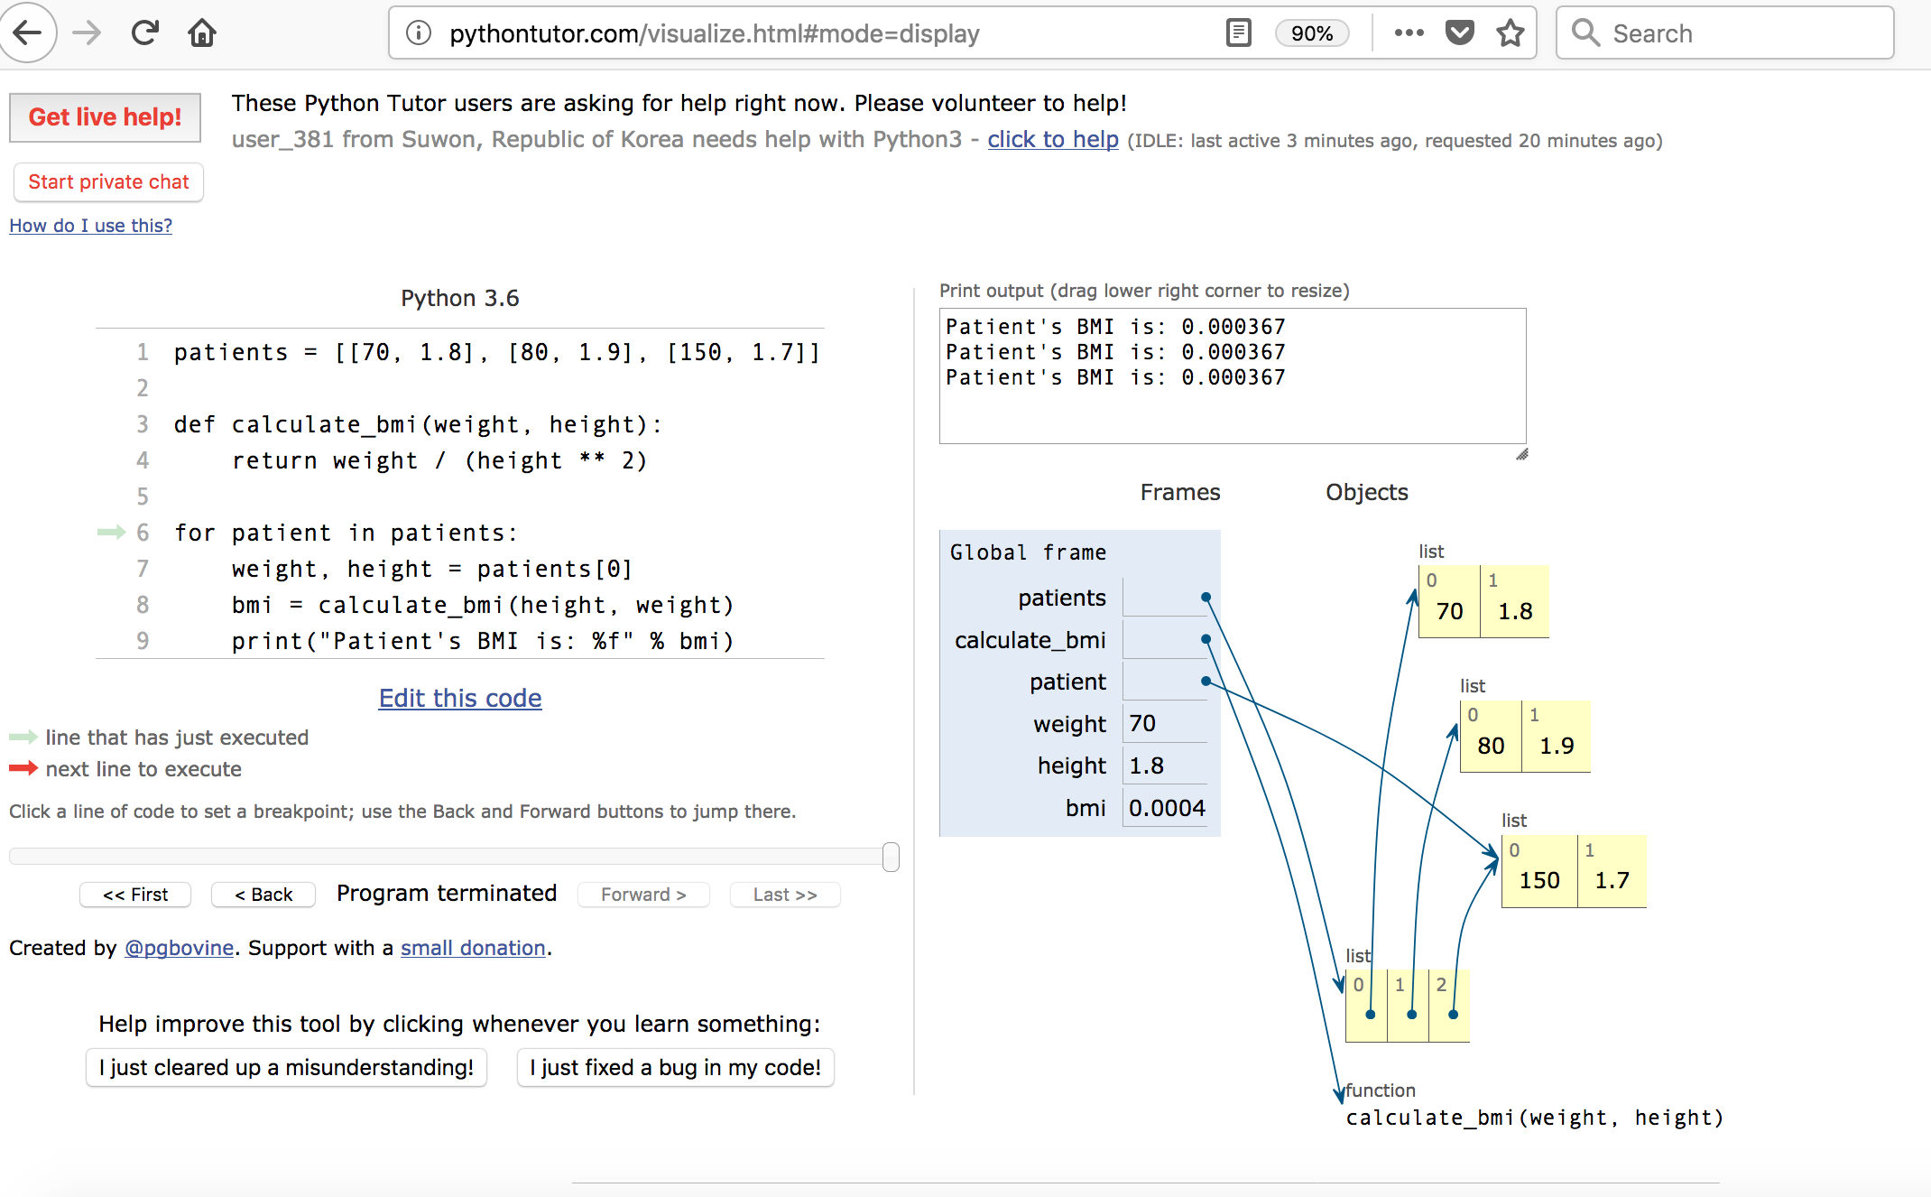

Slide 7
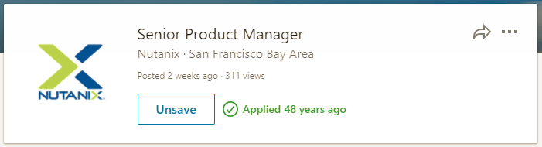
Ways of testing your code
Try to write test functions that call your code with test data and defined output = a pass
If you alter code to ‘improve’ it, then run the tests. If they do not pass then you’ve broken something ☺
Often useful if there is another package that does calculations e.g. ANOVA in R that you can run in parallel with your code – do you get the same/similar results with the same data?
Get another programmer to review your code (Many eyes principle). If nothing else it will be a test of your documentation and code comments (You did do that didn’t you?).
https://thedailywtf.com/articles/version-itis#Pic-2

