Slide 1
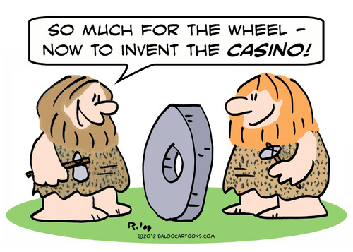
Research before writing
Or how to avoid writing code that’s already been written

Slide 2
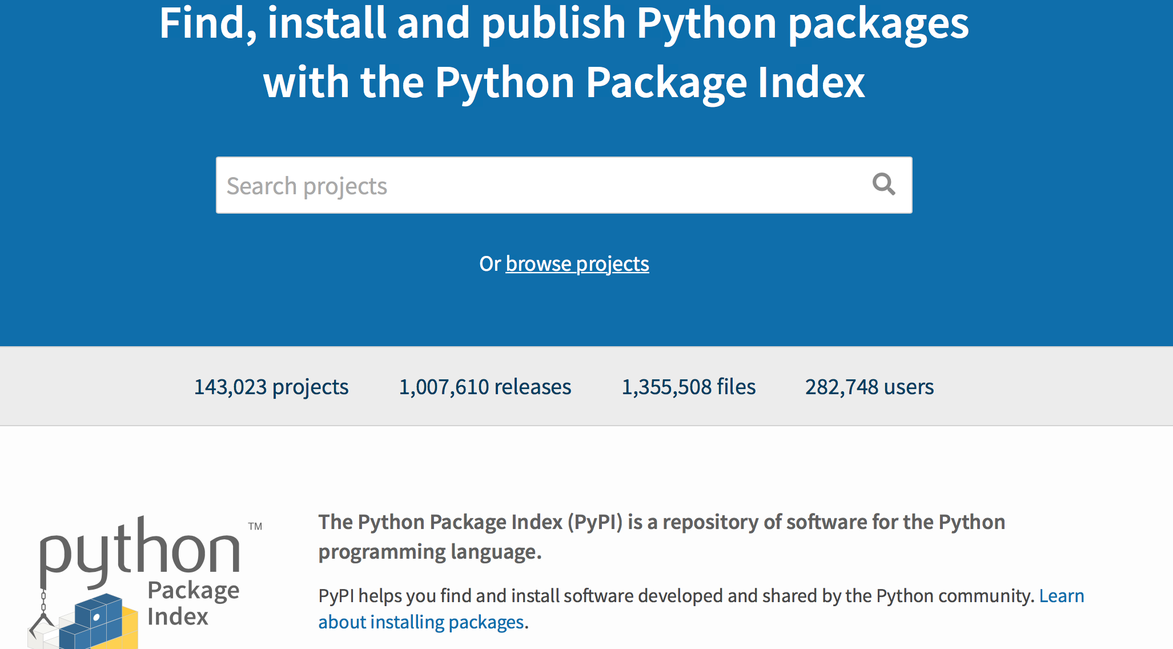
In the same way that before carrying out an experiment you would review the available literature, it is sensible to research if there are resources that will make it easier for you to write your program.
Python has MANY function libraries (called modules) which can be easily installed using the pip command and then you can import them into your code. Look here for a searchable index https://pypi.org
Look on https://github.com for examples of code from authors tackling similar problems. Useful place to learn programming tricks (Can find good and bad code on display here).

Slide 3
Read the Documentation
Python has extensive online documentation at https://docs.python.org/3.5/index.html
This is for Python 3.x. There are pages for Python 2.x as well. There is an extensive tutorial at: https://docs.python.org/3.5/tutorial/index.html
Online Fora Useful for searching but if you wish to post a query please follow the sites ‘Netiquette’ and check that the question hasn’t been asked before.
https://stackoverflow.com – mostly programming but not just Python
https://www.biostars.org - Bioinformatics Q&A with some programming questions
http://seqanswers.com - Similar to Biostars

